Slide 1
Weather Community of Interest (COI) Update
Friends and Partners of Aviation Weather
Randy Bass
November 16, 2023

Slide 2
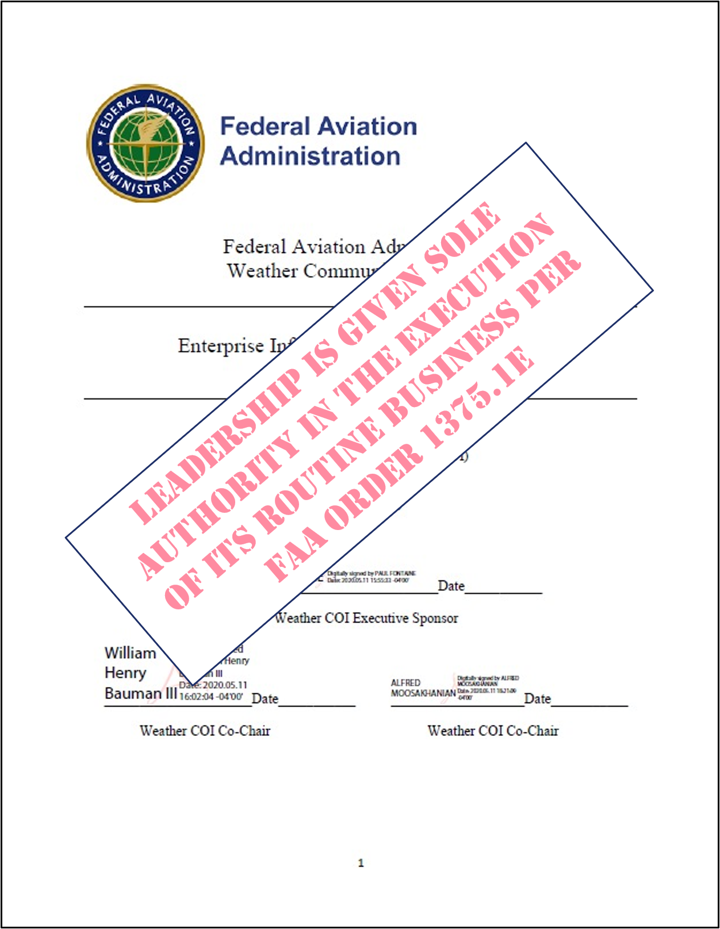
What is the Wx COI¹?
Chartered under Enterprise Architecture Board and Enterprise Information Management Steering Committee (EIMSC) per FAA Order 1375.1F
Executive Sponsor
Paul Fontaine, Assistant Administrator for NextGen
Co-chairs
Randy Bass, NextGen, Aviation Weather Division
Alfred Moosakhanian, Program Management Organization
Secretariat/Contract Support
David Strand and Matt Fronzak, MITRE
50-60 persons from across the FAA attend the near-monthly plenary meetings
75+ persons from the FAA, other government agencies, FFRDCs and FAA contractors actively participate in Wx COI working groups
¹A Community of Interest (CoI) is a group of people whose goal is to further a common cause by sharing wisdom, knowledge, information, or data, and interactively pursuing informed courses of action.

Slide 3
What Does the Wx COI Do?
Promotes collaboration, communication, and sharing of weather data and information among FAA organizations, and with other Federal agencies, industry, and international partners
Resolves and/or mitigates mission-specific, data and information sharing challenges across the weather enterprise
Ensures appropriate access to, along with availability and consistency of, weather data and information
Identifies and assimilates operational and business needs for weather data and information in the NAS

Slide 4
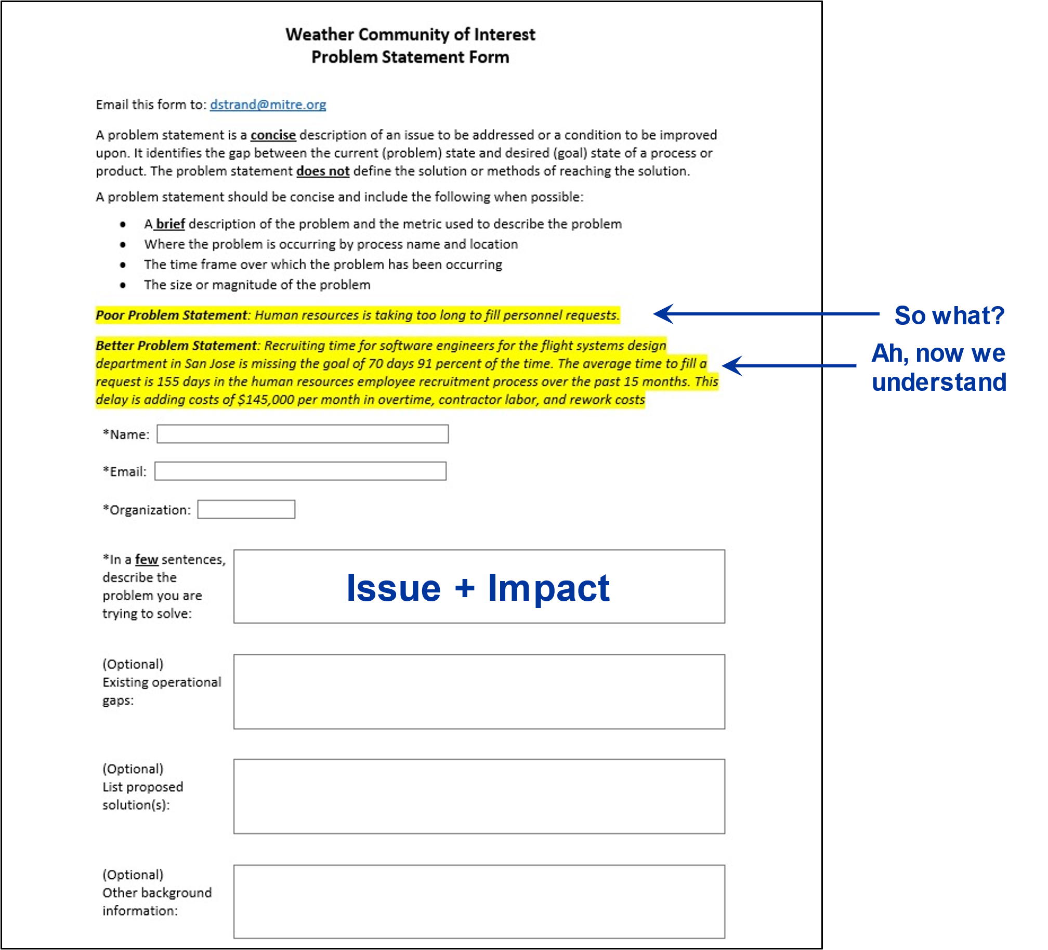
How Does the Wx COI Do Work?
Problem Statement: a concise description of an issue to be addressed or a condition to be improved upon
Identifies gap between the current (problem) state and desired (goal) state of a process or product
Assigned by Wx COI for resolution to a working group known as a Special Weather Action Team (SWAT)

Slide 5
Summary: FAA Wx COI So Far
First plenary meeting: July 21, 2020
Number of plenary meetings since then: 33
Average number of participants/plenary meeting: 50-60
Number of Problem Statements submitted: 62
Number of SWATs created: 11
Number of SWATs currently active: 8 (plus 2 in hibernation)
Number of Problem Statements closed: 26
Number of briefings given by external organizations: 12 (ICAMS, NOAA/NWS, MIT LL, NCAR, A4A, AOPA, MITRE, ALPA, NBAA, ADF, VFS, NATCA)
Number of briefings given by internal organizations: 9 (ICN [ANG-3], PS Lifecycle [Wind SWAT], Analyzed Weather [Standards & Policy SWAT], SFO MSFS [ANG-C6], Flight Service [AJR-B1], PIREP Research [CAMI], PADWOS [Wind SWAT], ONA Intake Process [Standards and Policy SWAT], Performance Based Weather [AFS])

Slide 6
What the Wx COI has been up to since the last FPAW Meeting…
June 2023
Briefing from AFS on Performance Based Weather
Closed one Problem Statement (Definition of Local Wx – Standards/Policy SWAT)
August 2023
Briefing from Wx COI Core Team on “The Wx COI – A Look Back and A Look Ahead”
Two new Problem Statements
September 2023
Briefing from Vertical Flight Society (VFS) concerning their weather issues
Two new Problem Statements (including proposal for a Wx COI Strategic Planning Team (SPT)
October 2023
Briefing from NATCA on “Top Weather Issues from the Controller’s Perspective”
One new Problem Statement
November 2023
Briefings on status of formation of Wx COI SPT and possible Wx COI SWAT refocus

Slide 7
Wx COI Changes
In July/August, Wx COI SWAT leads participated in a survey
The main plenary presentation during the August plenary meeting, “The Wx COI – A Look Back and A Look Ahead,” was based in part on the results of the survey
Key takeaways:
Every single respondent recognized the value in bringing together representatives of every FAA line of business and staff office that are either affected by weather or have a role to play in getting weather information to the right people at the right time
Because the Wx COI does not have a budget per se, it was very difficult for SWAT leads to keep positive momentum in the face of higher priority tasks
Current SWAT focus areas may be too narrow or less than ideal
The Wx COI leadership team is discussing ways to positively evolve the Wx COI

Slide 8
FAA Weather Strategy SPT and the Wx COI
In FY22, senior FAA executives kicked off an effort to develop an agency weather strategy
In FY23, the weather strategy effort continued to be pursued, although somewhat more intermittently
Also in FY23, the Wx COI Wind Forecast SWAT submitted a Problem Statement (PS) asserting the need for an FAA Weather Strategy; the PS was accepted, but has yet to be assigned
The Wx COI Core Team has been discussing how to “work” this PS
Initial thoughts are that a different mechanism may be required, e.g., a Strategic Planning Team (SPT), not a SWAT
May become part of the evolution of the Wx COI

Slide 9
Should the Wx COI and FPAW Set Up a Formal Relationship?
The FAA Aeronautical Information Products and Services (AIPS) COI has an ongoing, formal relationship with the Aeronautical Charting Meeting
See FAA Order 7910.5E, and Charting Group and Instrument Procedures Group web pages
They use this relationship to receive feedback from, and provide feedback to, the users and providers of charted aeronautical information
Is this a role that FPAW could fill for the Wx COI?
A standing wedge of time has been set aside in each of the last three FPAW agendas for a Wx COI update
Should this be turned into an open public Weather Data/Information Exchange and Coordination Meeting between FPAW and the FAA Wx COI?

Slide 10
Proposed Wx COI Briefing at Spring FPAW Meeting
Strategic Planning Team update
FAA Weather Strategy development status
Wx COI reorganization update
Review of open Problem Statements
FPAW/FAA Wx COI formal relationship update

Slide 11
QUESTIONS

