Slide 2
Welcome Friends and Partners of Aviation Weather!
Fall 2025 Meeting
Campell Scientific, Logan, Utah

Slide 3


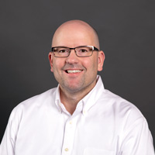

Meet your hosts
Jesse Heers
Aspen Neilsen
Nick Demetriades
Business Development Director
Marketing Specialist
Environmental Division Director

Slide 4
A few items to cover:
Limit picture taking to the main meeting room and front lobby area (ISO 27001:2013)
Avoid wandering past the breakroom, lobby, and restrooms areas without escort
During lunches, feel free to bring food back into meeting rooms
Talk to a Campbell Scientific host if you need a conference room reserved (or any other need)
Always wear your name badge
For the tours and dinner on Wednesday, no sign-up necessary, we’ll make it work

Slide 5
Campbell Scientific Introduction

Slide 6
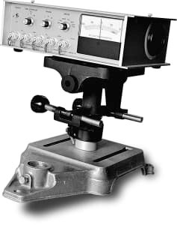
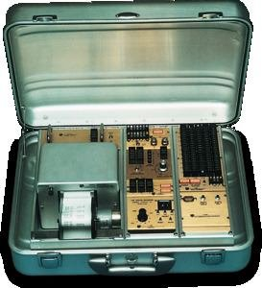
Who is Campbell Scientific?
In 1974, co-founding brothers, Eric and Evan Campbell develop the CA-9 Path-Averaging Laser Anemometer.​
In 1975 Campbell Scientific introduces their first datalogger, the CR5 Digital Recorder.

Slide 7
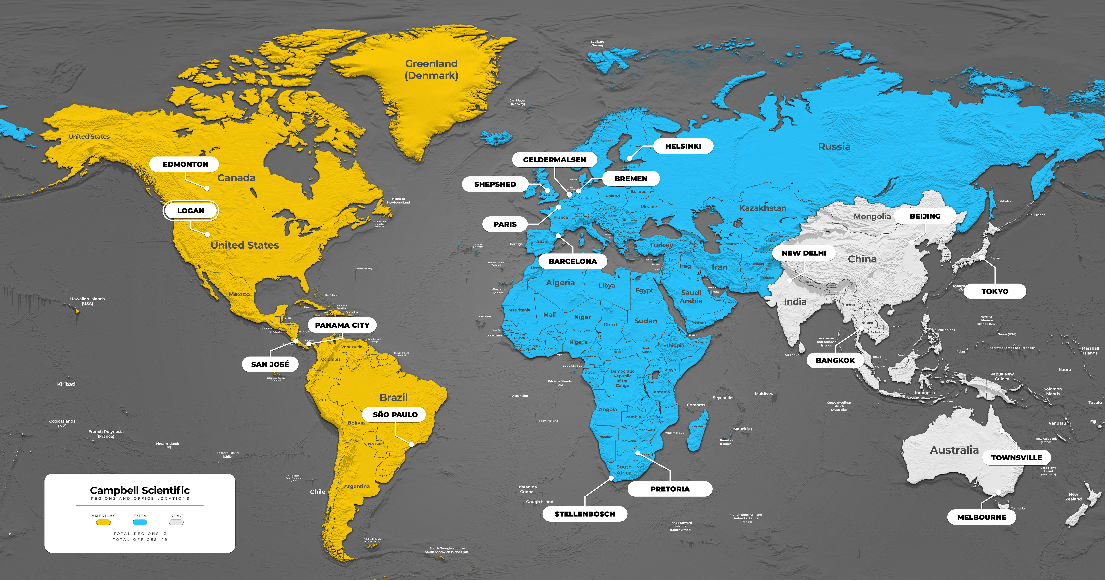

Company Profile
A global company with 16 offices around
the world​
Over 675 Employees​
We remain a privately held by employees, former employees, and the Campbell family​
No “exit strategy” – we maintain a long-term perspective​
Strong guiding philosophy of giving back to the communities in which we live and work

Slide 8

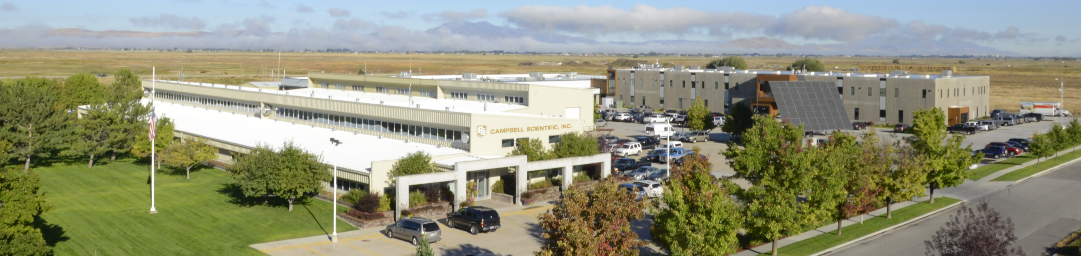
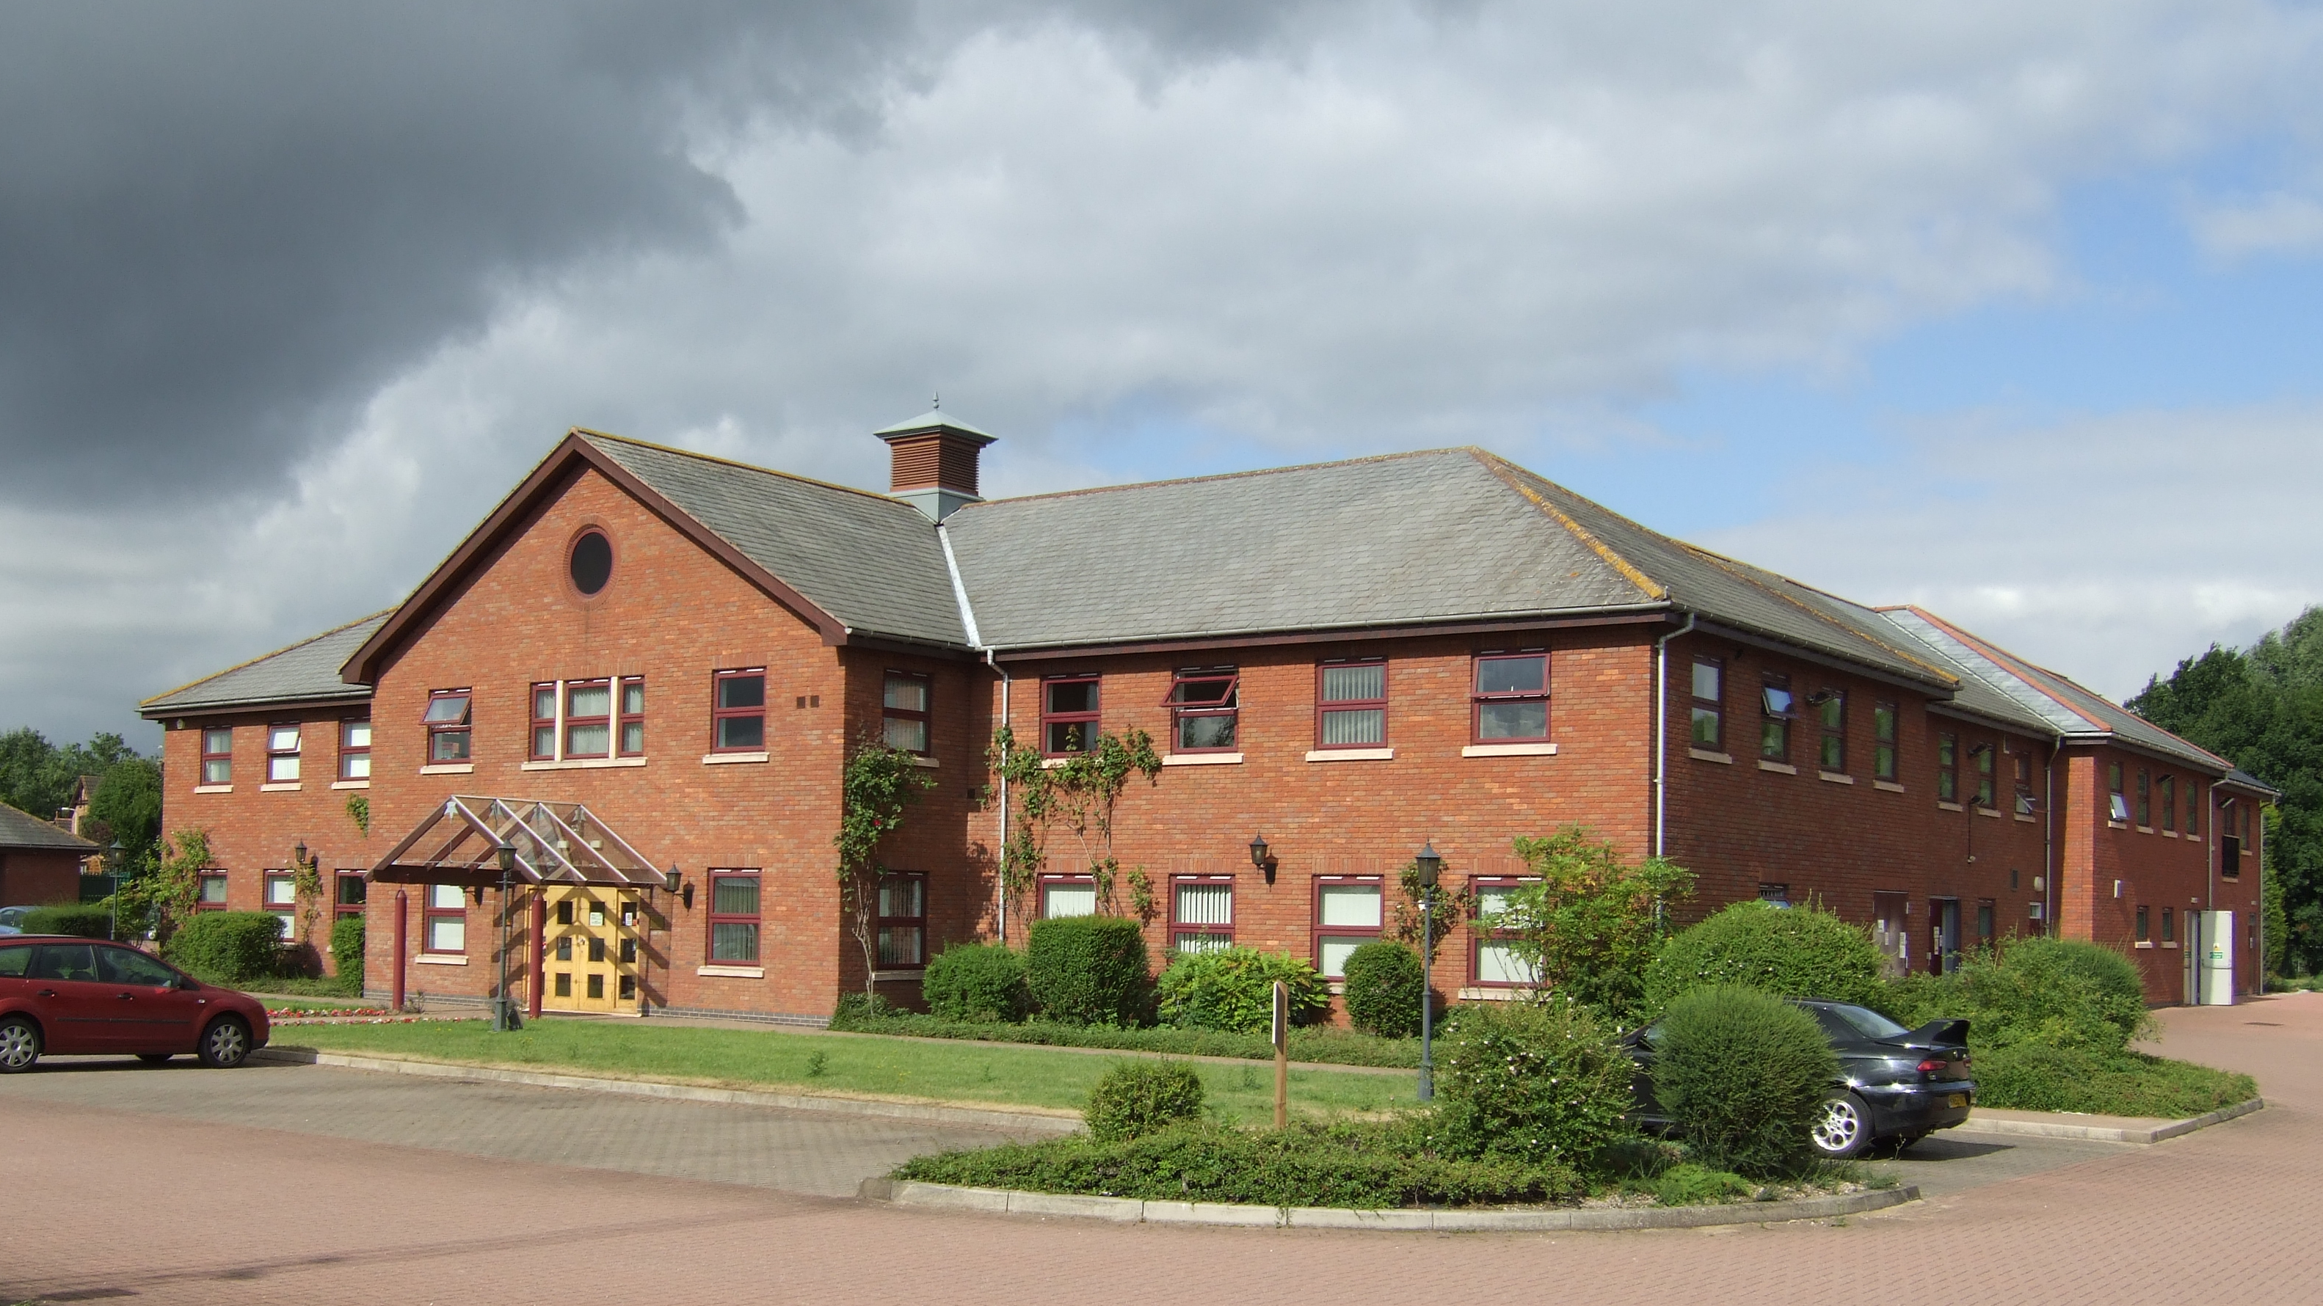
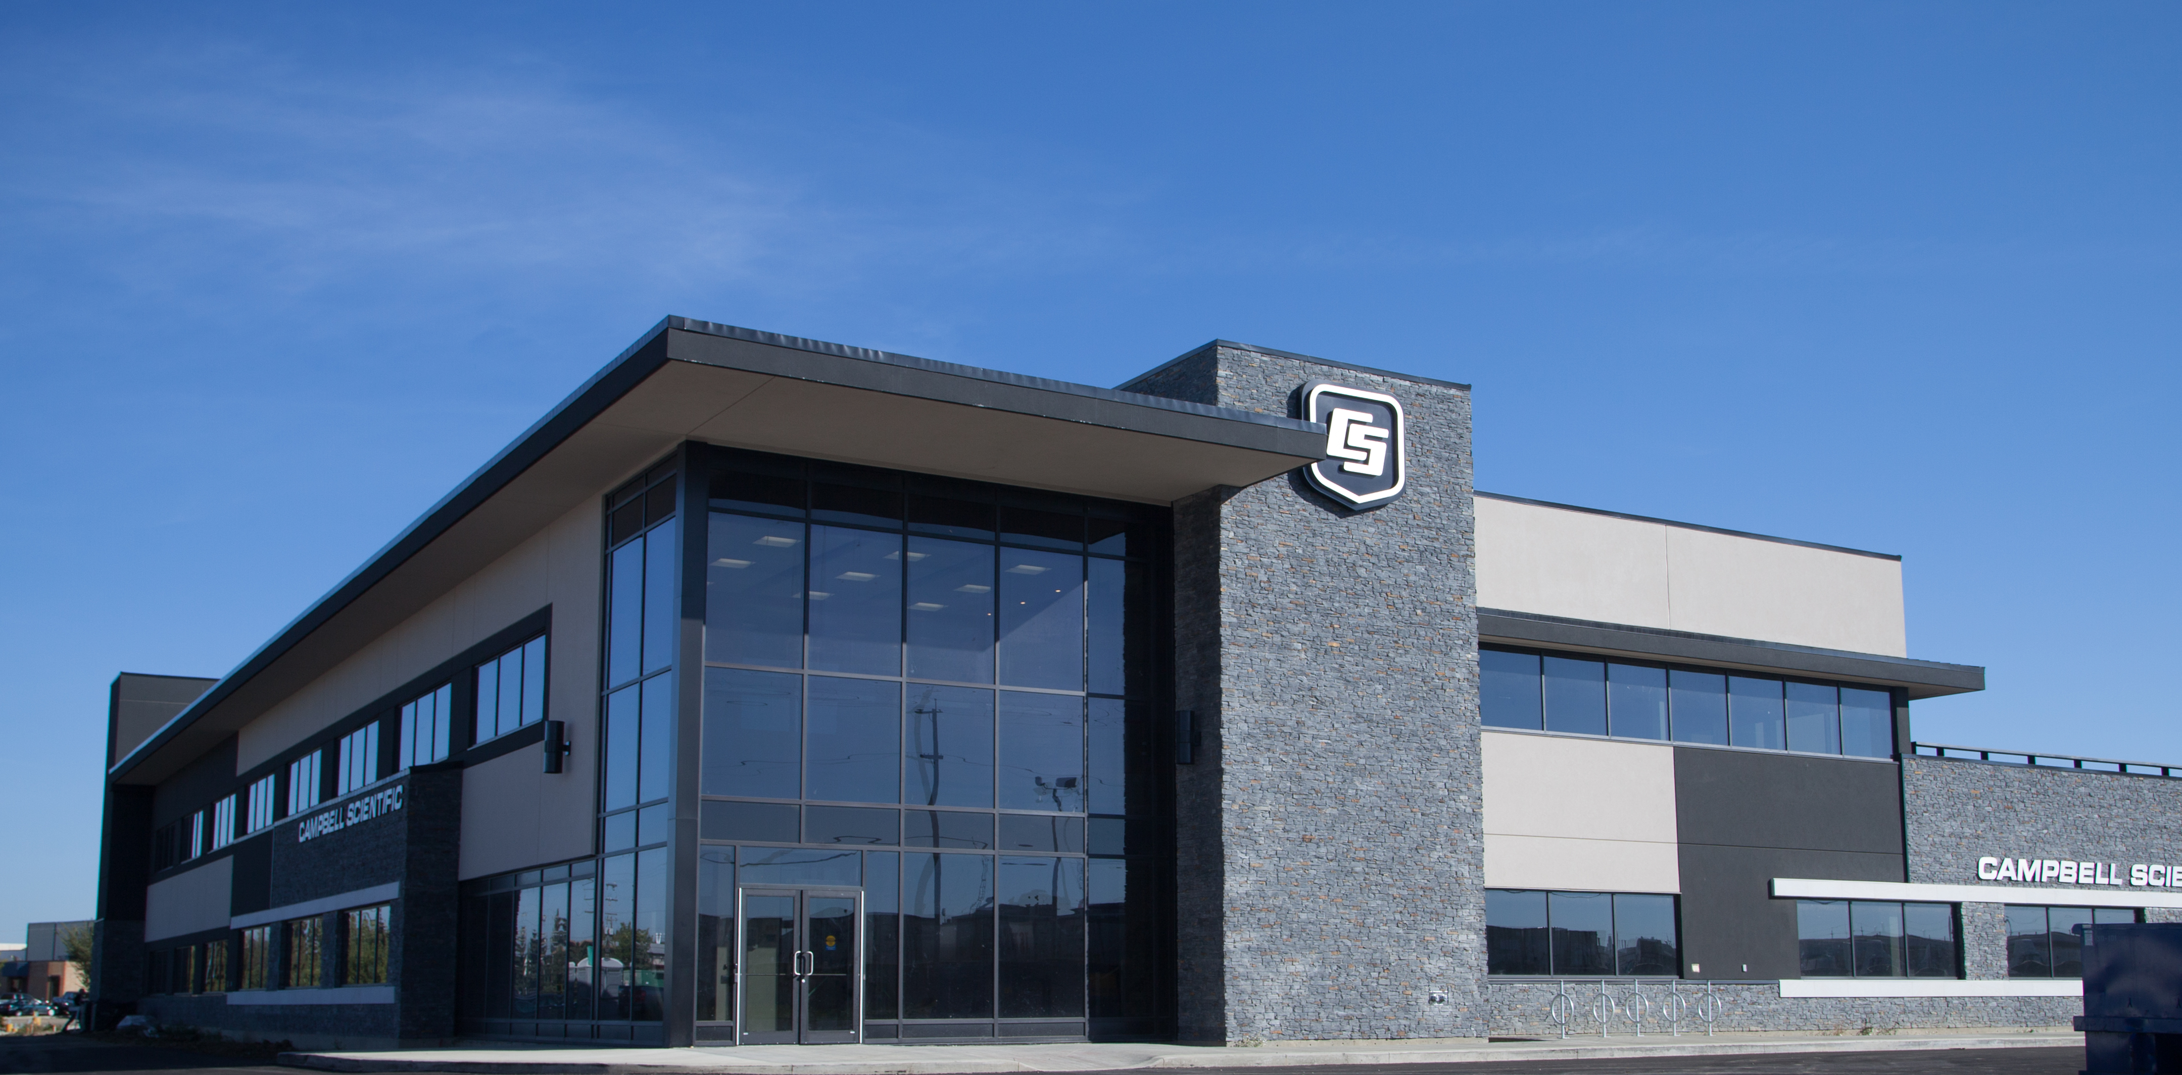
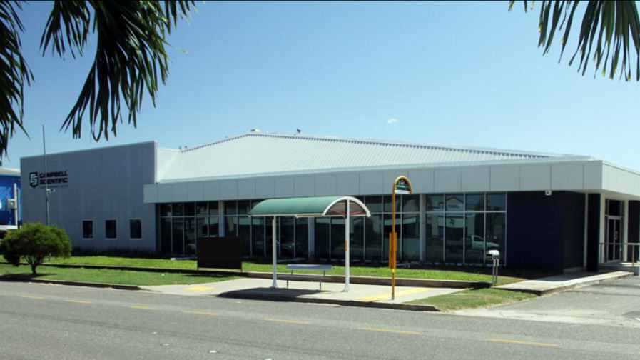
Global Presence
UNITED STATES
UK
CANADA
AUSTRALIA

Slide 9
Campbell Scientific Aviation Weather
Campbell Scientific involvement in aviation weather instrumentation started years ago - mostly peripherally involved providing sensors to the market
In 2016 we purchased Coastal Environmental to further our involvement in the aviation weather market
Today we offer a full suite of products – sensors, systems and software

Slide 10
Campbell Scientific Aviation Weather
Won many Campbell Aero airport AWOS projects globally.
World class optical sensors for visibility, present weather and cloud height
Open hardware and software ecosystem solution where we integrate third party sensors - offering freedom and flexibility to clients to create the system that is right for them.

Slide 11

First experience

Slide 12
Importance of Aviation Weather
Airports are vitally important to the economic growth of the surrounding community
We believe that by being a part of a growing, thriving aviation community we help:
Save lives
Save time / logistics
Communities grow and prosper

Slide 13
Thank-you for allowing us to host the Fall 2025 FPAW Meetings

Slide 14
Thank you and enjoy the meeting!

