Slide 1
Scott Landolt
Research Applications Laboratory
What's in a METAR? A brief insight
into creating an automated observation
Friends and Partners in Aviation Weather – Fall Meeting
October 7, 2025

Slide 2
Group Exercise
What mathematical methods/techniques/etc. are used to produce an official “observation” of temperature and wind?

Slide 3
Temperature Observations
Temperature measurements are taken every ten seconds
Measurements are averaged over one minute to develop a one-minute observation
One-minute observations are averaged over five minutes, updating every minute
The observation is rounded to the nearest °F and converted to the 0.1 °C
Measurements for the Past Minute
50 °F
50 °F
49 °F
49 °F
49 °F
48 °F
49.1 °F
50.3 °F
50.9 °F
51.4 °F
52.0 °F
50.74 °F
51 °F
10.6 °C

Slide 4
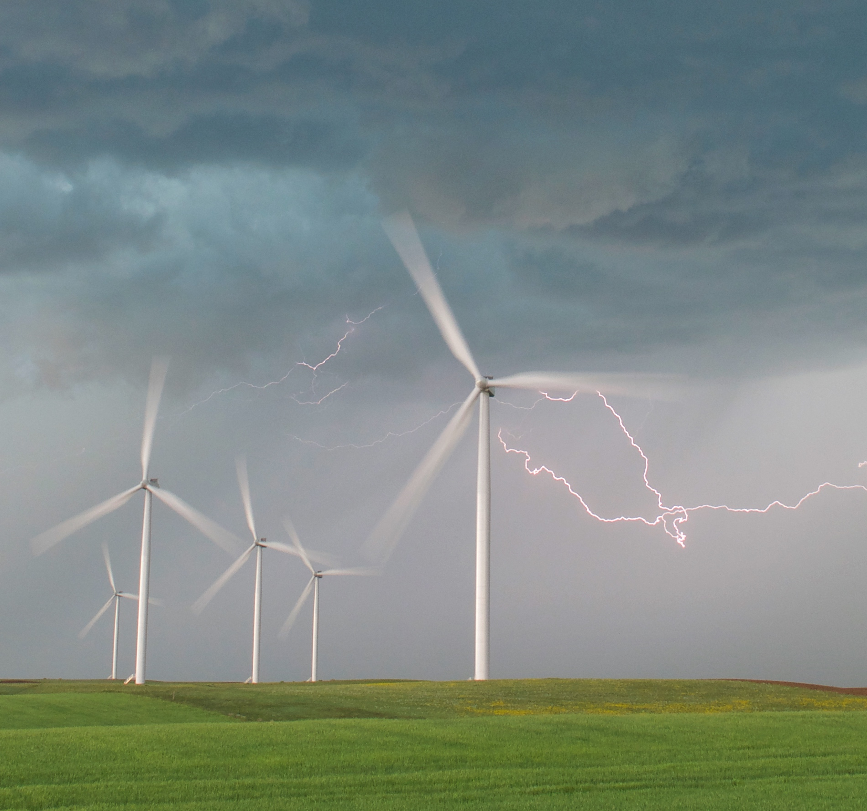
Wind Observations
Observations of speed and direction are taken once a second
Five second averages of speed and direction are computed and rounded to the nearest degree and nearest knot
Every 5 seconds a running 2-minute average wind velocity is computed. If the computed 2-minute average wind speed is 2 knots or less, the 2-minute average wind direction and speed is reported as “calm”

Slide 5
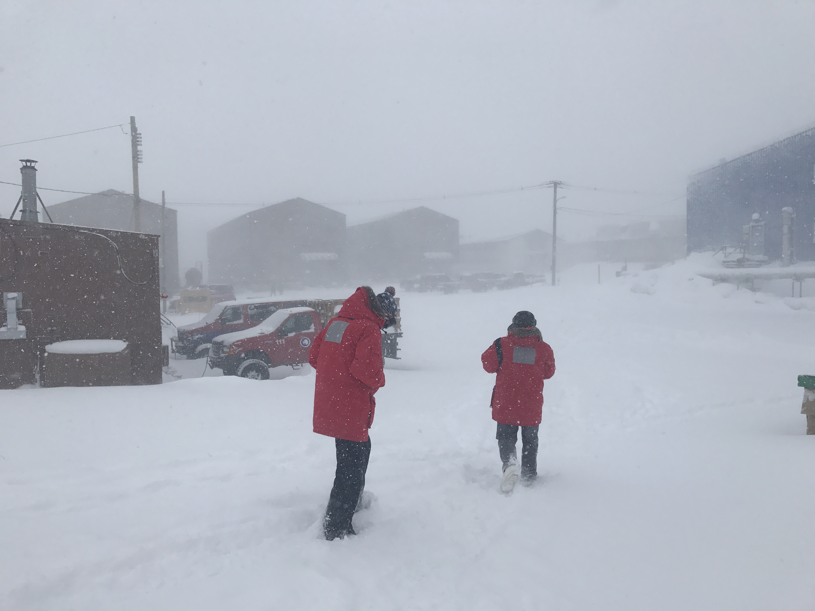
Wind Gust Observations
If:
The current 2-minute average wind speed is equal to or greater than 9 knots
The greatest 5-second average wind speed (during the past minute) exceeds the current 2-minute average speed by 5 knots or more
Then:
The greatest 5-second average speed observed during the past minute is stored in memory as a gust for 10 minutes.

Slide 6
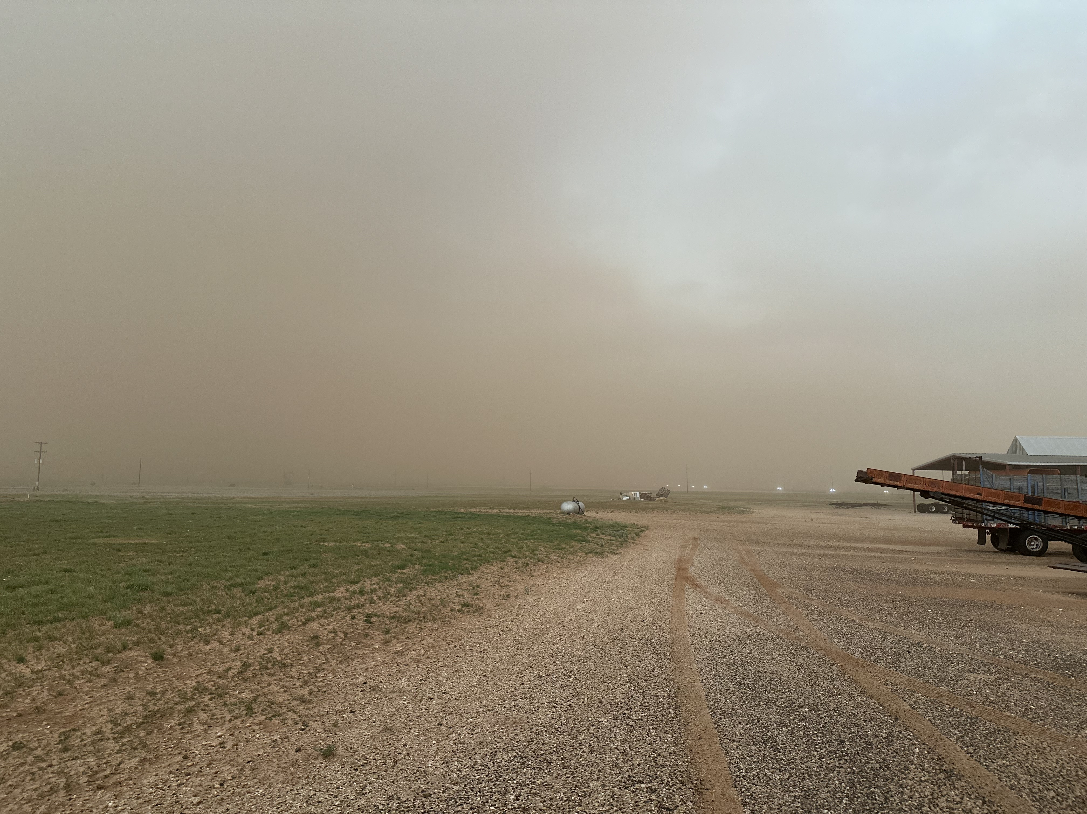
Wind Gust Observations
Once every 5 seconds, the ASOS compares the highest gust stored in memory for the past 10 minutes with the current 2-minute average wind speed
If:
The difference between the two is 3 knots or more
The current reported wind speed is greater than 2 knots
The highest gust exceeds the minimum 5-second wind speed in the past 10 minutes by 10 knots or more
Then:
The highest gust stored in memory is designated as the reportable gust.

Slide 7
Other Considerations
Doesn’t account for quality control algorithms
METAR algorithms have additional processing
Observations are typically hourly
SPECIs can still have delays!
Errors can still make it through the QC algorithms
KDEN 070253Z 07003KT 10SM OVC023 08/07 A3026 RMK AO2 RAB22E47 SLP229 P0000 60000 T00780067 51018 KDEN 070153Z 08006KT 10SM OVC019 08/07 A3024 RMK AO2 SLP221 T00830067 KDEN 070053Z 06006KT 10SM OVC018 08/06 A3023 RMK AO2 RAE2358B23E32 SLP217 P0000 T00830061 KDEN 062353Z 04006KT 9SM -RA OVC021 09/06 A3020 RMK AO2 RAE12B37 SLP207 P0002 60002 T00890061 10100 20083 53005 KDEN 062328Z 04006KT 10SM BKN022 BKN037 BKN110 09/06 A3020 RMK AO2 RAE12 P0001 T00890061 KDEN 062253Z 05009KT 9SM -RA BKN022 BKN050 OVC060 09/06 A3018 RMK AO2 RAB47 SLP197 P0000 T00940056

