Slide 1
ASOS/AWOS Accuracy Misunderstandings, Representativeness, and Discrepancies
Friends and Partners In Aviation Weather
Fall 2025 Workshop
Bass Weather Services, LLC 7 Oct 2025

Slide 2
Agenda
ASOS/AWOS Weather Observing Systems
Sensor Calculation/Determination Example
Location and Siting Study Overview and Status
Examples of Findings
Summary

Slide 3
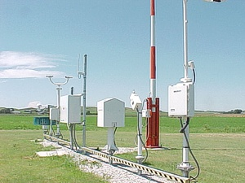
Weather Observing Systems
Two primary types of fixed surface weather observing systems in use in the United States
Automated Surface Observing System (ASOS)
Automated Weather Observing System (AWOS)

Slide 4
ASOS
Joint effort between the National Weather Service, the Federal Aviation Administration, and the Department of Defense
The ASOS serves as the United States’ primary surface weather observing network
Designed to support weather forecast activities and aviation operations
Usually installed near airport runway touchdown zones
Also supports the needs of the meteorological, hydrological, and climatological research communities
Provides the necessary information to generate weather forecasts (Terminal Aerodrome Forecasts or TAFs)
Not just one sensor or one piece of equipment – contains a complement of weather sensors measuring atmospheric phenomena important to the aviation community
Observations are updated every minute, but most data are not publicly reported except for hourly reports (METARs) and “specials” (SPECI) which occur when conditions exceed preselected weather element thresholds

Slide 5
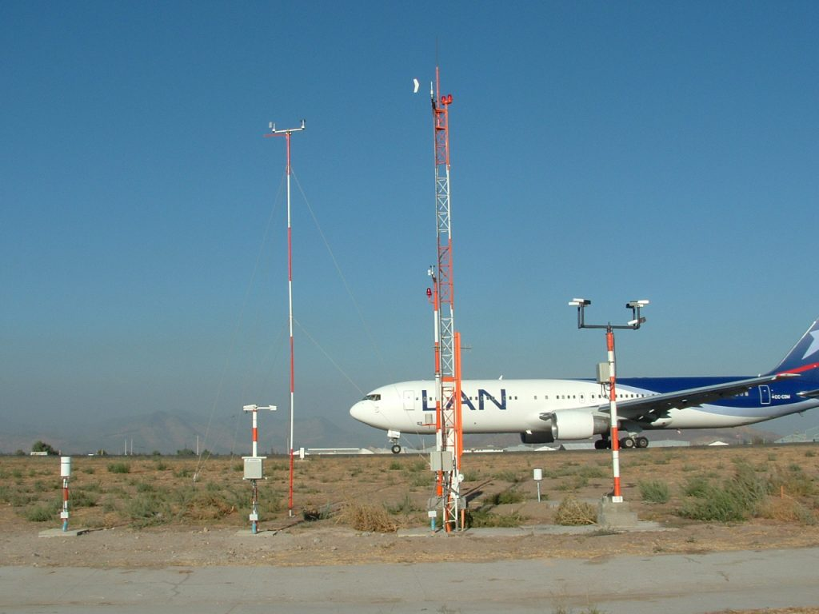
AWOS
The AWOS is a similar system to ASOS but for use beyond the federal government
Systems not owned and operated by the FAA are termed “Non-Federal” systems
AWOS was designed to provide basic weather observation data
Similar to ASOS, an AWOS also observes, formats, archives, and transmits observations automatically in the form of METARs and SPECIs

Slide 6
Conclusion/Spoiler Alert
ASOS and AWOS sensors are very accurate
For how they are designed
Based on the algorithms used to determine outputs
For the specific location they are placed at
For the meteorological conditions they measure at that specific location

Slide 7
Conclusion/Spoiler Alert
ASOS and AWOS sensors are very accurate
For how they are designed
Based on the algorithms used to determine outputs
For the specific location they are placed at
For the meteorological conditions they measure at that specific location
BUT

Slide 8
Conclusion/Spoiler Alert
ASOS and AWOS sensors are very accurate
For how they are designed
Based on the algorithms used to determine outputs
For the specific location they are placed at
For the meteorological conditions they measure at that specific location
BUT
They may not always be representative of surrounding conditions
Hyperlocal weather phenomena
The way the algorithms determine values
Location errors
Obstructions

Slide 9
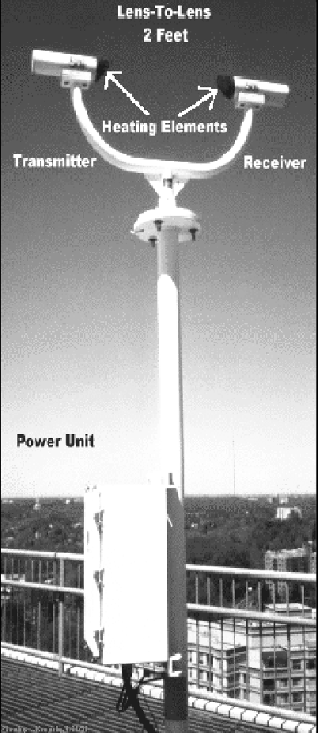
Precipitation Identification Sensor
Differentiates rain from snow
Intensity of precipitation can only be determined when the precipitation is not mixed, (i.e., pure rain or pure snow)
Rain intensity is determined through an empirical relationship which can distinguish light (up to 0.10 inch per hour), moderate (0.11-0.30 inch per hour), or heavy (greater than 0.30 inch per hour) intensities for rain
The size and fall velocity of the snowflakes determines their size distribution, which correlates well with rate of snow accumulation
However, the density of snow varies significantly depending on whether the snow is “wet” or “dry,” and therefore the liquid content cannot be accurately determined

Slide 10
Precipitation Identification Sensor
Snowfall intensity
The report of intensity is well correlated with the rate of snow accumulation but is not directly related to the visibility reduction due to snow, which observers use to differentiate between light, moderate, and heavy snow
Processing algorithms use the visibility sensor data to modify the snow intensity report so that moderate snow is not reported when the visibility is greater than 1/2 mile and heavy snow is not reported when the visibility is greater than 1/4 mile
The current sensor has no ability to detect and report ice pellets, snow grains, snow pellets, or hail
Type of Weather Occurrence | ASOS Present Weather Report
Ice Pellets (PL) | -RA, RA, or +RA
Ice Pellets and Snow (SN) | -SN, SN, or +SN
Ice Pellets and Freezing Rain | -FZRA, or FZRA
Ice Crystals | No Precipitation
Hail (GR) | +RA
Snow Grains (SG) | -SN, SN, or +SN
Snow Pellets (GS) | -SN, SN, or +SN

Slide 11
Freezing Rain Sensor
Outputs a report each minute
Sensitive enough to measure accumulation rates as low as 0.01 of an inch per hour

Slide 12
Freezing Rain Algorithm
The freezing rain report is set to “FRZA” under the following combined conditions:
If the current ice accretion exceeds 0.005 inch
If the current ice accretion exceeds the minimum accretion since the sensor was last declared operational or during the past 15 minutes, whichever is less, by 0.002 inch
If the current five-minute ambient temperature is less than 37°F
Freezing Rain Sensor Report | Precipitation Identification Sensor Report | ASOS Present Weather Report
FZRA | No Precip. | NP
FZRA | Missing | NP
FZRA | UP | - FZRA
FZRA | - RA | - FZRA
FZRA | RA | FZRA
FZRA | +RA | FZRA
FZRA | - SN | - SN
FZRA | SN | SN
FZRA | +SN | +SN

Slide 13
Location and Siting Study
Undertaking a study to review ASOS/AWOS documented locations to determine accuracy of siting and representativeness of local conditions
Compare coordinates listed in documentation I received from Feb 2025 to imagery (Google Maps) for location accuracy
Highlight differences and determine error
When errors are evident, I look up the ICAO identifier to see if that sensor is still operating, and if so what the coordinates are showing for that site
Review imagery for adherence to siting criteria per FAA Order JO 6560.20C
Review imagery for possible obstructions
Limitations:
Concentrating on CONUS first; no AK, HI, VI, PR, etc.
Imagery is sometimes old
Sensors could have been moved for perfectly logical reasons such as construction

Slide 14
Siting Guidelines
Non-Federal AWOS are owned, operated and maintained by the airport owner
Usually once a sensor is installed and approved, the FAA has little to do with it
Sensor siting must not violate runway or taxiway object free areas, runway or taxiway safety areas, obstacle free zones or instrument flight procedures surfaces
The sensor exposure must strive to minimize or eliminate the effects of man-made or geographical obstructions
Sensors should be located as far as practicable from cultivated land to reduce contamination by dust and dirt
Selecting appropriate locations to assure that the resultant observations are representative of the meteorological conditions affecting aviation operations
Consider future plans for the airport that could impact placement of sensors, such as the addition or removal of precision approaches, RVR instrumentation, runway construction, building construction (e.g., aircraft hangars, etc.), and future vegetation growth

Slide 15
Status So Far
Completed review of 119 out of (at least) 825 sites – 14%
111 of 119 sites are spot on (93%)
Duluth, MN (DLH) primary sensor located 45 feet S of coordinates
Philadelphia (PHL) primary sensor located 60 feet ENE of coordinates
Clines Corner, NM (CQC) sensor located 100 feet SE of coordinates
Rome, OR (REO) sensor located 980 feet E of coordinates
Des Moines (DSM) sensor permanently relocated 1400 feet NW due to construction
Baltimore City (DMH) sensor located >1400 feet ESE of coordinates (more on this one)
Downtown Los Angeles (CQT) sensor no longer exists (more on this one)
Some have possible obstructions
And then there’s Arkansas

Slide 16
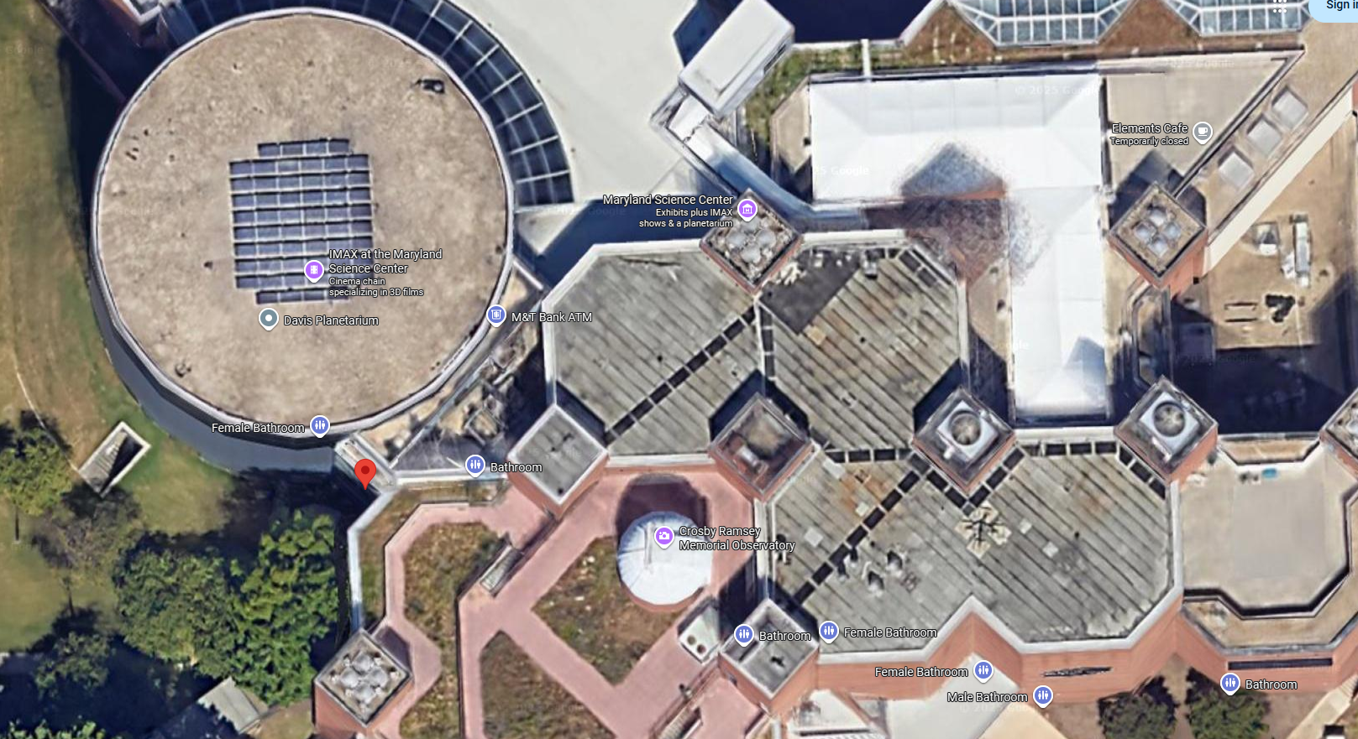
Baltimore City Sensor
Baltimore City (DMH) sensor listed as being located at 39.281254, -76.612217
Roof top of Maryland Science Center
X
Icon – Spreadsheet Location
X – Where I think it’s actually located (45 feet east)

Slide 17
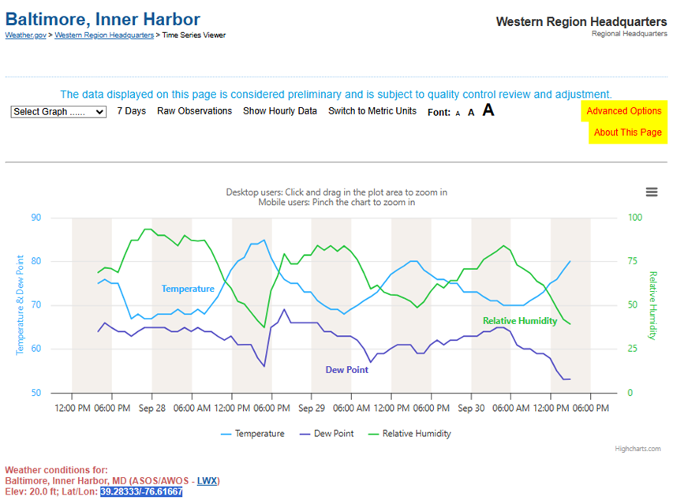
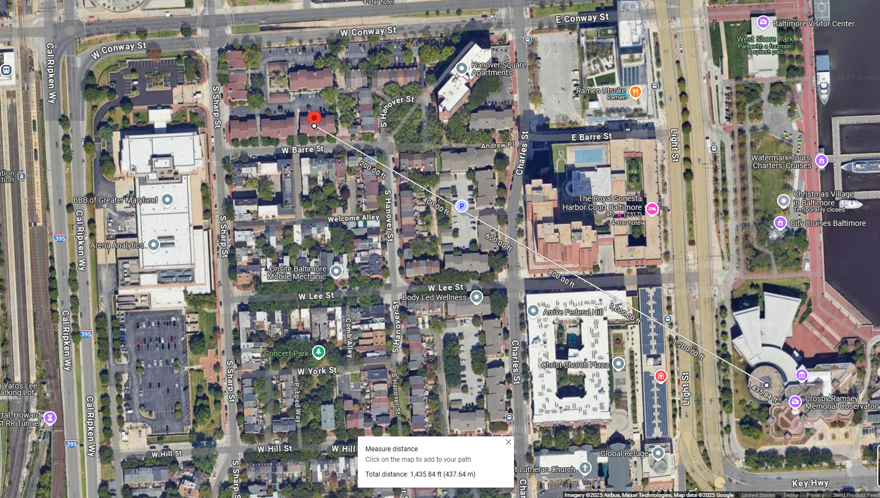
Baltimore City Sensor
NWS shows coordinates as 39.28333, -76.61667 (https://www.weather.gov/wrh/timeseries?site=KDMH)
>1400 feet WNW of actual location (also says the elevation is 20 feet)

Slide 18
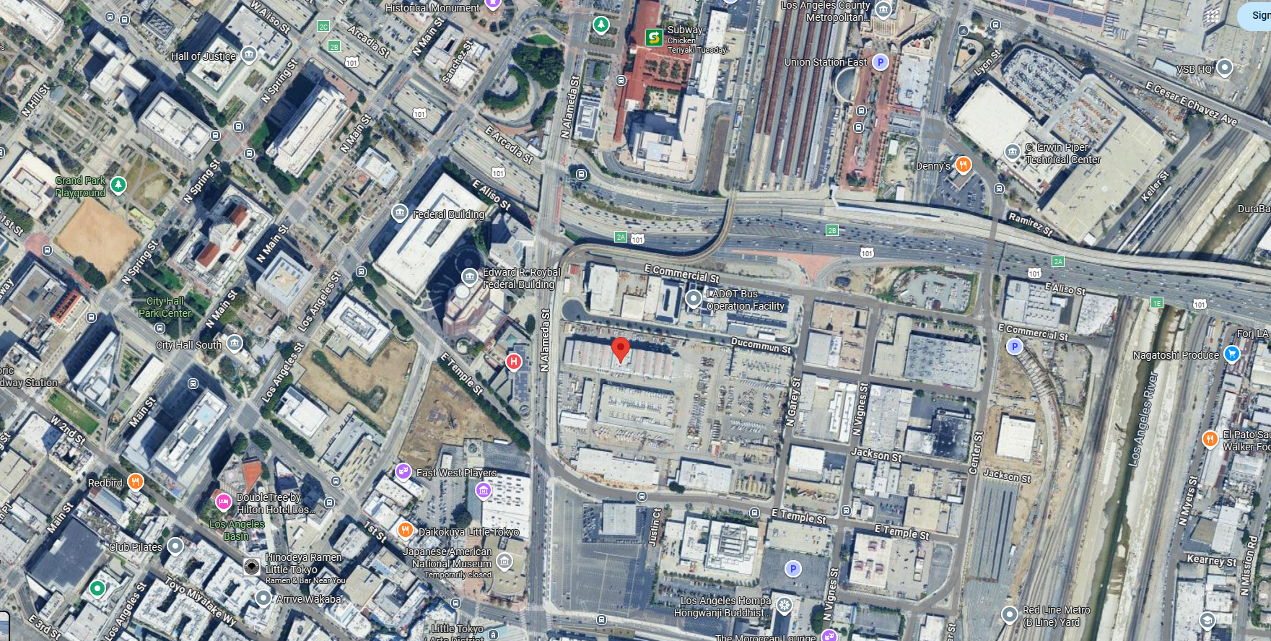
Downtown Los Angeles Sensor
KCQT ASOS was located on the University of Southern California (USC) campus
Was official downtown LA weather site since 1999
Site no longer exists
According to NWS Service Change Notice 24-47:
Effective Thursday, May 20, 2024 around 1500 Coordinated Universal Time (UTC), the official Downtown Los Angeles, CA weather observations site (KCQT) will be relocated to the Frank Hotchkin Memorial Training Center on the south side of Dodger Stadium
Gathering observations farther inland at the Frank Hotchkin Memorial Training Center is expected to better represent the weather and climate of Downtown Los Angeles
KCQT site at USC

Slide 19
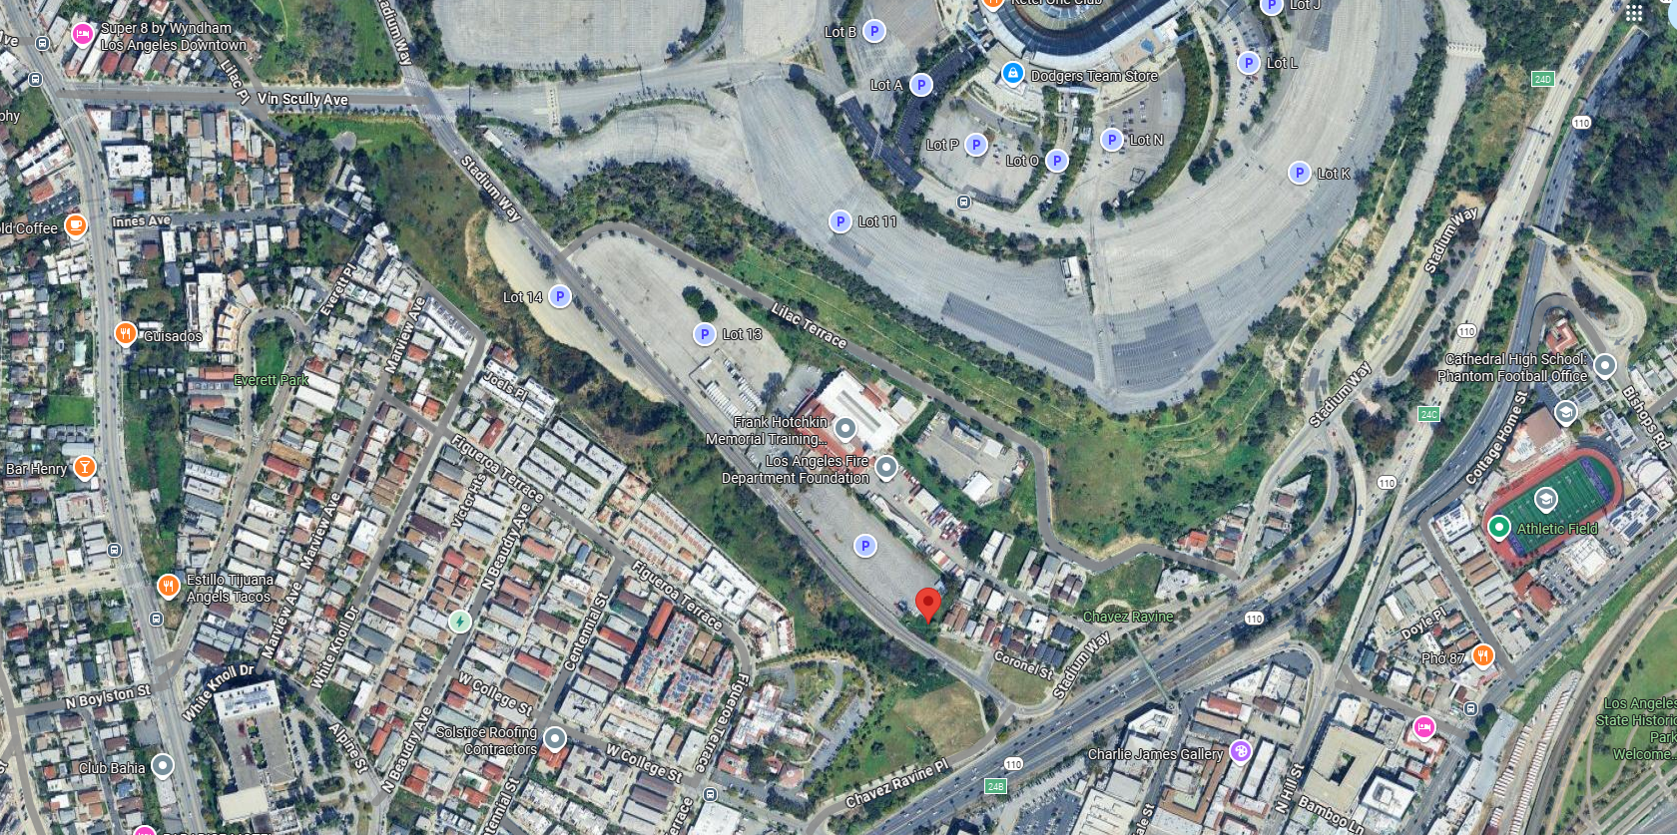
Downtown Los Angeles Sensor
New identifier is FHMC1
Cooperative Observer Program (COOP) instead of ASOS
New observations should be warmer with lower dewpoints since the site is beyond the sea breeze that affected the USC site
New site has different surroundings (trees around sensor) and is at a different height (413 feet) than the old sensor (183 feet)
FHMC1 site near Dodger Stadium

Slide 20
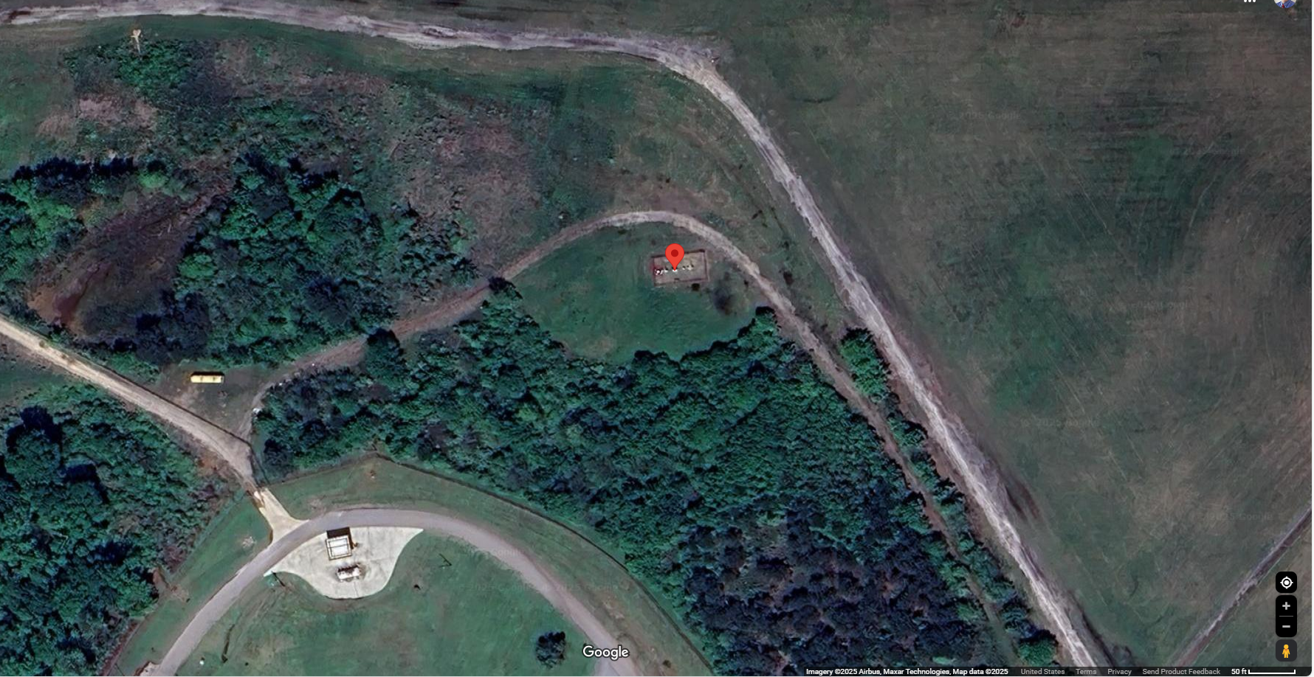
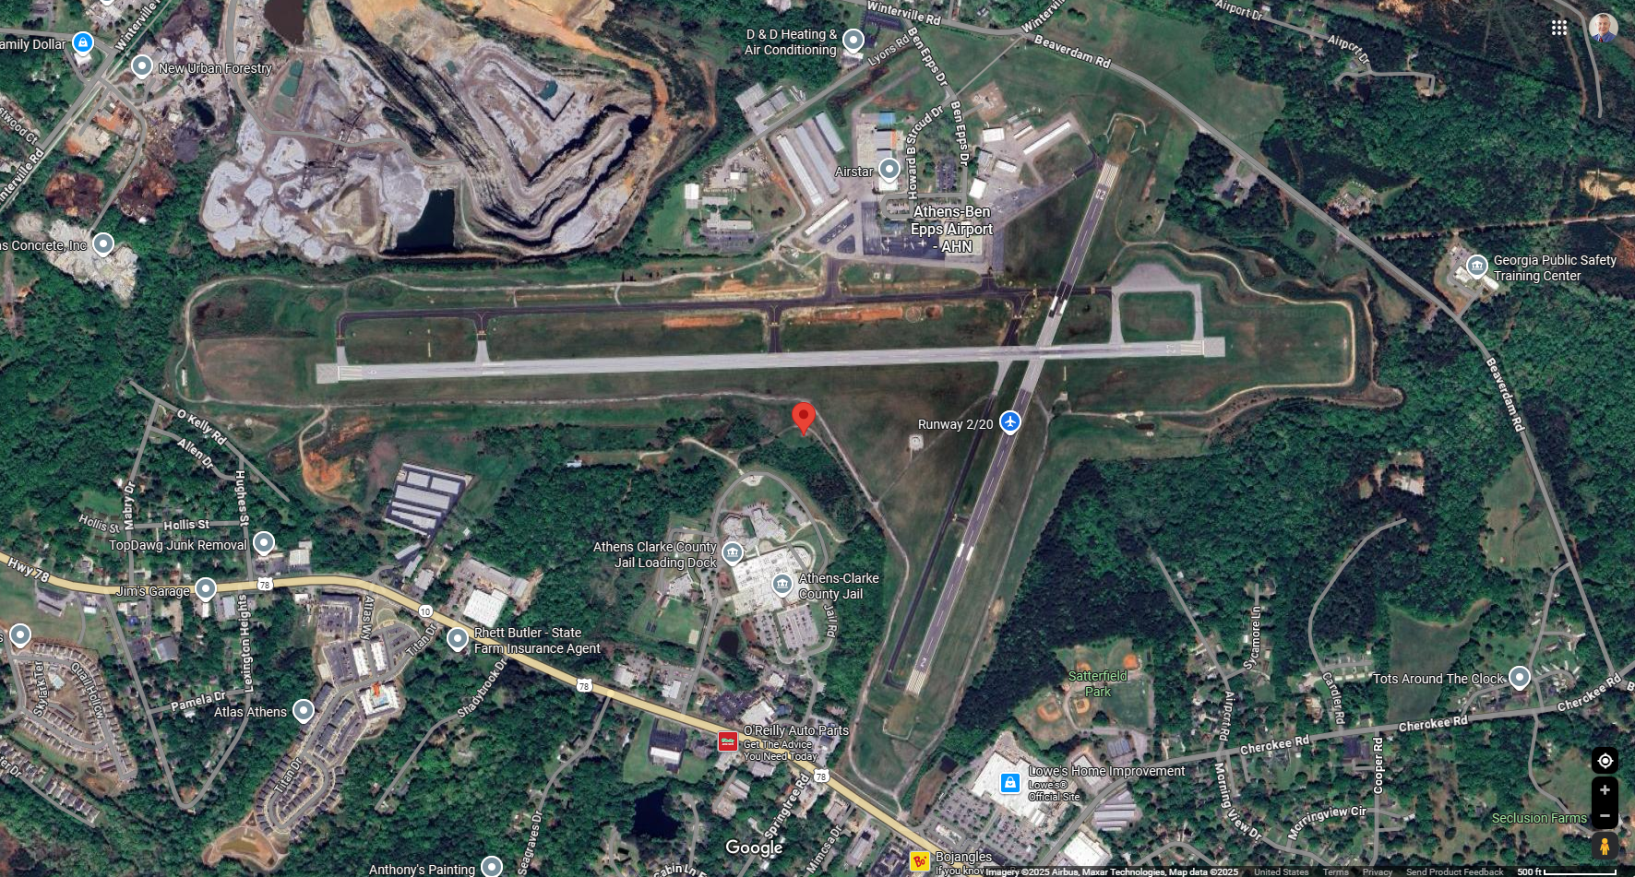
Athens, GA Airport Sensor
Athens, GA airport weather sensor located to the south of Runways 09/27
Grove of very tall trees 100 feet southeast to 170 feet west
Wind reporting could be impacted when using RWY 20
Athens-Ben Epps Airport. Icon is location of ASOS.

Slide 21
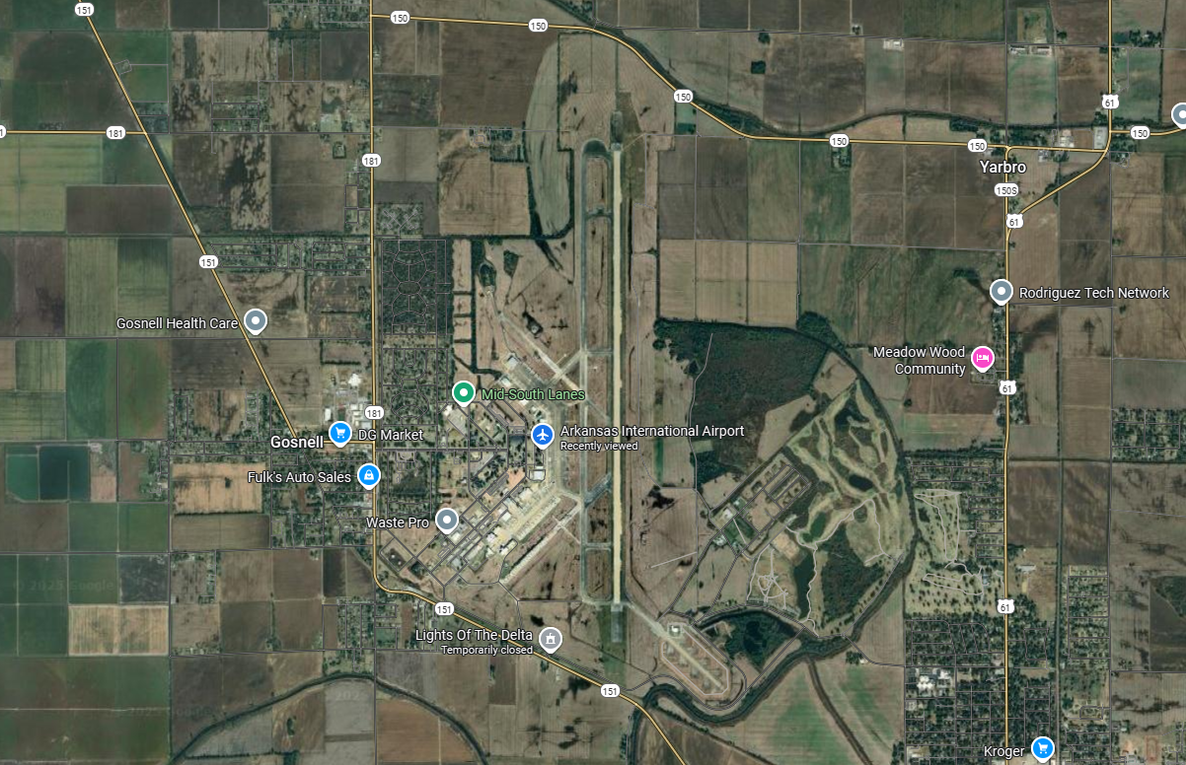
Arkansas International Airport
Blytheville, AR, far northeast corner of the state
Longest runway in the state (11,600 feet)
Arkansas International Airport, Blytheville, AR (formally Eaker AFB)

Slide 22
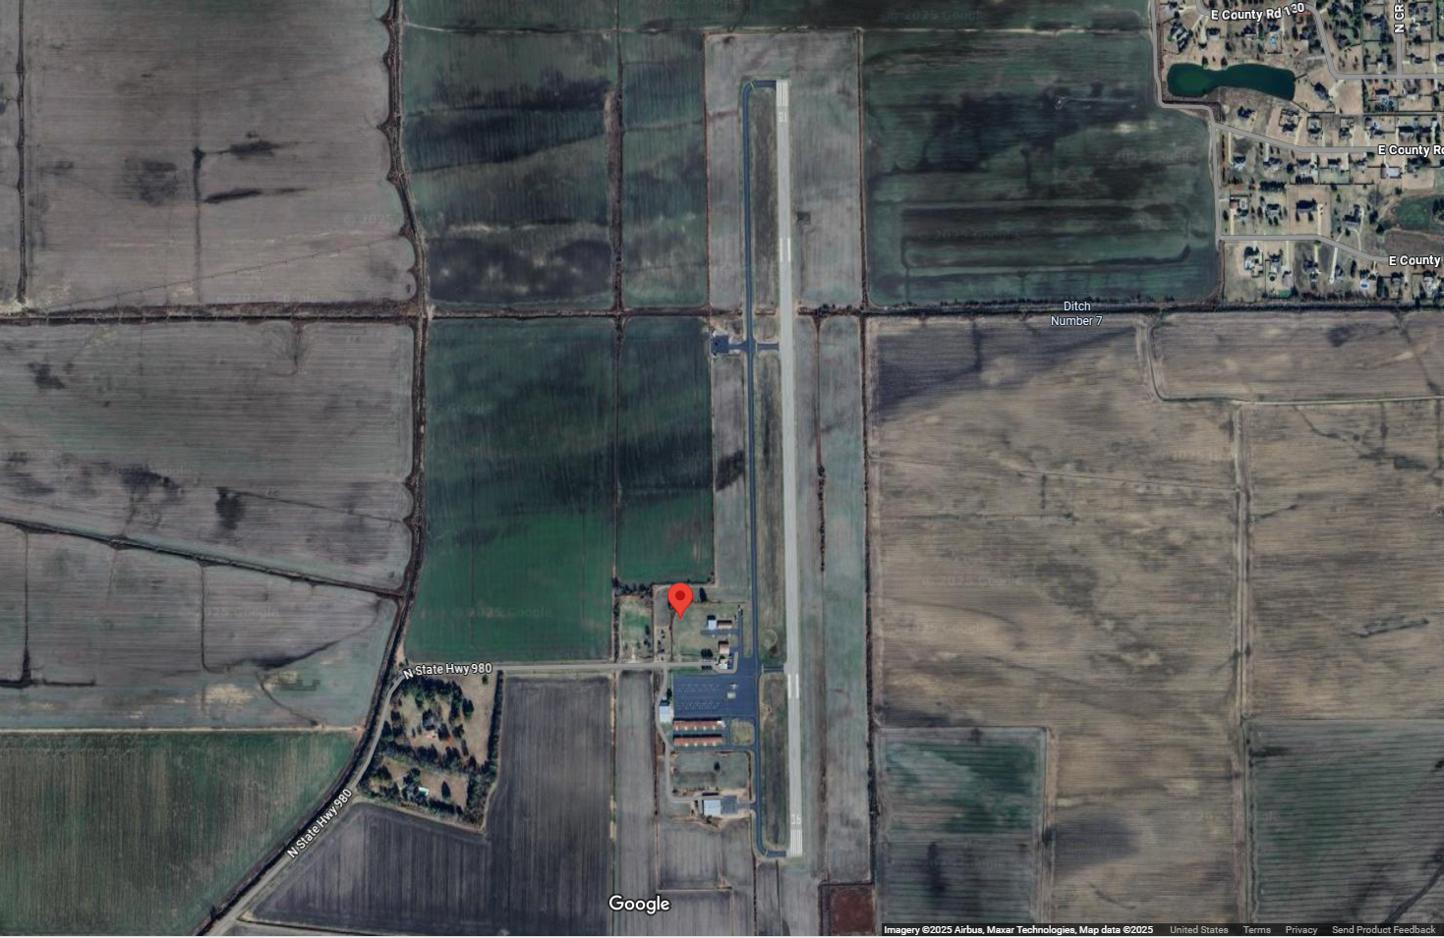
Arkansas International Airport
Blytheville, AR, far northeast corner of the state
Longest runway in the state (11,600 feet)
But a major issue with the ASOS:
Blytheville, AR ASOS site

Slide 23
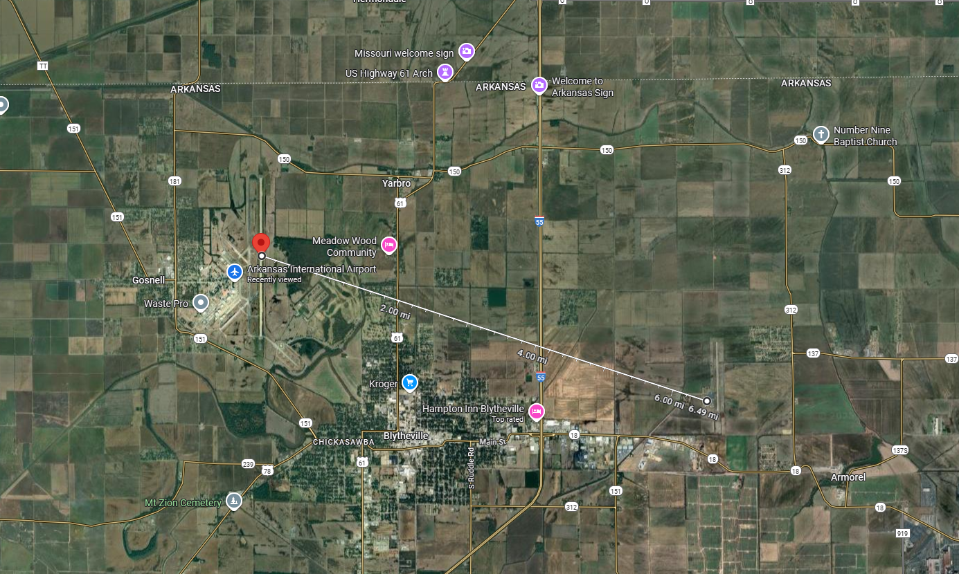
Arkansas International Airport
Blytheville, AR, far northeast corner of the state
Longest runway in the state (11,600 feet)
But a major issue with the ASOS:
It’s not at the airport!
ASOS site serving AIA is 6.5 miles east-southeast at Blytheville Municipal Airport

Slide 24
Summary
Both ASOS and AWOS record surface observations, many directly used to support aviation
ASOS and AWOS sensors are very accurate but may not always be representative of surrounding conditions
Study ongoing to verify locations of ASOS and AWOS
Large majority of sensors are sited accurately and have no obstructions
Some sensors are over a thousand feet off in terms of location
Some sensors have potential obstructions
Impacts to aviation due to sensors that have location differences or obstructions are unknown

Slide 25
For questions and comments please contact Randy Bass at Bass Weather Services, LLC
bassweather@gmail.com
540-943-8559
www.bassweather.com

Slide 26
ASOS Observations
Basic weather elements measured and reported by ASOS include:
Sky condition: Cloud height and amount (clear, scattered, broken, overcast) up to 12,000 feet
Visibility (to at least 10 statute miles)
Basic present weather information: Type and intensity for rain, snow, and freezing rain
Obstructions to vision: Fog, haze
Pressure: Sea-level pressure, altimeter setting
Ambient temperature, dew point temperature
Wind: Direction, speed and character (gusts, squalls)
Precipitation accumulation

Slide 27
ASOS/AWOS Capability Comparisons
Element Reported Type | Wind | Visibility | Temperature Dew Point | Altimeter | Density Altimeter | Cloud/Ceiling | Precipitation Identification | Thunderstorm/ Lightning | Precipitation Occurrence | Rainfall Accumulation | Runway Surface Condition | Freezing Rain Occurrence | Remarks
ASOS | X | X | X | X | X | X | X |  |  | X |  | X | X
AWOS−A |  |  |  | X
AWOS−A/V |  | X |  | X
AWOS−1 | X |  | X | X | X
AWOS−2 | X | X | X | X | X
AWOS−3 | X | X | X | X | X | X
AWOS−3P | X | X | X | X | X | X | X
AWOS−3T | X | X | X | X | X | X |  | X
AWOS−3P/T | X | X | X | X | X | X | X | X
AWOS−4 | X | X | X | X | X | X | X | X | X | X | X | X
Manual | X | X | X | X |  | X | X |  |  |  |  |  | X
REFERENCE− FAA Order JO 7900.5B, Surface Weather Observing, for element reporting.
AWOS-3 systems are the most comparable to ASOS
Some ASOS and AWOS locations are augmented by certified observers

Slide 28
Precipitation Accumulation - Rain
The precipitation accumulation algorithm obtains precipitation accumulation data from the Heated Tipping Bucket (HTB) precipitation gauge once each minute
Valid for discrete 60-second periods ending at M+00
Algorithm corrects the tipping bucket measurement, particularly during periods of high rainfall rates, using the following equation:
C = A (1 + .60A)
Where C = the calculated rainfall amount and A = the measured amount from the tipping bucket
The HTB has a precipitation accumulation range of 0 to 10.00 inches per hour, a resolution of 0.01 inch (i.e., one tip) and an accuracy of ± 0.02 inch or 4% of the hourly total (whichever is greater)
Limitation: During extremely heavy rainfall events the HTB may still under-report the total rainfall accumulation

Slide 29
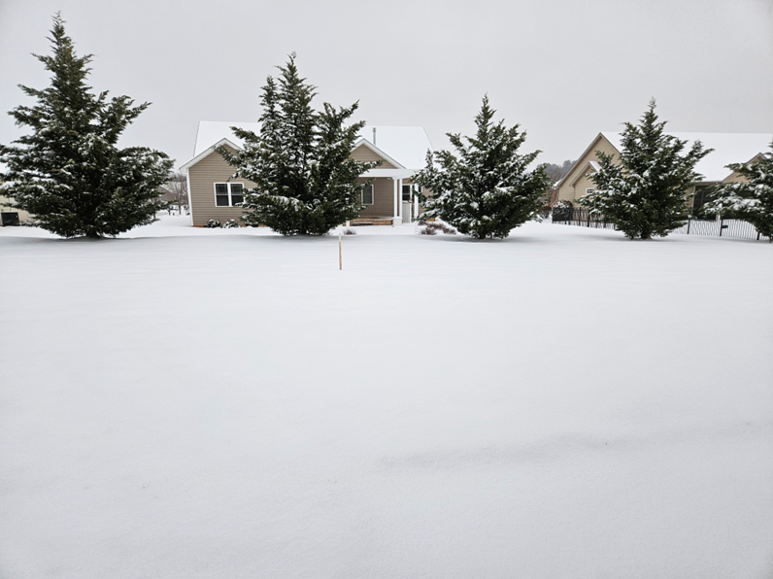
Precipitation Accumulation - Snow
The algorithm process is the same for snow as it is for rain to measure precipitation equivalent with the following additions:
The HTB has 2 heating elements -- one heating element is wrapped around the underside of the collector funnel, and the other around the drain tube
Each heater is separately thermostatically controlled to maintain a temperature of 40°F
Power is turned on when the temperature falls below 40°F and is turned off when the temperature falls below -20°F
Power is not turned on again until the temperature rises above -12°F
Power is turned off when the temperature is at or above 40°F
Limitation: The application of heat to melt snow and prevent gauge icing also induces evaporation or sublimation, especially during light freezing rain or snow events at temperatures near 32°F

Slide 30
ASOS/AWOS Systems
ASOS and AWOS Systems in Operation
 | Systems in Operation | Systems Augmented by Controllers | Systems Augmented by Contract Weather Observers | Standalone Systems
ASOS (FAA and NWS) | 880 | 346 | 133 | 401
Fed AWOS | 237 | 23 | 2 | 214
Non-Fed AWOS | 1400 | 24 | 0 | 1376
Total | 2517 | 393 | 135 | 1991
Note that the Navy and Army have an additional 75 ASOS

Slide 31
ASOS Accuracy Specifications for Rain, Snow, and Freezing Precipitation
Sensor | Limits | Accuracy | Resolution
Rain Accum | 0 to 10.0"/hr | ±0.02" or 4% of hourly total, whichever is greater | 0.01"
Snow Depth | 0 to 99" | 0 - 5": ±½" >5 - 99": ±1" | ½" 1"
Frozen Precip Water Equiv | 0 to 40" | ±0.04" or 1% of the total accumulation | 0.01"
Freezing Rain Occurrence | -- | Detection is reported whenever freezing rain accumulates to 0.01". | --
Present | Occurrence 99% of time | 0.01"/hr or 10%, whichever is greater
Weather | Identification:
 | Rain 90% of time
 | Snow 97% of time
 | Precip 99% of time

Slide 32
Present Weather Sensor
Potential Upgrades and Improvements
As stated earlier, the current precipitation identification sensor has no ability to detect and report ice pellets, snow grains, snow pellets or hail
Also only able to report one type of precipitation at a time
FAA’s Weather Observation Improvement (WOI) program evaluated a potential replacement called the Present Weather Sensor (PWS)
The PWS can identify and report freezing drizzle and rain as well as identify and distinguish between rain, drizzle, snow, ice pellets, and hail
Benefits of the new PWS include:
Provides terminal area freezing precipitation information in supercooled large drop icing conditions
Provides capability to identify categories of freezing precipitation to support use of Holdover Time tables
Provides potential for incorporation into automated Holdover Time Determination Systems for FZDZ and FZRA

Slide 33
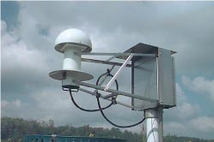
Temperature/Dew Point Calculation
The hygrothermometer continually measures the ambient temperature and dew point, and provides sample values approximately six times per minute
Samples are averaged to determine a 1-minute average temperature/dew point at M+00
Once each minute the algorithm calculates the 5-minute average temperature and dew point from the 1-minute average observations
These 5-minute averages are rounded to the nearest degree Fahrenheit, converted to the nearest 0.1 degree Celsius, and reported once each minute as the 5-minute average temperature and dew point
All mid-point values are rounded up (e.g., +3.5°F rounds up to +4.0°F; -3.5°F rounds up to -3.0°F; -3.6 °F rounds to -4.0 °F)
Limitations:
Sensor can go out of tolerance if calibration maintenance is not done on schedule
Loss of siting integrity (vegetation growth, construction near sensor, etc.)
The dew point temperature may become stuck at around zero degrees Celsius

Slide 34
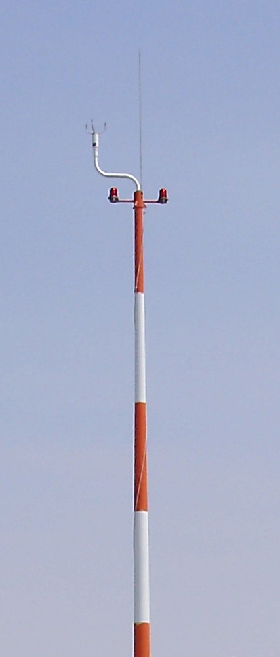
Wind Measurement Calculation
Wind Direction
The system reports a 2-minute average of 5-second average wind directions once a minute (i.e., 24 samples each minute)
The current 2- minute average wind direction is included in the transmitted METAR/SPECI messages
The direction from which the wind is blowing is reported to the nearest 10 degree increment (e.g., 274 degrees is reported as 270 degrees)
Wind direction is reported relative to true north in the METAR/SPECI message, in the daily/monthly summaries, and on all video displays
Wind direction is reported relative to magnetic north in the computer-generated voice messages

Slide 35
Wind Measurement Calculation
Wind Speed
Similar to wind direction, a 2-minute average is updated once every 5 seconds and is reported once every minute
Wind Gust
Once every 5 seconds, the algorithm computes the greatest 5-second average wind speed during the past minute, and once each minute stores this information in memory for 12 hours
Every 5 seconds the system computes the current 2-minute average wind speed and compares it with the greatest 5-second average wind speed during the past minute
If the current 2-minute average wind speed is equal to or greater than 9 knots AND the greatest 5-second average wind speed during the past minute exceeds the current 2-minute average speed by 5 knots or more, then the greatest 5-second average speed observed during the past minute is stored in memory as a gust for 10 minutes

Slide 36

Wind Measurement Calculation
Once every 5 seconds, the system compares the highest gust stored in memory for the past 10 minutes with the current 2-minute average wind speed
If the difference between the two is 3 knots or more, the current reported wind speed is greater than 2 knots, and the highest gust exceeds the minimum 5-second wind speed in the past 10 minutes by 10 knots or more, then the highest gust stored in memory is designated as the reportable gust
This value is appended to the current wind direction and speed reported in METAR/SPECI reports
The minimum gust speed reported by the system is 14 knots
Limitations:
Lag in reporting wind shifts -- the wind shift algorithm cannot rely on external clues used by the observer for early collateral assurance of a wind shift - frontal passage occurrence
Must wait the full 15-minutes required in the definition of wind shift before outputting a remark

Slide 37
Wind Gust Schematic
No gust reported
Every 5 seconds
Compute greatest 5-second average wind speed during last minute
Does greatest average wind speed during the past minute exceed current 2-minute average speed by 5 knots or more?
No
No
No
Difference between the two 3 knots or more?
Yes
No
Every 5 seconds
Compute greatest 5-second average wind speed during past minute to current 2-minute average wind speed
Yes
Current reported wind speed greater than 2 knots?
Greatest 5-second average wind speed observed during the past minute stored in memory as gust for 10 minutes
Yes
No
Highest gust exceeds minimum 5-second wind speed in the last 10 minutes by 10 knots or more?
Yes
Is current 2-minute average wind speed greater than 9 knots?
Yes
Every 5 seconds
Compare the highest gust in 10-minute memory with current 2-minute average wind speed
Highest gust stored in memory is designated as the reportable gust and appended METAR/SPECI reports
No
No gust reported

Slide 38
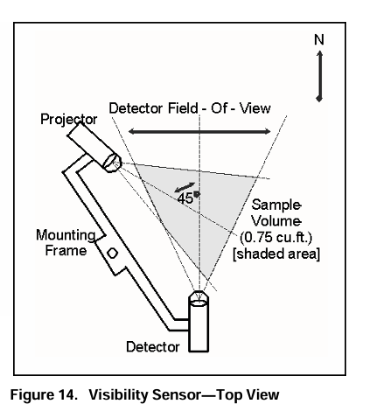
Visibility Sensor and Calculation
The Sensor Equivalent Visibility (SEV) is derived by frequently measuring the forward scatter characteristics of a small atmospheric sample (0.75 cubic feet) near the sensor
The algorithm samples sensor data every minute, obtaining a 1-minute average extinction coefficient and day/night indication
The algorithm calculates a 1-minute average visibility every minute and stores the value for 10 minutes
Finally, it computes a running 10-minute harmonic mean once per minute from the stored data to provide the latest visibility
A harmonic mean is used in the final computation rather than an arithmetic mean because it is more responsive to rapidly decreasing visibility conditions
and will generally yield a lower value than the arithmetic mean
Result provides an earlier warning of deteriorating conditions and is best for aviation use
Limitations:
The small sampling volume (0.75 cubic feet) can give undue weight to small scale differences in the atmosphere
The value is valid at the sensor and may not represent the entire airport area, especially during rapidly changing conditions such as fog banks or precipitation

Slide 39
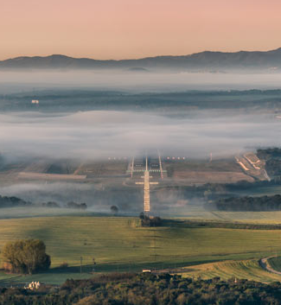
Visibility Sensor and Calculation
The harmonic mean is computed from the formula:
V = n / (1/V1 + 1/V2 + ...+ 1/Vn)
Where V is the harmonic mean, n = 10, and V1 , V2,... Vn , are the individual 1-minute values
The difference between the harmonic mean and the arithmetic mean can be seen when a fog bank moves in and suddenly drops the visibility from 10 miles to 1/4 mile
Initially there are 10, 1-minute values of visibility equal to 10 miles and both the arithmetic and harmonic mean are reporting 10 mile visibility
In the first minute, there are nine values of 10 miles and one value of 1/4 mile used to compute the current visibility -- the arithmetic mean yields 9.025 miles while the harmonic mean yields 2.041 miles
In the second minute, there are now eight values of 10 miles and two values of 1/4 mile used to compute current visibility -- the arithmetic mean is 8.050 miles and the harmonic mean is 1.136 miles

Slide 40
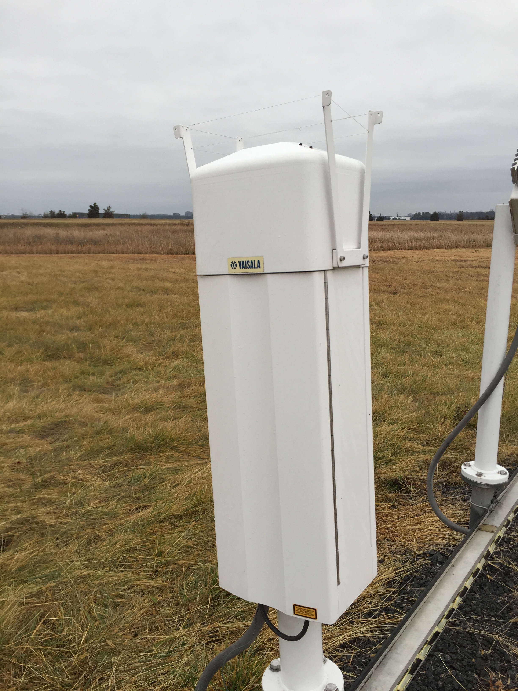
Cloud Height Sensor and Calculation
Laser beam ceilometer with a vertical measuring range of 12,600 feet and reporting range of 12,000 feet
Cloud sensor is a vertically pointed laser transmitter and receiver
Every 30 seconds a sample is compiled from the sensor’s back scatter returns taken from the most recent two or three 12-second processing intervals completed within the 30 second period
These data are processed to determine the height of the returns and whether the sample compiled from these returns is a “cloud hit” or an “unknown hit”
Every minute, the system processes the most recent 30 minutes of 30-second sample data; the last 10 minutes of data are processed twice (double weighted) to be more responsive to the latest changes in sky condition
This technique provides a total of 80 samples; 40 in the first 20 minutes and 40 in the last 10 minutes

Slide 41
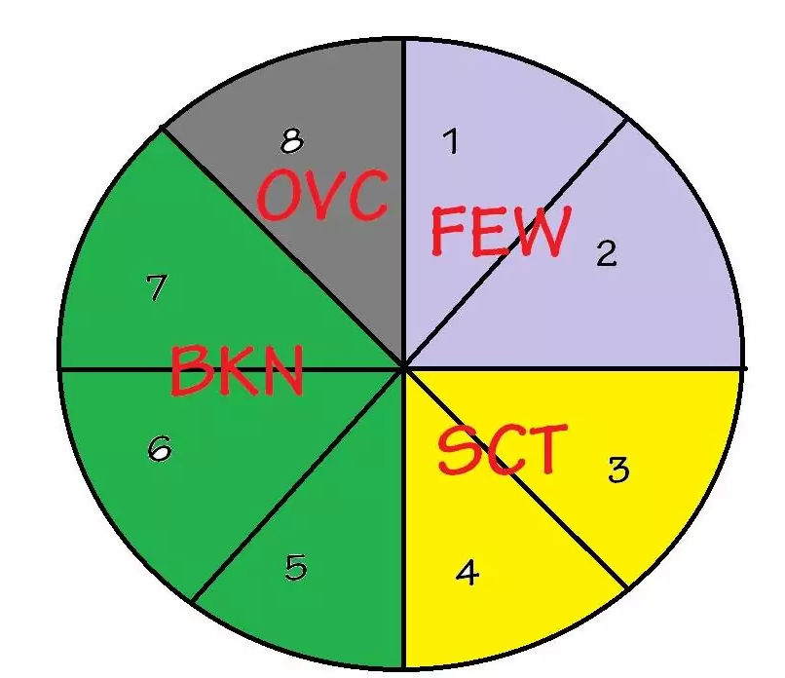
Cloud Height Sensor and Calculation
The cloud signal hits for the latest 30 minutes are then rounded or “binned” to the nearest 100 feet for cloud heights between the surface and 5,000 feet; to the nearest 200 feet for heights between 5,000 and 10,000 feet; and to the nearest 500 feet for heights above 10,000 feet
Accuracy: ±100 ft or 5%, whichever is greater
Reports will contain only opaque clouds -- moisture layers or thin clouds detected and considered too thin to be a cloud are reported as a restriction to vertical visibility or simply not reported
Limitations:
The sensor does not measure or know what is happening along the horizon
The algorithm does not respond immediately to changes in sky condition – if a
solid cloud deck suddenly appears, the algorithm will report a “FEW” layer within
2 minutes and a “BKN” ceiling layer within 10 minutes

Slide 42
Dew Point Determination
To determine dew point temperature, a mirror is cooled by a thermoelectric cooler until dew or frost begins to condense on the mirror surface
Once dew or frost occurs, the mirror’s surface is in vapor pressure equilibrium with the surrounding air (i.e., has reached the saturation vapor pressure)
The temperature required to maintain this equilibrium is, by definition, the dew point temperature
Optical techniques using the hygrothermometer are used to detect the presence of surface condensation
The dew point calculation uses the same process and method as the temperature calculation to determine the reported value
Limitations:
The dew point temperature may become stuck at around zero degrees Celsius
Excessive mirror contamination due to dust or other atmospheric aerosols may cause unrepresentative values

Slide 43
Siting Guidelines for Specific Sensors
Pressure Sensors - The distance between the elevation of the pressure sensors and the field elevation must not exceed 100 feet (30 meters)
Exceptions to this distance are allowed for offshore platforms that are used for aviation operations, but do not have published instrument approaches direct to the landing area
Visibility Sensors - The area within 6 feet (2 meters) of the sensor must be kept free of all vegetation and well drained
Grass or vegetation within 100 feet (30 meters) of the sensor must be clipped to a height of about 10 inches (25 centimeters) or less to reduce the probability of carbon- based aerosols and insects from interfering with sensor performance
Forward and backscatter-type sensors must have no obstructions within a horizontal distance of 50 feet (15 meters) that would cause the surrounding air mass to be non-uniform in nature (e.g., buildings)
The visibility sensor must not be located in known areas of concentrated local ground fog
Includes river banks, lake shores, and other locations where at certain times of the year, a small, very localized fog pocket appears that is not an indicator of the overall weather in the area, and does not obscure the runway

Slide 44
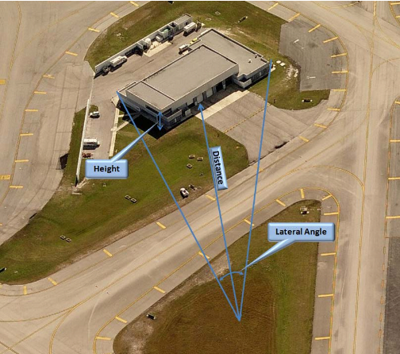
Siting Guidelines for Specific Sensors
Wind Sensor - The sensor must be mounted at 30 to 33 feet (9 to 10 meters) above the average ground height within a radius of 500 feet (150 meters)
All obstructions (e.g., vegetation, buildings, etc.) must be at least 15 feet lower than the height of the sensor within the 500 foot radius and be at least 10 feet lower than the height of the sensor from 500 to 1000 feet
An object will become a sheltering obstruction if the distance between the sensor and the object is less than ten times the height of the object and the lateral angle from the sensor to the ends of the object exceeds 10 degrees
The sensor must also be located such that it is not subject to jet blast from aircraft during engine run-up or taxiing
It must be located such that it is not susceptible to wake vortices from departing or landing aircraft

Slide 45
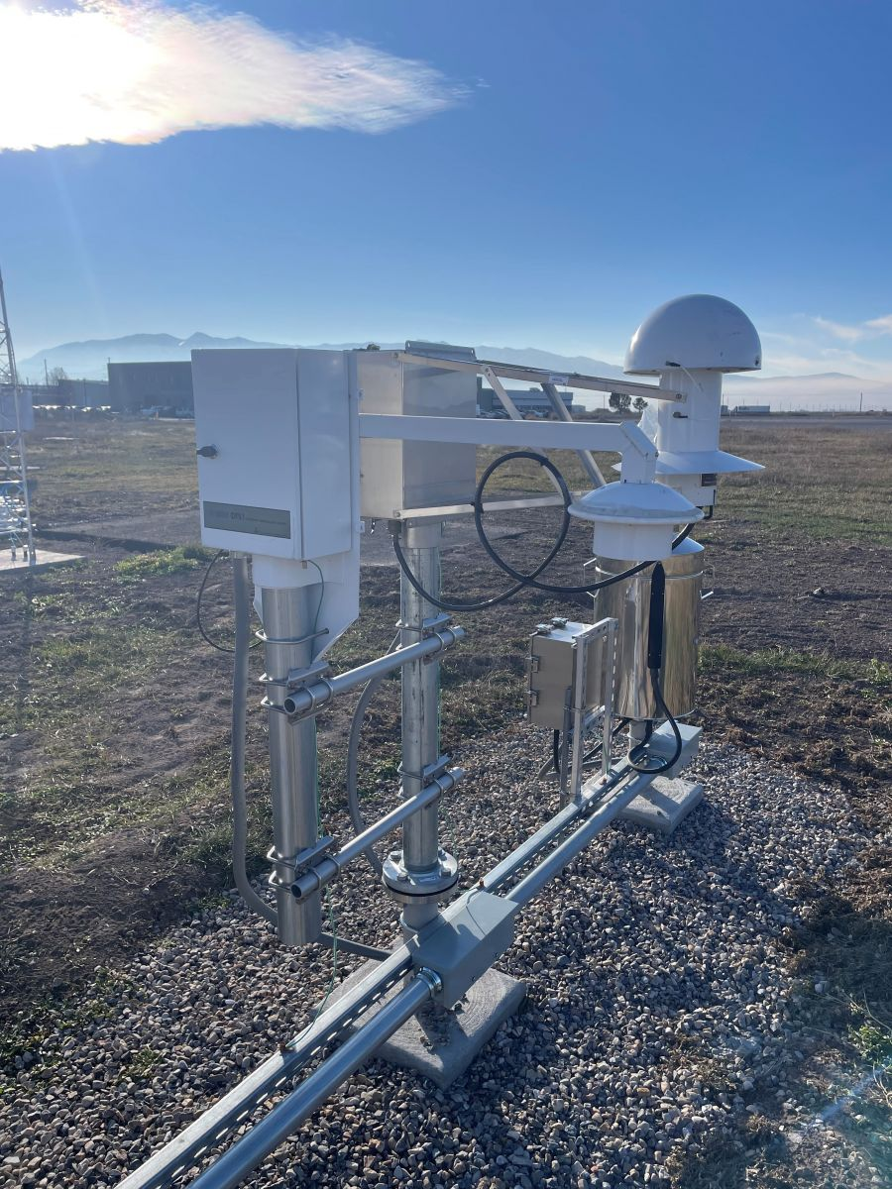
Siting Guidelines for Specific Sensors
Temperature, Dew Point and Relative Humidity Sensors
Must be mounted so that the aspirator intake is 5 ± 1 feet (1.5 ± 0.3 meters) above ground level or 2 feet (0.6 meters) above the average maximum snow depth, whichever is higher
The sensors must be installed in such a manner as to ensure that measurements are representative of the free air circulating in the locality and not influenced by artificial conditions such as large buildings, cooling towers, and expanses of concrete and tarmac
Any grass and vegetation within 100 feet (30 meters) of the sensor should be clipped to height of about 10 inches (25 centimeters) or less

Slide 46
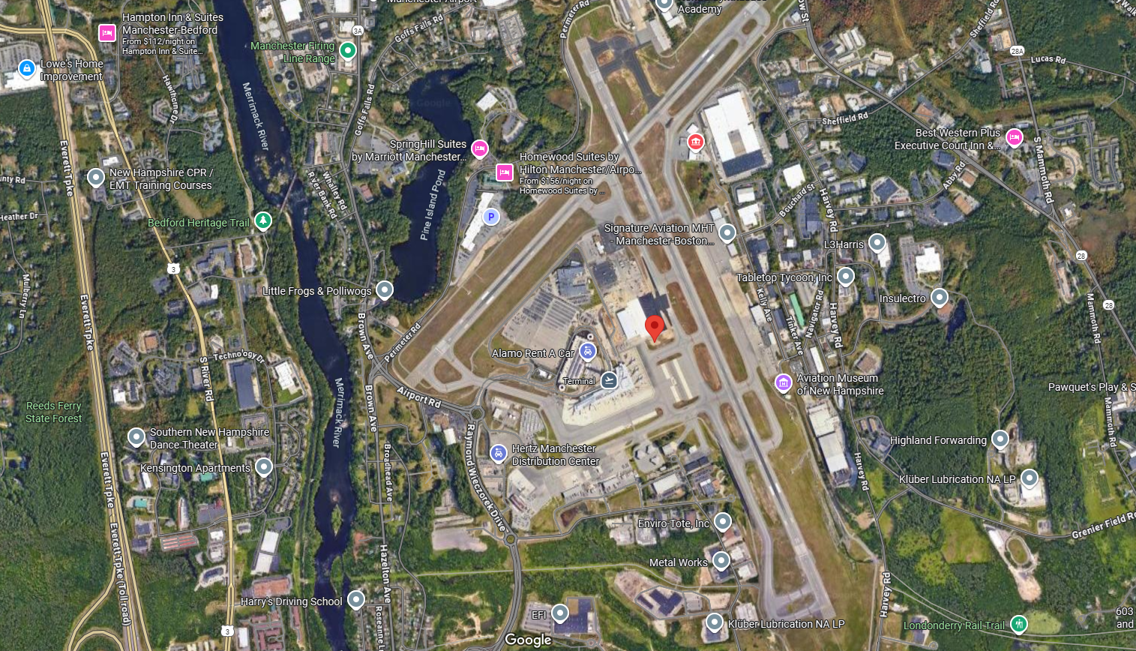
Manchester, NH Airport Sensor
Manchester – Boston International Airport
Red icon is where coordinates from KMHT ASOS says it is
Blue circle is where spreadsheet says it is
2800 foot difference

