Slide 1


November 5, 2024
ASOS Modernization
October 7, 2025

Slide 2

ASOS Modernization
Brief Overview:
In September 2019, Campbell Scientific was awarded a contract to perform a Service Life Extension Program (SLEP) or a refresh of ASOS operated by NWS
Most of the targeted weather stations are located at airports (major and minor) within the NAS (National Aerospace System)
A small handful of other sites were targeted including locations like Central Park, NY, high-elevation mountain pass locations, and remote, un-manned airports in Alaska
Contract issued by a government tri-agency that included NWS, FAA, DoD with NWS having lead role
Notes:
NOTES:

Slide 3
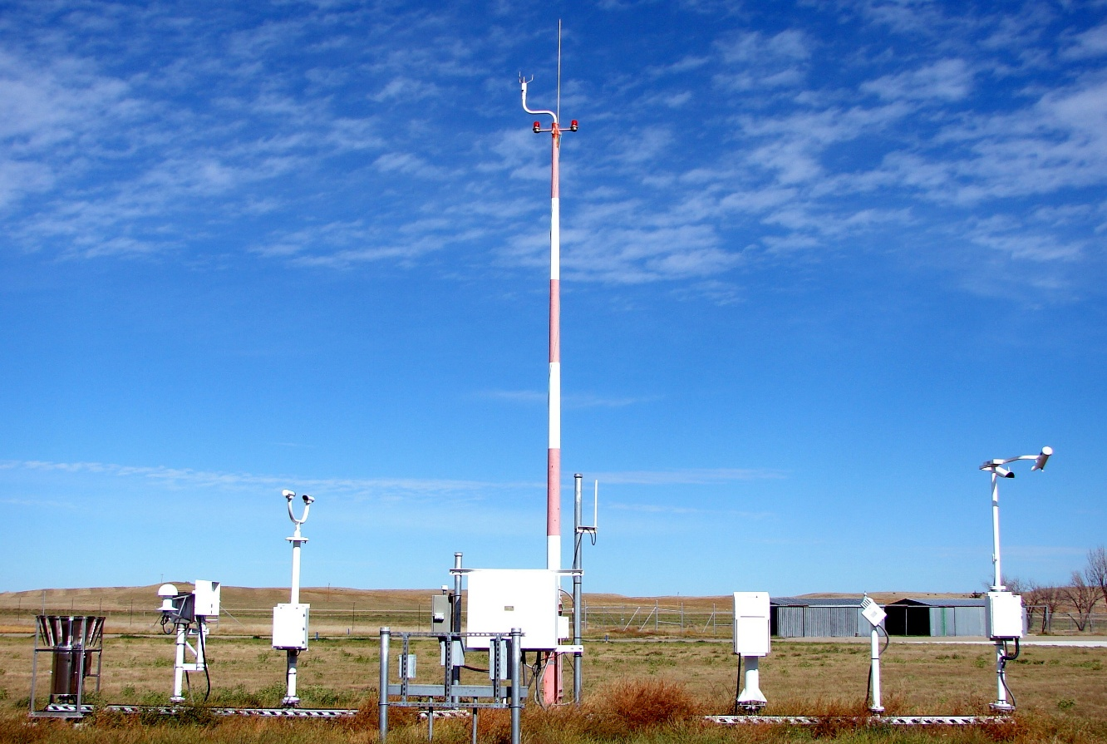
ASOS Modernization
ASOS weather sensor array at a typical US airport
Notes:
NOTES:

Slide 4
ASOS Modernization
Original Contract Deliverables:
Acquisition Control Unit (ACU) – The main ASOS computer processor located indoors (Qty 700)
Data Collection Package (DCP) – Weather sensor data collection box located on the tarmac next to sensors (Qty 782)
Single Cabinet ASOS (SCA) – A combined ACU and DCP into a single box for locations that do not have a suitable indoor location for the ACU to be located (Qty 50)
Notes:
NOTES:

Slide 5
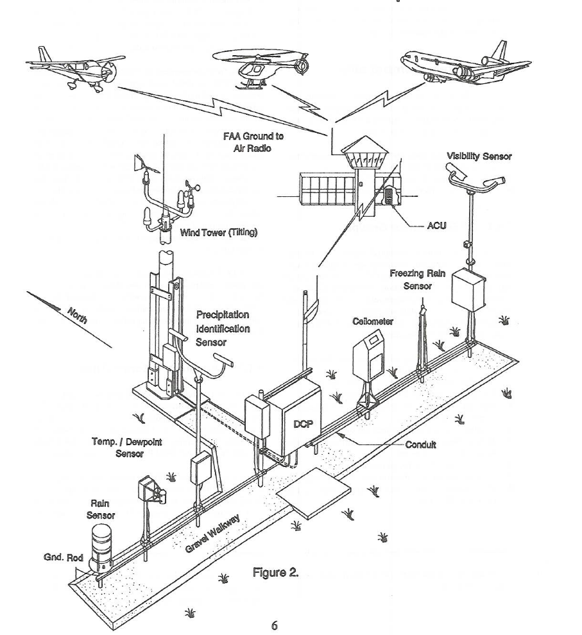
ASOS Modernization
ACU – Located indoors:
Air Traffic Control Tower
Adjacent NWS Facility
Other Adjacent Building
DCP – Located on Tarmac
Uniform sensor layout
Conforms to sensor siting standards
Notes:
NOTES:

Slide 6
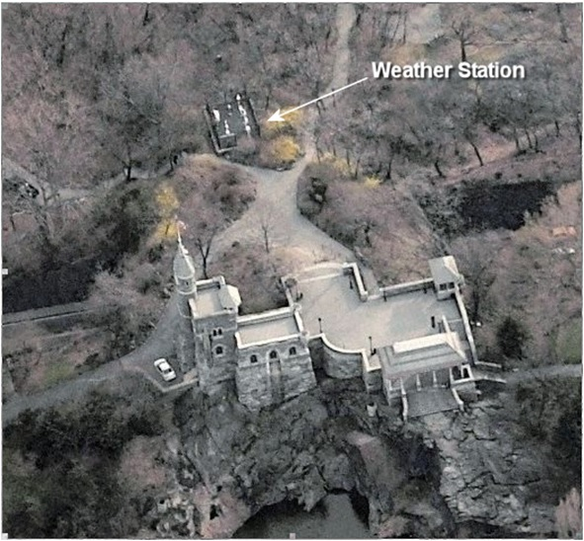
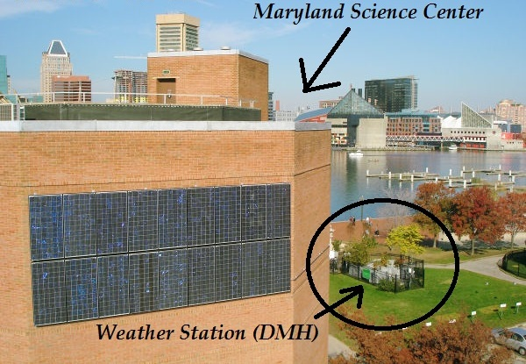
ASOS Modernization
Examples of unique
locations targeted for ASOS upgrades
Central Park, NY
(Near Belvidere Castle)
Baltimore Harbor
Notes:
NOTES:

Slide 7
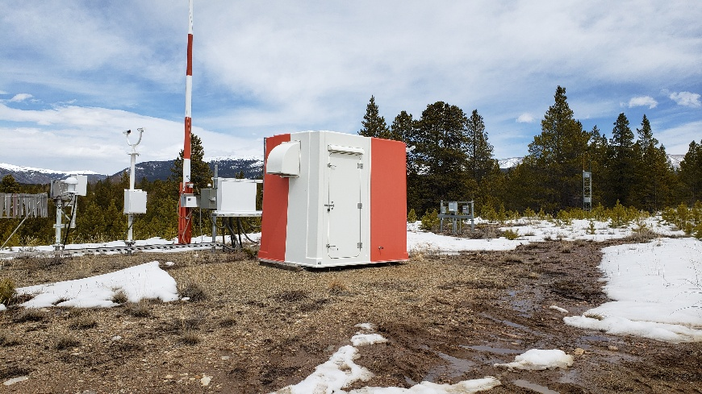
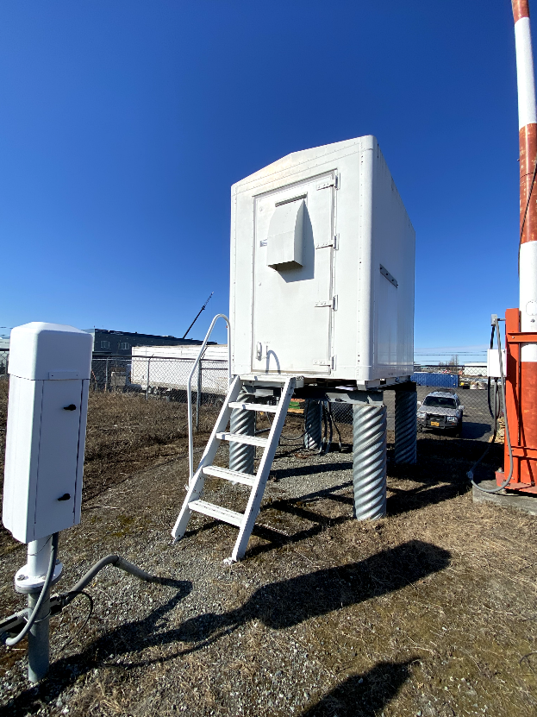
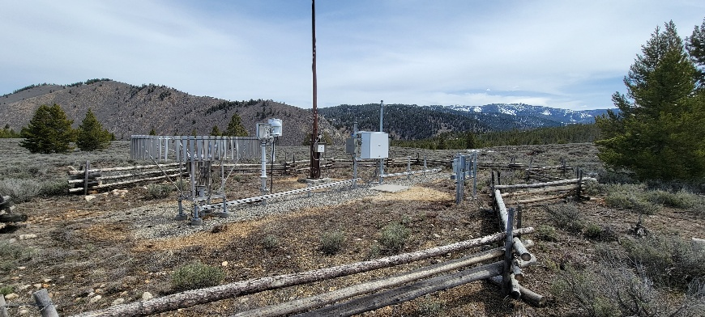
ASOS Modernization
Leadville, CO
Highest Airport in US
(9,934 ft)
Stanley, ID
High-elevation Pass
(8727 ft)
Lake Hood, Anchorage, AK (SCA Shelter)
Notes:
NOTES:

Slide 8
ASOS Modernization
ASOS History:
The existing (legacy) ASOS at airports was designed in the 1980’s utilizing 1980’s technology
Some minor upgrades were made throughout the 1980’s and 1990’s
There has been no significant refresh since the 1990’s
Government personnel at a reconditioning facility in Grandview, MO have become experts in extending the life of this aging technology
Notes:
NOTES:

Slide 9
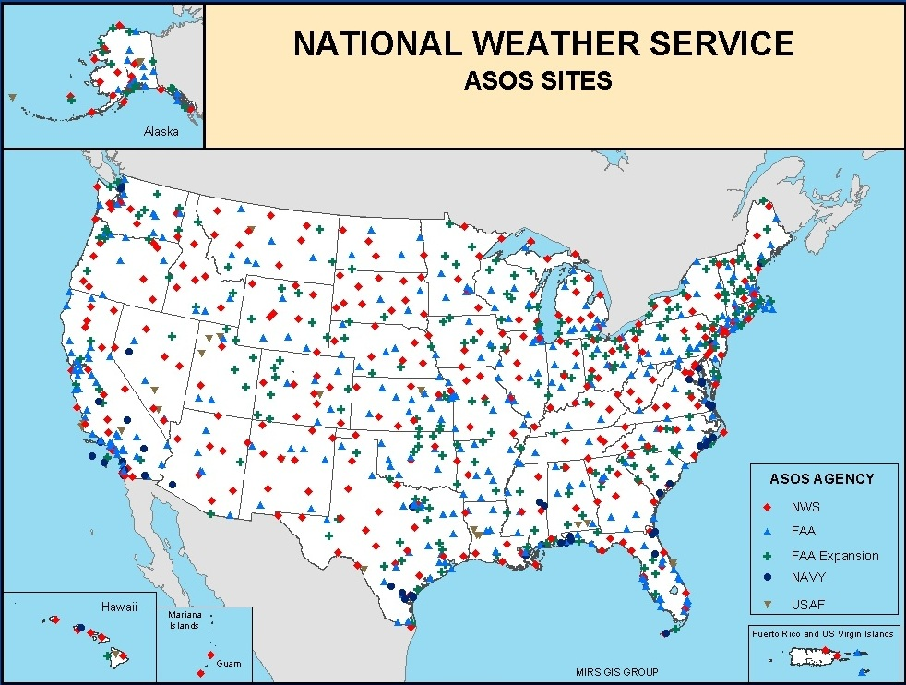
ASOS Modernization
Notes:
NOTES:

Slide 10
ASOS Modernization
Initial Contract Timeline:
The government originally provided CSI with a design developed by their own engineers
This design basically brought the technology of the ASOS barely into the 21st Century
18 ASOS were built with the government design
CSI held discussions with government stakeholders offering a more modern solution
A pivot to the CSI solution occurred in November 2020
Notes:
NOTES:

Slide 11
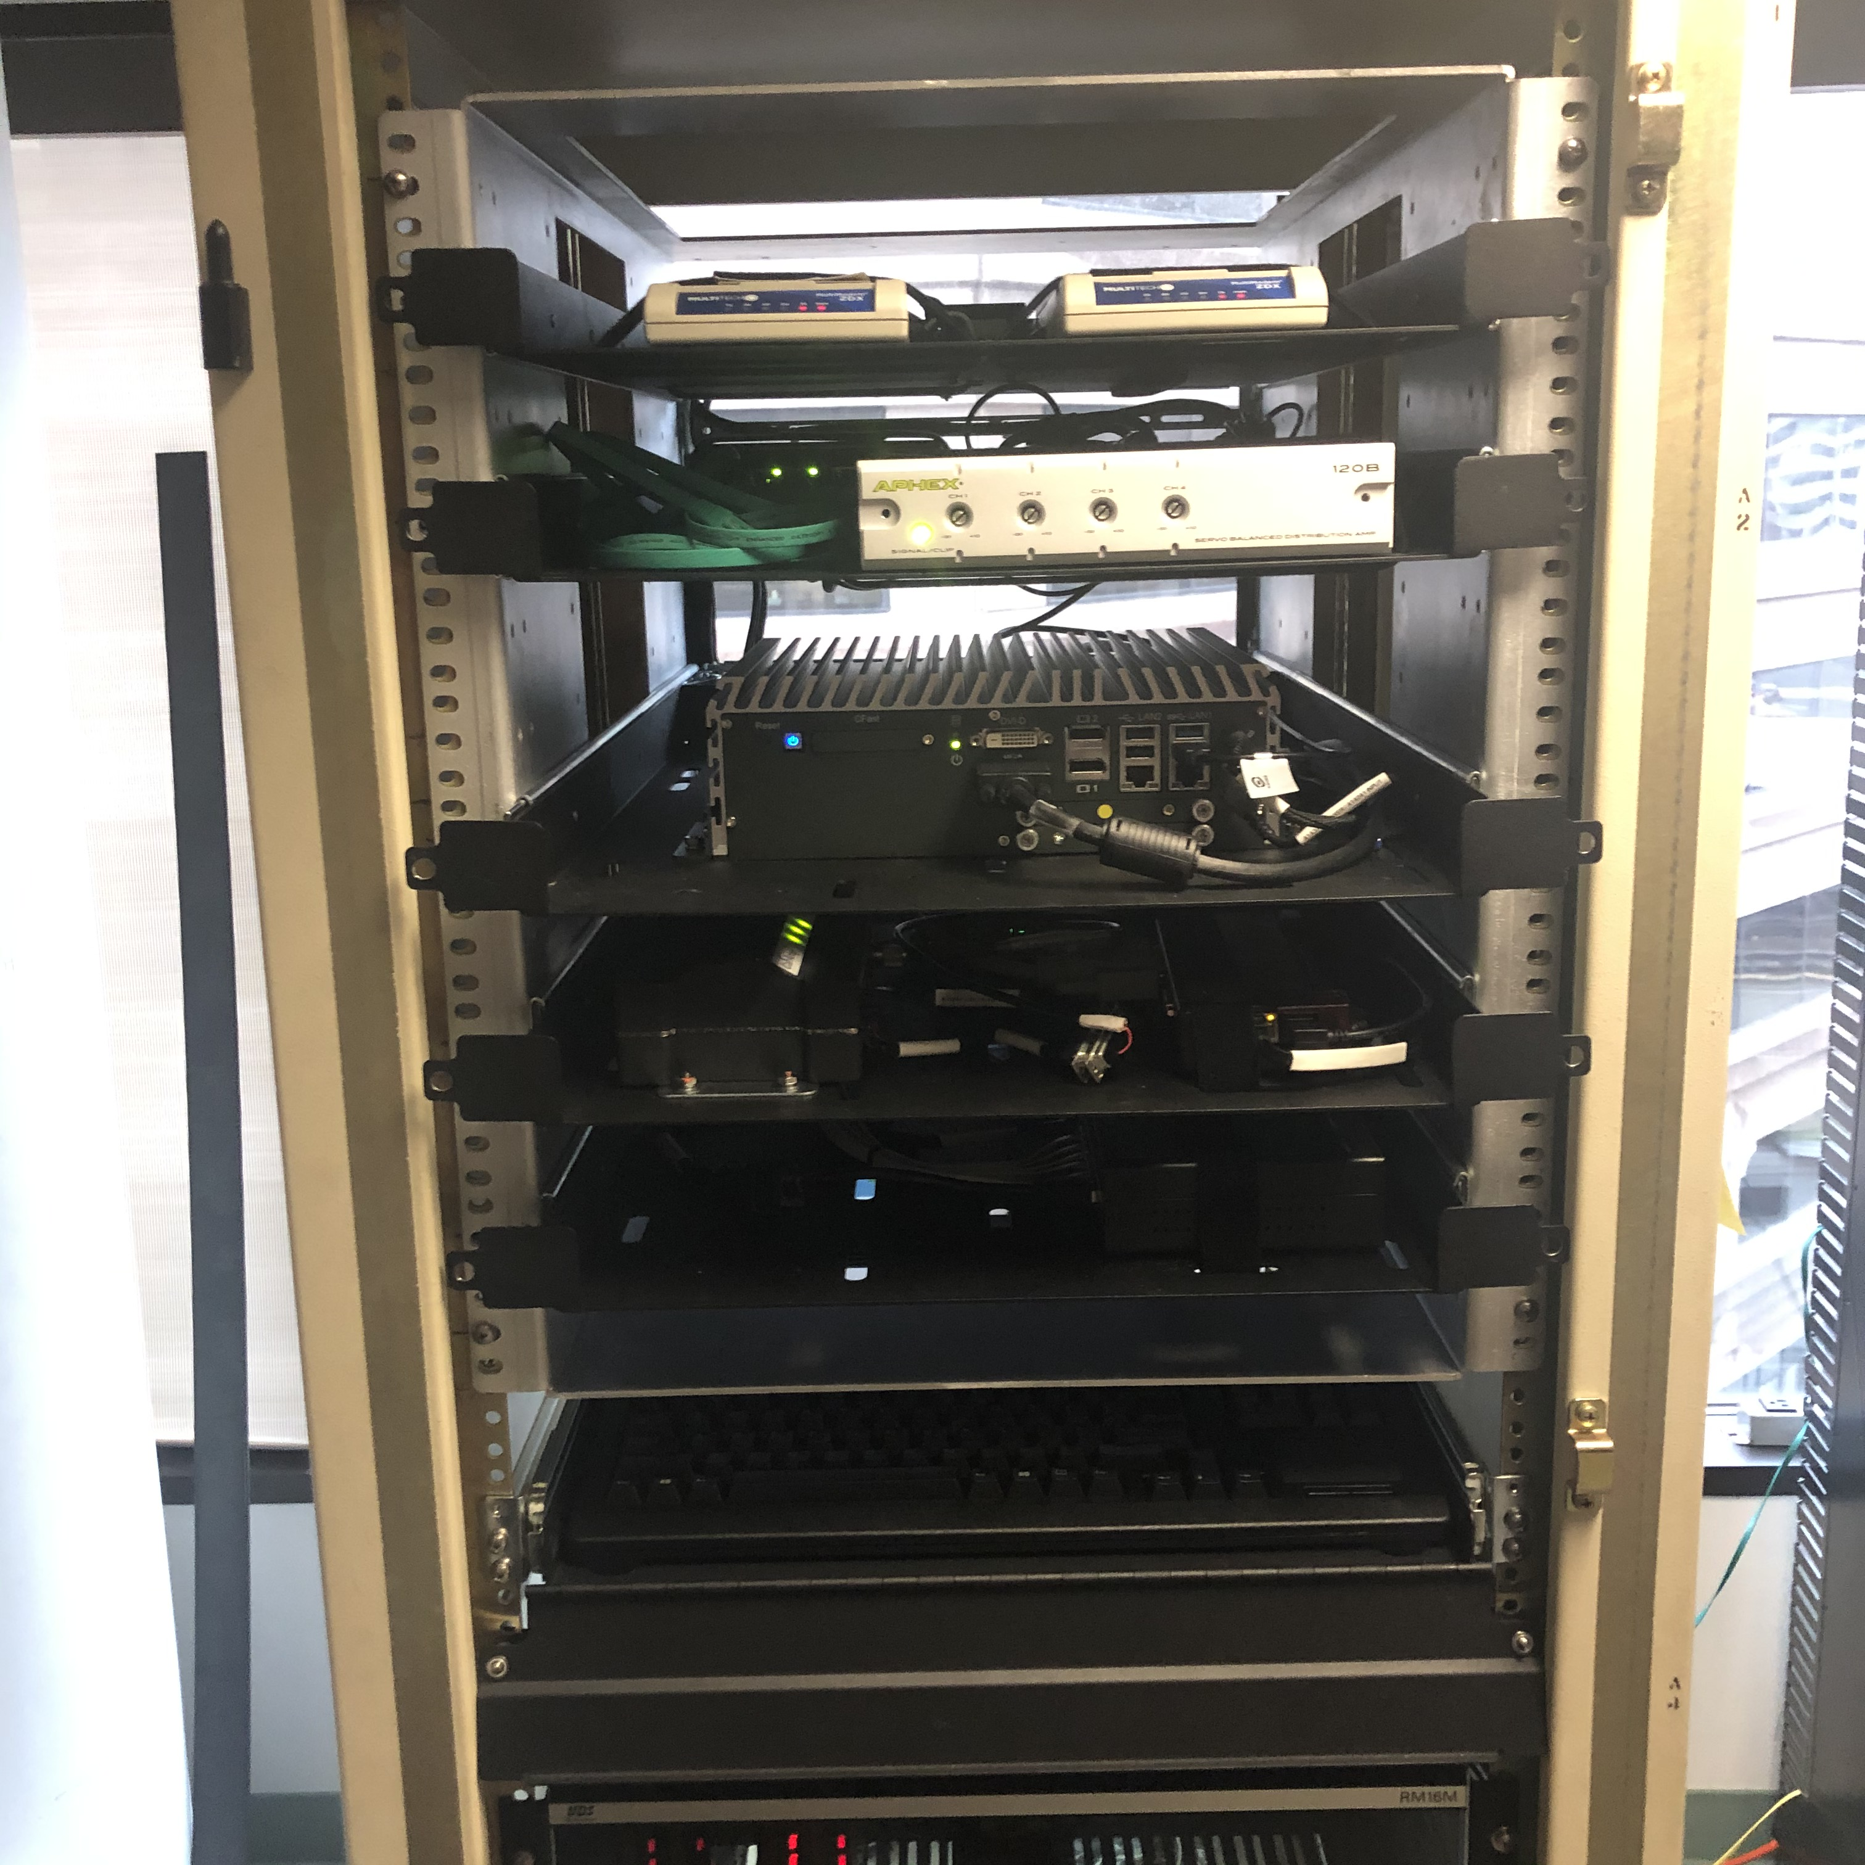
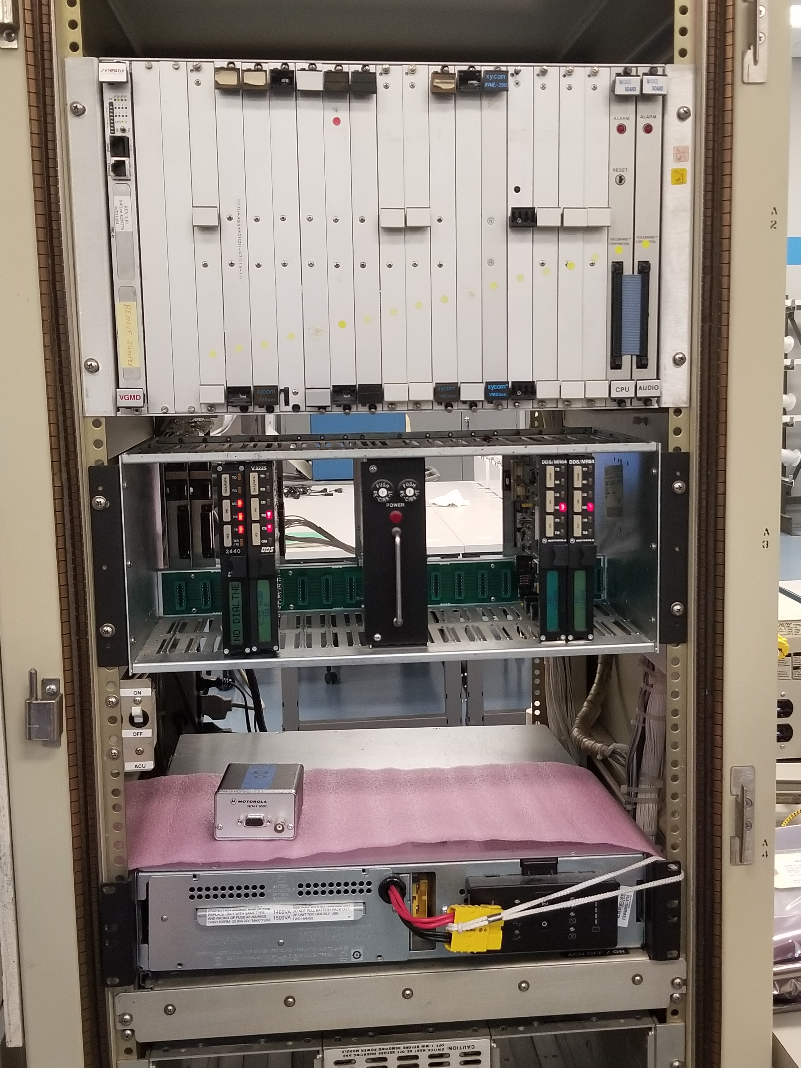
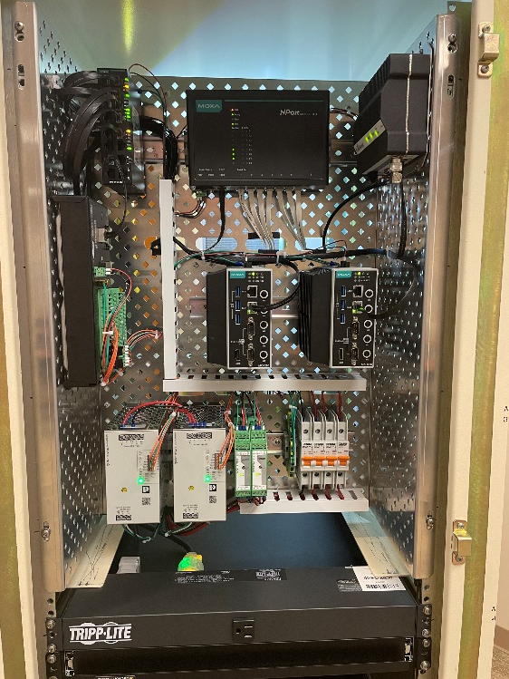
ASOS Modernization
ACU Evolution – Legacy to CSI Solution
Government Design
(SLEP 1.0)
CSI Design
(ASOS 2.0)
Legacy ACU
Notes:
NOTES:

Slide 12
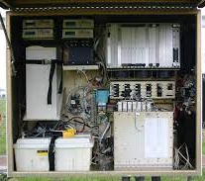
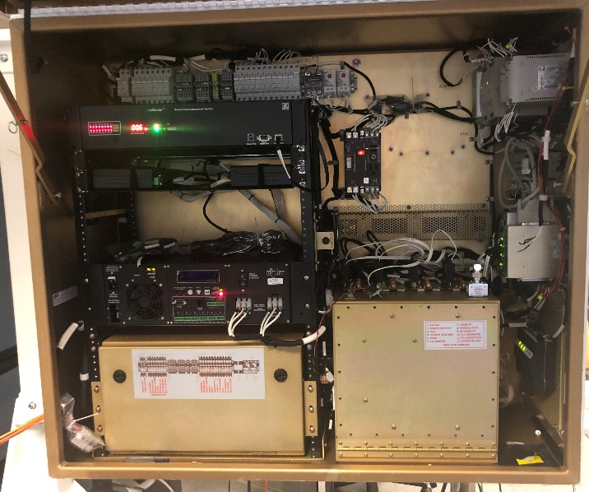
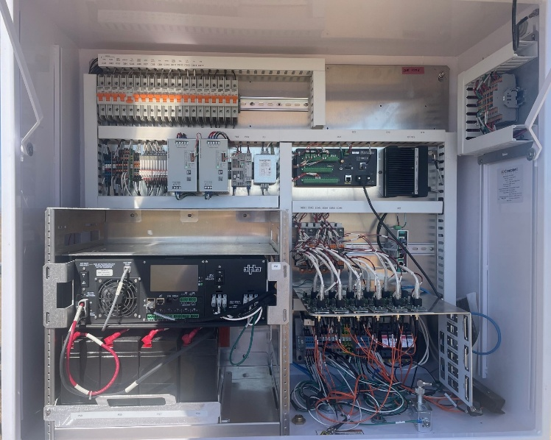
ASOS Modernization
DCP Evolution – Legacy to CSI Solution
Government Design
(SLEP 1.0)
CSI Design
(ASOS 2.0)
Legacy DCP
Notes:
NOTES:

Slide 13

ASOS Modernization
Campbell Scientific’s aviation weather software package - Campbell AeroTM – was a significant contributor to the government’s decision to pivot the contract from the government design to a Campbell Scientific solution
Notes:
NOTES:

Slide 14
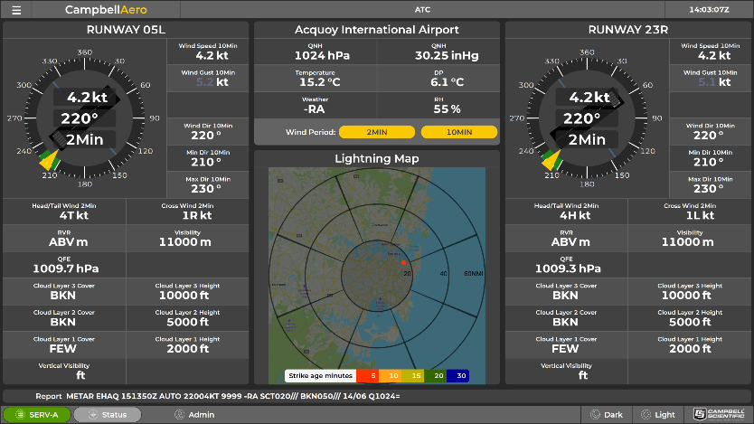
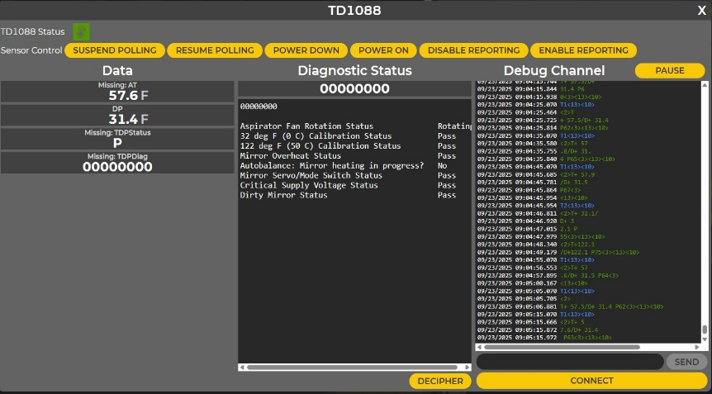
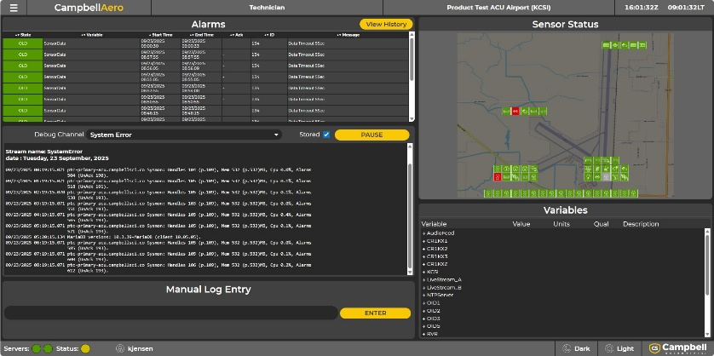
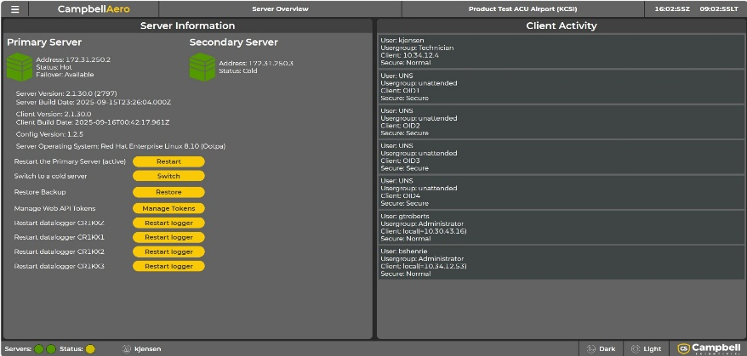
ASOS Modernization
Notes:
NOTES:

Slide 15
ASOS Modernization
Challenges:
Supply-chain issues resulting from the COVID pandemic resulted in delays in major component deliveries
The government did not have a modern TCP/IP network to interconnect the ASOS network
The FAA asked that all interfaces and displays that the ATC would be using would not change
Notes:
NOTES:

Slide 16
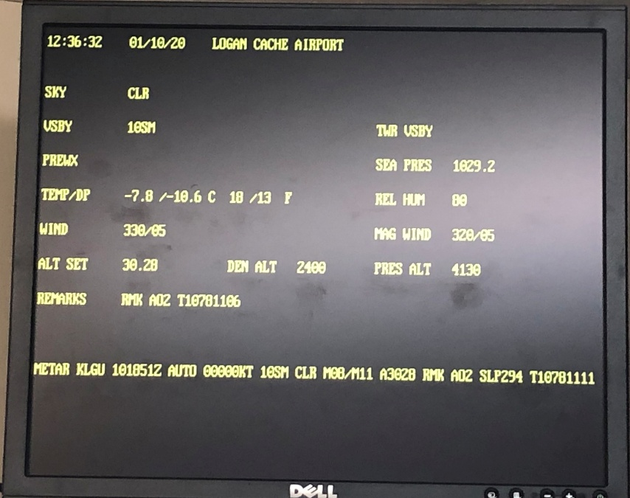

ASOS Modernization
Legacy
ATC Display
Campbell Aero
ATC Display
Notes:
NOTES:

Slide 17
ASOS Modernization
Current Status:
CSI has delivered all hardware to an NWS warehouse
The government is currently finalizing the development of a modern IT network to interconnect the ASOS network
Functioning ASOS 2.0 systems have been installed at two NWS test sites, one FAA test site, and one Navy test site
NWS is preparing to perform a SAT (Site Acceptance Test) at approximately 50 locations
Notes:
NOTES:

Slide 18
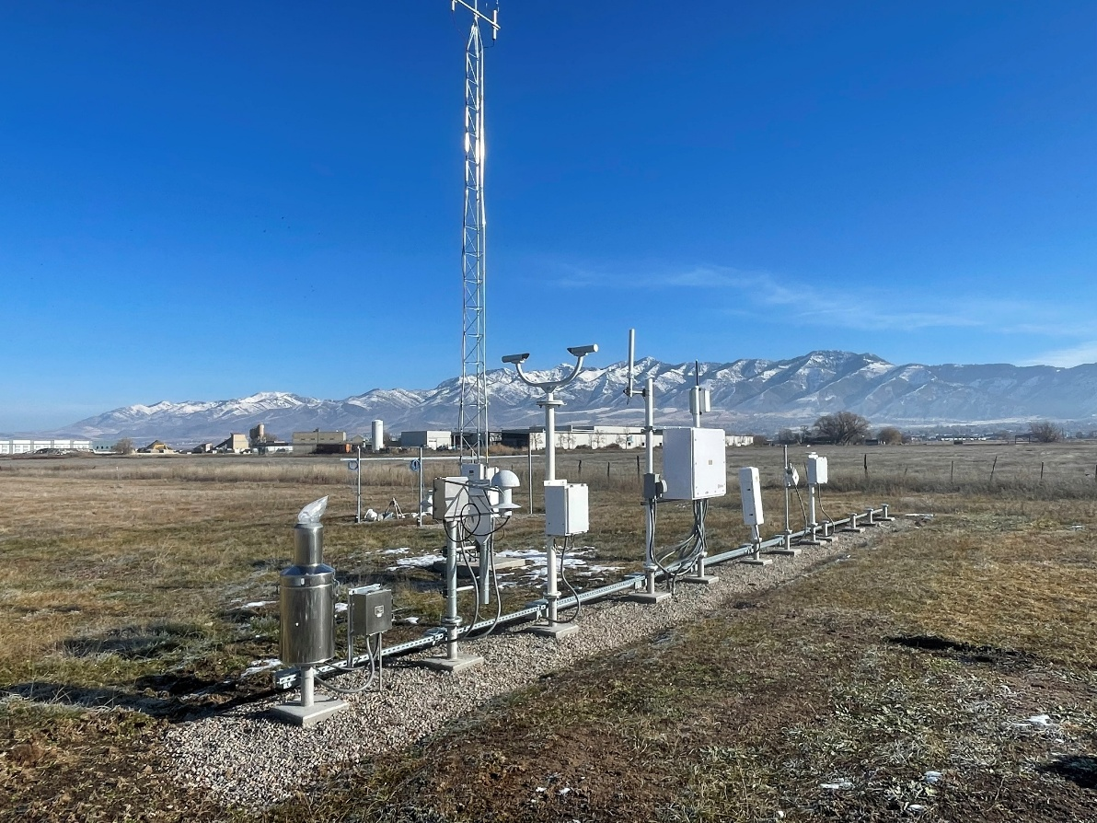
ASOS Modernization
ASOS Weather Sensor Array
Located in CSI’s “Met Garden” which is NE of CSI campus
Includes government provided weather sensors
Has operated 24/7 since November 2023
Allows for real-time testing of any hardware or software changes
Notes:
NOTES:

Slide 19
ASOS Modernization
Follow-on NWS Activities:
Aging Weather Sensors are being replaced
Temp / RH
Barometers
Ceilometers
Present Weather / Visibility Combined Sensor
ASOS 2.0 will have the capability to poll the ceilometer and deliver backscatter files to assist in forecasting:
Volcanic ash dispersion
Wildfire smoke dispersion
Notes:
NOTES:

Slide 20
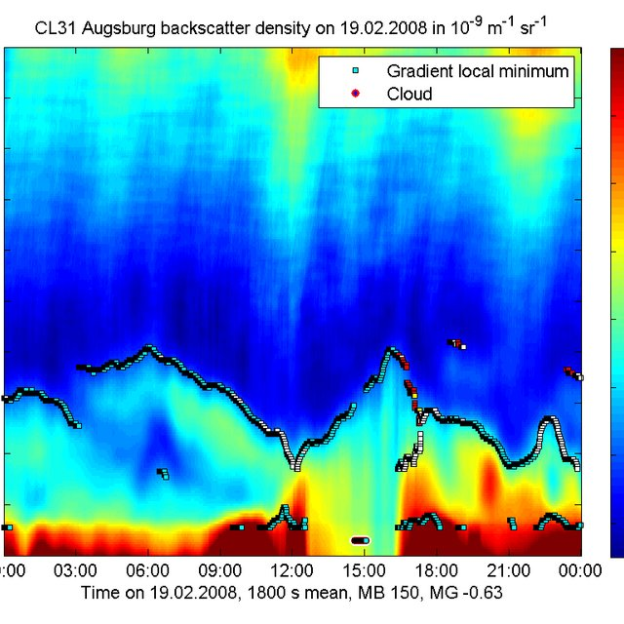
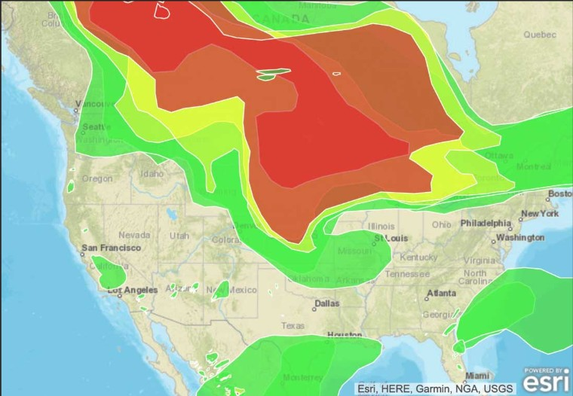
ASOS Modernization
The 700+ nationwide network of ASOS could significantly improve NOAA’s ability to forecast wildfire smoke patterns
Backscatter profile produce by CL31 Ceilometer
Notes:
NOTES:

Slide 21
ASOS Modernization
Closing Remarks
Q&A
Notes:
NOTES:

