Slide 1
ASOS reports of VCTS & TS
ASOS reports
Vicinity Thunderstorms (VCTS)
Area Thunderstorms (TS)
Rules dictating VCTS versus TS
TS is declared if NLDN detects 2 strikes within 15 min of each other that occur as follows
2 CG strikes within 5 mi
1 CG strike within 5 mi and 1 within 5-10 mi
1 CG strike within 10 mi and 1 IC strike within 10 miles*
2 IC strikes within 10 mi*
*NLDN precision on the location of IC lightning is limited, so any IC strike within 10 miles is considered to be a TS strike.
VCTS is declared if NLDN detects 2 strikes within 15 min of each other that occur as follows
2 CG strikes within 5-10 mi
Vicinity
Terminal
Area
5 mi
10 mi

Slide 2
Total lightning (VCTS & TS) from 2019-2024
> 4000
3000 to 4000
2000 to 3000
1000 to 2000
500 to 1000
0 to 500
*

Slide 3
Total lightning (VCTS & TS) from 2019-2024
> 4000
3000 to 4000
2000 to 3000
1000 to 2000
500 to 1000
0 to 500
*
BCT - 1718
PMP - 4113

Slide 4
Total lightning (VCTS & TS) from 2019-2024
> 4000
3000 to 4000
2000 to 3000
1000 to 2000
500 to 1000
0 to 500
LAL - 1531
GIF - 4395
*
BCT - 1718
PMP - 4113

Slide 5
VCTS/TS Augmented versus automated reports
> 90% augmented
80 – 90% augmented
60 – 80% augmented
40 – 60% augmented
20 – 40% augmented
< 20% augmented
*

Slide 6
VCTS/TS Augmented versus automated reports
> 90% augmented
80 – 90% augmented
60 – 80% augmented
40 – 60% augmented
20 – 40% augmented
<20% augmented
Fraction of augmented TS/VCTS metars
*
Large Medium Small Non-Primary None Noncommercial

Slide 7
VCTS/TS Augmented versus automated reports
> 90% augmented
80 – 90% augmented
60 – 80% augmented
40 – 60% augmented
20 – 40% augmented
< 20% augmented
LAL – 74%
GIF - < 1%
*
BCT – 100%
PMP – 81%

Slide 8
Ratio of VCTS to TS
Rules dictating VCTS versus TS
TS is declared if NLDN detects 2 strikes within 15 min of each other that occur as follows
2 CG strikes within 5 mi
1 CG strike within 5 mi and 1 within 5-10 mi
1 CG strike within 10 mi and 1 IC strike within 10 miles*
2 IC strikes within 10 mi*
*NLDN precision on the location of IC lightning is limited, so any strike within 10 miles is considered to be a TS strike.
VCTS is declared if NLDN detects 2 strikes within 15 min of each other that occur as follows
2 CG strikes within 5-10 mi

Slide 9
Ratio of VCTS to TS
Rules dictating VCTS versus TS
TS is declared if NLDN detects 2 strikes within 15 min of each other that occur as follows
2 CG strikes within 5 mi
1 CG strike within 5 mi and 1 within 5-10 mi
1 CG strike within 10 mi and 1 IC strike within 10 miles*
2 IC strikes within 10 mi*
*NLDN precision on the location of IC lightning is limited, so any strike within 10 miles is considered to be a TS strike.
VCTS is declared if NLDN detects 2 strikes within 15 min of each other that occur as follows
2 CG strikes within 5-10 mi
VCTS >= TS*1 VCTS >= TS*2 VCTS > = TS*3

Slide 10
Ratio of VCTS to TS
Rules dictating VCTS versus TS
TS is declared if NLDN detects 2 strikes within 15 min of each other that occur as follows
2 CG strikes within 5 mi
1 CG strike within 5 mi and 1 within 5-10 mi
1 CG strike within 10 mi and 1 IC strike within 10 miles*
2 IC strikes within 10 mi*
*NLDN precision on the location of IC lightning is limited, so any strike within 10 miles is considered to be a TS strike.
VCTS is declared if NLDN detects 2 strikes within 15 min of each other that occur as follows
2 CG strikes within 5-10 mi
VCTS >= TS*1 VCTS >= TS*2 VCTS > = TS*3
TS >= VCTS*1 TS >= VCTS*2 TS > = VCTS*3
Oddly, there seems to be a preference for more TS relative to VCTS in the central US.

Slide 11
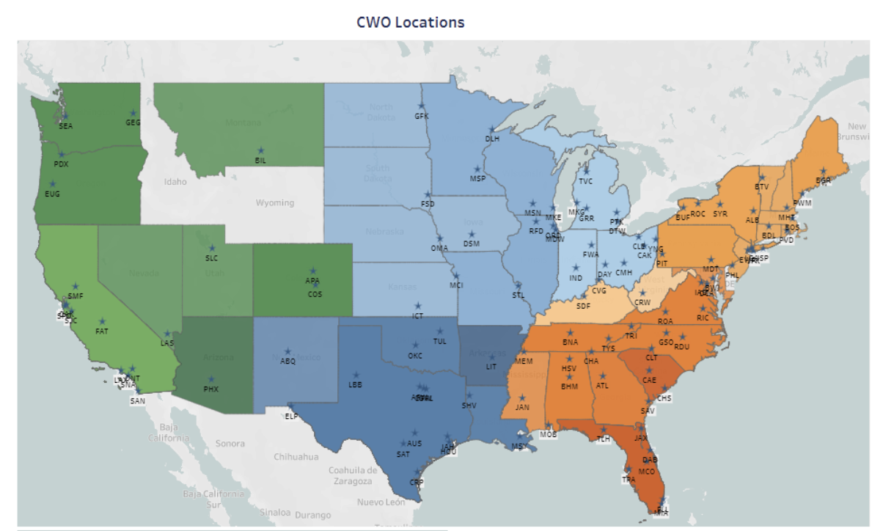
Ratio of VCTS to TS
Rules dictating VCTS versus TS
TS is declared if NLDN detects 2 strikes within 15 min of each other that occur as follows
2 CG strikes within 5 mi
1 CG strike within 5 mi and 1 within 5-10 mi
1 CG strike within 10 mi and 1 IC strike within 10 miles*
2 IC strikes within 10 mi*
*NLDN precision on the location of IC lightning is limited, so any strike within 10 miles is considered to be a TS strike.
VCTS is declared if NLDN detects 2 strikes within 15 min of each other that occur as follows
2 CG strikes within 5-10 mi
VCTS >= TS*1 VCTS >= TS*2 VCTS > = TS*3
TS >= VCTS*1 TS >= VCTS*2 TS > = VCTS*3
Oddly, there seems to be a preference for more TS relative to VCTS in the central US.

Slide 12
Ratio of VCTS to TS
% of Augmented reports that are TS
> 90% 80 – 90% 60 – 80% 40 – 60% 20 – 40% < 20%
*

Slide 13
Ratio of VCTS to TS
% of Augmented reports that are TS
% of Augmented reports that are TS
Large Medium Small Non-Primary None Noncommercial
> 90% 80 – 90% 60 – 80% 40 – 60% 20 – 40% < 20%
*

Slide 14
Ratio of VCTS to TS
% of Augmented reports that are TS
MDW – 96%
% of Augmented reports that are TS
PHL – 94%
DAL – 99.6%
IAD – 98%
Large Medium Small Non-Primary None Noncommercial
> 90% 80 – 90% 60 – 80% 40 – 60% 20 – 40% < 20%
*

Slide 15
ASOS reports of VCTS & TS
OKC ASOS TS/VCTS 7 May 2024
Time (UTC) | Report
0404 | TS
0438 | TS
0440 | TS
0452 | TS
0458 | TS
NLDN total lightning count within 10 nmi of OKC: 1405 strikes
48 TS reports
8 VCTS reports

Slide 16
ASOS reports of VCTS & TS
OKC ASOS TS/VCTS 7 May 2024
Time (UTC) | Report
0404 | TS
0438 | TS
0440 | TS
0452 | TS
0458 | TS
NLDN total lightning count within 10 nmi of OKC: 1405 strikes
48 TS reports
8 VCTS reports

Slide 17
So many questions…
Why does the central US have a different ratio of VCTS to TS than the east and west? Could training be a contributing factor?
2. Why do larger airports trend toward TS over VCTS in augmented reports? Is this accurate?
Why aren’t there SPECIs issued every time the ASOS rules for TS/VCTS are met? Are the rules accurately described?
If we did issues SPECIs every time the rules are met, should we laugh or cry when there are entire hours with every minute having a SPECI?

