Slide 1
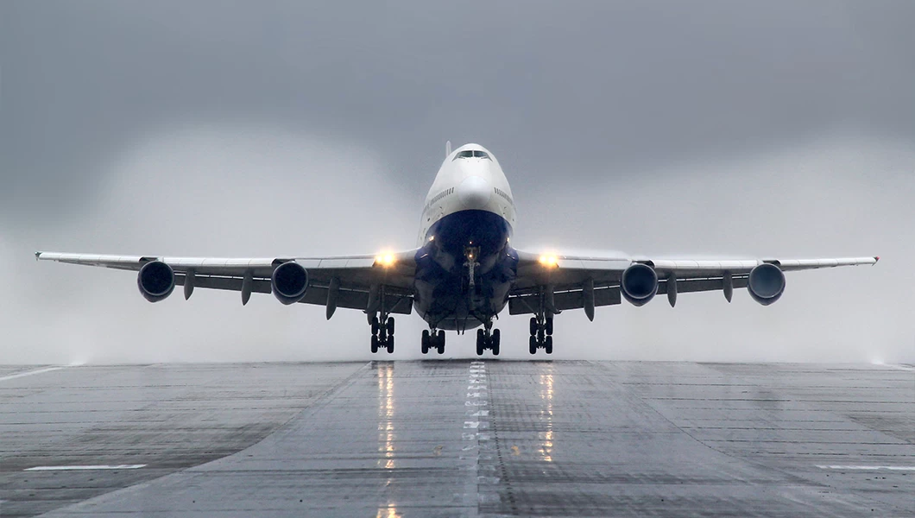
Friends and Partners in Aviation Weather 2025 Fall Meeting
Session 1b: Cleared for Takeoff: Improving Aviation Decisions through Better Weather Observations
Co-Chairs
Scott Landolt - UCAR
Elizabeth Wilson – Synoptic Data PBC

Slide 2
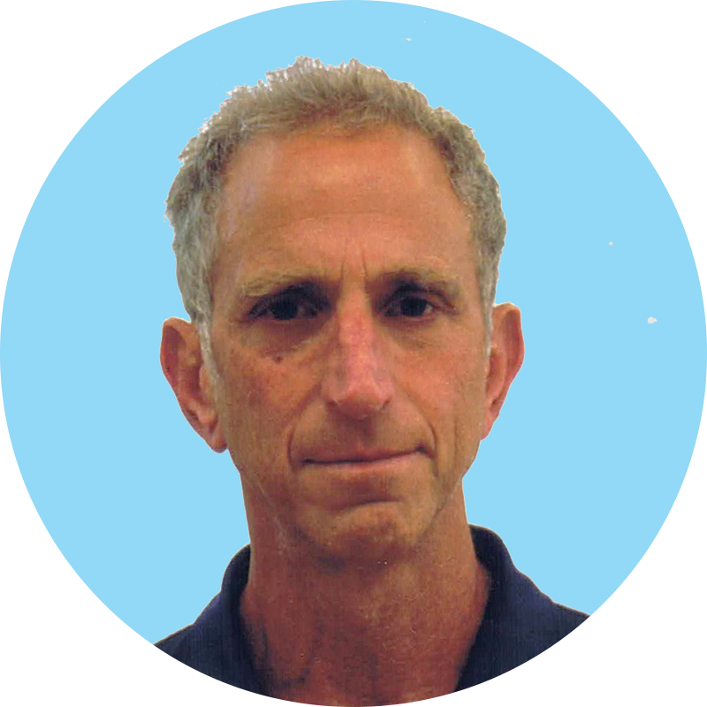
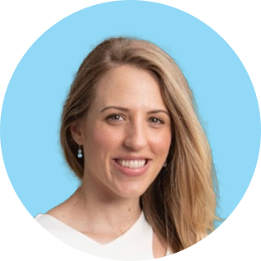

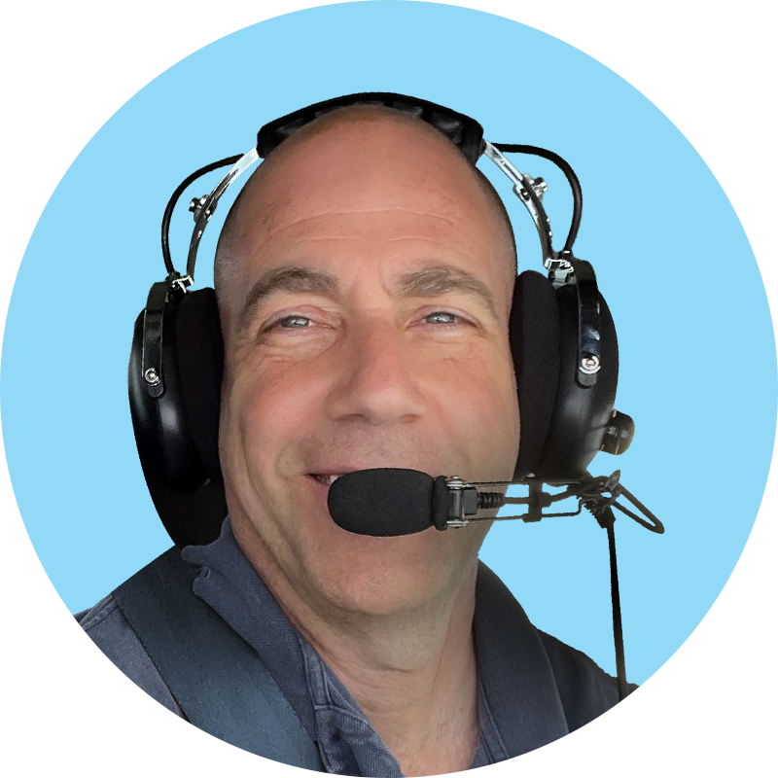
Session 1b: Cleared for Takeoff: Improving Aviation Decisions through Better Weather Observations
Correlating Information from Certified and Non-Certified Weather Sources
Gary Pokodner/FAA
An Inventory of Non-Certified Weather Sources
Elizabeth Wilson/Synoptic Data PBC
Testing and Evaluating ASTM F38 Weather Standards
Chris Zarzar/TruWeather
Flipping the Observation Paradigm on its Head
Ethan Krimins/FlightProfiler

Slide 3
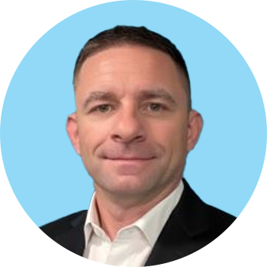

Session 1b: Panel Discussion – On Using Non-Certified Weather Information in the NAS
Gary Pokodner/FAA
Elizabeth Wilson/Synoptic Data PBC
Moderator
Scott Landolt/UCAR
Chris Zarzar/TruWeather
Ethan Krimins/FlightProfiler
Jesse Heers/Campbell Scientific

