Slide 1
Correlating and Aggregating Wx Sources
FPAW 7-9 October 2025

Slide 2
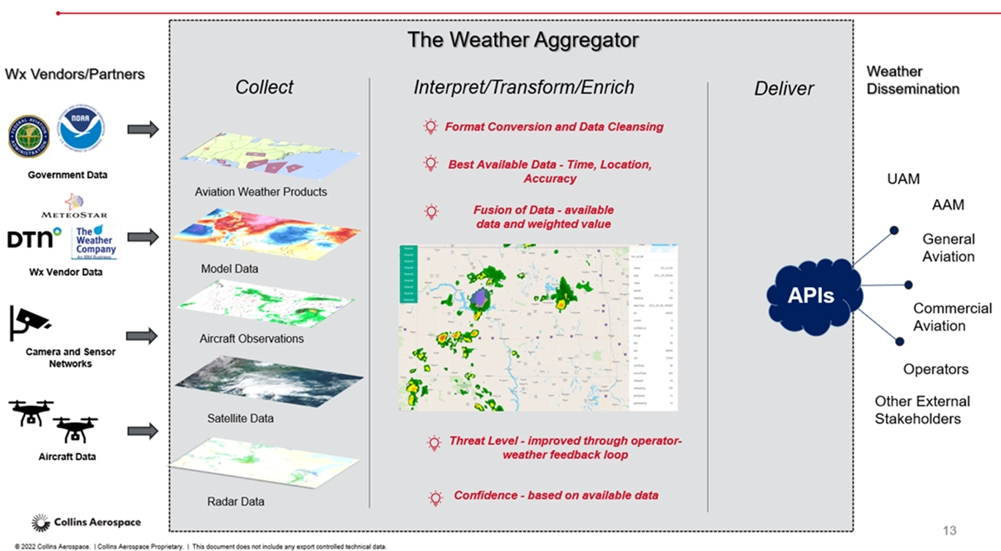
What is Weather Aggregation

Slide 3


U.S. Civil Aviation Accident Summary for 2022
Introduction: The Problem
From 2008 – 2022*
  Part 121: 420 Accidents, 164 Weather-Related, 3 Fatal
  Part 91: 19,538 Accidents, 4,341 Weather-related, 990 Fatal
  Part 135: 689 Accidents, 197 Weather-related, 56 Fatal
 | Total | Fatal | Fatalities | Flight Hours | Accidents per 100,000 hr | Fatal Rate 100,000 hr
Part 121 Air Carriers | 20 | 1 | 1 | 17,972,372 | 0.112 | 0.0006
Part 135 Commuter & On-Demand Carriers | 53 | 5 | 18 | 4,835,934 | 1.096 | 0.103
General Aviation | 1,205 | 214 | 339 | 22,542,999 | 5.336 | 0.945
Totals 1,277 220 358
*Source: NTSB FPAW Brief, April 30, 2024

Slide 4











GA –Weather-Related Accidents, 2008-2022
Updrafts/Downdrafts
Precip 2%
Total Accidents
Weather-Related
22%
3%
Weather
Windshear 2%
Turbulence
1%
Carburetor icing 8%
Structural Icing 2%
Thunderstorms 3%
Adverse Wind
Low Ceilings/Visibility Density Altitude Thunderstorms Structural Icing Carburetor icing Turbulence Windshear
Updrafts/Downdrafts Precip
Density Altitude 6%
Adverse Wind 58%
Low Ceilings/Visibility 15%
Source: NTSB

Slide 5
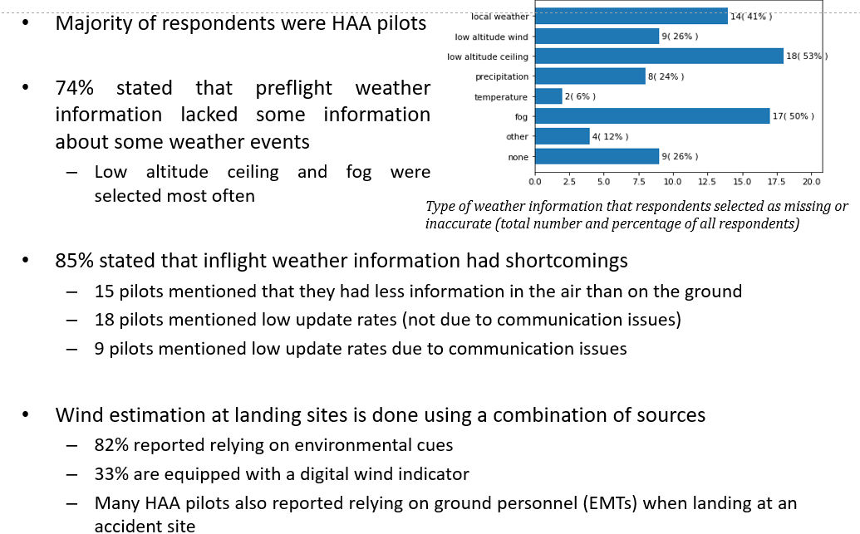
The Problem – Helicopter Pilot Survey Results

Slide 6
The Problem – Helicopter Pilot Survey Results
Technology adoption is hampered by unreliability:
  Pilots want to retain ability to operate without equipment in case of failure, sometimes pilots forgo using technology to maintain skills
  Error-prone equipment adds to workload due to the need for monitoring the equipment
Wind events disproportionately affect private pilots flying for personal reasons or pilots in training
Poor visibility conditions affect trained, well-equipped air ambulance pilots as well as more inexperienced pilots

Slide 7
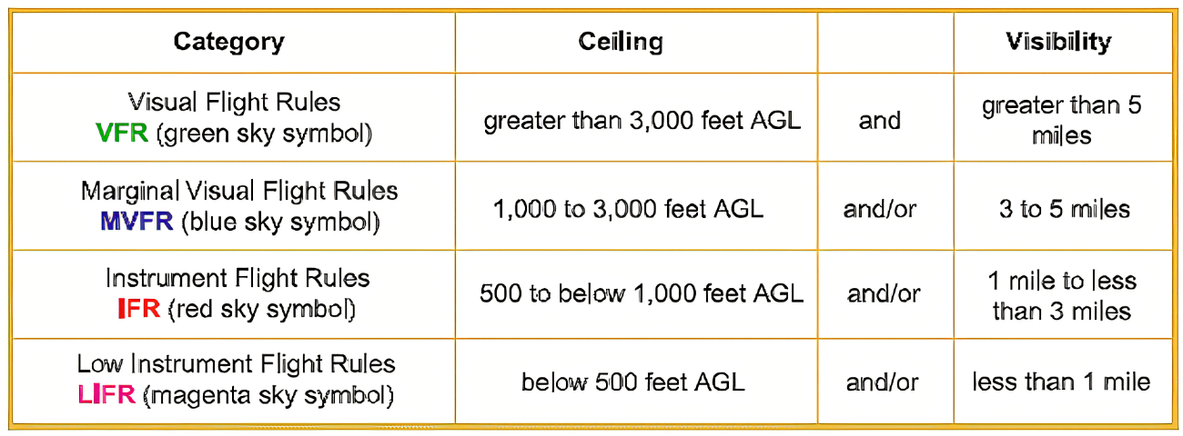
The Problem - Wx Flight Rules Categories

Slide 8
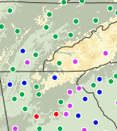
The Problem – Decision Risk
Correlation of Weather Observations
  The degree we can expect that two locations will have similar weather conditions. This can also be thought of as agreement or association.
  It is expected that the farther two locations are from each other the higher the probability they will not be correlated.
  The correlation between locations can be influenced by other factors besides spatial separation (such as topography) and can change in seasonally.
  This concept of correlation can help establish risk at locations of unknown weather.
What is the safety criticality of adverse Wx avoidance decisions from each direction? What are the implications to Wx automation, autonomous operations, and data quality?
‹#›

Slide 9
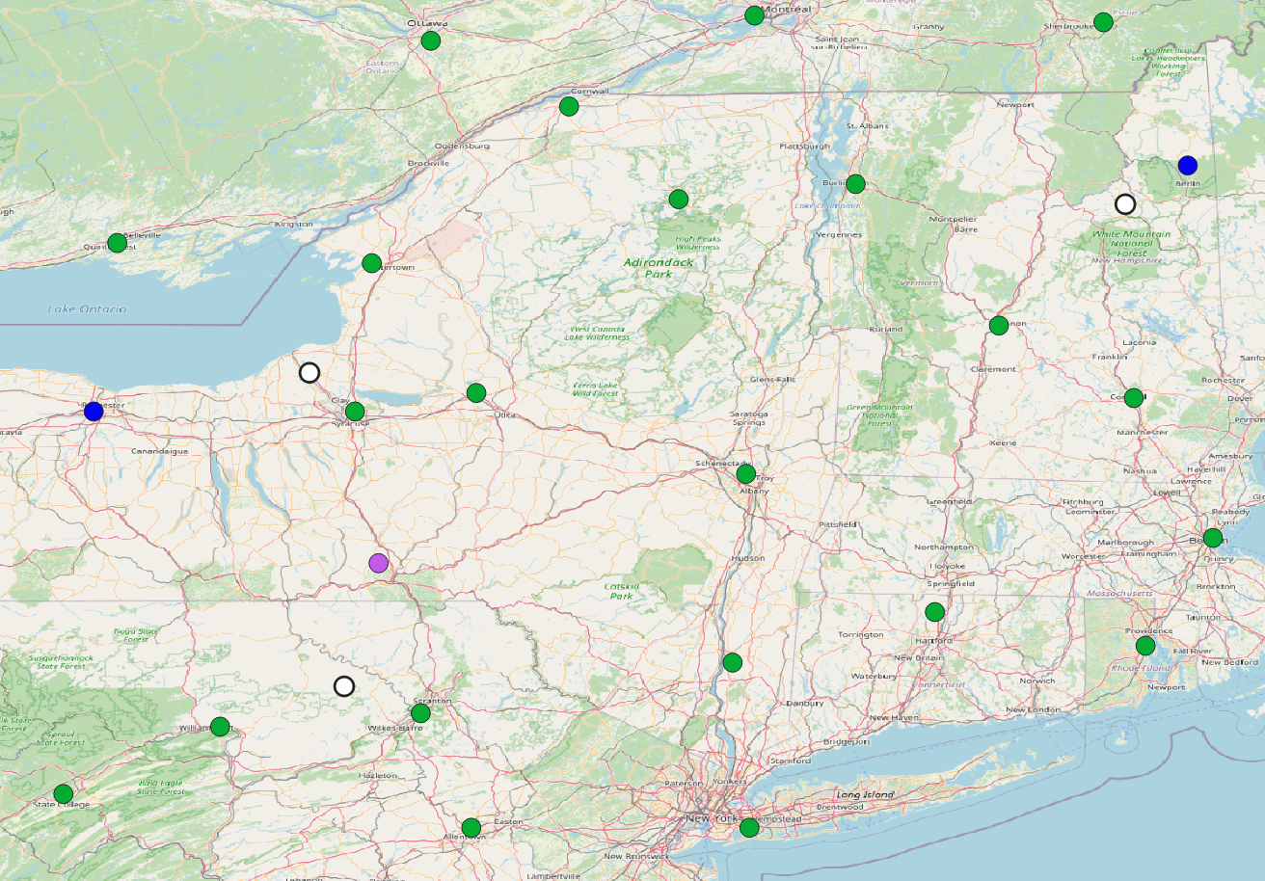

A
B
C

Slide 10
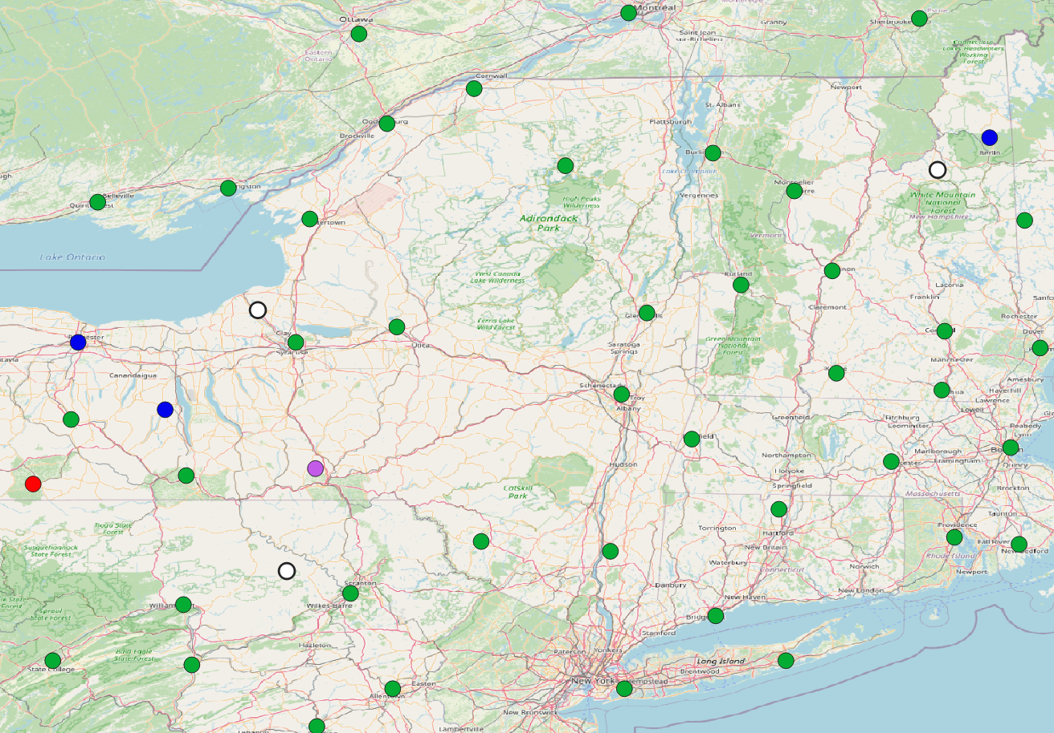
A
B
C

Slide 11
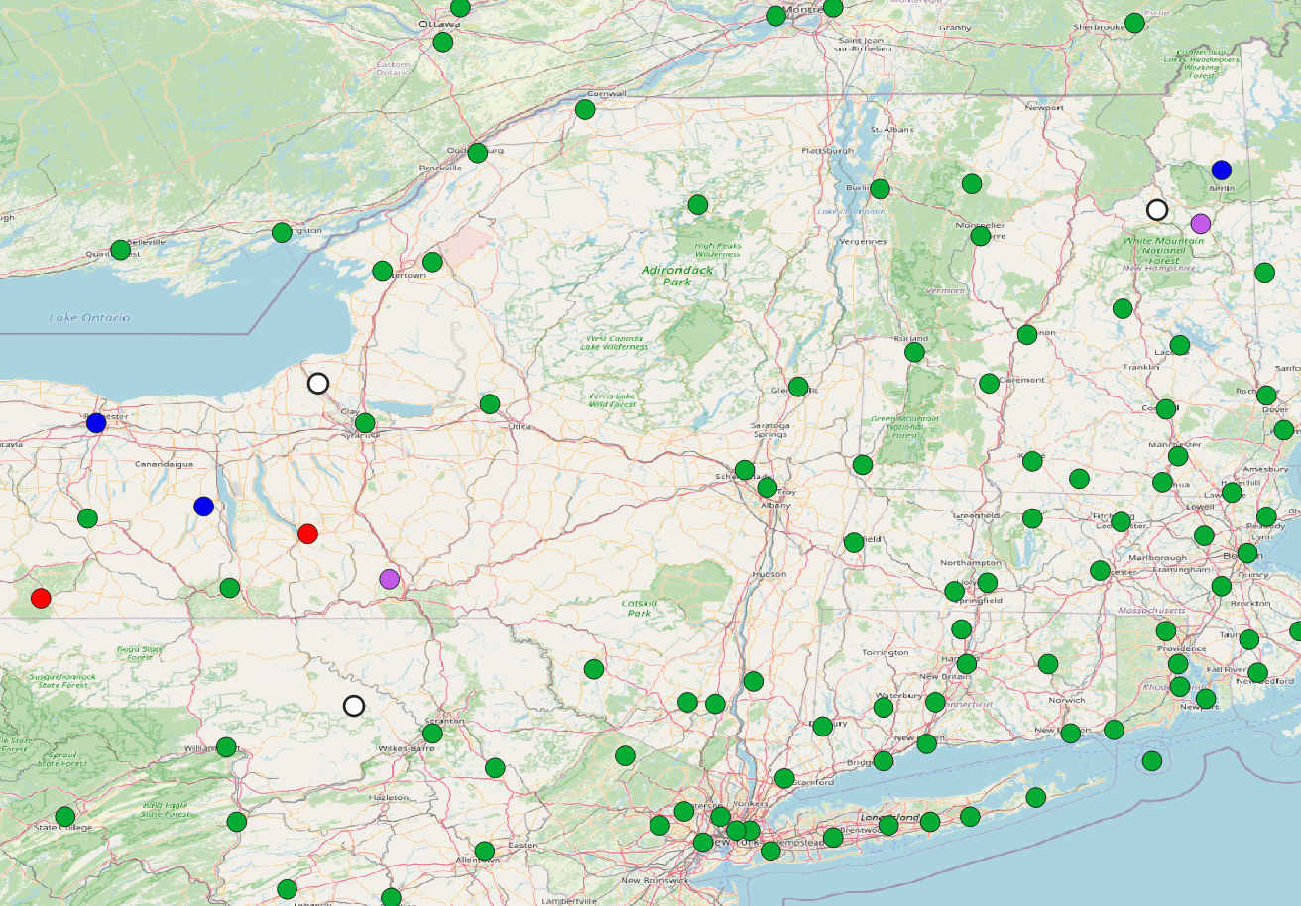
A
B
C

Slide 12
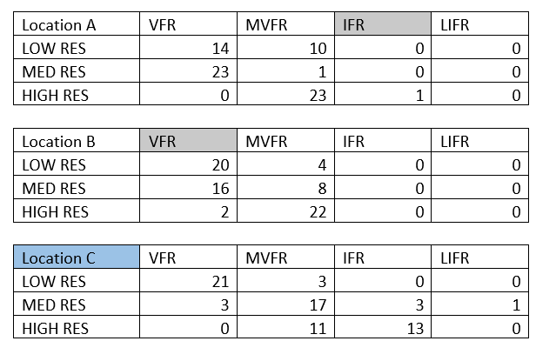
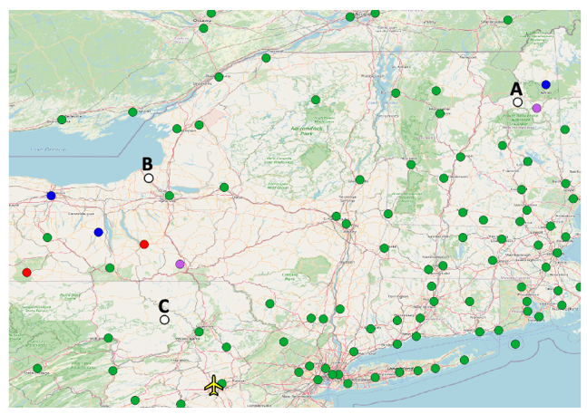
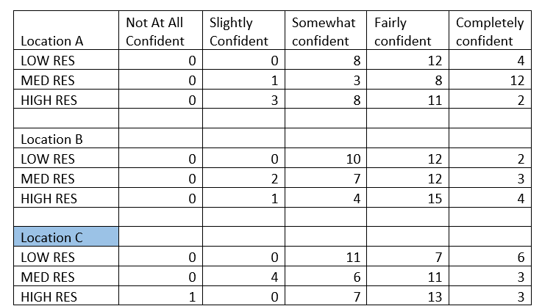
Pilots Understanding Observation Uncertainty – Automation?
Experiment Scenario Example and Results
Answers
A = IFR
B = VFR
C = IFR/LIFR
Great Lakes Region Scenario Showing highest resolution

Slide 13
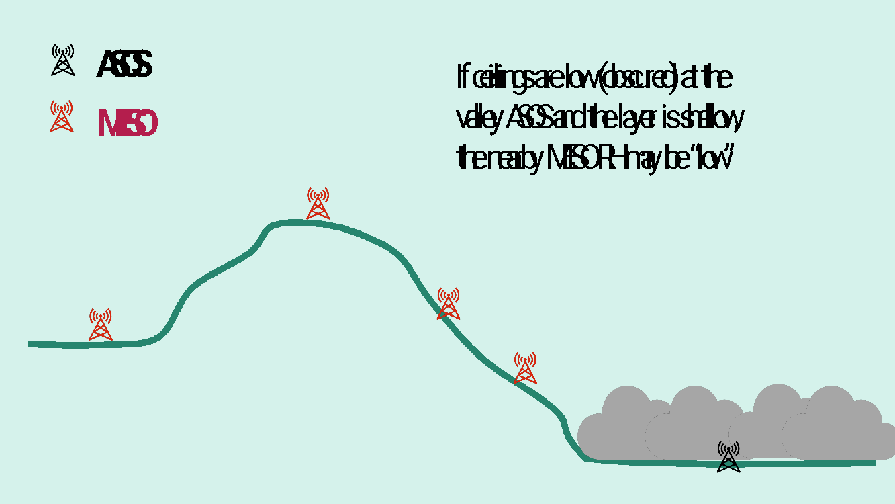
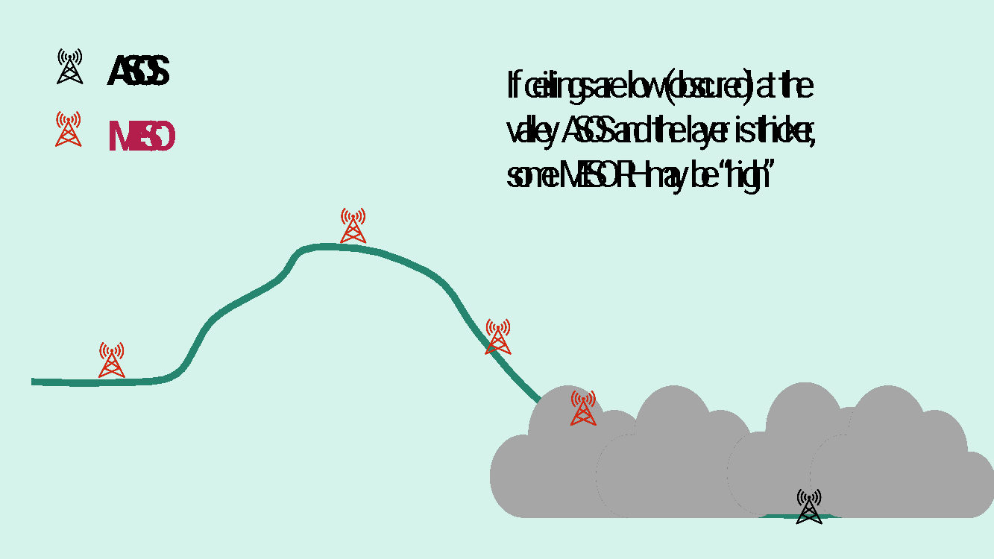
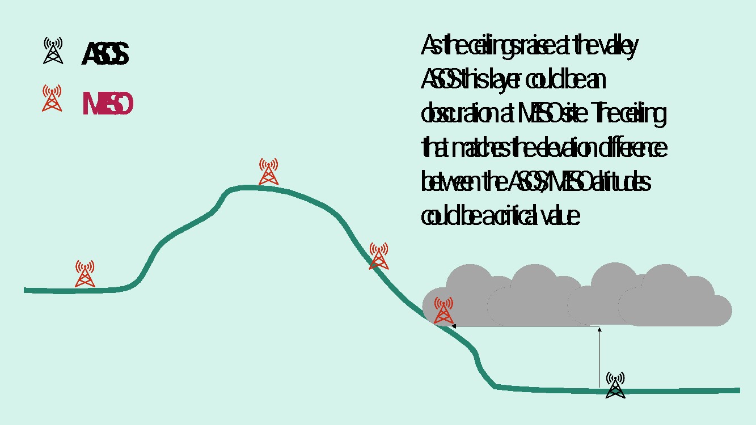
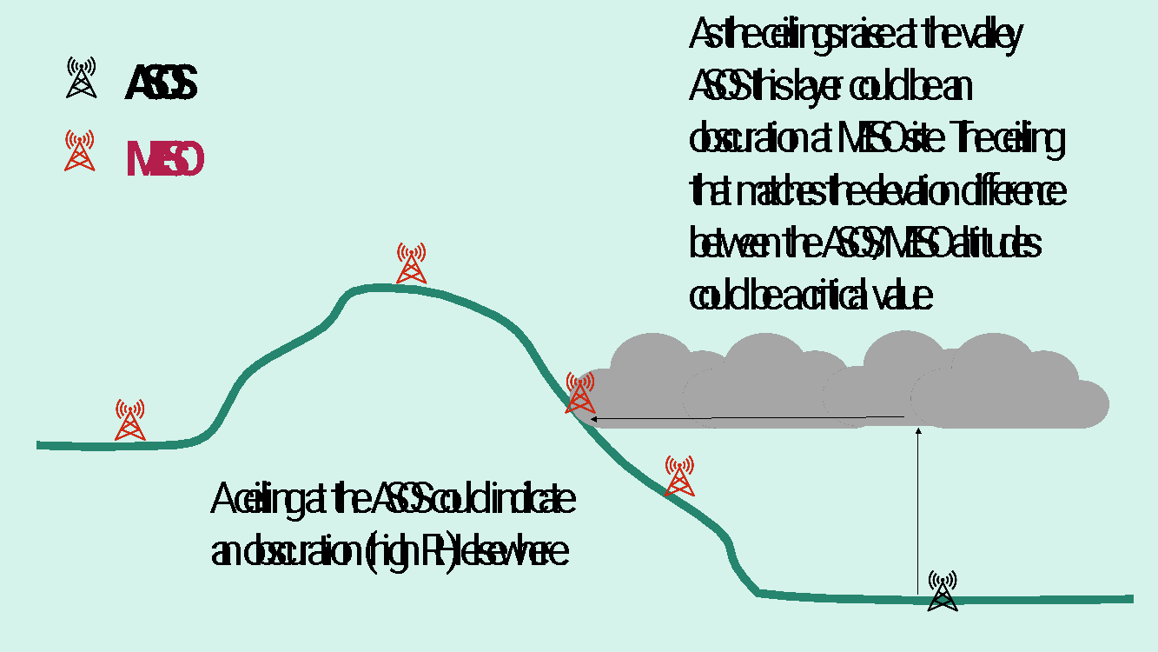
Correlating - ASOS/AWOS With Non-Certified Sensors
Conceptual Model
ASOS/AWOS are typically in the low-lying areas or valleys
When there are low clouds or obscurations at low altitude mesonet stations at higher altitude be at lower relative humidity.
As cloud layers rise with respect to the valley, mesonet stations at higher altitude may get into “weather” and the relative humidity increases while decreasing at the valley floor.

Slide 14
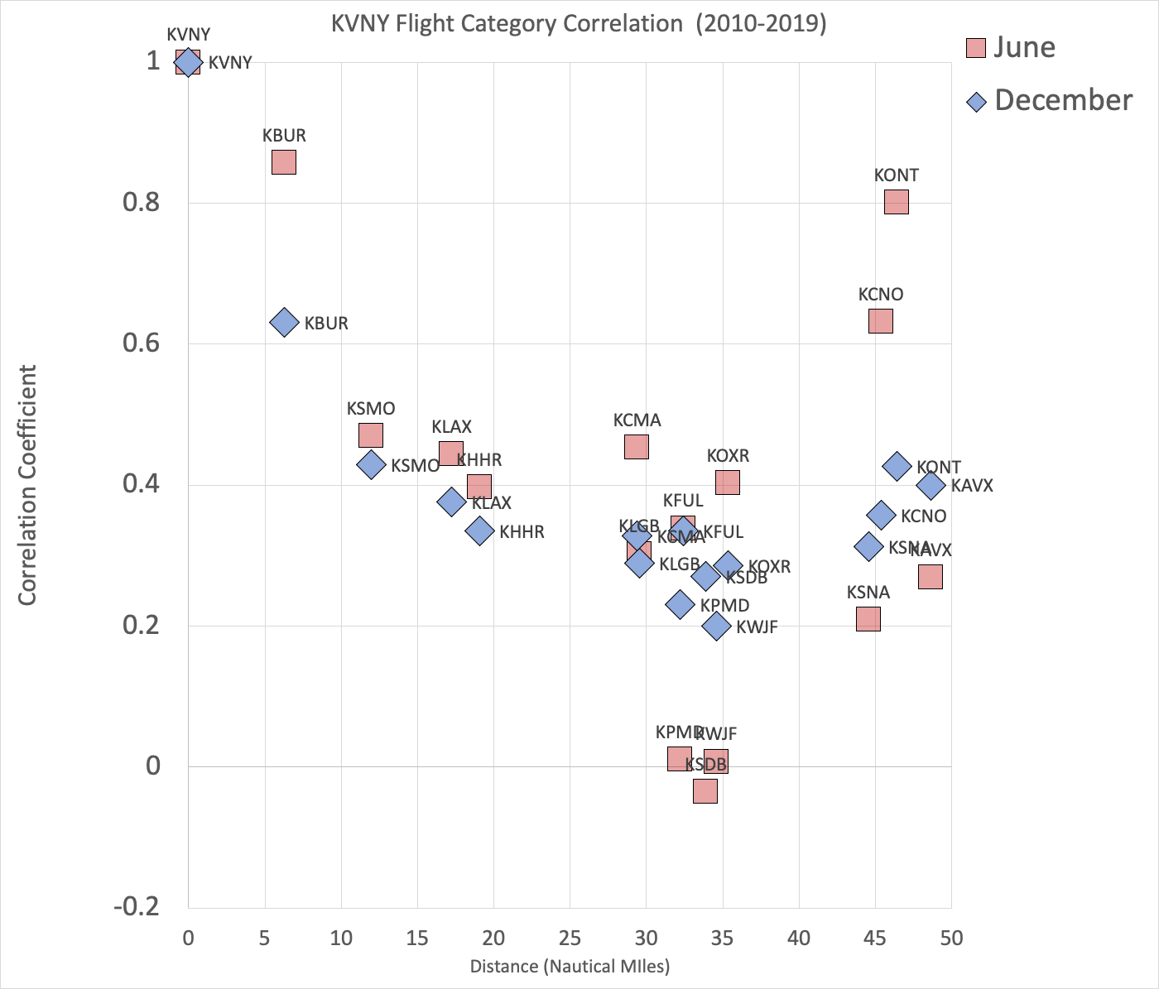
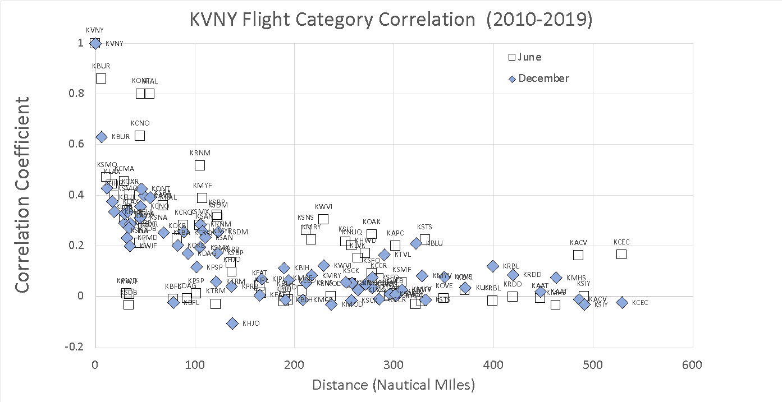
Wx Flight Rules
Spatial Representativeness
Flight Rules Category Decorrelation vs. Distance from KVNY (Van Nuys)
General decrease with distance, but with significant variation
Seasonal changes significant
  KONT in June at over 45 nautical miles away is better correlated than KBUR in December at just over 5 nautical miles away.

Slide 15
N666DS Accident on Approach to MYF
A Cessna S550 Citation S/II, N666DS, was destroyed when it crashed while on approach to runway 28R at Montgomery-Gibbs Executive Airport (MYF/KMYF), San Diego, California. May 22, 2025 at 3:47 am PDT, 10:47 UTC
According to air traffic control data, during the final portion of the flight, the pilot(s) enquired about the conditions at other nearby airports, because the ASOS at KMYF was not working
Applications of past and ongoing Project 36 work
  Risk assessment using ASOS ceilings and mesonet relative humidity reports
  Neural network machine learning

Slide 16
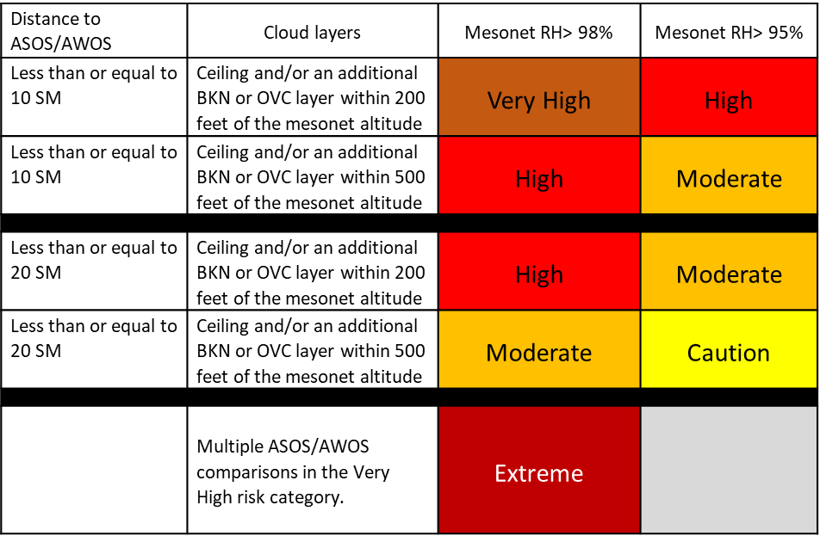
Risk Assessment Matrix using ASOS Ceilings and Mesonet RH

Slide 17
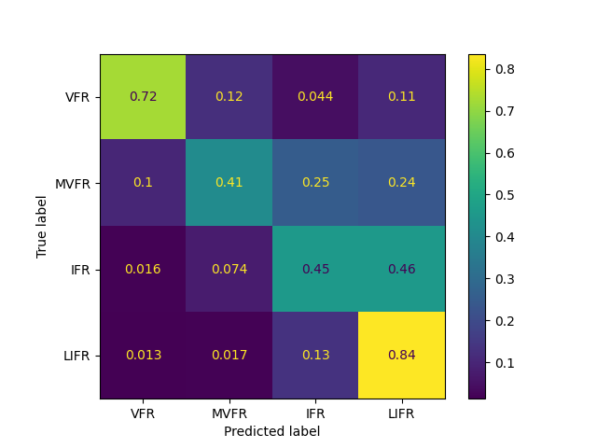
Bidirectional Long-Short Term Memory (BiLSTM) ML
Goal: Use of machine learning to predict conditions/risk
  At an ASOS/AWOS that reports weather but may be temporarily missing
  At a mesonet location which doesn’t report ceilings and visibility
  At an undefined location
Methods: Bidirectional Long-Short Term Memory (BiLSTM) ML
  ASOS Data (hourly METARs) in two focus regions
    CPSA: 5 years (2019-2023) 150+ stations
    SoCal incident: 6 years (2019-2024) 8 stations
  Test: Predict Flight Rule Category condition at a specific ASOS
  Results for the Columbia Plateau/Southern Appalachian (CPSA) region
  Test 1
    37 stations (with most complete data records)
    No geophysical elements used as features
    24-hour sequences
    Penalty for “under-prediction”.
      We’d rather error on the side of predicting a worse category vs. a better category.
    Most data along the optimal diagonal except for the model tendency to predict LIFR in IFR conditions.

Slide 18
Crowd Sourcing in Wx Aggregation
ASOS
Non
Certified Sensors
Pilot
VEIA
Cloud Type
ML
Final Visibility Output
This is like Crowd sourcing again. Aggregate the votes of the different systems, weighted by their usage by pilots / ‘experience’.

Slide 19
TBD - Supervisory controller
F₁
F₁ | Feature 1: Time of day
F₂ | Feature 2: Season
F₃ | Feature 3:Wind speed/direction
F₄ | Feature 4:Recent observations
Bayesian Network learnt from SME provided features & data
F₂
F₄
F₃
AI Weather
Wx Model
Observer
VWOS
P(visibility | Model)
P(visibility | Human)
P(visibility | VWOS)
P(visibility | AI Wx)
Final Visibility
Encode human expertise and subject matter knowledge and data uncertainty into a verifiable algorithm

Slide 20
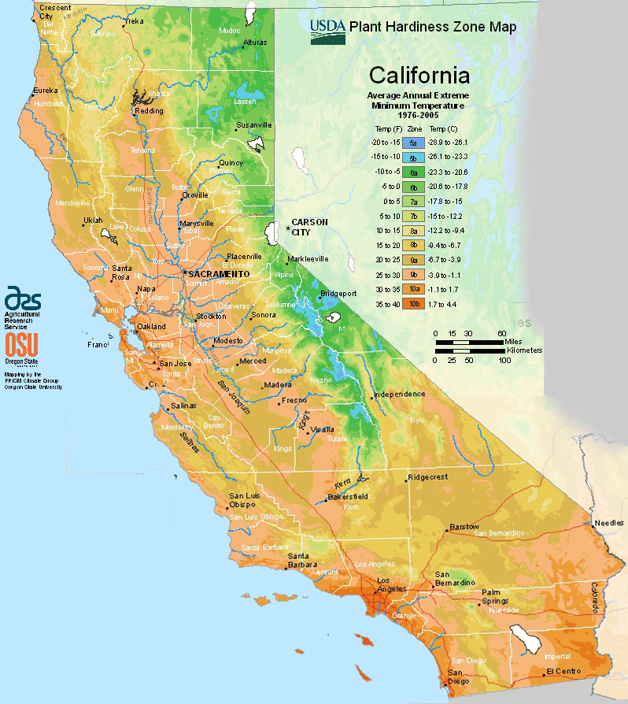
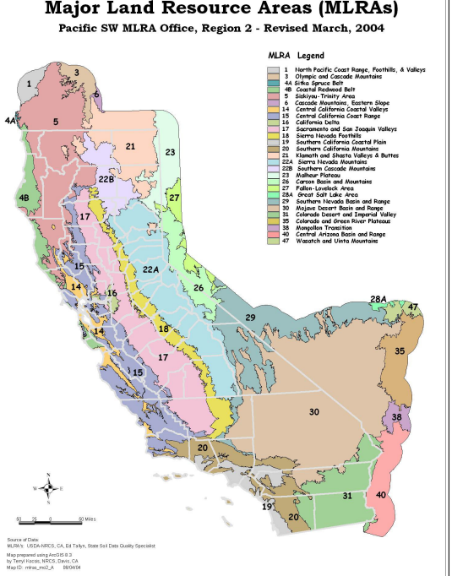
Climate Zones Models – Potential Correlation Parameters
Koppen-Geiger climate zones
Major Land Resource Area
Level IV Ecoregions
Jepson Ecoregions
Evapotranspiration (ETo) zones
Plant Hardiness Zones
Fenneman/Johnson physiographic divisions
National Interagency Fire Center Dispatch Center zones
National Predictive Service Area (PSA)

Slide 21
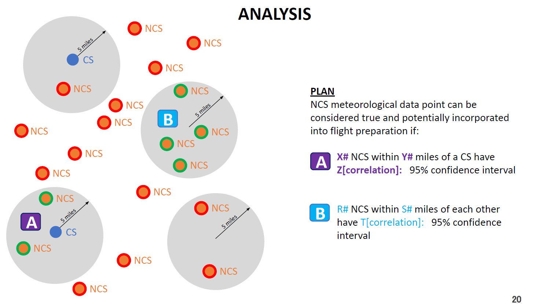
Proof of Concept Correlation Algorithm

Slide 22
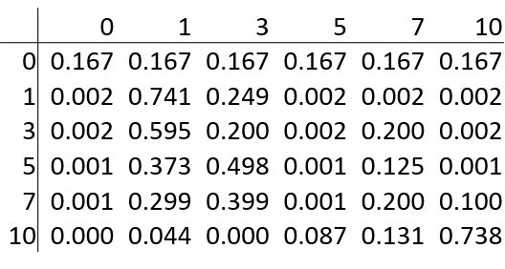
Crowd Sourcing - Expectation Maximization (EM) Algorithm
The EM algorithm also keeps track of the likelihood of a worker to accurately annotate each visibility category
An example of the ability matrix for a worker looks like (no experience in 0 row):
The rows represent the image visibility category and the values along that row represent the likelihood of the worker annotating the visibility category of that column. If the visibility category of an image has been determined to be 5, it is 49.8% likely that the worker will annotate it as category 3.
The ability score is calculated based on the averaged sum of the elements on the main diagonal so in the example the ability score is (74.1+20.0+0.1+20.0+73.8)/5=37.6

Slide 23
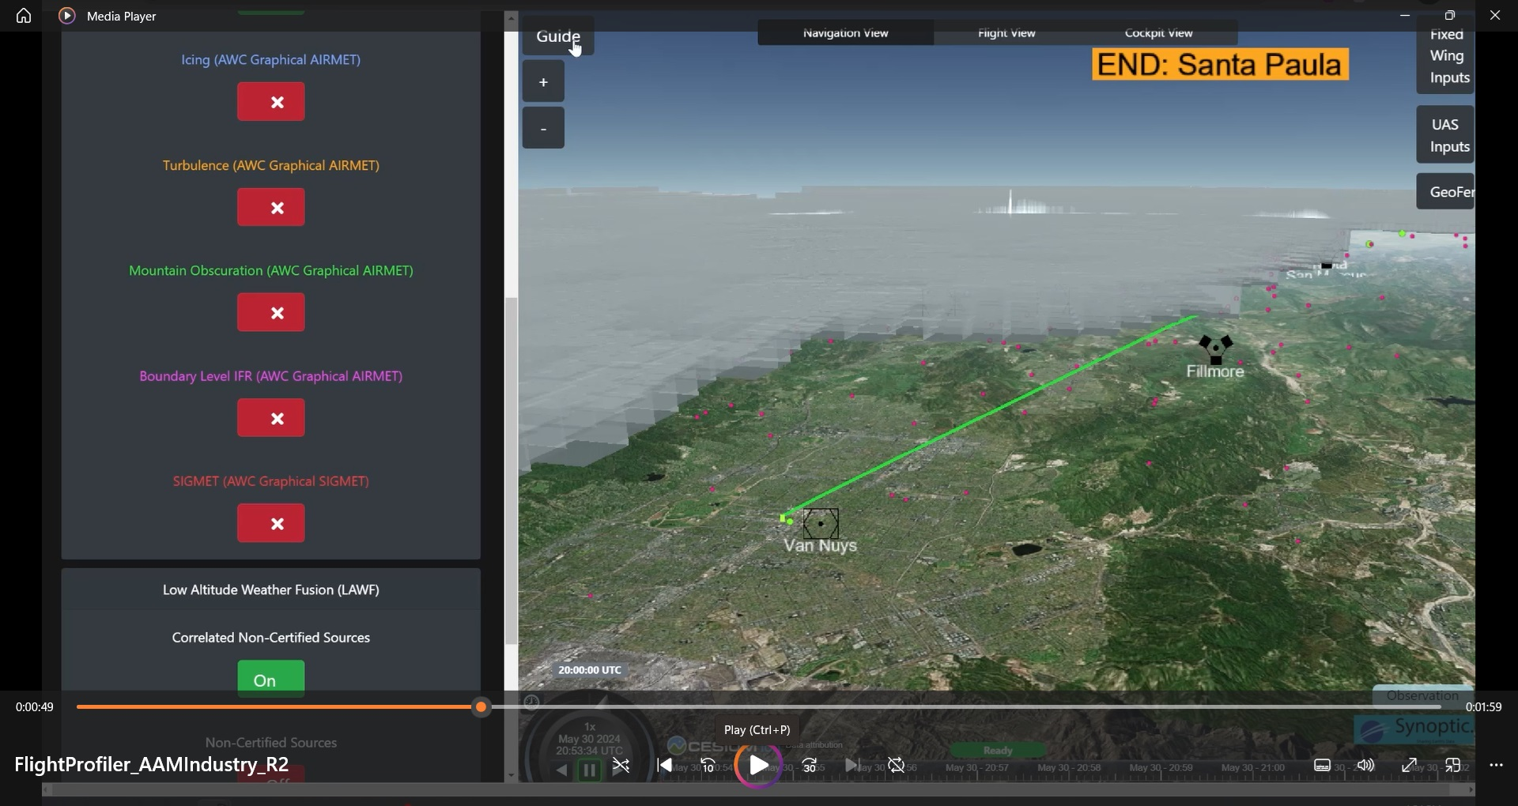
Proof of Concept Output – Van Nuys to Santa Paula
Green dot is only
METAR and it is
at Van Nuys
Pink dots are
correlated
non-certified
Sensors (trust
outputs to 95%
Confidence)

Slide 24
Current Aggregator Tasks
Techniques for grouping sensors in a crowd sourcing configuration (historical correlations, weather/climate zones, altitudes, etc.)
Sensor scoring techniques as crowd worker (accuracy, reliability, correlation percentage with crowd)
Supervisory controller techniques with lack of “truth source” and human SME observer
“Flight Management Service” to keep human in the loop (Wx advisory)
Aggregator Outputs and Formats
  Pilot Cognitive Assistance Tools (PCAT) may enable voice control to ask for type of weather data (i.e. visibility data sensors correlated to 98% confidence)

Slide 25
Questions and Contact Information
Gary Pokodner
Weather Technology in the Cockpit Program Manager
Gary.Pokodner@FAA.GOV
202-267-2786

