Slide 1


ASTM F3673-24
Testing and Evaluating the ASTM F38 Weather Standard
Notes:
Give quick overview of TruWeather as well

Slide 2

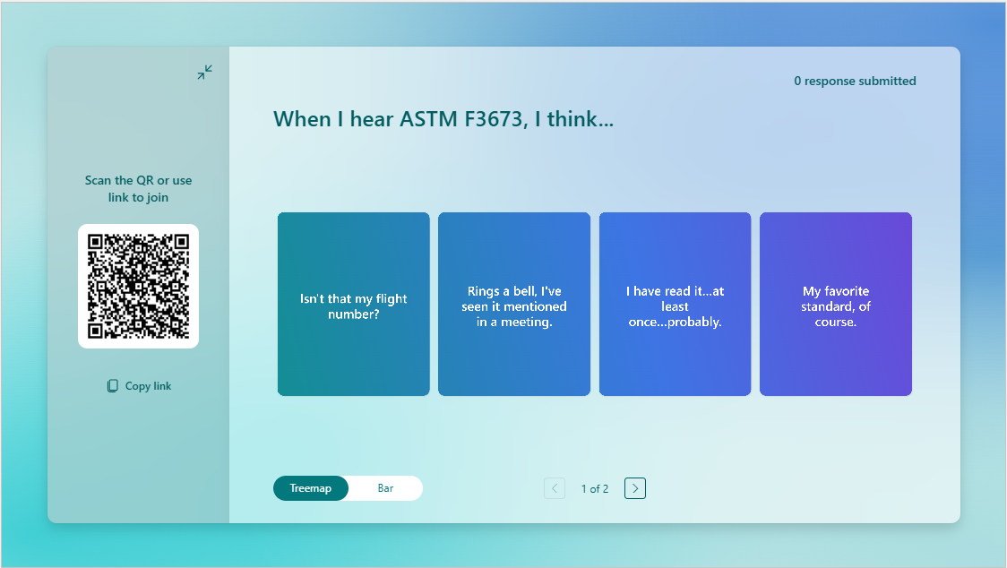
ASTM F3673-24
Notes:
Focus on the initial poll slide. I can add to talk through this as people work through the poll. People often review to Table 1 which has the Tiers, but I am intentionally not putting that up because that is an important but only partial portion of the standard, there are numerous other quality control, metadata, and data reliability, security, and management requirements that must also be addressed by the WIP providing these services.
Purpose: Define performance requirements for Weather Information Providers (WIPs) to ensure weather data is reliable, secure, and from a trusted source for Part 108, Part 135, and Part 91 operations.
Scope: Extensible traffic management systems, uncrewed aircraft systems, and vertical takeoff and landing systems operating from the surface to 5000 ft above ground level.
Approach: Data performance approach that leverages a tier-based weather data quantification framework.
Key Principle: The standard of performance depends on the reporting of data performance accuracy from reliable sources meeting security requirements.
Primary Components
Weather Data Performance and Tiering
Quality Control Measures
Data Reliability, Security, and Management
Metadata

Slide 3
Overview of ASTM F3673−24
Purpose: Define performance requirements for Weather Information Providers (WIPs) to ensure weather data is reliable, secure, and from a trusted source for Part 108, Part 135, and Part 91 operations.
Scope: Extensible traffic management systems, uncrewed aircraft systems, and vertical takeoff and landing systems operating from the surface to 5000 ft above ground level.
Approach: Data performance approach that leverages a tier-based weather data quantification framework.
Key Principle: The standard of performance depends on the reporting of data performance accuracy from reliable sources meeting security requirements.
Primary Components
Weather Data Performance and Tiering
Quality Control Measures
Data Reliability, Security, and Management
Metadata
Notes:
Focus on the initial poll slide. I can add to talk through this as people work through the poll. People often review to Table 1 which has the Tiers, but I am intentionally not putting that up because that is an important but only partial portion of the standard, there are numerous other quality control, metadata, and data reliability, security, and management requirements that must also be addressed by the WIP providing these services.

Slide 4
Current Status of F3673-24
Current edition published November 2024
Next revision likely in 2026
  Expected to go to ballot December 2025
  Will capture MOC, metadata, and other items that emerged during previous balloting
Means of Compliance (MOC) Working Group
  Developing MOC Annex with supporting appendices
  MOC Working Group only recommending revisions to ASTM F3673-24 required to enable the writing of an associated MOC

Slide 5
ASTM F3673-24 Evaluation and Advancement
Testing and Evaluation of the Standard will inform future revisions and regulatory adoption
TruWeather is evaluating through two complementary pathways:
  FAA NTAP – Currently working with an operator in Dallas area
  NASA-funded effort to determine Minimal Operational Procedure (MOP) for 3PWPs – Will leverage TruWeather Testbeds
Notes:
Briefly explain NTAP and how we are working directly with FAA to understand the current state of the standard, but the challenge of this approach with the knowledge of a forthcoming revisions.
MOP Project will:
Focus on safe integration of 3PWP information into the NAS
Testing campaign designed to evaluate ASTM F3673-24 requirements in practice
Leverage TruWeather testbeds

Slide 6
NPRM: NTAP, Part 108, Part 146, and ADSPs
NTAP: Near Term Approval Process
Automated Data Service Providers (ADSPs): Will serve as certificated sources distributing approved performance-based services.
Part 108: Defines operational requirements for BVLOS UAS.
Part 146: Establishes oversight for ADSPs through Service Provider Standard Orders (SPSOs) compliance mechanisms.
NPRM addressing the issue of BVLOS weather risk:
  2120-AL82 1652-AA80 BVLOS NPRM (pp. 96-99, Preamble): “Given that part 108 UAS operations would operate primarily outside of this area of approved observation coverage, those operations will need additional sources of weather information to operate safely. FAA anticipates that some of this weather information gap could be filled by third-party weather providers or come from other non-traditional sources, such as locally owned and operated devices.”
  The ASTM Weather Standard is a consensus-based standard to support on-ramping of "trusted" weather reports into the aviation system.
Notes:
Briefly explain NTAP and how we are working directly with FAA to understand the current state of the standard, but the challenge of this approach with the knowledge of a forthcoming revisions.
MOP Project will:
Focus on safe integration of 3PWP information into the NAS
Testing campaign designed to evaluate ASTM F3673-24 requirements in practice
Leverage TruWeather testbeds

Slide 7
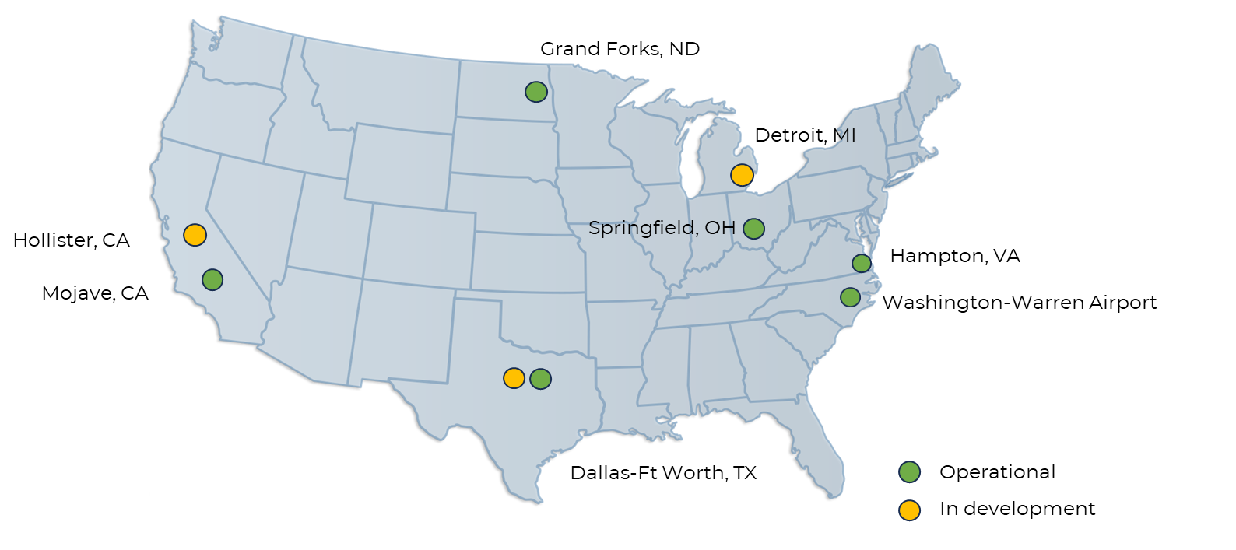
TruWeather's Public/Private Funded Ecosystem
Infrastructure Traction to Date
TruWeather is deploying low altitude weather infrastructure in support of drone and e-VTOL operations where conditions exist for organized testing and demonstration of Beyond-Visual-Line-of-Sight (BVLOS) drone operations and urban air mobility.
Notes:
Describe the different testbeds and how our initial effort for both pathways is focused on the Dallas-Fort Worth Area. Dallas is where we are working with an operator through the NTAP process. The goal with NTAP is that TruWeather will receive a letter of authorization which allows the Champion Operator we are working with to leverage the weather data we provide them to support their Part 135 operations.

Slide 8
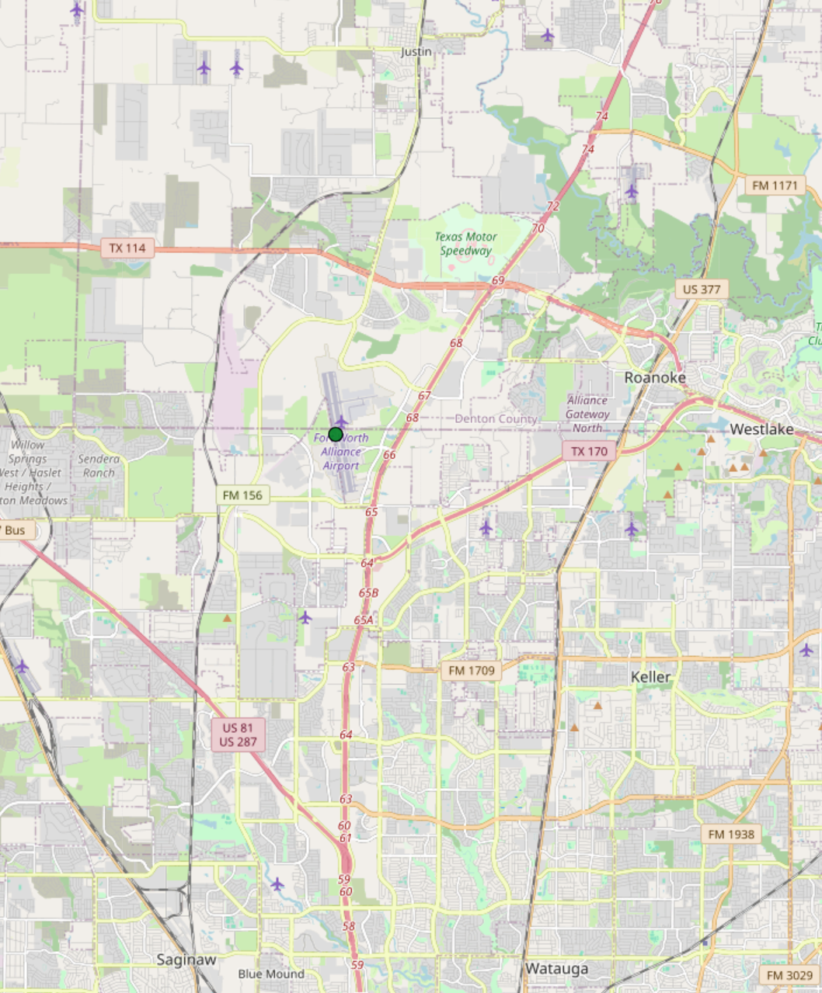
Dallas-Fort Worth
Project Weather Sensors
#
US DOT SMART Grant (City of Fort Worth)
MetroWeather Wind Scanning LiDAR (1)
Intellisense Weather Stations w/Ceilometers (2)
Tempest Weather Stations (co-located with road sensor) (4)
Frost Solutions Road Sensors (10)
NASA SBIR (TruWeather)
MetroWeather Wind Scanning LiDARs (2)
Barani Weather Stations (4)
MetroWeather (TruWeather Partner)
NRG Vertical Wind LiDARs + Anemometers on Cell Towers (4)
#
#
#
#
Notes:
Next, zooming to Fort Worth is where I will maintain much of my focus when discussing the second pathway because this is where we will initiate the effort because of the opportunity to evaluate a variety of weather data information sources.

Slide 9
ASTM F3673-24 MOP Project
Identify core ASTM F3673-24 requirements critical to safe 3PWP NAS integration
  Comparison with qualified reference sources (ASOS, AWOS)
  Laboratory calibration with manufacturers
  Cross-validation against neighboring data sources
  Recommendations for representativeness evaluations
Develop algorithm for consistent, repeatable qualification of 3PWP data
Long-duration field trials (6–12 months)
Demonstrate continuous data health and compliance system
Recommended revisions to ASTM F3673-24 from this and other 3PWP testing/feedback
Notes:
Expecting to evaluate:
Comparison with qualified reference sources (ASOS, AWOS)
Laboratory calibration with manufacturers
Cross-validation against neighboring data sources
Recommendations for representativeness evaluations

Slide 10
Early Findings from Evaluation and MOC WG
Achievable pathway with MOC Annex adoption
Overly burdensome requirements need to be addressed
  E.g., Grid-to-point verification for analyzed weather data
Tier approach limits communication of dynamic uncertainty information
Methods defining representativeness need to be demonstrated

Slide 11
Weather Standard(s) Next Steps/?s
How do we best support Part 108 and future autonomous operations?
  New standard required for Nowcasts
  Revise ASTM F3673 and expand scope?
Needs of Human-in-Loop vs. Human-out-of-the-loop?
  F3673-24 tiering approach is effective to support human operator decision making
  Autonomous operations best served with dynamic uncertainty information to continuously calculate and mitigate risk
Prescriptive tiers → uncertainty reporting transition?
  Dynamic uncertainty reporting enables risk management at scale
Notes:
And risk mitigation based on platform and payload characteristics
Weather data already has dynamic uncertainty (e.g. radar data impacted by ground clutter, hail spikes, bird migrations)
Today: meteorologists interpret uncertainty for human operators
Tomorrow: machines will need direct uncertainty inputs to assess risk in real time

Slide 12

Thank You
truweathersolutions.com
Contact:
Chris Zarzar
Chris.Zarzar@TruWeatherSolutions.com

Slide 13
