Slide 1
Weather Community of Interest (COI) Update
Friends and Partners of Aviation Weather
Starr McGettigan and Doug Murphy
October 7, 2025

Slide 2
Today’s Agenda
Why, What and How (By the Numbers)
Since We Last Met
Current Problem Statements
FPAW Feedback to the Wx COI
Q&A

Slide 3
Wx COI: Why?
U.¹The Assistant Administrator – NextGen is the ICAO U.S. Met Authority

Slide 4
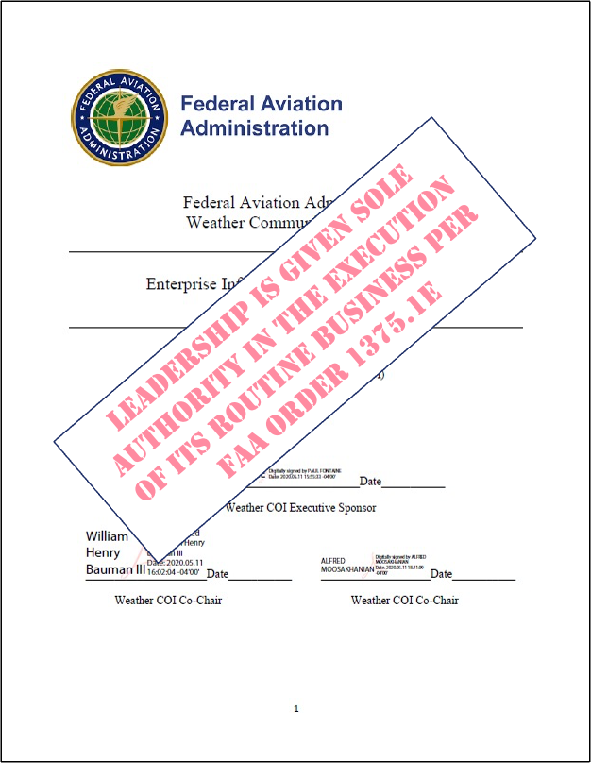
Wx COI: What?
FAA Order 1375.1F – Data and Information Policy, Chapter 3
3.2.c Communities of Interest (COI¹):
Governance communities that are business-facing and specific to an
information domain as defined by the FAA Enterprise Information Architecture.
COIs are focused on information requirements and coordination across
programs and organizations.
COIs receive requirements, problem statements, and needs for products
and services, external partners, external organizations, and programs, and
communicate these requirements to SCOPs as necessary.
Reviewing the analyses and recommendations provided by working groups
pertaining to their information domain.
Identifying, defining and satisfying the information needs of end users and
business activities within their domain.
Determining Strategic activities and viable plans for transitioning to a desired future state.
Managing baseline and change control of the FAA Enterprise Information Architecture for their domain.
Ensuring interoperability across FAA LOBs/SOs and information domains.
¹A Community of Interest (CoI) is a group of people whose goal is to further a common cause by sharing wisdom, knowledge, information, or data, and interactively pursuing informed courses of action.

Slide 5
Wx COI: How? (By the Numbers)
First plenary meeting: July 21, 2020
Number of plenary meetings since then: 47
Average number of participants/plenary meeting: 45-55
Number of Problem Statements submitted: 68
Number of SWATs created: 12
Number of SWATs currently active: 6 (plus 2 in hibernation, 4 disbanded)
Number of Problem Statements closed/resolved: 40
Number of briefings given by external organizations: 16 (ICAMS, NOAA/NWS x 3, MIT LL x 2, NCAR, A4A, AOPA, MITRE, ALPA, NBAA, ADF, VFS, NATCA, Spaceport America)
Number of briefings given by internal organizations: 19 (Info-Centric NAS [ANG-3], PS Lifecycle [Wind SWAT], Analyzed Weather [Standards & Policy SWAT], SFO MSFS [ANG-C6], Flight Service [AJR-B1], PIREP Research [CAMI] x 2, PADWOS [Wind SWAT], ONA Intake Process [Standards and Policy SWAT], Performance Based Weather [AFS], Digital Twins Concept for Weather [ANG-B1] x 2, WMSCR [AJM-33]), FAA Emergency Management [AXE-500], Weather Camera Program [AJR-B200] x 2, NextGen NAS Modernization [ANG-1], Airport Cooperative Research Program [AAS-100], Weather EA Roadmap [ANG-B])

Slide 6
Wx COI: Since We Last Met… (1 of 2)
November 2024 (Plenary Meeting 24-09)
  FAA Weather Strategy update and Wx COI Strategic Planning Team (SPT) status
Late November 2024 / Early December 2024
  Randy Bass retires, Starr McGettigan/ANG-C63 assumes his role as Wx COI Co-Chair
January 2025 (Plenary Meeting 25-01)
  Digital Twin Briefing and Collaboration Request from ANG-B1 DT Team
  Closed PS #54 Making ASOS/AWOS Ceilometer Cloud Reports Available Up to FL250
March 2025 (Plenary Meeting 25-02)
  Briefing from Patrice Kone/ANG-B, titled “Overview of EA Weather Roadmaps”
Late April 2025 / Early May 2025
  Alfred Moosakhanian retires, Doug Murphy/AJM-33 assumes his role as Wx COI Co-Chair
May 2025 (Plenary Meeting 25-03)
  Briefing from Jonathan Leffler/NWS, titled ”How the AWC uses PIREPs in G-AIRMETs and SIGMETs”

Slide 7
Wx COI: Since We Last Met… (2 of 2)
July 2025 (Plenary Meeting 25-04)
  Briefing from Mike Matthews/MIT LL, titled “Visibility and Cloud Estimation through Image Analytics”
  Closed PS #60 CoSPA Storm Metrics
  Transferred PS #11 Impact of Improved Weather Observations and Forecasts on Reducing Delays/Improving NAS Efficiency to Systems SWAT
  Disbanded Weather Metrics SWAT
July and August 2025
  Core Team discussed, explored, developed potential Wx COI reorg solutions
September 2025 (Plenary Meeting 25-05)
  Briefing from Starr McGettigan and Doug Murphy, Wx COI Co-Chairs, titled “Reorganizing the FAA Wx COI: Some Alternative Solutions”
  Added new Problem Statement (#68, Exact Text TBD) and assigned to the System SWAT
    The new PS is centered on the proper use of information from Liquid Water Equivalent (LWE) systems to inform ground deicing processes

Slide 8
Wx COI: Current Problem Statements (1/4)
PS # | Submitter | PS | SWAT | Status
9 | AFS-200, -400 | Missing METAR elements at airports without CWOs | Standards/Policy | A5
10a | NATCA | Precipitation information not on controller primary display for areas not serviced by weather radar (i.e., OPC) | Systems/Comm | A5
11 | ANG-B | Unknown impacts of improved weather info on NAS | Systems/Comm
16 | AIR | Operation of some aircraft turbine engines in greater than light-moderate snow | Winter Wx/Deicing | A5
21 | AIR | Operation of some icing-certified aircraft in –ZR/-ZL | Winter Wx/Deicing | A5
31 | AJM-33 | Imprecise winter weather precipitation phase analyses and forecasts | Winter Wx/Deicing | A4
32 | AJM-131 | PIREP formatting and encoding issues | PIREPs
33 | AJM-131 | FAA lacks national coordination and synchronized approach to PIREP modernization | PIREPs
34 | AJM-131 | PIREPs do not get to WMSCR, are not widely disseminated | PIREPs

Slide 9
Wx COI: Current Problem Statements (2/4)
PS # | Submitter | PS | SWAT | Status
36 | AFS-200, -400 | Web-base RVR information when ATCT is closed | Systems/Comm | A6
40 | AFS-200, -400 | Runway and taxiway excursions due poor reporting | PIREPs
41 | AJM-131, NATCA | Lack of integration of dynamic weather products onto controller workstations | Systems/Comm | A5
43 | AFS-200, -400 | Lack of approved weather standards, certification process for 3rd party weather providers and SDSPs | UAS (Primary) Standards/Policy (Secondary) | A5
44 | ANG-C6 | Lack of resolution of observation and forecast information in support of UAS operations | UAS | A5
47 | AJI-1 | Inability to modify submitted PIREP | PIREPs | A4
48 | AFS-220 ANG-E282 AIR-600 | Inability of ASOS/AWOS to report multiple precipitation types | Winter Wx/Deicing | A4

Slide 10
Wx COI: Current Problem Statements (3/4)
PS # | Submitter | PS | SWAT | Status
49 | AFS-220 ANG-E282 AIR-600 | Erroneous freezing mist/fog and snow in METARs | Winter Wx/Deicing | A4
55 | AFS-200, -400 | Wet and dry snow differentiation in aircraft takeoff performance assessment | Winter Wx/Deicing | A4
57 | AFS-200, -400 | Use of LWE for precipitation intensity determination | Winter Wx/Deicing | A4
58 | AIR-714 | Need for 4-D visualization of weather along aircraft flight path pre- and in-flight | Systems/Comm | A4
59 | AFS-200, -400 | Imprecise winter weather precipitation phase analyses and forecasts | Winter Wx/Deicing | A4
62 | NATCA | Amend PIREP submission to allow use of RNAV fixes | PIREPs

Slide 11
Wx COI: Current Problem Statements (4/4)
PS # | Submitter | PS | SWAT | Status
63 | ANG-C6 AFS-400 AJV-S AJT-2 | Need for FAA Weather Strategy | Strategic Planning Team (SPT)
64 | NATCA | Use of heavy and severe icing categories | Wx Impact Metrics
65 | ANG-C6 | Need for future FAA weather radar needs, in support of NOAA Radar Next project | Radar Next
66 | AJW-121 | Approving the Use of Non-Federal Weather Sensors and Systems | Standards and Policy
67 | AJW-121 | Erroneous AWOS Information | Systems/Comm
68 | AFS-200, -400 | Proper use of LWE information vs. METAR vs. visual observations | Systems/Comm

Slide 12
The Wx COI and FPAW: A Path Forward?
Previous conversations centered around setting up a semi-formal relationship between the two organizations
  While that remains a possibility, it has not advanced beyond conversational stage
There is a viable way for FPAW to submit feedback on aviation weather gaps/problems to the FAA, either as individuals or as a group, via the public-facing ANG-C6 Weather Needs Portal (WNP)
  This topic was briefed at the Fall 2023 FPAW Meeting by Becky Kotten
  (see https://fpaw.aero/sites/default/files/169/rkotten-fpaw-2023-wnp.pdf)
  Weather Needs portal URL: https://www.faa.gov/nextgen/programs/weather/suggestions/
Success story: recently closed PS #54, Making ASOS/AWOS Ceilometer Cloud Reports Available Up to FL250, came to the Wx COI via the WNP, was worked there and resolved earlier this year

Slide 13

QUESTIONS

Slide 14
BACKUP

