Slide 1
FAA NextGen Weather Data Access
CSS-Wx and NWP Overview/Status
Friends and Partners in Aviation Weather (FPAW)
Doug Murphy, FAA NextGen Wx Program Office
October 7, 2025

Slide 2
Purpose
Provide overview of NextGen Weather Systems
Common Support Services – Weather (CSS-Wx)
NextGen Weather Processor (NWP) and Aviation Weather Display (AWD)
How to Access NextGen Weather Data Services
Available weather products
SWIM availability
NWP External Web Service (EWS)
CSS-Wx/NWP Status

Slide 3


NextGen Weather Programs Overview
Common Support Services – Weather (CSS-Wx)
NextGen Weather Processor (NWP)
Improve weather information management and user access; provide new interface standards and formats
Increase NAS efficiency and safety by improving weather product generation, translation, and display for aviation weather users
Reduce FAA cost by enabling decommissioning of legacy weather dissemination and processor systems (e.g., WARP, WINS, FBWTG, CIWS, CDDS)
CSS-Wx Capabilities | NWP Capabilities
Single provider of weather data products within the NAS, using standards-based weather dissemination Makes weather products available from NOAA, NWP and other data sources for integration to air traffic systems Provides weather products via a set of common Web Services for weather, using international data access and data format standards | Produces advanced aviation specific weather products, e.g., Real-time weather radar information (e.g., ERAM) 0 to 8 hour aviation weather products Convective Weather Avoidance Fields Translates weather information into weather avoidance areas for integration into decision support tools (e.g., TFMS, TBFM) Provides Aviation Weather Display (AWD) of NextGen weather information for AT users

Slide 4
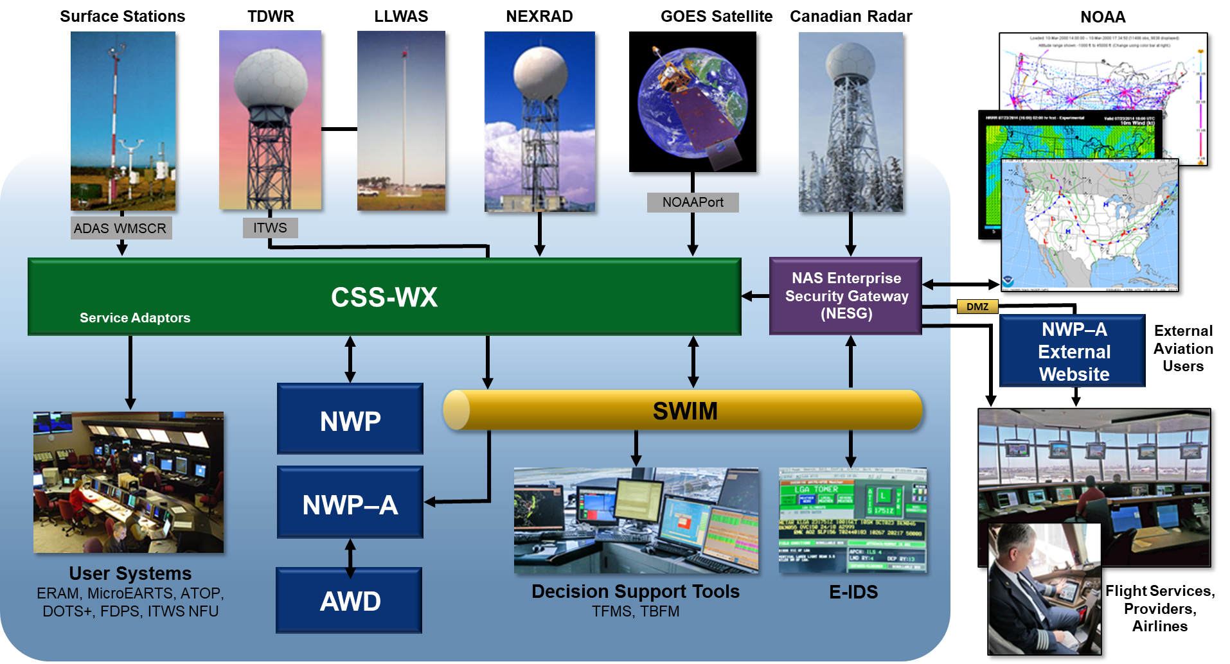
NextGen Weather Providers/Consumers

Slide 5
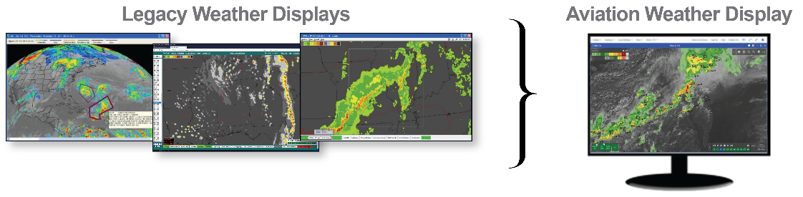
Aviation Weather Display (AWD)
AWD provides users with access to aviation specific weather information from CSS-Wx generated by NWP, NOAA, other sources
AWD Servers obtain information from CSS-Wx published on SWIM
AWD will be used in designated Air Traffic (AT) facilities by users such as AT specialists, Center Weather Service Units (CWSU) meteorologists
Authorized users internal and external to the FAA will have access to the AWD via the internet through the AWD website
Replaces legacy weather displays, e.g., WARP Briefing Terminals, CIWS Situation Displays and CIWS/CoSPA Website

Slide 6
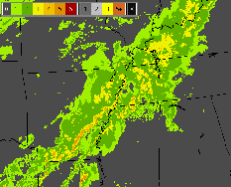
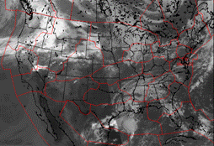
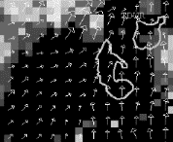
Types of Data Products: Gridded Data
Gridded products represented as uniformly spaced observations or computed values on rectangular arrays
Mapping projection needed to map data grid to earth’s surface
Examples: Lambert Conformal, Lambert Azimuthal Equal Area
Network Common Data format (NetCDF4) used to model gridded data products
Precipitation (VIL) Mosaic
Satellite Mosaic
Terminal Winds
Notes:
What data formats does CSS-Wx use?

Slide 7
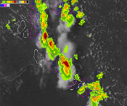
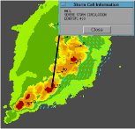
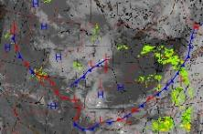
Types of Data Products: Non-Gridded Data
Non-gridded products express singular or sparsely distributed geospatial sets of observations or forecasts
Contours, point products, text products
XML format and extensions used to represent non-gridded data
Geography Markup Language (GML), ICAO Weather Exchange Model (IWXXM), etc.
Geo-reference coordinates (latitude, longitude) used to represent data locations.
Precipitation Contours
Storm Motion Vectors, Extrapolated Positions, Hazard Text
Fronts and Fronts Forecast
Notes:
What data formats does CSS-Wx use?

Slide 8
NextGen Weather Data Access
Available Products are listed in NAS Service Registry Repository (NSRR) https://nsrr.faa.gov
Documentation that provides product details and information on how to acquire
Sample products can be made available upon request (outside NSRR)
Users outside the FAA obtain products through Subscription Service
Data available to consumers via SWIM
JMS destination is configured specifically for subscriber
Products distributed to subscriber as received

Slide 9
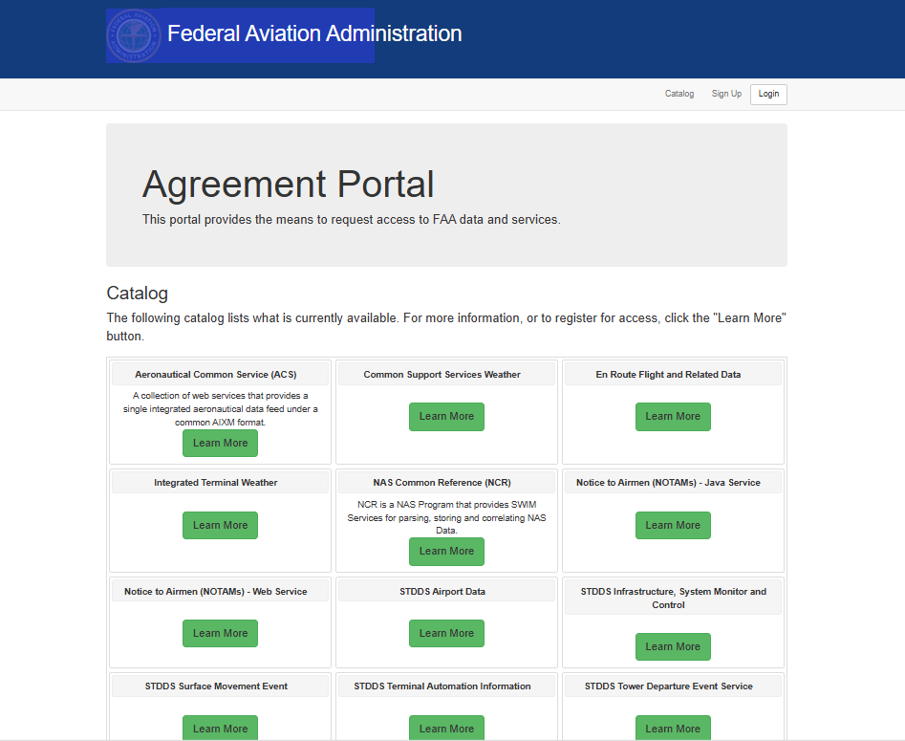
NextGen Weather Data Access
NWP and NWS-sourced products available via SWIM
NESG connections for partners that require operational data usage
FAA is discussing future availability on the SWIM Cloud Distribution Service (SCDS)
Establishing data access begins with FAA Agreement Portal
Registration required
Agreement Portal
Email to complete onramping
Data-To-Industry@faa.gov

Slide 10
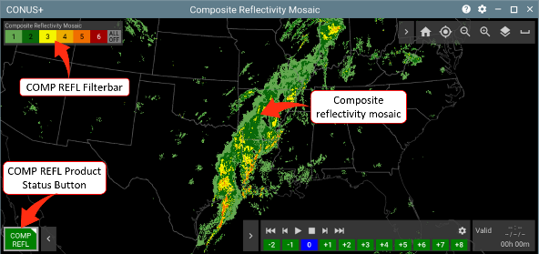
NWP’s External Web Service (EWS) Key Features
EWS will be publicly accessible for approved internet-based users
“Look and feel” of EWS much like dedicated AWDs
Architected similarly to the web server providing weather products to the AWDs within FAA air traffic facilities
Currently designed to be viewed on a workstation/laptop form factor

Slide 11
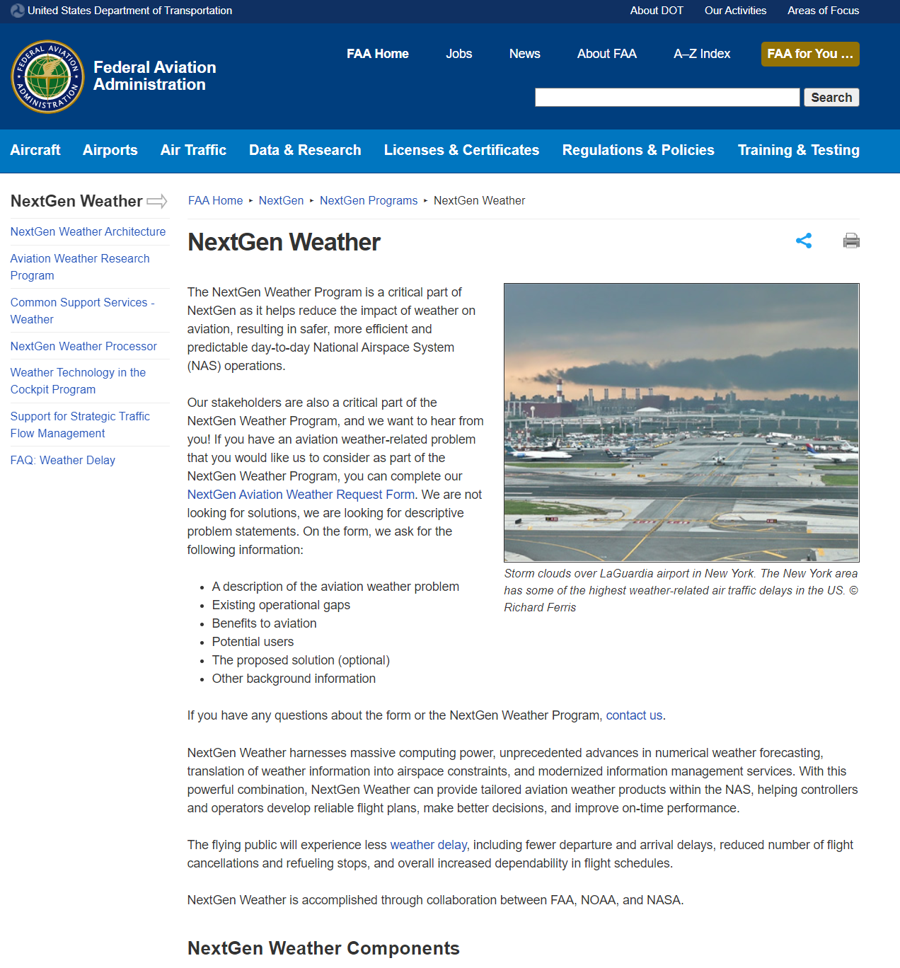
Register for an account
Coming soon, we will be updating the NextGen Weather faa.gov website (https://www.faa.gov/nextgen/programs/weather/nwp/awd) with information for users to learn more about the EWS and how to register for an account
This will be the landing page that is Internet searchable and communicate to users about the EWS, how to obtain an account and how to obtain support
New users will need to complete an account registration form and be granted approval for access
Name, Email, Organization, Need statement, etc.

Slide 12
EWS Timeline
Test system being configured
Opening to early adopters soon
Test onboarding processes, access to EWS test instance, fine-tuning of server, establish support desk
Not to be used for operational decision-making
Testing and software updates will result in periods of downtime
Compiling list of early adopters
Email EWSUserRegistration@faa.gov to join
Registrants will be notified when test system becomes available
Full operational system targeted for Spring of 2026
FAA, NAV Canada and airline users will be prioritized for access
Existing CIWS/CoSPA users will not be automatically migrated over to the EWS
New registration required for all users of EWS

Slide 13
CSS-Wx and NWP Program Status
Initial Operating Capability (IOC) declared September 2024
Includes centralized processing at Atlanta and Salt Lake City
NWP Aviation Weather Displays at keysites
Established operational data publication to SWIM
Working toward In-Service Decision (ISD) milestone in first quarter of CY26
Marks acceptance of systems in NAS and allows full deployment of systems
Decommission of CIWS/CoSPA/WARP begins after ISD
End of CIWS/CoSPA website targeted for Summer 2026
Registered users of CIWS/CoSPA will receive notification email as date nears
Questions about CSS-Wx or NWP? Contact…
Doug Murphy (douglas.e.murphy@faa.gov) or
Wil Brown (william.n.brown@faa.gov)

Slide 14
Backup

Slide 15
NextGen Weather Products – Gridded
Gridded Weather Data
Precipitation (VIL) Precipitation (VIL) with Mask Precipitation (VIL) Forecast Precipitation (VIL) Forecast with Mask Echo Tops Echo Tops Forecast Precipitation (Base Reflectivity) Precipitation (Composite Reflectivity) Precipitation (Composite Reflectivity) with Mask Surface Precipitation Phase Surface Precipitation Phase Forecast | Icing Layer Composite Icing Icing Layer Forecast Composite Icing Forecast Turbulence Layer Turbulence Layer Forecast Composite Turbulence Composite Turbulence Forecast Convective Weather Avoidance Fields Convective Weather Avoidance Field Forecast Satellite Terminal Winds NOAA Model Data (RAP, HRRR, GFS, NAM)*
NOAA Produced*

Slide 16
NextGen Weather Products – Non-Gridded
Non-Gridded Weather Data
Precipitation (VIL) Forecast Accuracy Precipitation (VIL) Forecast Contours Echo Tops Forecast Accuracy Echo Tops Forecast Contours Lightning Storm Information Hazard Text Storm Information Leading Edges Storm Information Motion Vectors Fronts Forecast Growth Trends Decay Trends | Forecast Confidence (or Traffic Flow Impact) Convective Weather Avoidance Polygons / CWAP Forecast Wind Profiles Tornado Detections Icing Layer Contours Composite Icing Contours Turbulence Layer Contours Composite Turbulence Contours Pilot Report (PIREP) Urgent Pilot Report (PIREP) ICAO Aircraft Report (AIREP)* Significant Meteorological* Information (SIGMET)* Convective Significant Meteorological Information (Convective SIGMET)* TFM Convective Forecast (TCF)* | Airmen's Meteorological Information Advisories (AIRMET)* Graphical AIRMET (G-AIRMET)* Winds Aloft Forecast* Surface Weather Observations Aviation Watch Notification* Tornado Warnings* Severe Thunderstorm Warnings* Public Severe Weather Watch Notification (SEL)* Volcanic Ash Advisory Statement (VAAS)* Terminal Area Forecast (TAF)* Center Weather Advisories* Meteorological Impact Statements* Severe Weather Statements (SVS)*
NOAA Produced*

