Slide 1
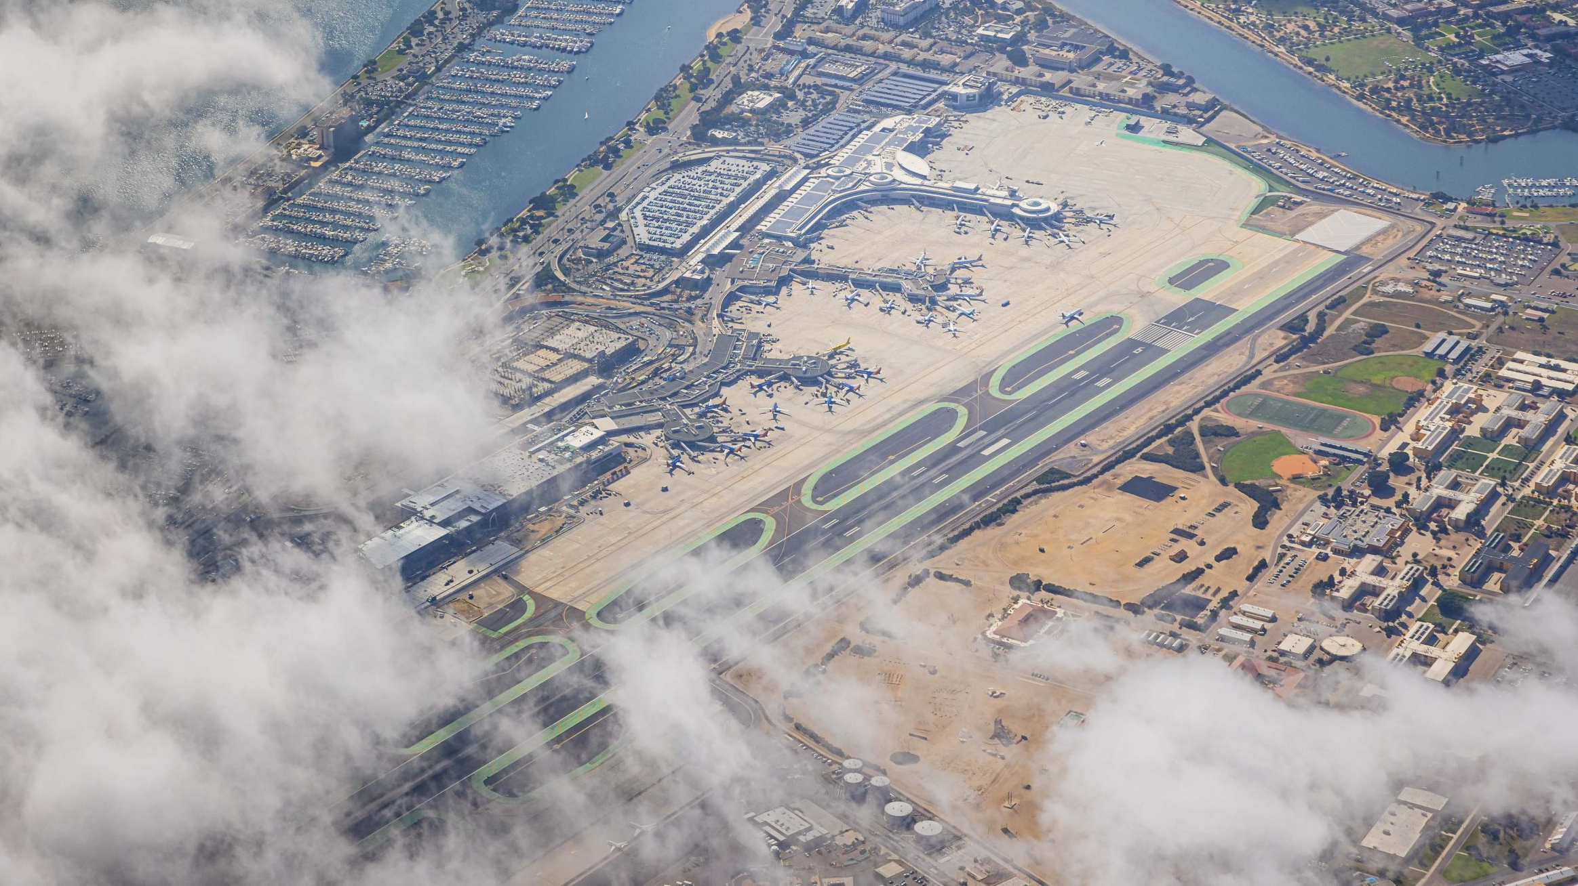
Two Sides of the Coin: METAR Representativeness for Gustiness and Obscurations
Prof. Michael Splitt
Florida Tech
College of Aeronautics
Melbourne, FL

Slide 2
Representativeness of METAR weather
“Representativeness is the extent to which a set of measurements taken in a space-time domain reflects the actual conditions in the same or different space-time domain taken on a scale appropriate for a specific application.”
Nappo, C. J. (1983). The representativeness of meteorological observations.
“Definition of Representativeness. An observation is representative if it accurately portrays the weather conditions present at the primary instrument approach. If the observation differs by reportable values, but the differences do not change operations of the airport or aircraft, then the differences are not operationally significant. The observation would continue to be representative.”
NWS instruction 10-1301 from Jan 16 2008

Slide 3
Representativeness of METAR weather (wind specific)
“Wind information for use at airports can be called representative if it provides an optimal estimate of wind variations to be expected over the runway.”
“In the last half-minute of an approach, the airplane descends through the bottom 60 m of the atmospheric surface layer, covering a horizontal distance of 1-2 km in the meantime. This defines the space-time volume to which the term "representative" applies when wind reporting for final approach or takeoff is the observation purpose.”
Wieringa, J. (1980). Representativeness of wind observations at airports. Bulletin of the American Meteorological Society, 61(9), 962-971

Slide 4

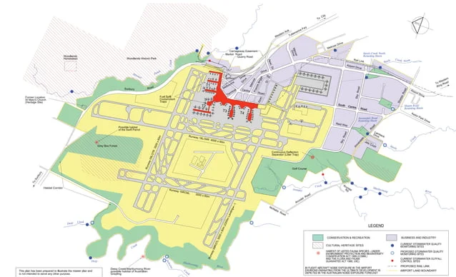
What geographic area does the METAR represent?
+25 SM
5 SM
10 SM
15 SM
20 SM
25 SM

Slide 5
Pilot Forum #1
Being overseas, and on a small island, I dont get much interaction with automated weather. I was just curious as to how far of a distance (nm) does the AWOS/ASOS cover around an airport? I.E. 1/3/5 NM around the airport? Is it the same coverage as ATIS? Common sense tells me 1 NM around the airport, but I couldn't find a reference anywhere.
I couldn't find any info in the AIM, but I'm thinking there really is no specified range that the systems look out to. They all measure local conditions and in some cases lightning in the vicinity.
It looks straight up, thats it. Of course it could be corrected by an observer for an ATIS.
Yes the AWOS does measure up pretty much so whatever the conditions are at that part of the airport where the equipment is is what will be measured.
I vaguely remember a question on my instrument ride about effective ranges of the METAR and TAF reports. IIRC, METARs are good for 5 miles and TAFs are good for 10 from the reporting airport.
But a TAF... isn't that good for 5 NM? (I can't remember!)
Terminal Aerodrome Forecast... Good for the area within a 5 mile radius of the airport. Don't ask where in the AIM it is, because I can't find it to referenece but bank on it... It's totally 5 miles.
I just looked in Aviation Weather Services Explained (ASA) and cannot find any mention of effective ranges of METAR or TAF. Weird...
0 distance from the airport. It is only valid for the airport.

Slide 6
Pilot Forum #2
I know that TAFs cover a distance of 5 sm of the reporting airport. Does anyone know the distance that METAR covers?
A TAF is a forecast of conditions surrounding the site, therefore the 5sm radius. A METAR is a report of conditions “at” a specific reporting location.
As Steve said, it’s basically where the sensors and/or observers are that determine what’s in the main part of the METAR. There’s a few things that can be qualified as VC(5-10 mi), and then DSNT (10+). If you ever want to learn all the nuiances of how METARs can be manually done, the Surface Weather Observers order is the go-to guide for how manual observations are taken. http://www.faa.gov/documentLibrary/media/Order/JO%207900.5C.pdf

Slide 7
Pilot Forum #3
What is the coverage area for a METAR report? My instructor is not sure because we are finding 5 miles(radius) but also 10 miles as well.
At least in Canada a METAR is wx within 3KM of the reporting station, with VC (vicinity) weather within 8KM.
TAF's cover up to 8NM from the reporting station.
The difference in units is a mystery.’
Always thought it was the same as a TAF which is 5SM. Although, I have been to airports which didnt have their own METAR and instead they used the METAR of another nearby airport that was 20ish miles away so....hmmm
I've never heard of an airport using another airports METAR. It would make sense to be the same as the TAF but I was really curious since I can't find a specified source for it.
Local pilot here (CYQM but originally from CYYG) Trenton uses Charlottetown weather because it's the closest airport, that weather can be similar but also can be quite drastically different. It is information only in any case
I was taught the METAR is right there directly at the weather station. It doesn't cover anything larger. I like to check surrounding METARs to give me a better picture.
I check a bunch of different sources for weather, other METARS included. But it would surely have to give more then just right above it.
Perhaps if they're generated by a person. Wherever I've flown so far, the METARs are automatically generated, meaning they come from the weather station at that airport. Cloud height, wind, temp, everything is right there at that station. In fact, watch the METAR for an airport with an air show going on and check cloud height

Slide 8
Pilot Forum #4
What geographical area does a METAR cover?
Geographically METARS are for a single specific location (the station identified in the report).
An automated METAR with no human supervision covers the conditions within approximately 6 inches of the weather station reporting it (for example, a badly positioned AWOS/ASOS station may be shielded from wind in some directions which affects what it reports).
A manual (or manually augmented) METAR covers the conditions the weather observer can physically see (clouds, precipitation, visibility, etc.) in addition to the ones they can measure (temperature, dew point, barometric pressure), which are valid for the point of measurement.
Practically speaking if the weather station is positioned well a METAR (like a TAF) is probably fairly representative of conditions within 5 miles, assuming there are no geographic features such as mountains which may mess with the weather. The data is still still "useful" within about 20 miles (e.g. KMTP uses the weather reported by KHTO, about 17 miles away), though you should obviously cross-check it - in that example the winds at Montauk (right on the water) can be noticeably different from the winds at East Hampton (further inland).
Some information is broadly useful over a wider area. FAR 91.121 requires you to set your altimeter to the value reported by a station "within 100 nautical miles" of your position when you're operating below 18,000 feet because things like barometric pressure tend to affect relatively large areas.

Slide 9
Pilot Forum #4
What geographical area does a METAR cover?
Since you mention it, there's a particular airport I fly into sometimes where they installed the ASOS gear right up against a tree line. You have to still fly over and check the sock because the winds it reports are often completely wrong. All the ASOS measure is which way the wind in the rotor by the tree line is going. Great answer, thanks. –
There are actually guidelines on how to properly site a weather station - it gets screwed up amazingly often though. –
AWOS/ASOS cloud cover isn't limited to the 6" cylinder of sky above the station - it has a much wider arc. That's how it calculates scattered, broken, etc. –
It's been said before in another forum, that a report of rain combined with CAVU, means that the lawn sprinklers are hitting the automatic weather station. –
there's a corn/soybean field at my airport near to the ASOS. Come harvest time we always have to edit the report, because the system thinks the visibility is very very low due to the (localized!) dust in the air. –
The ceilometer does just measure straight up. Automated SCT/BKN/etc are based off of time averages, not its view of the whole sky. One cloud parked over the AWOS all day will give OVC regardless of what the rest of the sky looks like.
A metar report is good within 5 NM of the station.

Slide 10
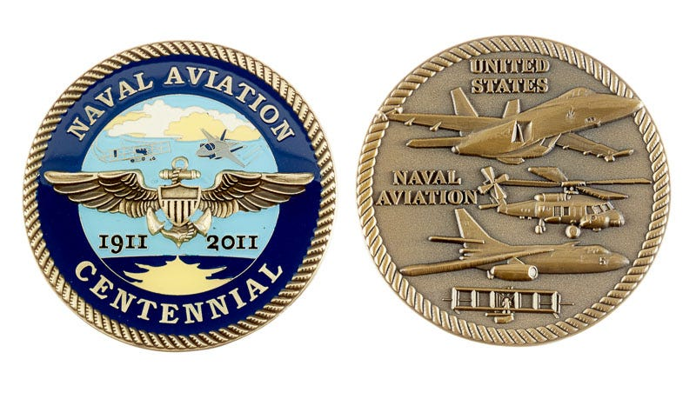
First side of the coin: “Ceilings”

Slide 11
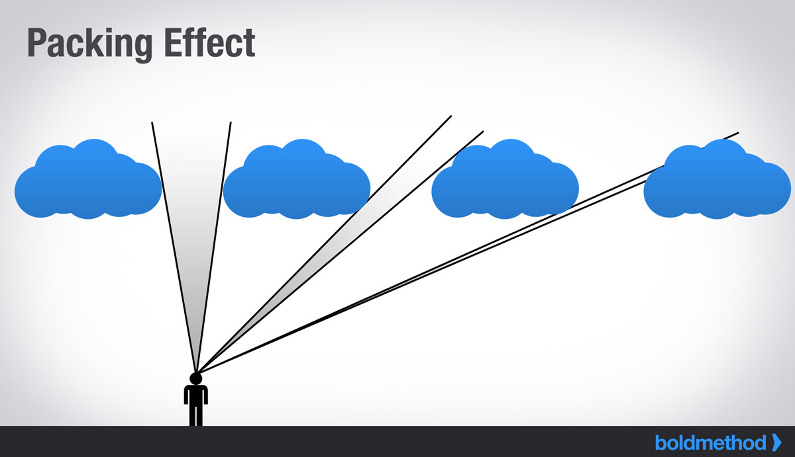
Clouds and Representativeness
Well behaved clouds!
Same cloud base!
Nice even spacing!

Slide 12

Clouds and Representativeness
Let’s get these clouds moving!

Slide 13
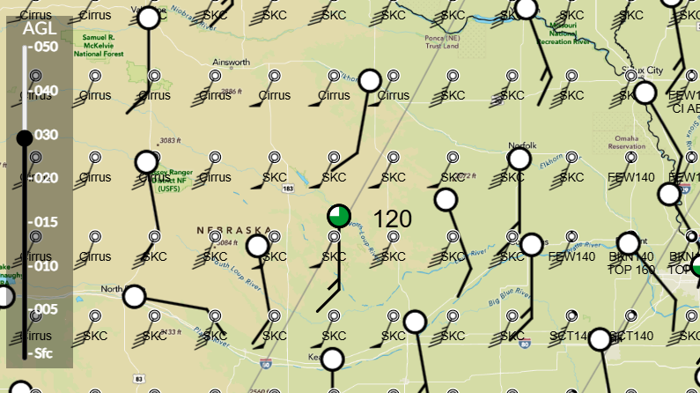
Low Cloud Movement LLJ Cu
50 NM/HOUR * 0.5 HOUR = 25 NM = 28.8 SM ~ 30 SM

Slide 14
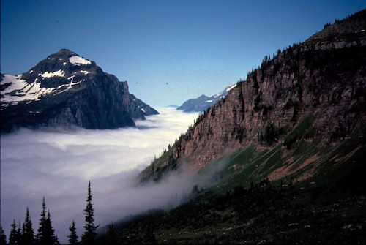
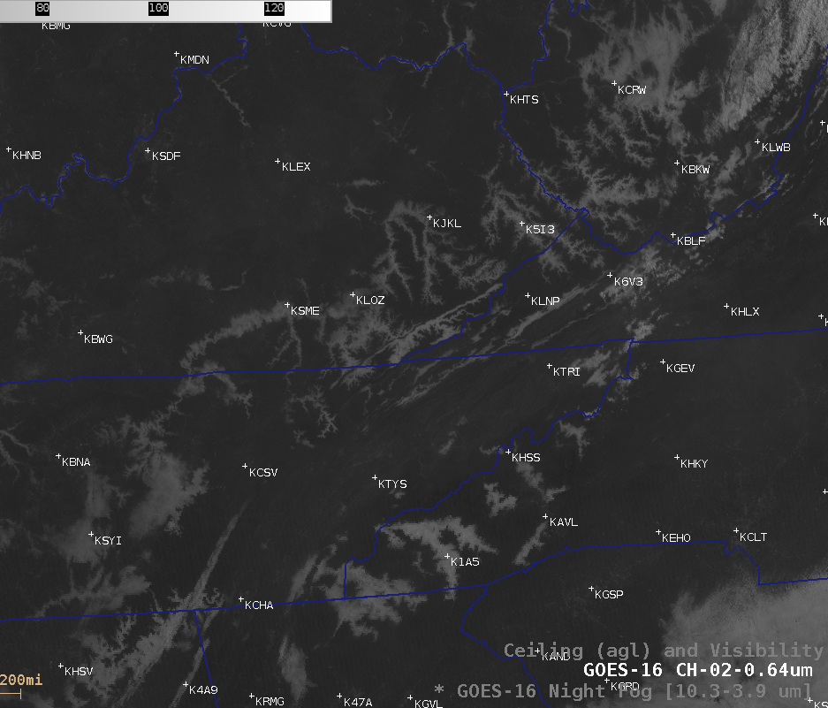


Represenativiness by direction in these scenarios?

Slide 15
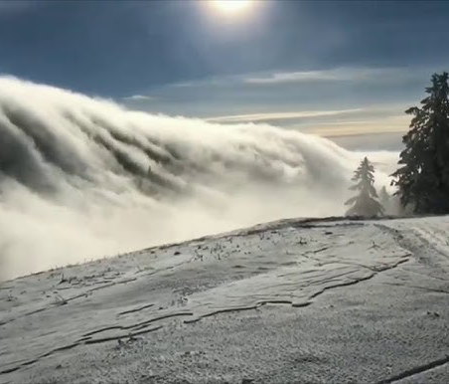


What to do with these scenarios?

Slide 16
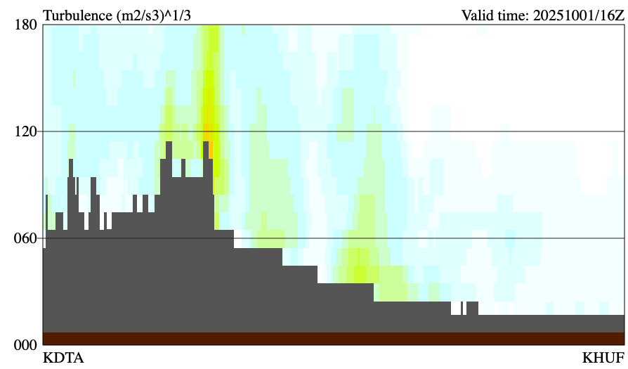

Do cumulus do this?

Slide 17
Or, do cumulus do this?

Slide 18
Do stratus do this?

Slide 19
Or, do stratus do this?

Slide 20

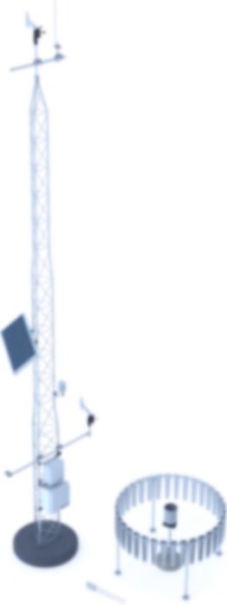
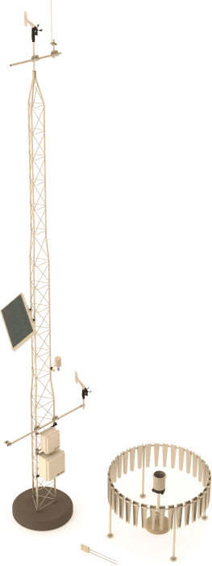
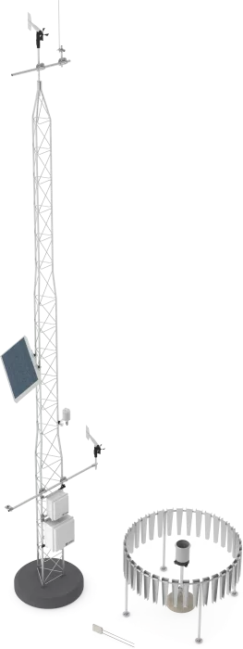
Mesonet Stations In and Out of the Cloud Layer (What if)

Slide 21
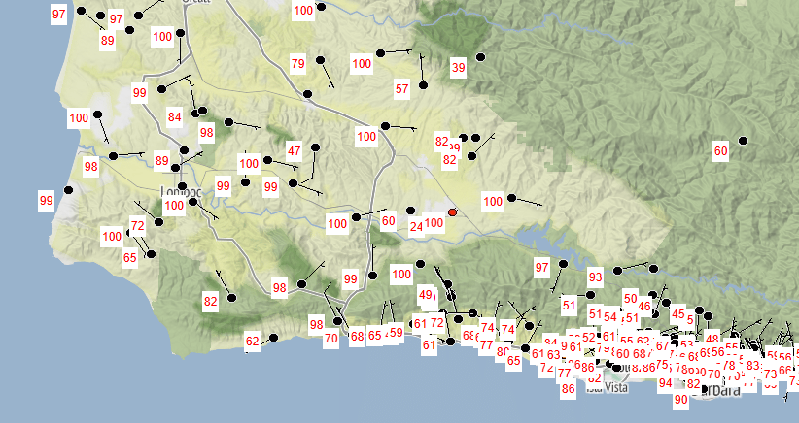
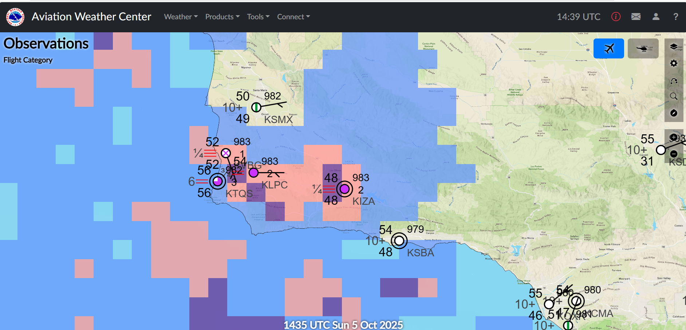
Mesonet Stations In and Out of the Cloud Layer

Slide 22
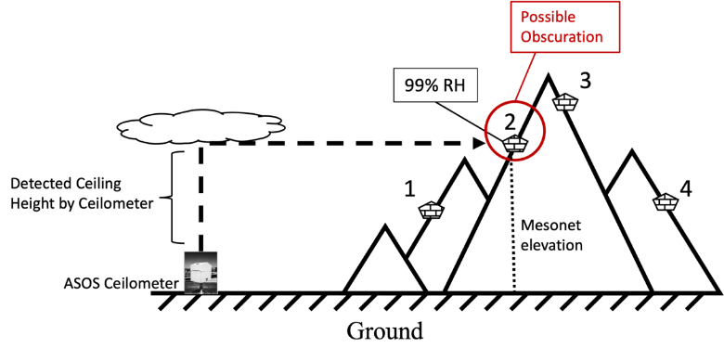
Ceilings Here/Obscuration There
Welch, Connor Hayden, "Using ASOS Ceilings and Mesonet Relative Humidity to Improve General Aviation Flight Planning and Decision Making in Complex Terrain" (2023). Theses and Dissertations. 1324. https://repository.fit.edu/etd/1324

Slide 23
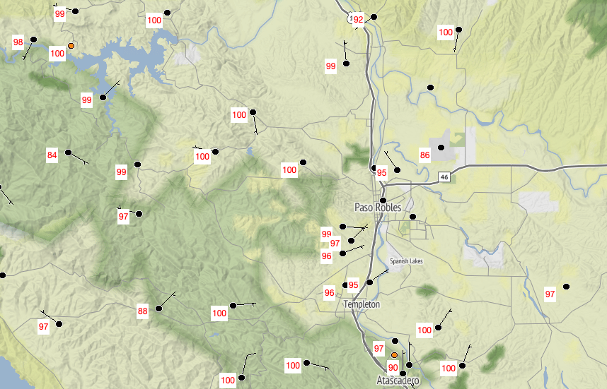
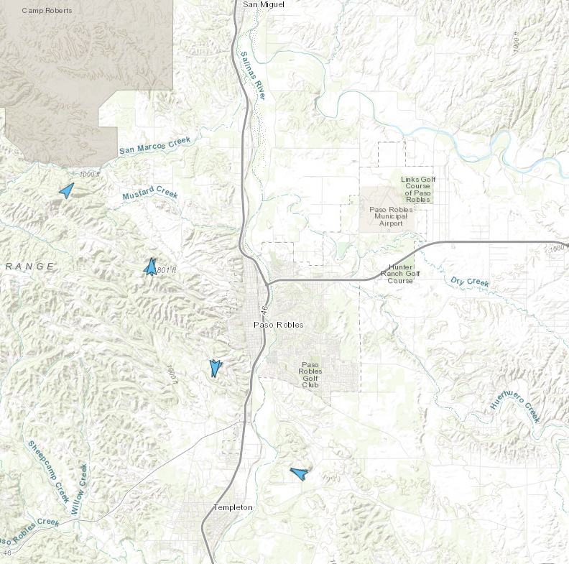
Paso Robles Municipal Airport Example: 01 OCT 2025
KPRB Airport
Mesonet Station
Camera

Slide 24
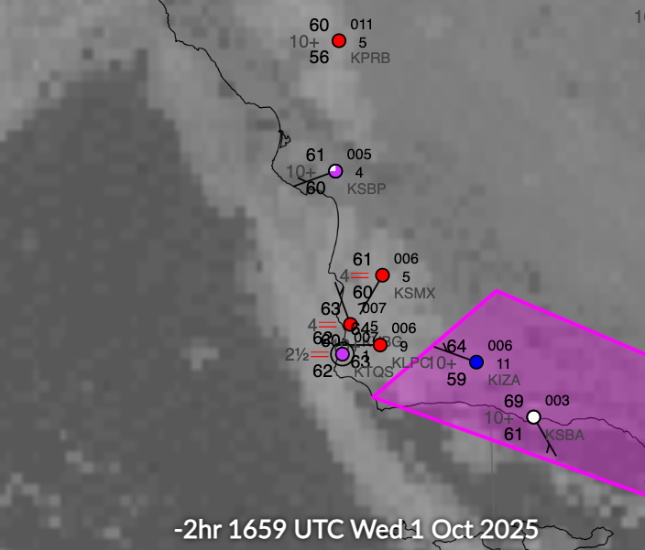
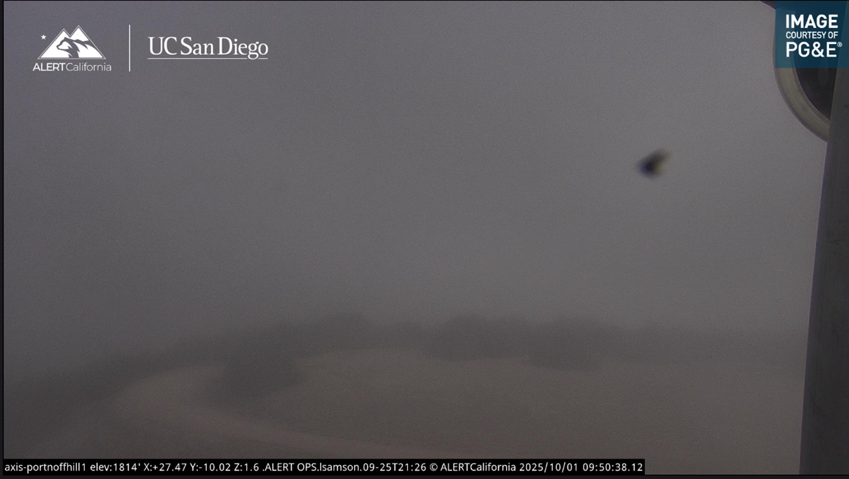
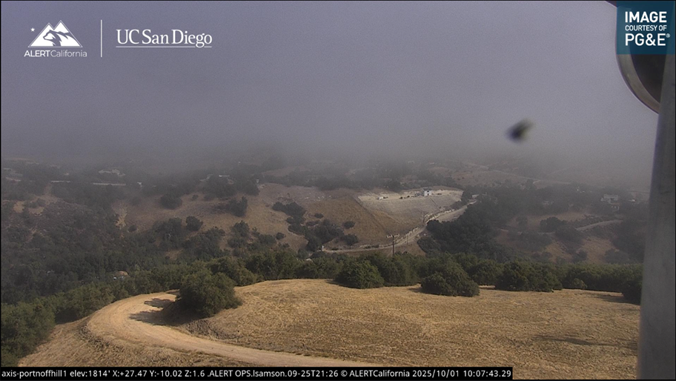
Paso Robles Municipal Airport Example: 01 OCT 2025
METAR KPRB 011653Z AUTO VRB03KT 10SM OVC005 16/13 A3011 RMK AO2 SLP193 T01560133

Slide 25
Paso Robles Municipal Airport Example: 01 OCT 2025
Obscuration Risk Assessment
Distance to ASOS/AWOS | Cloud layers | Mesonet RH > 98% | Mesonet RH > 95%
Less than or equal to 10 SM | Ceiling and/or an additional BKN or OVC layer within 200 feet of the Mesonet altitude | Very High | High
Less than or equal to 10 SM | Ceiling and/or an additional BKN or OVC layer within 500 feet of the Mesonet altitude | High | Moderate
Less than or equal to 20 SM | Ceiling and/or an additional BKN or OVC layer within 200 feet of the Mesonet altitude | High | Moderate
Less than or equal to 20 SM | Ceiling and/or an additional BKN or OVC layer within 500 feet of the Mesonet altitude | Moderate | Caution
 | Multiple ASOS/AWOS comparisons in the Very High-risk category. | Extreme
METAR KPRB 011653Z AUTO VRB03KT 10SM OVC005 16/13 A3011 RMK AO2 SLP193 T01560133
KPRB @ 810 Feet MSL (Station Elevation)
KPRB Ceiling @ 500 feet AGL
KPRB Ceiling @ 1310 feet MSL
PG532 @ 1560 feet MSL (Station Elevation)
250 feet from KPRB ceiling
PG532 @ 100% RH
PG532 distance from KPRB: 6.6 NM

Slide 26
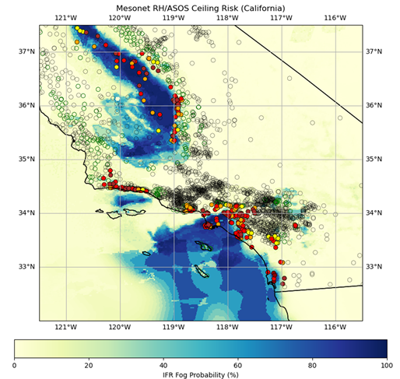
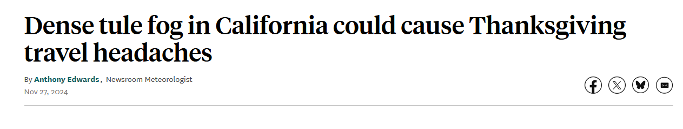
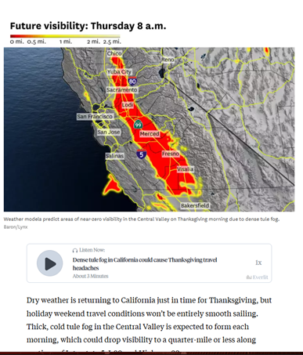
TULE FOG EVENT (RISK ASSESSMENT)
'IFR Fog Probability (%) from the ABI-L2-GFLSC GOES 18 data

Slide 27
Second side of the coin: “Gustiness”

Slide 28
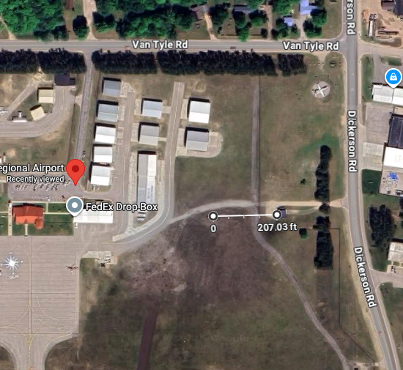
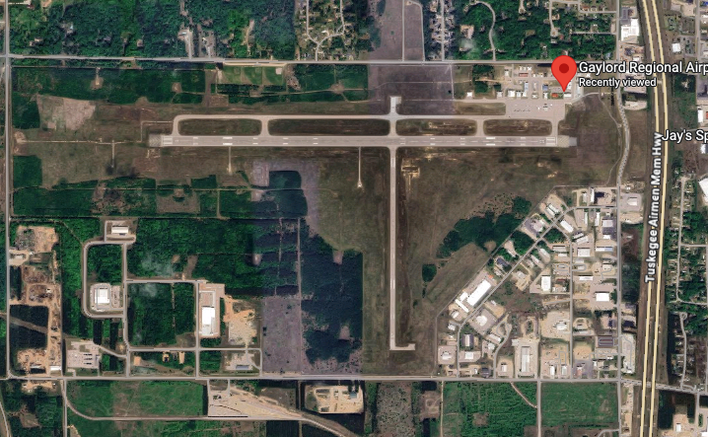
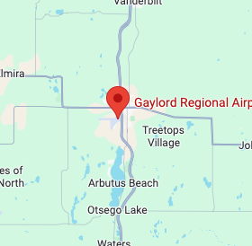
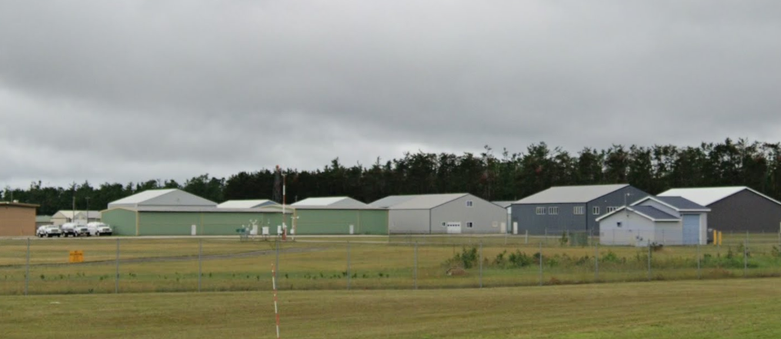
Gaylord Regional Airport (KGLR) ASOS
KGRL
Quote from A pilot forum
June something, 2005. Arriving at KGLR after my one and only VFR-into-IMC encounter. The AWOS reported OVC025. No freaking way. It was more like OVC014 or so and felt like scud running, given that I didn't know the area very well.
Ceilometers are subject to a number of different errors, depending on the type, and the wind is notorious for changing and can be 180 degrees different from one end of the field to the other. No question, AWOSs lie: take them with a grain of salt.
ASOS

Slide 29
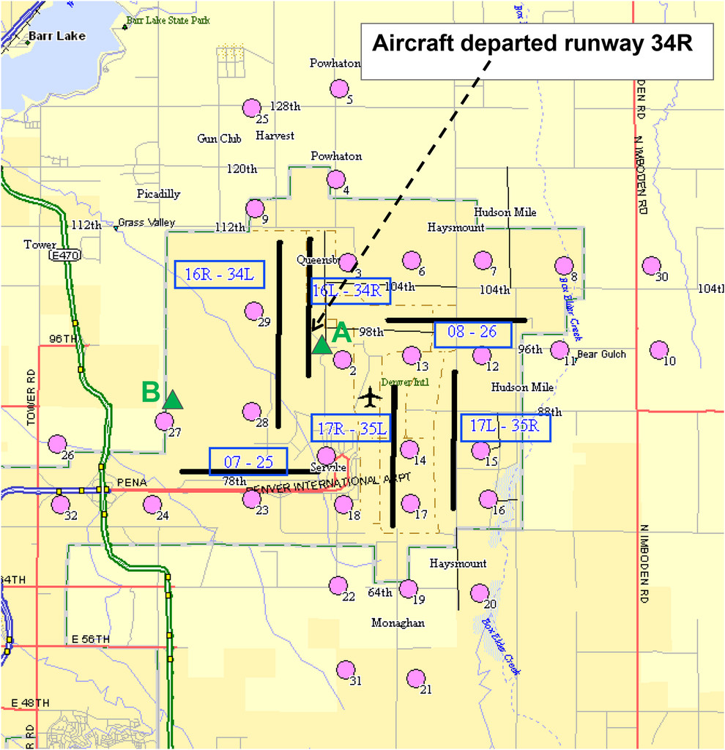
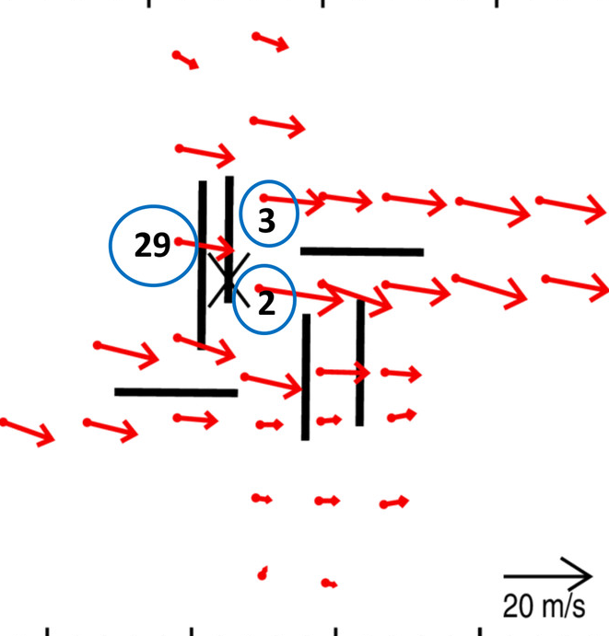
Wind Representativeness (Extreme Event)
Fig. 2. Schematic of the DIA property. Black lines represent the runways, and the corresponding runway numbers are indicated in the blue boxes. Runways are numbered according to their approximate magnet heading (divided by 10). Thus runways 34L and 34R, which are oriented approximately north–south (351.5° magnetic), refer to the southern end of the two parallel runways (left and right) marked 16R-34L and 16L-34R. Pink circles indicate the locations of the 32 LLWAS wind sensors. WSSDM surface stations are marked by the green triangles. The approximate location at which the aircraft departed runway 34R is indicated by the arrow.
NCAR’s Weather
Support to Deicing Decision Making (WSDDM)
From: Keller TL, Trier SB, Hall WD, Sharman RD, Xu M, Liu Y. Lee Waves Associated with a Commercial Jetliner Accident at Denver International Airport. J. Appl. Meteor. Climatol.. 2015;54(7):1373-1392. doi:10.1175/JAMC-D-14-0270.1

Slide 30
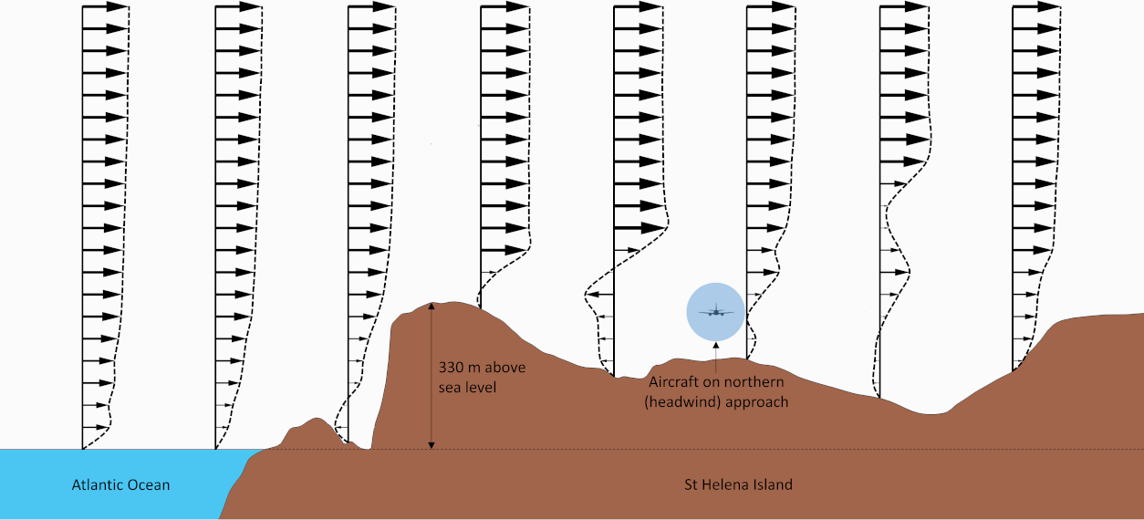
Modeling Assessments: Nearby Orography

Slide 31
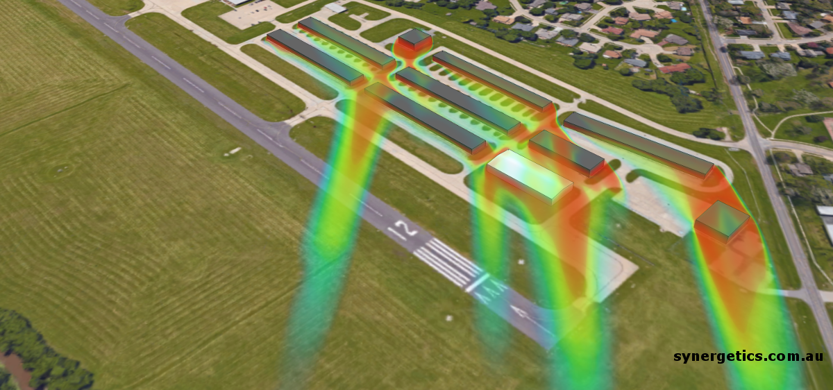
Modeling Assessments: Nearby Buildings

Slide 32
NASA ASRS: Mechanical Turbulence/Airports
ASRS Report Number | Location | Date | Relevant Report Text
1960621 | Unknown | 12/2022 | “This airport is known for rogue gusts as it sits on a hill with the south side of the runway having rising terrain, which seems to create gusts at the numbers on [the] Runway XY approach.” “Much of the time AWOS reports variable wind instead of a direction because it is varying anywhere from 20–40 degrees.”
1911945 | Unknown | 06/2022 | “There are buildings (and the helicopter pad) to the immediate north-east of the runway. Given wind direction, it is likely that the first part of the runway had stable winds, but the latter part of the runway had more abnormal gusts and eddies caused by wind at the time flowing over those structures.”
1910295 | Unknown | 06/2022 | “The gusty conditions interacting with the large buildings of the city led to downdrafts and mechanical turbulence that kept sucking us down as we tried to climb.”
1887173 | Unknown | 03/2022 | “I think it’s possible that the wind that we experienced was higher than what was reported; or possibly the direction of the wind, coming through the hangars and other airport buildings, might have introduced wind shear at the worst possible point in our landing.”
1864945 | Unknown | 12/2021 | “The east side of the airport is where the control tower, some hangars, and trees are. With the winds being out of the east it makes me wonder if we had a weird gust of wind mixed with some mechanical turbulence.”
1760076 | Unknown | 08/2020 | “I wonder if there could be a connection between the CRJ holding short, perpendicular to the numbers and the easterly, variable winds--possibly generating a unique mechanical turbulence which caused the rapid decay in descent so close to the runway”
Splitt, M., & Lazarus, S. (2025). Gust Factors in Aerodrome Weather and Climate Assessment. Meteorology, 4(3), 24.

Slide 33
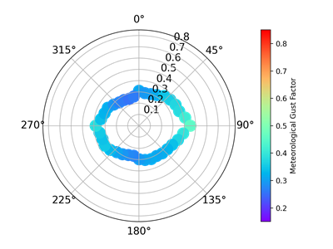
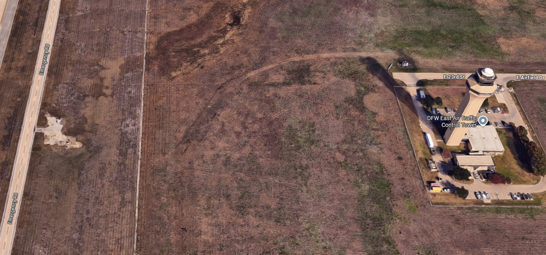
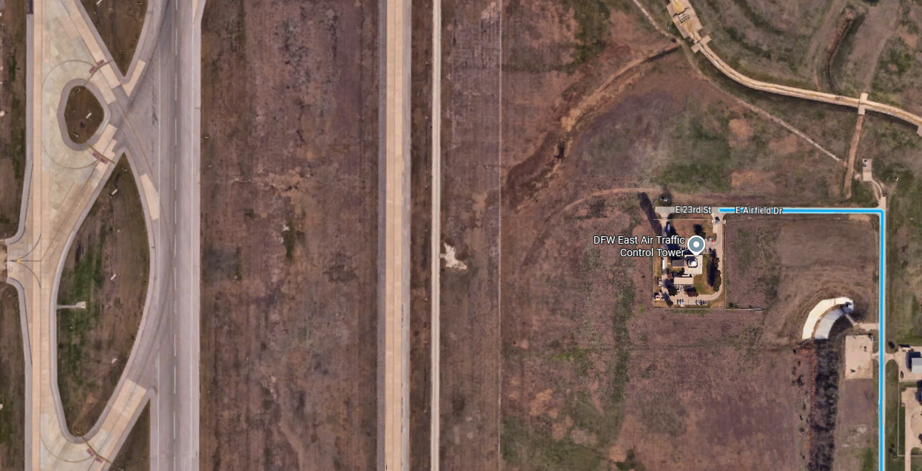
ASOS location at KDFW
Splitt, M., & Lazarus, S. (2025). Gust Factors in Aerodrome Weather and Climate Assessment. Meteorology, 4(3), 24.

Slide 34
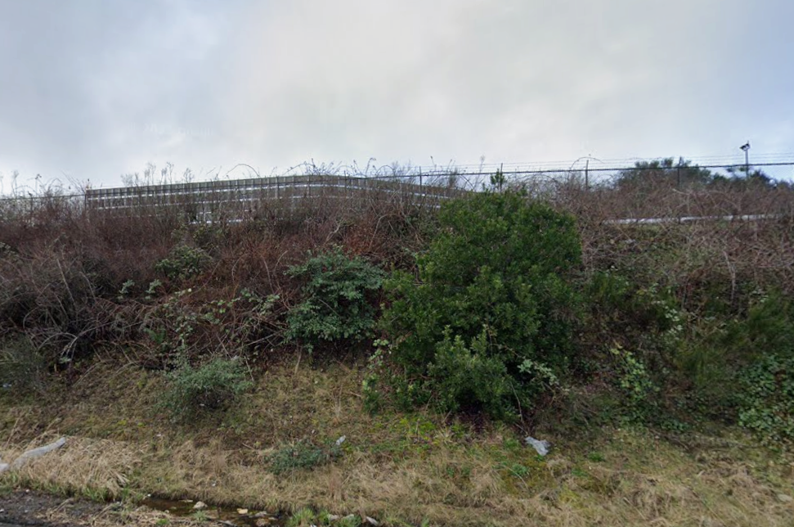
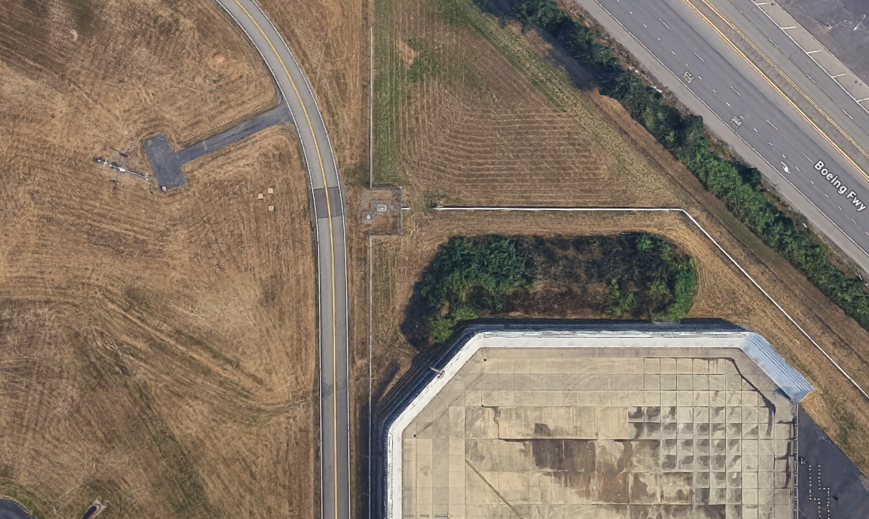
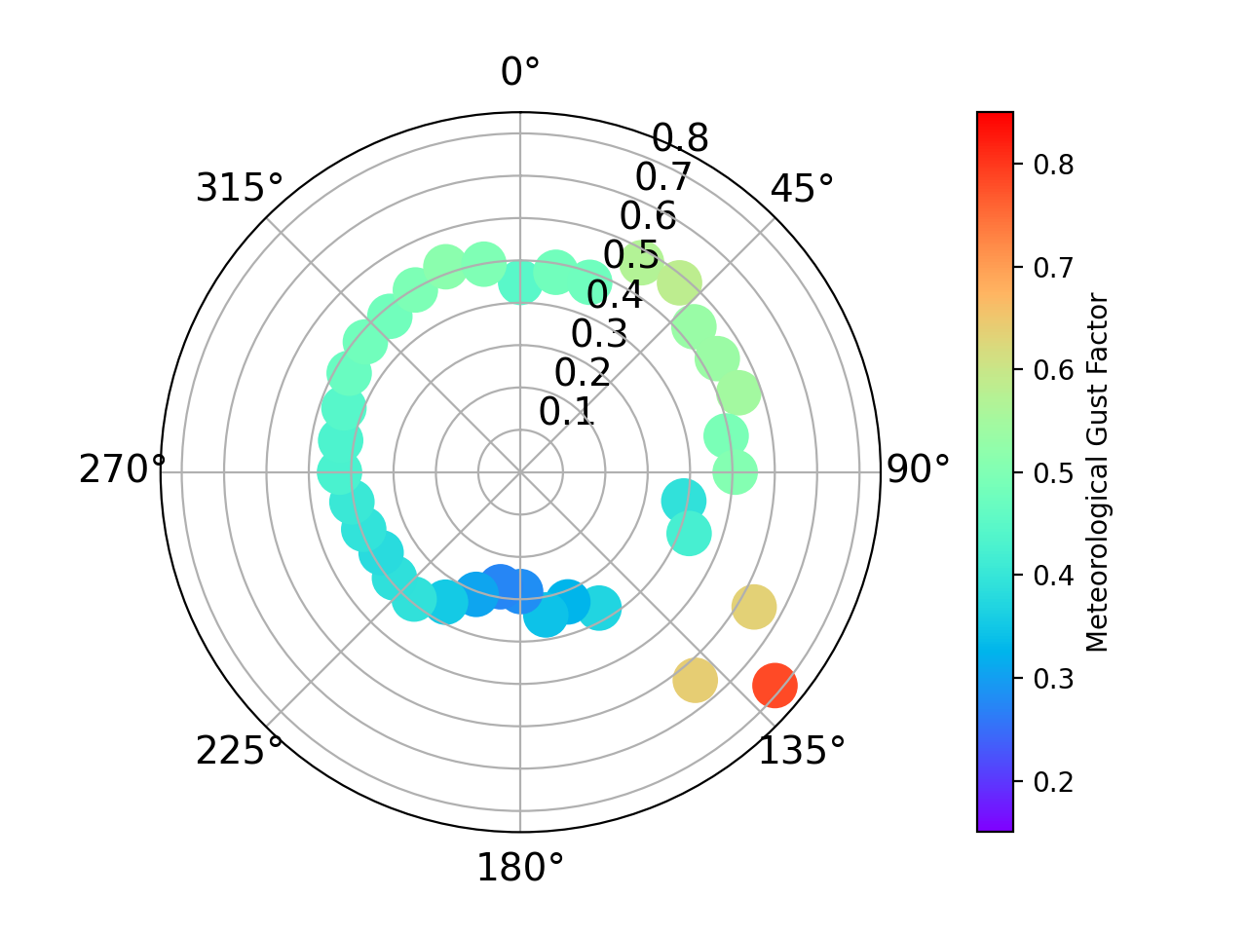
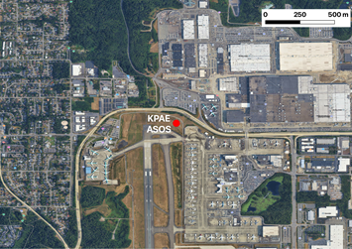
Problematic ASOS location at KPAE
Splitt, M., & Lazarus, S. (2025). Gust Factors in Aerodrome Weather and Climate Assessment. Meteorology, 4(3), 24.

Slide 35
Problematic ASOS location at KPAE
gust values: no filtering (blue box), 5+ kt (green triangle), 10+ kt (purple downward triangle), 20+ kt (red plus), and 25+ kt (black circle).
Splitt, M., & Lazarus, S. (2025). Gust Factors in Aerodrome Weather and Climate Assessment. Meteorology, 4(3), 24.

Slide 36
Moving forward?
• GFmet is sensitive to local obstructions ranging from small nearby airport equipment and small buildings to larger generalized areas of mixed airport-related development. While the unfiltered GFavn is less sensitive to local obstructions, there are cases of impactful obstructions that can mask higher gusts observed by aviators than are reported by the ASOS. The directional representativeness or quality of the gust information could be provided to aviators as a caveat for better situational awareness. Databases of directionally dependent surface roughness at ASOS locations, such as those by Masters et al. [20], have been created in the past and reflect the importance of site-specific guidance;
• An assessment of an ASOS relocation indicated that directional variation in GFmet was impacted (altering the peak gust direction from west to east) while being largely preserved for GFavn; however, the magnitude increased in most directions. This indicates that the unfiltered GFavn may be more representative of the larger-scale roughness and/or meteorologically driven gust events. Information regarding the impacts of ASOS location changes is not readily available to the aviation community.
Splitt, M., & Lazarus, S. (2025). Gust Factors in Aerodrome Weather and Climate Assessment. Meteorology, 4(3), 24.

Slide 37

METAR Element Poll: Best Case/Worst Case
Element | Hyperlocal | To 5SM | To 10SM | To 15SM | To 20SM | To 25SM | >25SM
Wind
Cloud Layers
Visibility
T/DP
Altimeter
TSRA
BR/FG
HZ
FU

Slide 38
METARs and Representativeness
Representativeness can differ by variable (and by season)
Gustiness can be extremely localized
Cloud information can represent a wide area
Altimeter can be representative for how far?
“The current reported altimeter setting of a station along the route and within 100 nautical miles of the aircraft”
Temperature/Dew Point
Present weather varies (FG vs. TSRA)
Representativeness can vary directionally
Orography, land cover, land use (localized to more regional)
Can we create some useful guidance for aviators?

