Slide 1
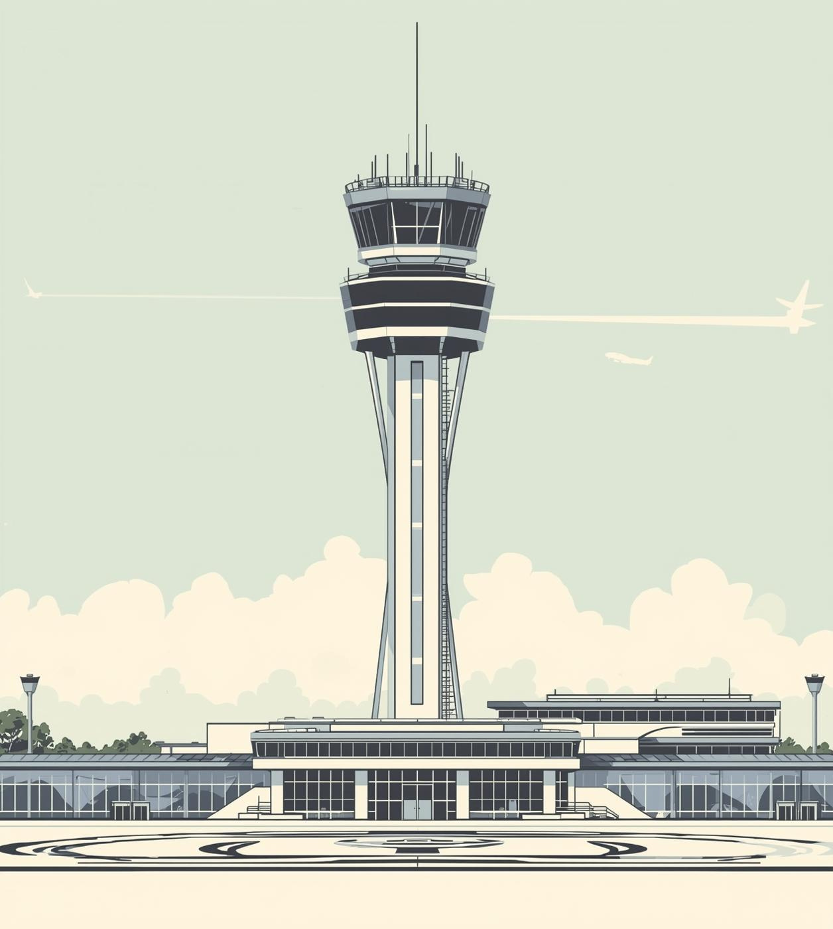

METAR Wind Observation Gaps
Understanding METAR wind observation gaps at airports
Bryan Beck
OCTOBER 2025

Slide 2

Understanding METAR Wind Reports
METAR wind observations are critical for flight operations, providing only a snapshot of wind conditions measured at an airport. Key limitations include averaging periods and rounding conventions, which may not fully represent the actual wind environment encountered by aircraft during operations.

Slide 3
Known METAR Wind Gaps
Spatial Gaps
Spatial gaps arise when wind measurements fail to represent conditions across the entire airport, leading to misleading data for pilots during critical operations.
Temporal Gaps
Temporal gaps result from the 2-minute averaging period, which may not reflect sudden wind shifts that can occur rapidly, impacting safety during takeoff and landing.
Altitude Gaps
Altitude gaps occur due to single sensor locations, which may not account for varying wind conditions at different heights, creating potential hazards for aircraft maneuvering.

Slide 4
Known METAR Gaps: Automation and Geographic
Automation Gaps
Automation gaps arise from insufficient sensor coverage and reliance on a singular data point, leading to incomplete wind information during critical operational periods.
Geographic Gaps
Geographic gaps in METAR reporting occur due to the variability of terrain, which can cause significant discrepancies in recorded wind data across nearby locations.
Operational Impact
The impact of these gaps on wind reporting accuracy is profound, potentially compromising flight safety and operational decision-making due to misleading information during critical phases of flight.

Slide 5
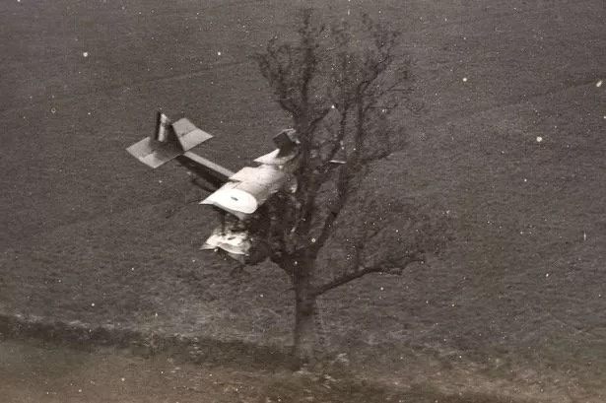
Is it safe to land?
-Rob Campbell, Campbell Scientific

Slide 6
Representative NTSB Cases on Wind Gaps
Microburst
DAL191 DFW
The dangers of inadequate sensors, where misjudged wind patterns led to catastrophic outcomes, emphasizing the need for comprehensive wind monitoring systems.
Terrain
COA1404 DEN
Wind readings caused by complex terrain resulted in critical flight safety issues,
Examining critical safety incidents linked to wind observation limitations
Numerous aviation accidents have underscored the significant operational risks associated with wind observation gaps.
Wind Gusts
N115WF ASE
WInd gusts and crosswinds severely impacted flight operations, reinforcing the importance of accurate and timely METAR data

