Slide 1
FPAW Fall 2025
Steamboat Surprise!
Adventures in Mountain
Flying
Captain Christian Amaral
Air Traffic Safety Group

Slide 2
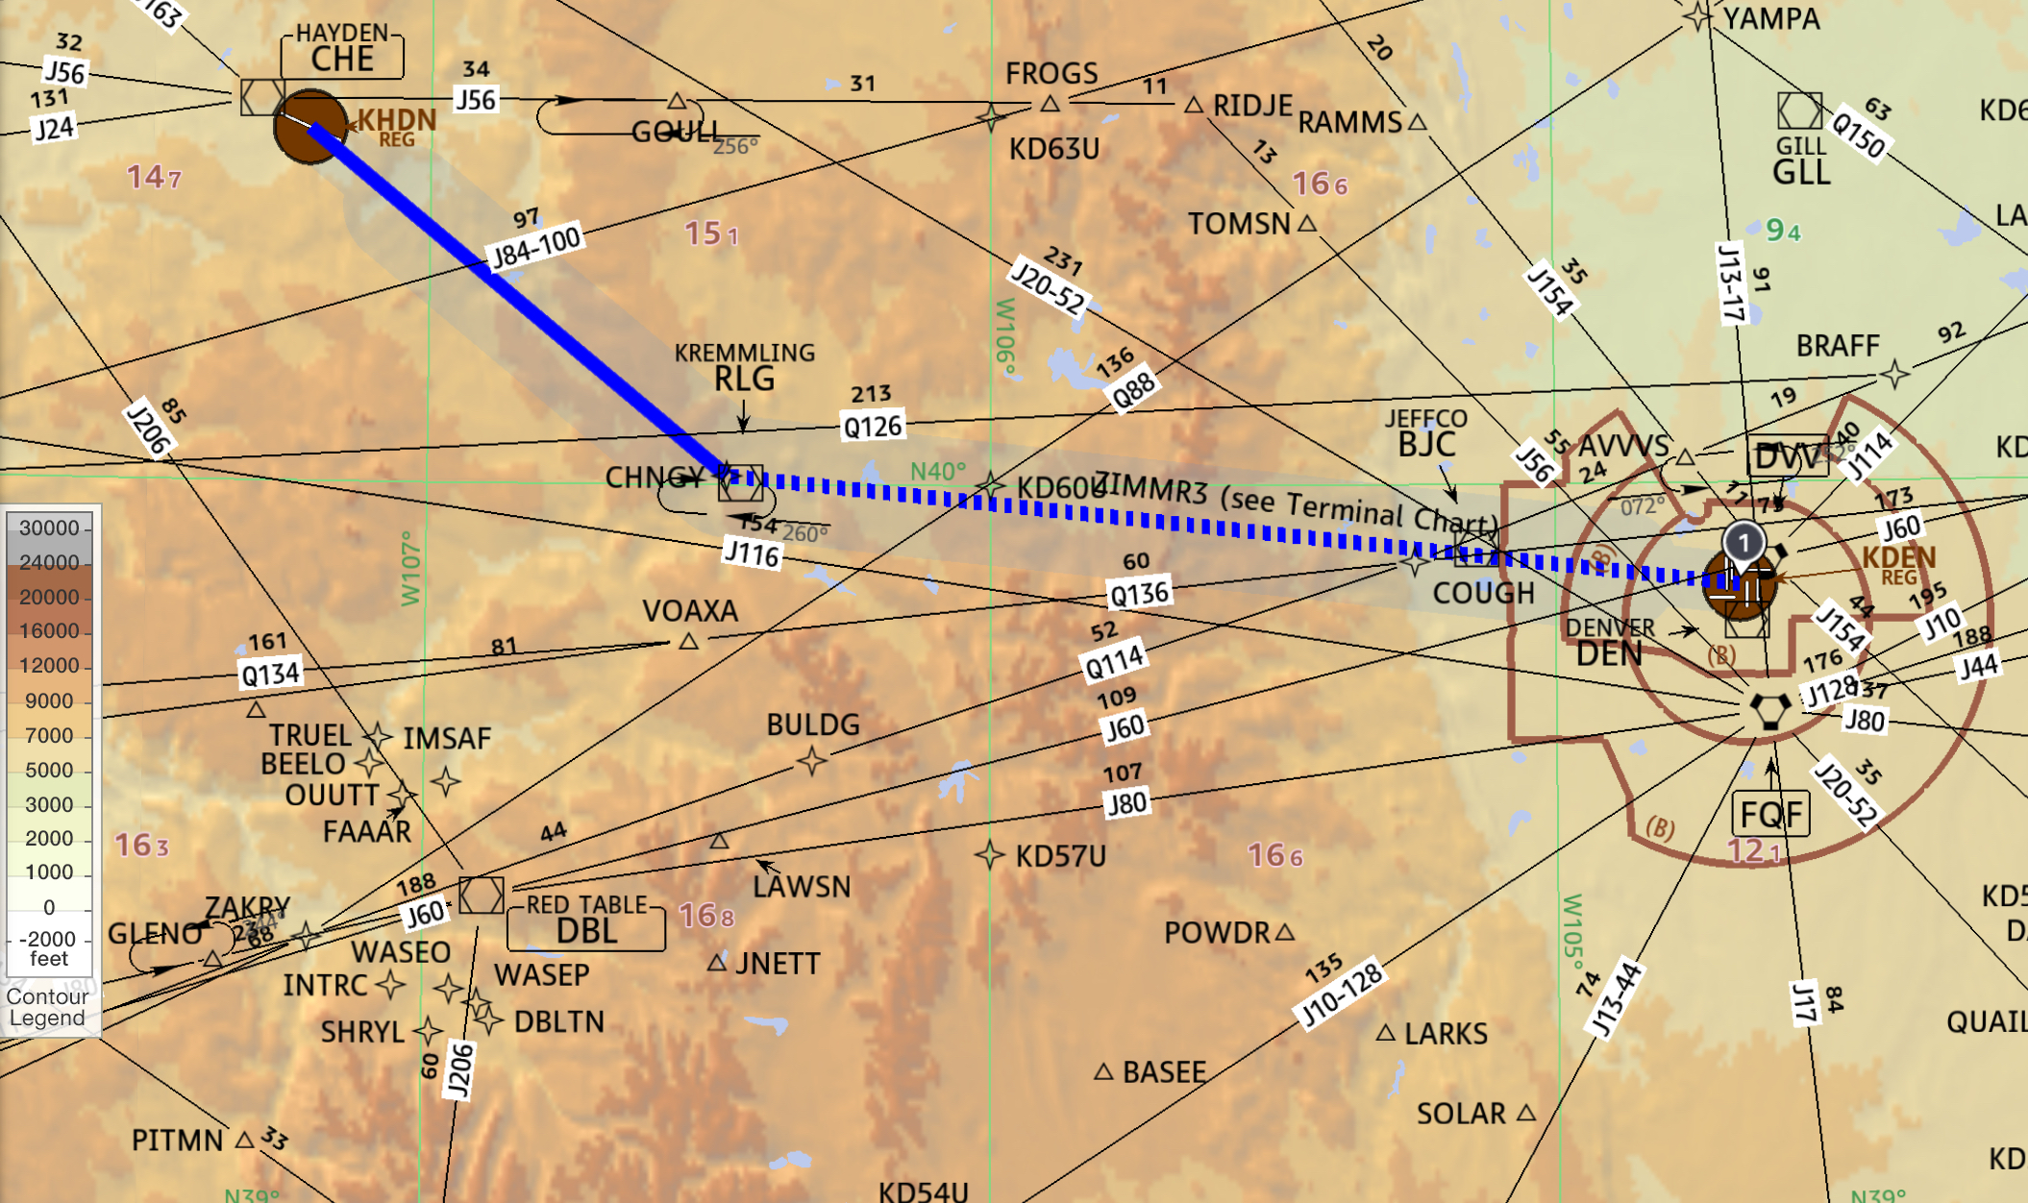
A Tale of Two Approaches – KDEN-KHDN
ATS Group

Slide 3
Threats
  26-minute flight!
  Complex nighttime approach
  Terrain
  Fatigue
  Uncontrolled field – “black box”
  Snowy conditions/contaminated runway
  High density altitude/high energy approach
  New hire F/O
  Confirmation bias
  Dynamic mountain weather
ATS Group

Slide 4
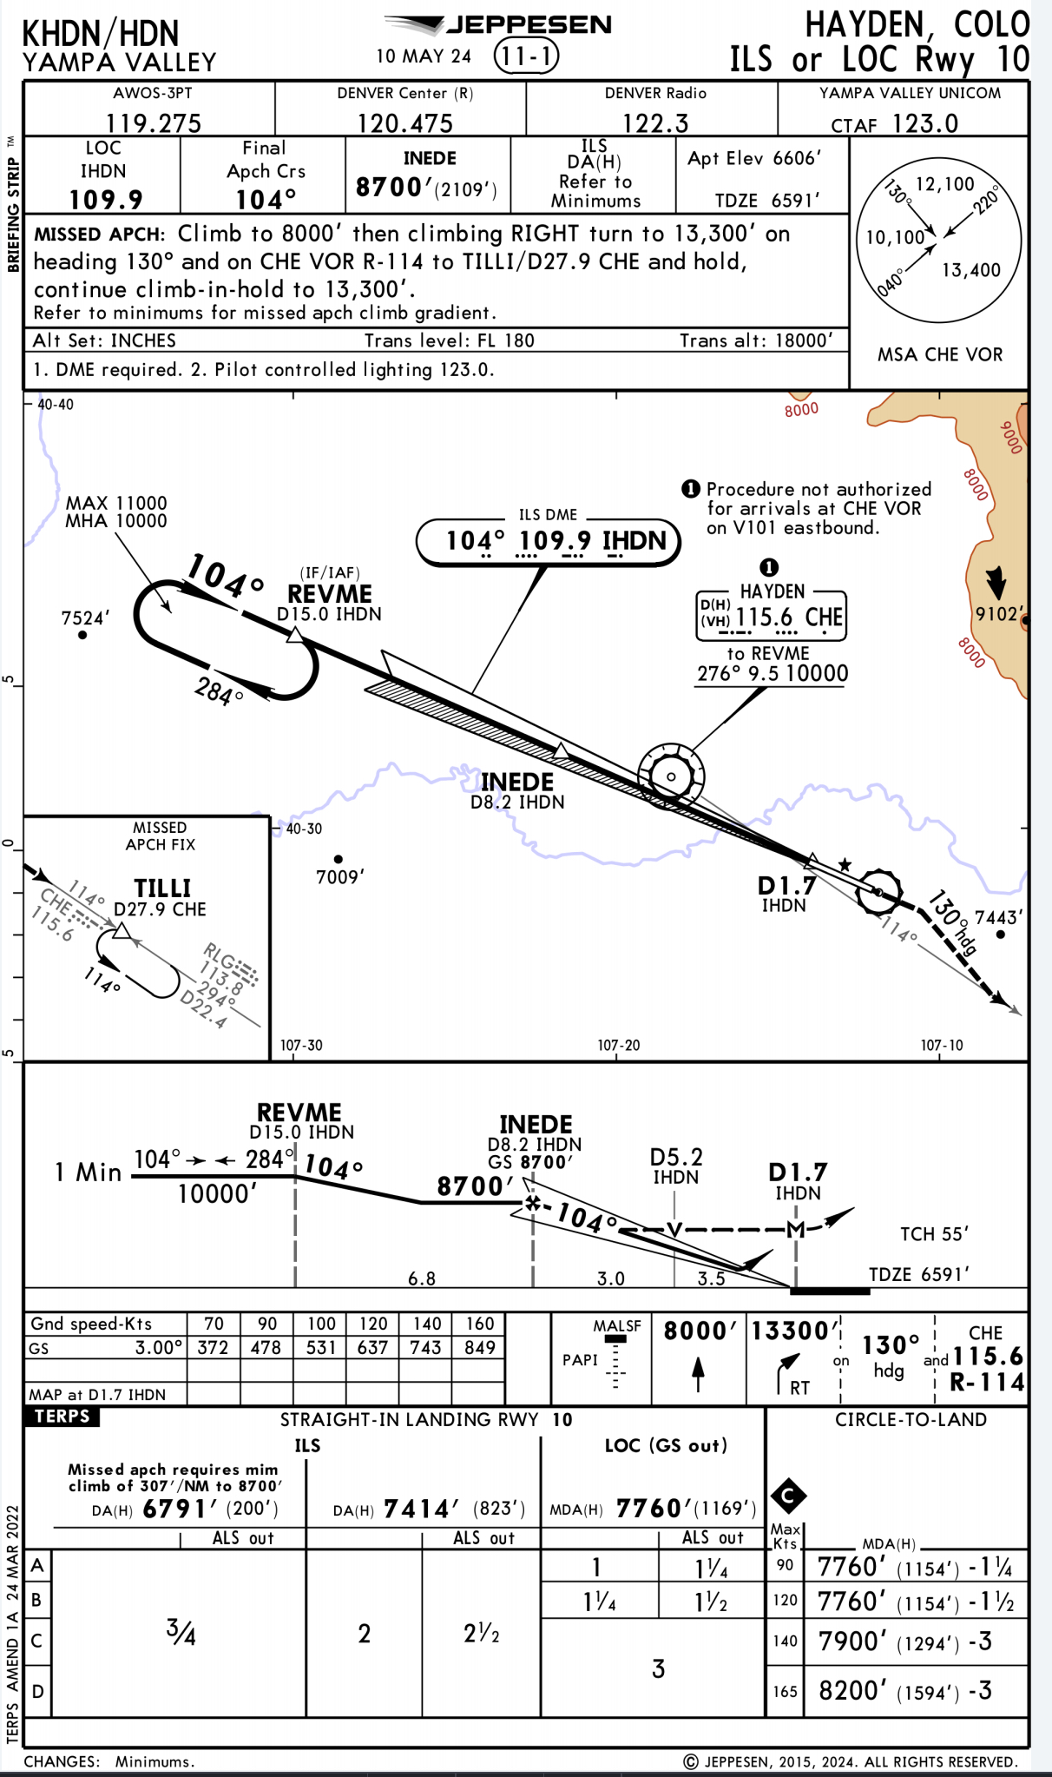
Great Expectations – January 2022
TAF and METAR suggest ILS to runway 10 👍
AWOS service volume small due to terrain
Actual AWOS: KHDN Wind 300/15G22 3SM –SN BKN010 -02/-05 A3022 ‼️
ATS Group

Slide 5
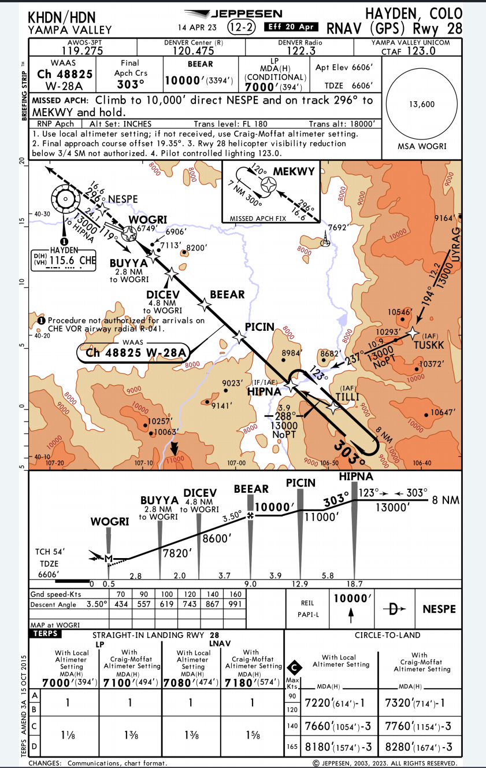
Offset
High descent angle
High vis required to initiate
AND, suddenly…
  Very high energy (~6k’ high and fast)
  Behind on workload
With experience and a plan B, success
ATS Group

Slide 6
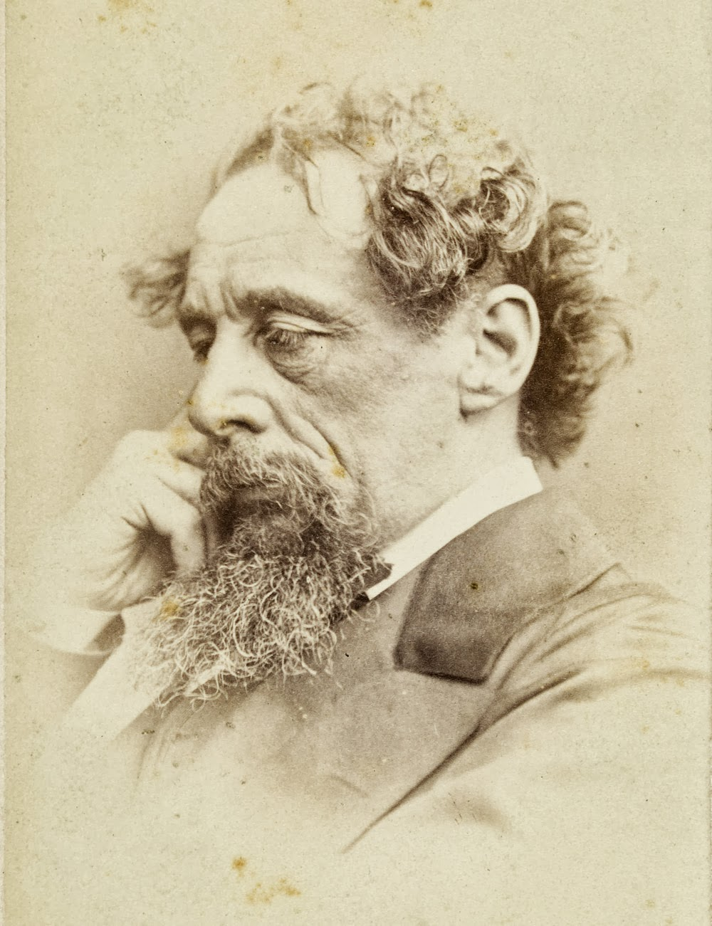
Debrief
NEEDS
  Real-time(ish) datalink wx
    Wx Needs Portal input
  RTMA and VEIA to fill gaps?
    RTMA useful for temp and pressure (FAA InFO 24001) when METAR not reporting
    Visibility Estimation through Image Analytics*
    Update Jepp company pages to let pilots know about these resources
(In the meantime…assume the worst)
This Photo by Unknown Author is licensed under CC BY-ND
ATS Group

Slide 7
Please sir, I want some more – December 2024
TAF and METAR suggest RNAV/GPS 28
Around TOD and planning accordingly, AWOS agrees 👍
KHDN Wind 260/10 3SM BKN013 -01/-05 A3011
And yet…
  No runway at minimums!
SOP (i.e. G/A) is backstop, but confirmation bias is dangerous
  (e.g. UPS in KBHM, Citation in San Diego)
Upshot
  Execute published missed, contact ZDV, assess fuel, re-tune AWOS (reporting roughly same wx as previously), re-brief and get in on second attempt 😮‍💨
ATS Group

Slide 8
Debrief
NEEDS: RNP approach with RF legs and lower mins (Weather Needs Portal?)
Mountain weather is very dynamic
  Beware expectation bias
This Photo by Unknown Author is licensed under CC BY-ND
ATS Group

Slide 9
Conclusion
Safety begins with good TEM to enable good decisions, which – particularly in challenging environments – depends on accurate, timely information.
ATS Group

