Slide 1
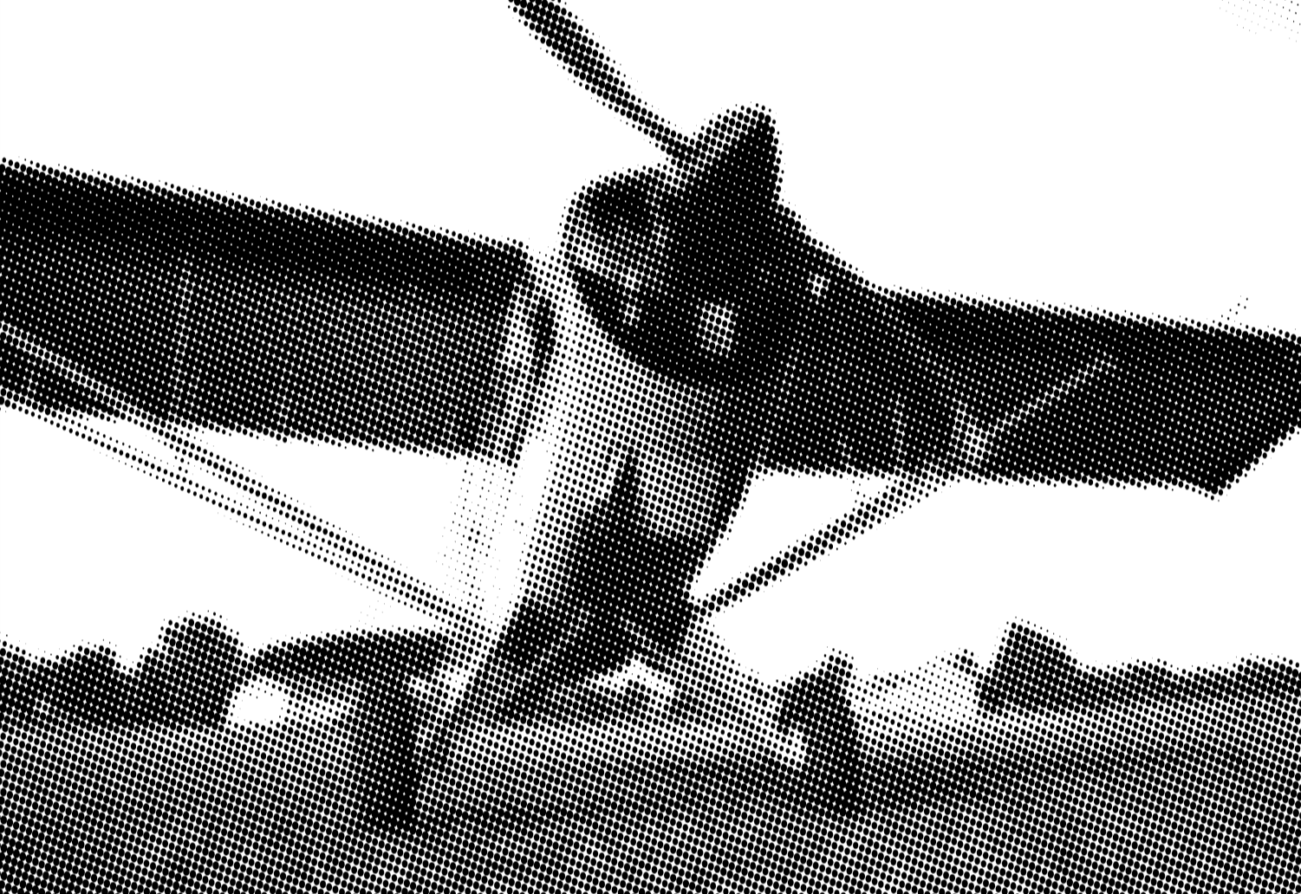

Flying in complex weather: VFR Alaska example
October 9, 2025
Tom George
AOPA Alaska Regional Manager
Aircraft Owners & Pilots Association

Slide 2
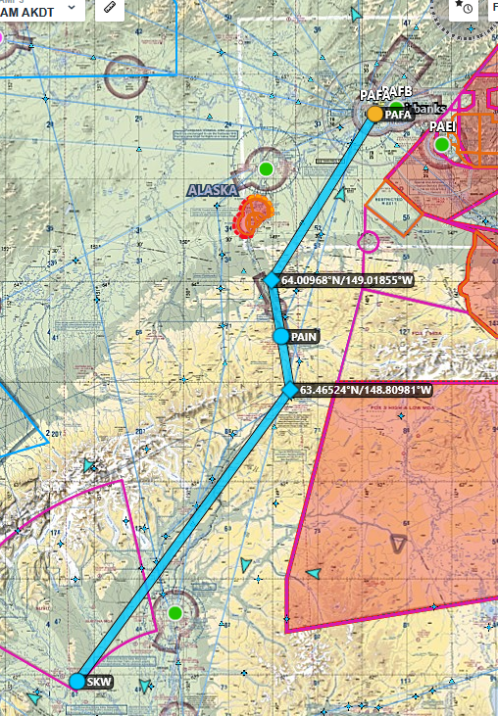
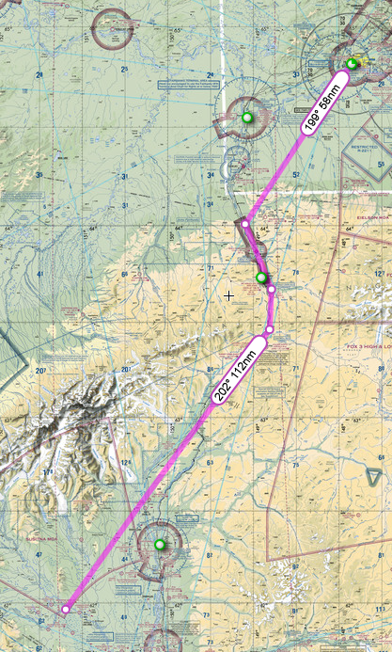
Pafa skw 9/03

Slide 3
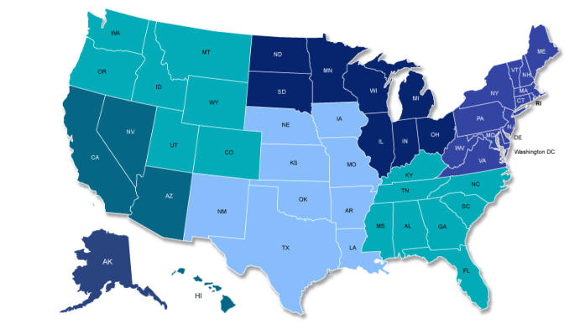
Putting Alaska in Perspective

Slide 4
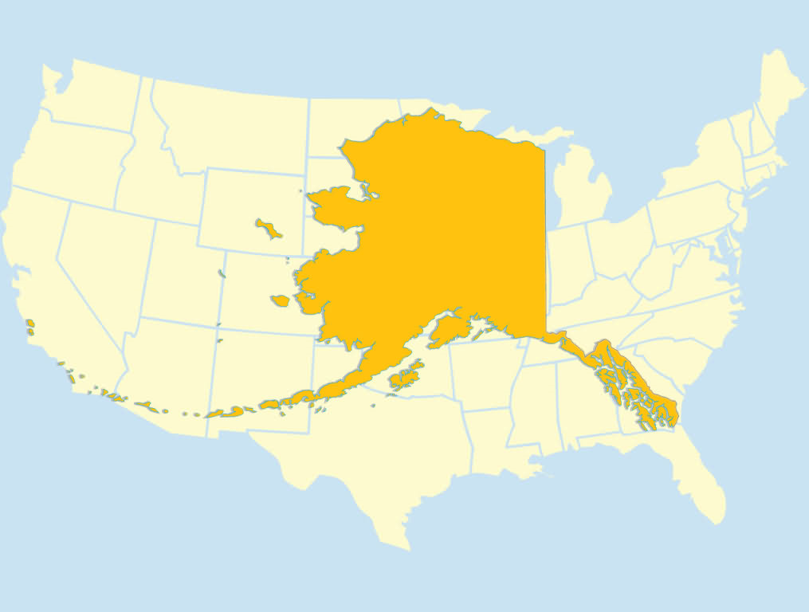

Slide 5
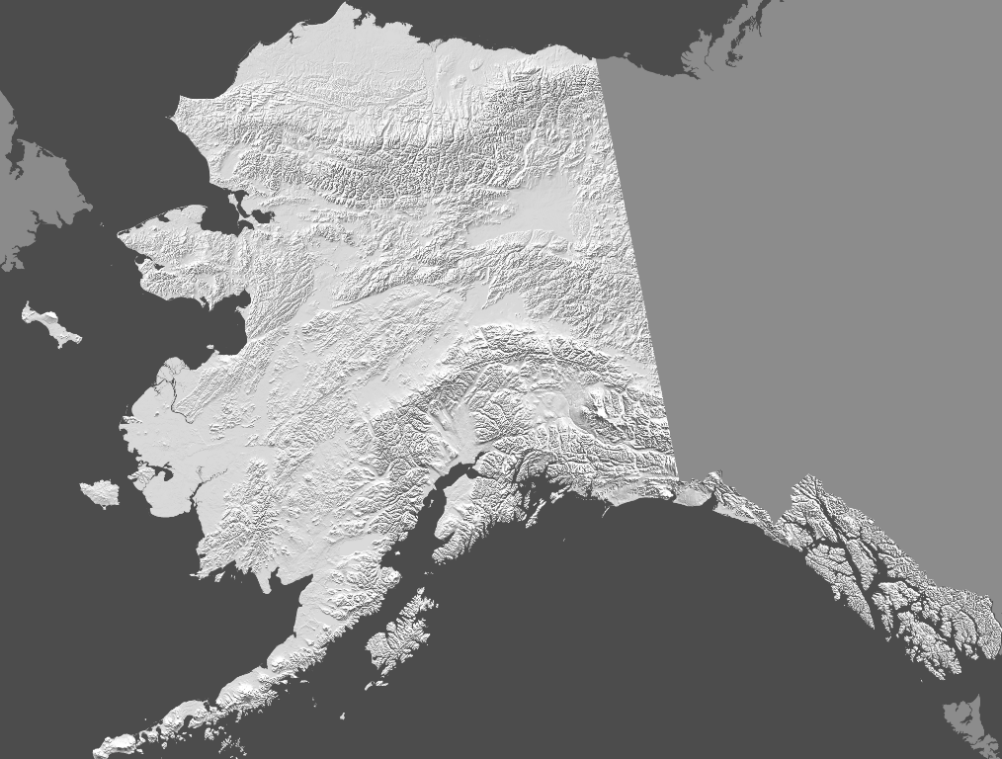

Slide 7
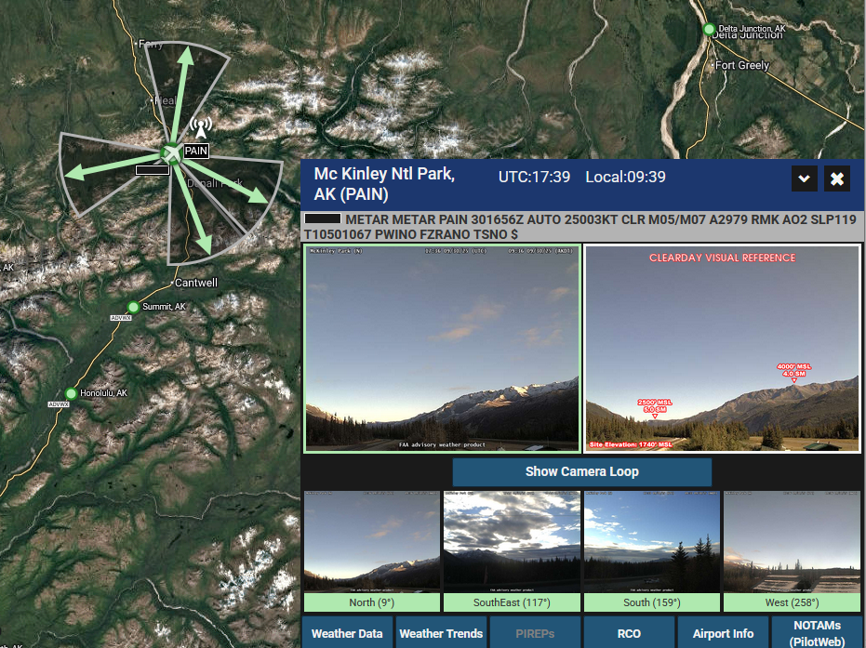

Slide 8
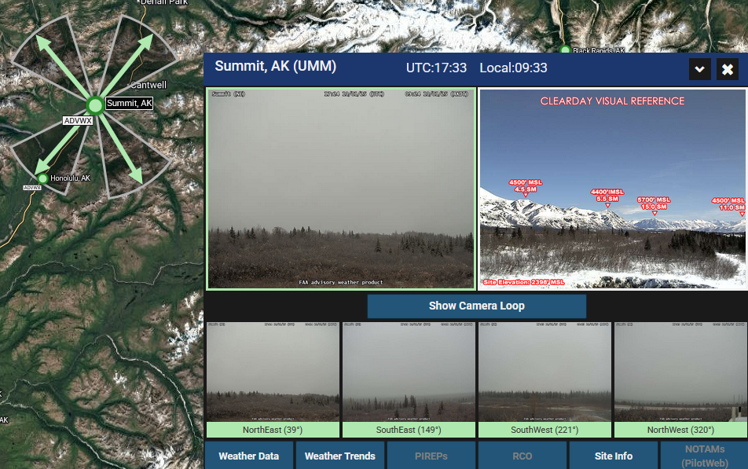

Slide 10
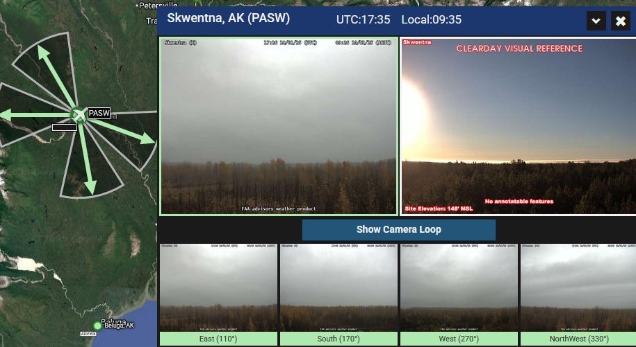

Slide 11
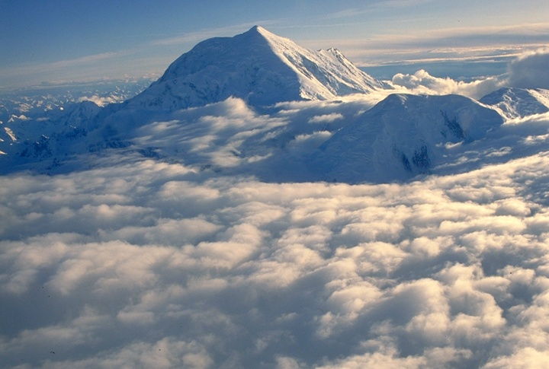
Background on Weather Cameras

Slide 12
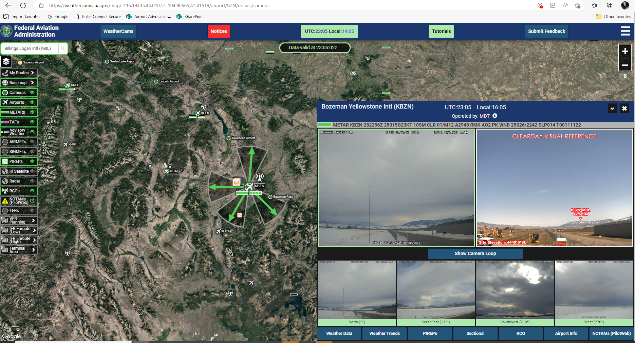
FAA Weather Cameras
https://weathercams.faa.gov/
Notes:
We have enjoyed these in Alaska for more than 20 years, but are now a new tool in the CONUS.
Locations typically have 3-4 cameras, posts images every 10 minutes, provides loop to review last 6 hours. Other features added such as airport info, METARs and PIREPs.

Slide 13
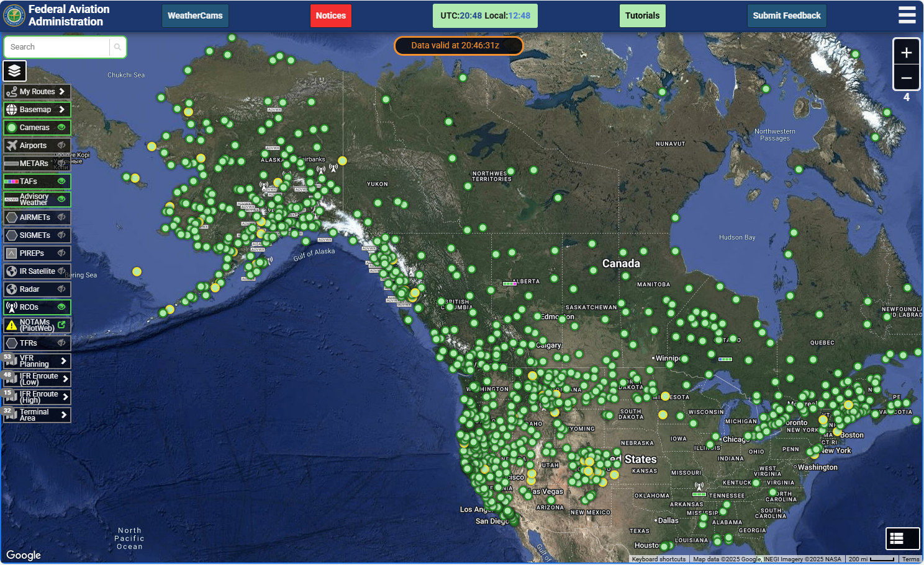
Growing network of stations
Started in Alaska
Expanding across the country
Includes FAA and third party hosted sites
Notes:
Started as a grad student project at University of Alaska Fairbanks, with three camera sites, in 1999. 160 new camera locations planned across the country over the next 5+ years.

Slide 14
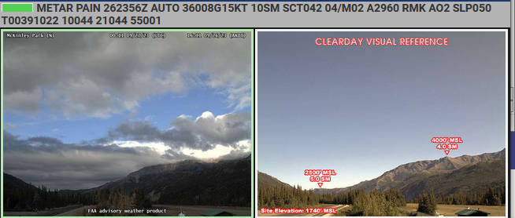
Compare current with annotated clear-day image

Slide 15
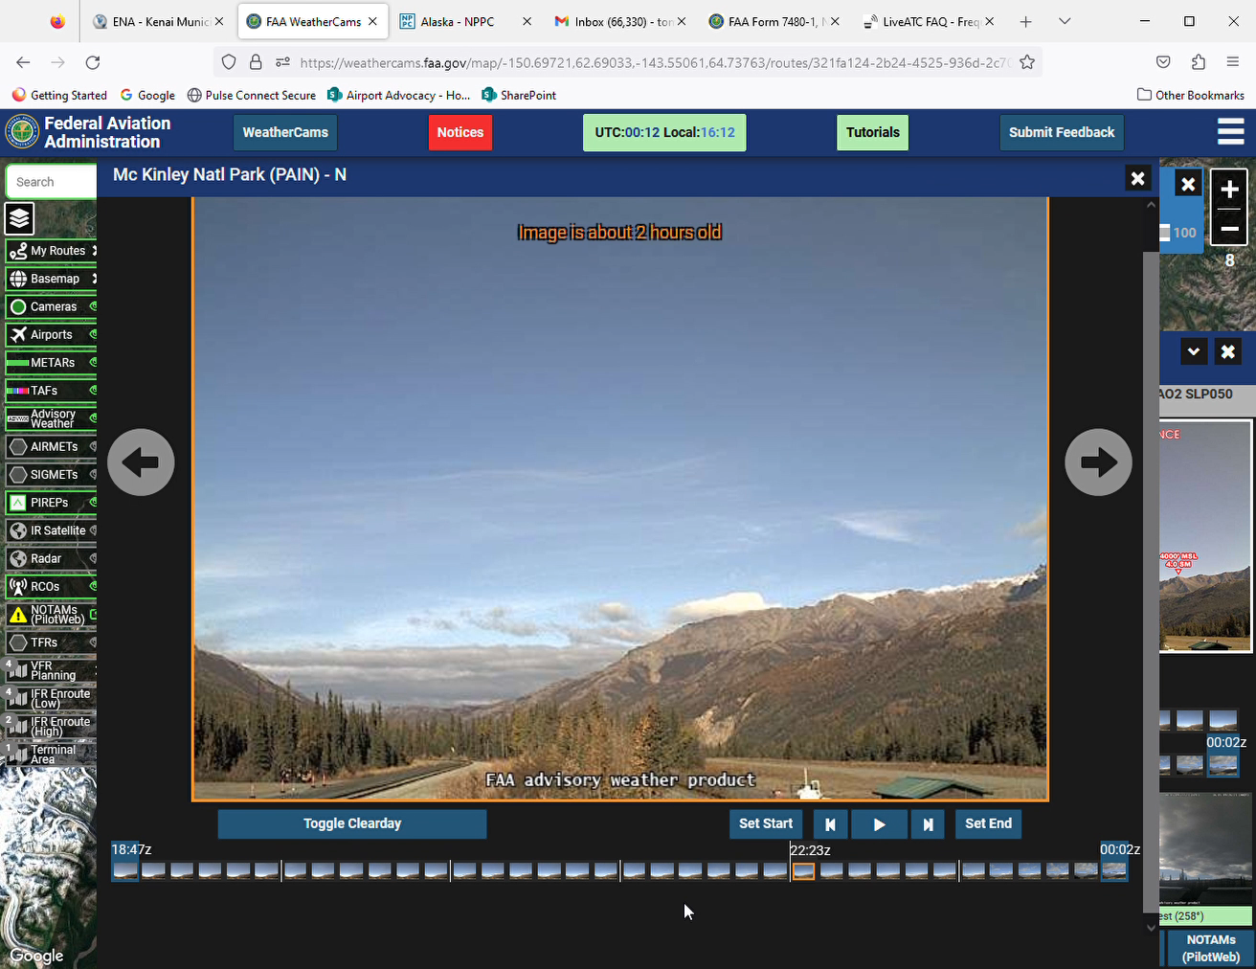
Wx Trends
Video loop
Six-hour lookback

Slide 16
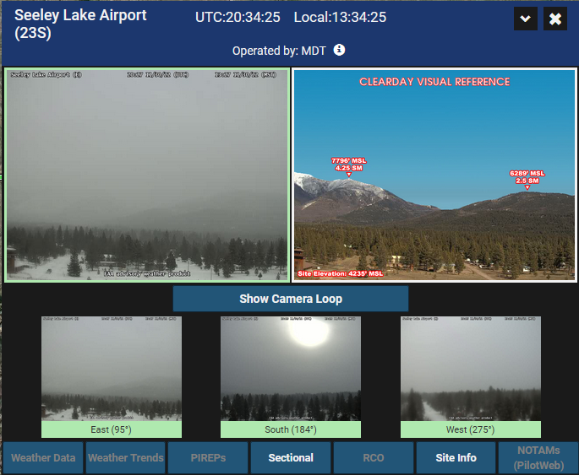
Stand-alone camera
This case shows sky condition and visibility based on reference features alone

Slide 17
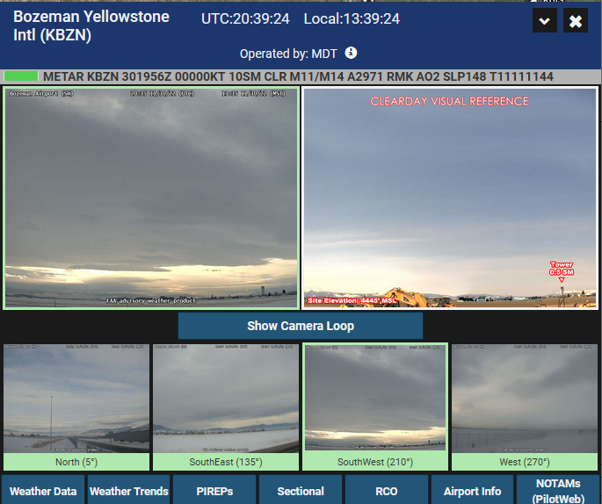
Supplements METARs
In contrast to the METAR alone, the weather camera paints a broader picture.
METAR reports sky clear
Notes:
Not here to bash AWOS or ASOS units. They are machines with limitations. Wx cameras complement them.

Slide 18
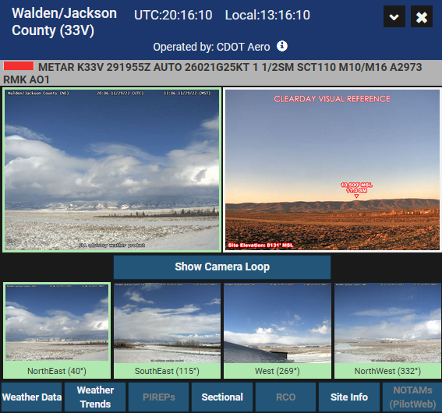
Supplements METARs
Visibility from METAR is 1.5, yet can see base of hills about 10 miles away
Most likely particles of blowing snow were being recorded by the AWOS visibility sensor
Notes:
Suspect that blowing snow was tricking the AWOS into thinking visibility was reduced.

Slide 19
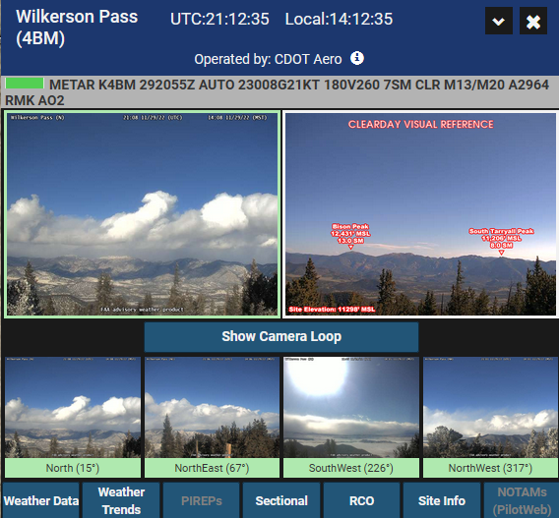
Supplements METARs
The cameras add information not contained in a text weather report
While no clouds over the sensor, distant clouds show in all directions
Notes:
Clouds outside the range of the AWOS sensors: cameras help fill in the weather picture.

Slide 20
Tom George
Tom.George@aopa.org
907-388-9955

