Slide 1

FLYING THE FORECAST
Weather Conversations with a Pilot

Slide 2

Bryce Moore
Chief Pilot, Campbell Scientific
Utah State University: Student Pilot – CFI
  Aviation Technology; Professional Pilot, Fixed Wing
SkyWest Airlines: First Officer – Captain
  Designated Mountain Assigned Pilot Program

Slide 3
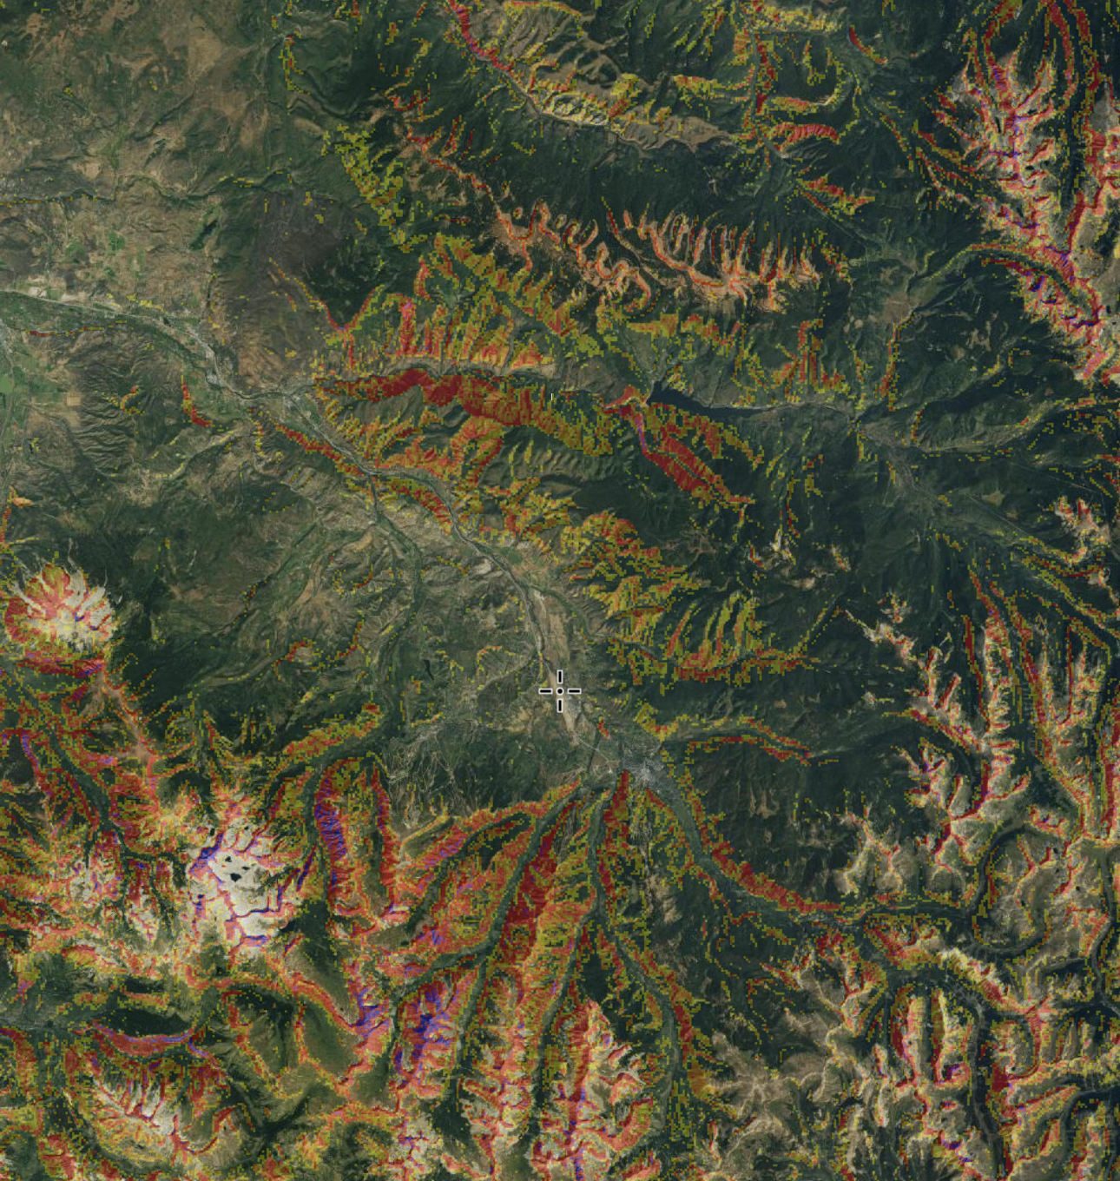
Aspen, CO
Elevation: 7,840’
Rwy Length: 8,000’
Notes:
  “One way in, one way out”
  Don’t miss

Slide 4
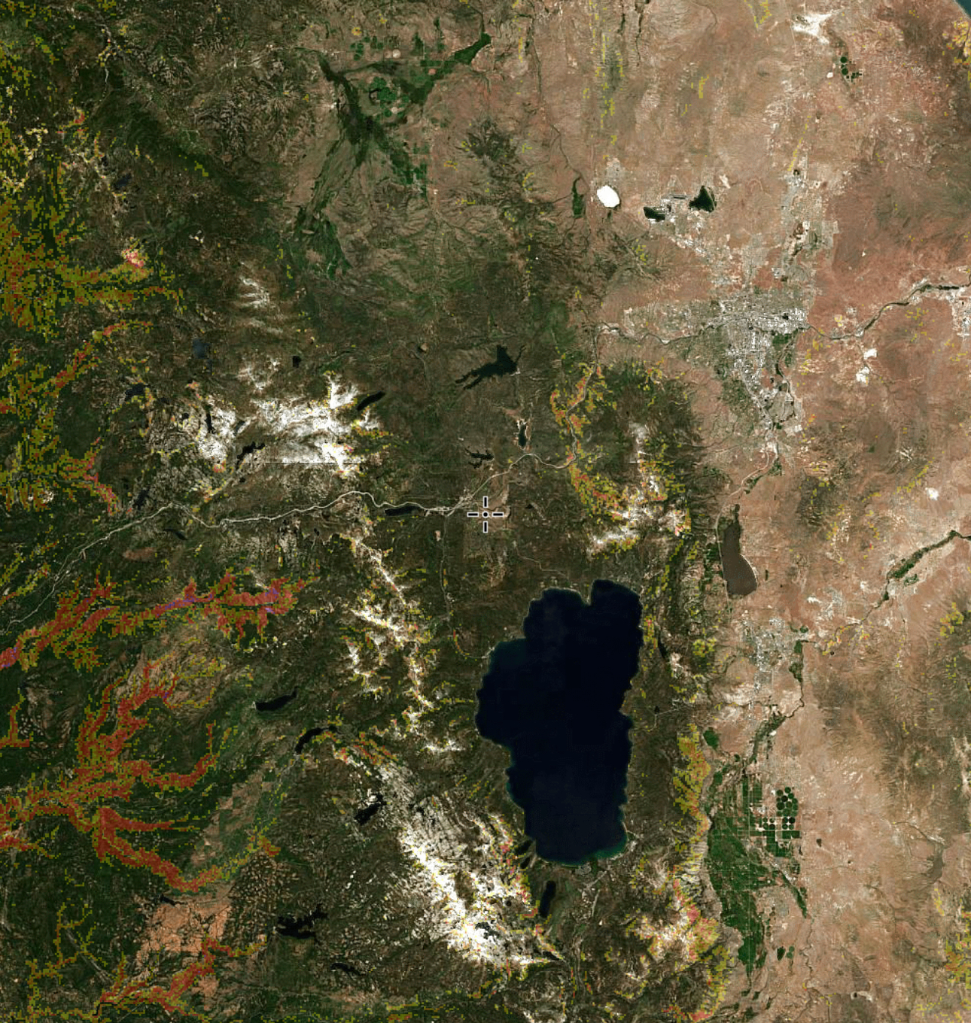
Truckee-Tahoe, CA
Elevation: 5,900’
Rwy Length: 7,000’
Notes
  Lake Effect
  Mountainous
  Oceanic Weather

Slide 5
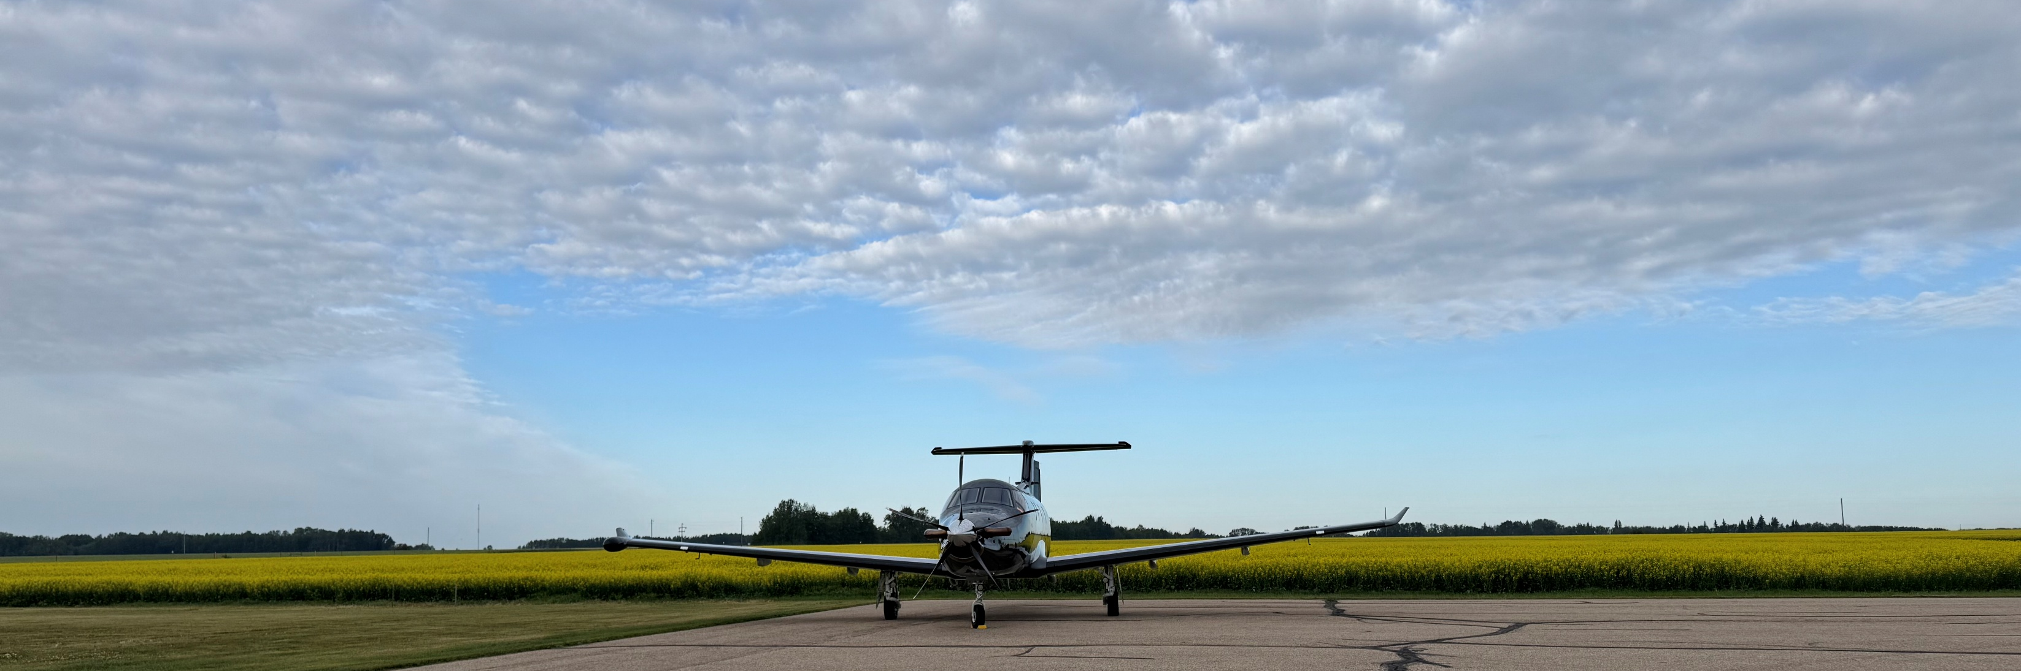
Concluding Remarks
- Open Discussion -

