Slide 1

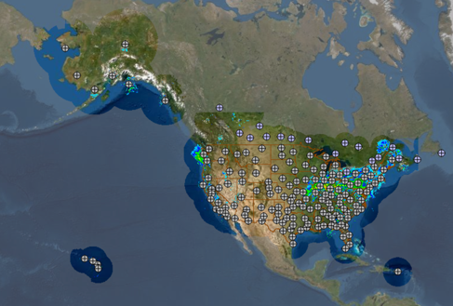
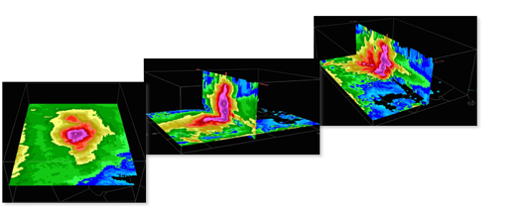
MRMS product expansion: Transportation
Multi-Radar Multi-Sensor (MRMS) is an advanced remote sensing processing system that:
Integrates radar, surface observations, satellite, lightning, and numerical weather prediction data into common reference grid
Automatically generates complete seamless national 3D radar mosaic, storm attributes and multi-sensor quantitative precipitation estimates at high temporal and spatial resolution
Operational Product Viewer: https://mrms.nssl.noaa.gov/qvs/product_viewer/
3 Science branches of MRMS
MRMS Severe
MRMS Hydro
MRMS Transportation

Slide 2
Two versions of MRMS
Operational
Experimental
Running operationally at NOAA/NCEP since 2014
Continuous hot-back up
Produces over 100 products at 2 min frequency with ~1 km horizontal resolution.
All products live streamed and available to the public via LDM service
All data now archived on AWS (since fall 2020).
Serves as a “proving ground” for new technology before onboarding to NWS.
Most experimental products are streamed via LDM service to .gov partners for live evaluation before transition into NWS operations

Slide 3
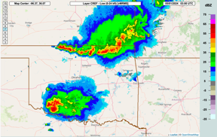
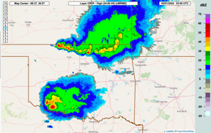
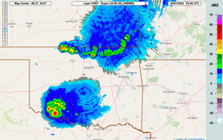
Emergent products in the Transportation Expansion
0-24 kft
24-60 kft
33-60 kft
Since it went operational, MRMS has produced layered composite reflectivity for different classes of airspace

Slide 4
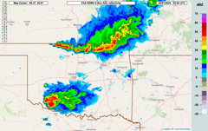

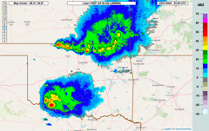
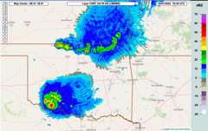
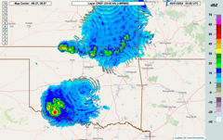
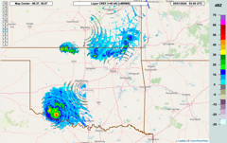
Emergent products in the Transportation Expansion
0-24 kft
24-60 kft
33-60 kft
Since it went operational, MRMS has produced layered composite reflectivity for different classes of airspace
0 – 4 km AGL
Feedback from our stakeholders suggests greater vertical precision is desired. The expansion pack includes the following new layered composite reflectivity grids. These support low-altitude flight or correspond to the flight layers in the Traffic Flow Management Convective Forecast (TCF).
18-25 kft
25-30 kft
30-35 kft
35-40 kft
40+ kft

Slide 5
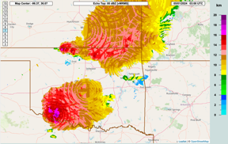
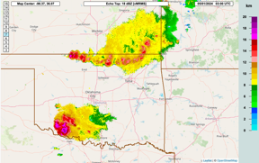
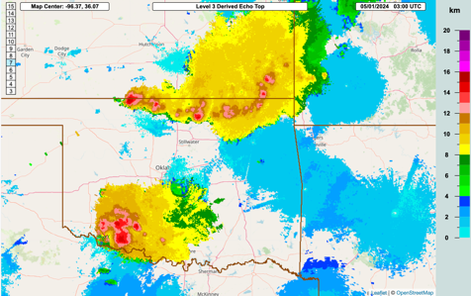
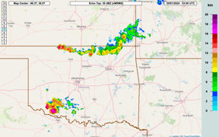
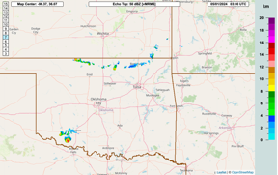
Echo top suite
We’ve been experimenting with different methods and thresholds for echo top and now have 6* versions available in the operational system.
Produced from the 3D radar mosaic in MRMS
0 dBZ
18 dBZ
Mosaic of Enhanced Echo Top (EET) created by WSR-88Ds
30 dBZ
50 dBZ
*60-dBZ ETP not shown

Slide 6
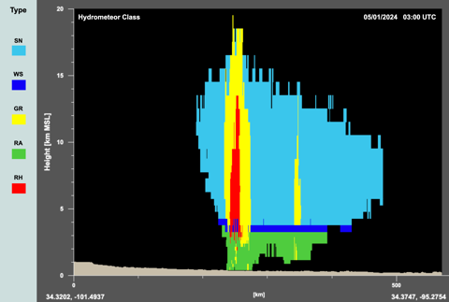
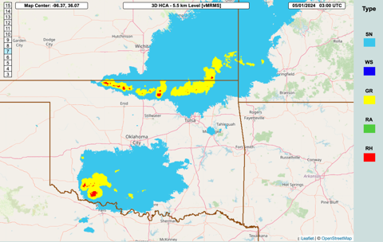
3D radar-derived hydrometeor classification
Radar observations are used to categorize the precipitation type as snow, melting snow, rain, graupel, or hail, providing a 3-dimensional depiction of hail cores and surrounding graupel.

Slide 7
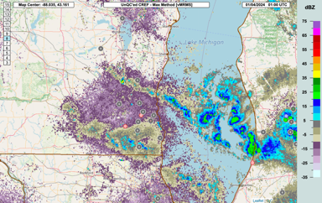
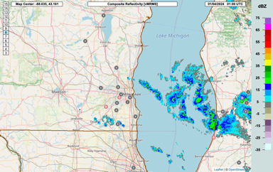
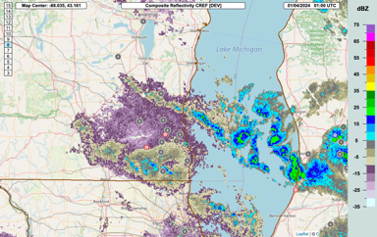
Improved QC of light winter echo
Light winter precipitation (very light snow, freezing drizzle) has similar reflectivites and radar characteristics as non-meteorological targets. Updates to the QC algorithm are necessary to keep these echoes, but still reject non-meteorological echoes.
Composite Reflectivity after experimental QC
Composite Reflectivity before QC
Composite Reflectivity after QC
snow rain frz rain ice pellets

Slide 8
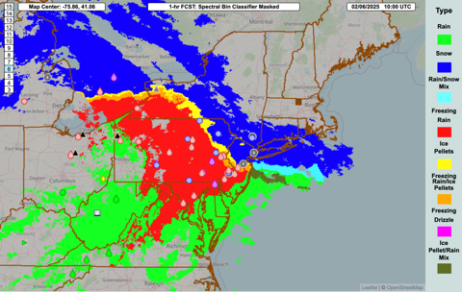
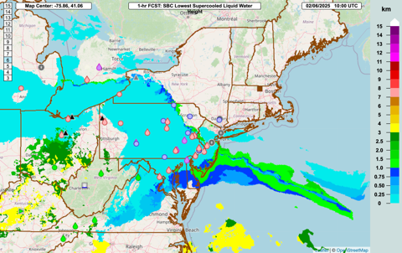
Surface precipitation type diagnosis
Surface precipitation type
A spectral-bin microphysics model has been embedded into MRMS to provide a diagnosis of the surface precipitation type. It is able to diagnose various mixes and the constituency of mixes.
This algorithm also provides the minimum altitude at which freezing rain exists, for cases of elevated FZRA.
Elevation of SLW

Slide 9
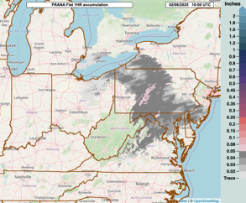
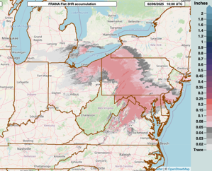
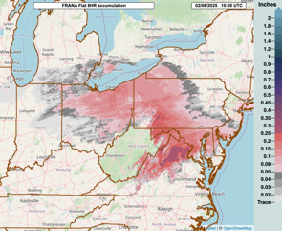
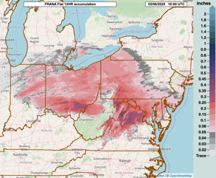
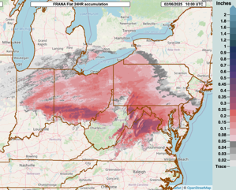
Freezing rain/snow accumulation rates
1-hr accum.
3-hr accum.
6-hr accum.
12-hr accum.
24-hr accum.
Ice accumulation rates for both flat (shown at above) and radial surfaces are provided for 1-, 3-, 6-, 12-, and 24-h periods.
Snow rates are in development.

Slide 10
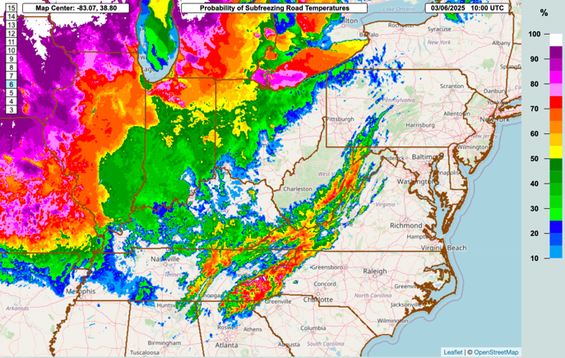
Road Temperature Analysis
MRMS includes a product that provides a 0-100% probability roads/pavement is subfreezing and may require chemical treatment.

