Slide 1
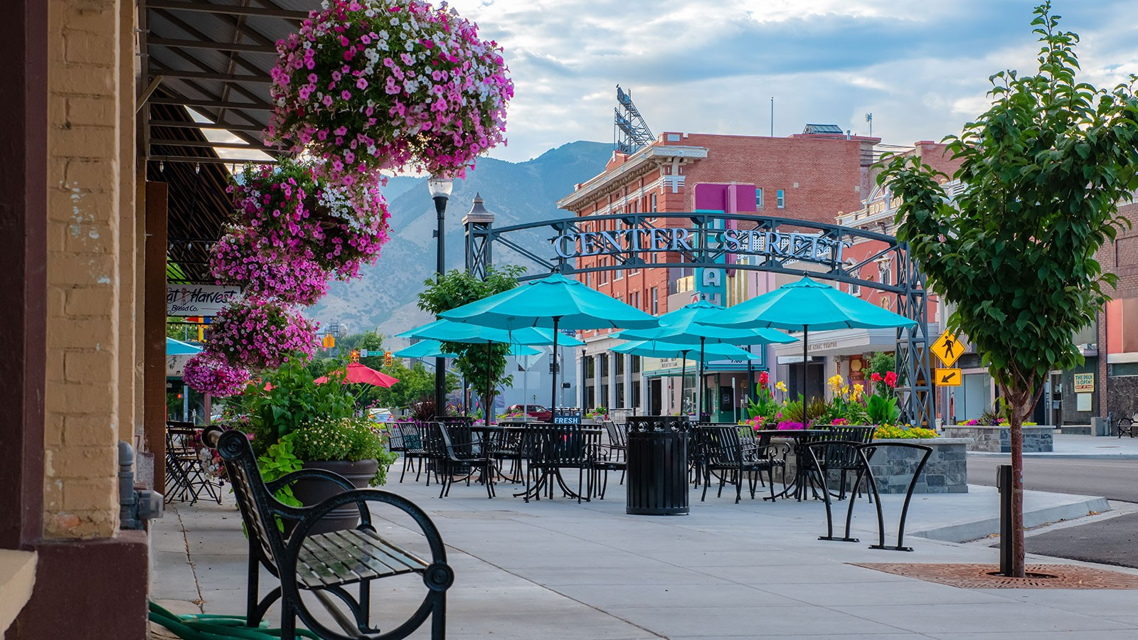

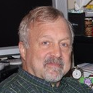
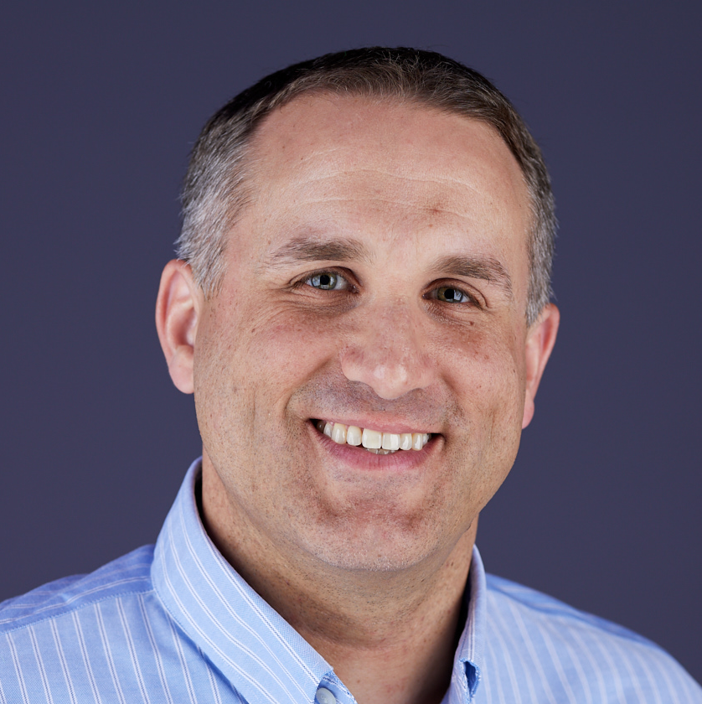

Future FPAW Meeting Planning
Matt Fronzak
The MITRE Corporation
mfronzak@mitre.org
Nathan Polderman
United Airlines, Inc.
Nathan.Polderman@united.com
Matthias Steiner
National Center for Atmospheric Research
msteiner@ucar.edu
Submit a topic: https://fpaw.aero/form/submit-a-topic

Slide 2
Spring 2026 FPAW Meeting
Meeting Location and Date
Oklahoma State University (Gus de Azevedo) – OKC
April 21-23 (tentative schedule)
Potential Conflicts
College Spring Break – February 21 to April 18 (95% from February 28th through March 28th )
Oklahoma State and University of Oklahoma both March 14-21
Cherry Blossom Festival in DC area – March 20 to April 12
Easter – April 5
Tax Day – April 15
Sun n’ Fun Aerospace Expo in Lakeland, FL – April 14-19
ATCA Tech Symposium in Atlantic City, NJ – ??
Mother’s Day – May 10
AUVSI XPONENTIAL in Detroit, MI – May 11-14
Memorial Day – May 25
EBACE in Geneva – May 27-29

Slide 3
Sketch for Spring Meeting Themes
Day 1
Major Topic #1
FAA Wx COI Update
Day 2
Major Topic #2
Minor Topic
Day 3
Major Topic #3.
Minor Topic
Sundry
FPAW Organizational Updates/Mini-Planning Meeting
Convective storm related topics
TCF applicability, NE-US SWAP
Ramp lightning – science, procedures
Microburst, wind shear
Hail inspection
Other topics
Volcanic ash

Slide 4
Fall 2026 FPAW Meeting
Possible Meeting Locations
TBD
Possible Meeting Dates – October/November 2026
TBD
Potential Conflicts
Weather Company Aviation User Conference – October ??
Columbus/Indigenous Peoples’ Day – October 12
NBAA-BACE in Las Vegas – October 20-22
WMO Aeronautical Meteorology Scientific Conference – ??
Halloween – October 31
Election Day – November 5
ATCA – November ??
Veterans Day – November 11
Thanksgiving – November 26

Slide 5
Sketch for Fall Meeting Themes
Day 1
Major Topic #1
FAA Wx COI Update
Day 2
Major Topic #2
Minor Topic
Day 3
Major Topic #3.
Minor Topic
Sundry
FPAW Organizational Updates/Mini-Planning Meeting
AAM & Weather
Joby, Google, NASA Ames hosting?

Slide 6
Topics for Discussion
Match to meeting location?
Potential Shorter Topics
Quantitative volcanic ash product
Space weather, space launch weather criteria
Weather needs for stratospheric operations (supersonic, balloons, UAS, etc.)
Alaska PIREP Smart Solicitation project
Potential Longer Topics
TCF meeting operational CW impact management needs of ATM
Wx for low altitude & off-airport flight operations (medical, oil platforms, etc.)
Observing infrastructure (gaps, refresh, mesonets, siting standards, urban, ABO, etc.)
Weather, climate & politics (roles/responsibilities, public/private partnership, workforce development)
Weather & automation/autonomy
Top 10 weather concerns from professional organizations (AOPA, A4A, NATCA, etc.)
Parking Lot for Future Consideration
??
Notes:
Brandee Harral – include Policy in Training session, or separate session on Policy?
PIREP discussion?
L. Wilson – new Quant VA product update? Will become ICAO standard in next few years. Washington VAAC manager on board. 30 minutes sounds appropriate, based on number of Qs
Space Weather
Wx COI Update
May want to keep 1 of the short sessions open until we hear from WJHTC re labs (S DiVito)

