Slide 1
“A Brief History of…(FPAW)…Time”
Friends and Partners in Aviation Weather
Warren Qualley
Retired (sort of)
October 8, 2025

Slide 2
Why Did FAW Get Started?
(Friends of Aviation Weather)
Four main events…
In 1993, the FAA convened the Aviation Weather User’s Forum.
  The output of that meeting was a long list of requirements for the FAA
Budget cuts in the mid-1990s led to demise of the NWS Aviation Weather Branch.
1995 release of FAA-funded National Research Council study: “Aviation Weather – A Call for Federal Leadership”
  Recommended that the FAA, not the NWS, take federal leadership role for aviation weather.
  Ron McPherson, then Director of NCEP, had a vision that resulted in the creation of the Aviation Weather Center.
led to…

Slide 3
…the first Friends of Aviation Weather meeting, held in September
1997 at the NBAA annual convention in Dallas
Principal parties:
David Rodenhuis (then-director of the Aviation Weather Center)
Paul Smith (National Business Aviation Association)
Carl Knable (retired United Airlines Manager of Meteorology)
Bruce Carmichael (National Center for Atmospheric Research)
The purpose was to bring together government, academia and industry to build a strategy for aviation weather. The meeting lasted 3 days, and it was… interesting… but there were no casualties!
Bottom line: FAW->FPAW formed due to User perception that neither NWS nor FAA took ownership of aviation weather.

Slide 4
Attendee list from
1997 Friends of Aviation Weather meeting
Bruce Carmichael – NCAR
Tom Carney – Purdue
Mike Edwards – ARINC
Dale Foster – Southwest Airlines
Rick Heuwinkel – FAA
Carl Knable – United Airlines
Dave Ladwig – USAF
Ken Leonard – FAA
Bob Massey – ALPA
John McCarthy – NCAR
Bill Phaneuf – ALPA
Rich Pryzwarty - NWS
Warren Qualley – American Airlines
Dave Rodenhuis – AWC
Wayne Sand – Aviation Weather
Consultant
Bill Sears – ATA
Lynn Sherretz – ESRL
Jaiwon Shin – NASA
Rich Wagoner – NCAR
Dave Whately – FAA
Skip Wright - OFCM

Slide 5
FRIENDS OF AVIATION WEATHER
BECAME
FRIENDS AND PARTNERS IN AVIATION WEATHER
Summer FPAW Vision meetings were added in 2005
Held in Washington, DC
Focus was on the meteorology part of the newly-established Joint Planning and Development Office (JPDO) of the Next Generation Air Transportation System (NextGen)

Slide 6
HOW MANY FAW/FPAW AND VISION/SUMMER MEETINGS HAVE BEEN HELD, BEGINNING IN 1997?
  8 from 1997 through 2004
  43 from 2005 through October 2025
  = 51, including this one!!!

Slide 7
Evolution of FPAW: 1997 to 2007
1997-2002: The Age of the Barbarians
“Progress Reports” followed by Provider and User Panels
Issues Identified by Users and Action Items assigned to FAA and NWS
Resulted in airline reps hammering government reps
2003-2007: The Age of Reconciliation
User Needs followed by Provider Progress
Operators/Industry realized that they needed the Gov’t
Less confrontational, but Gov’t still on the hook
Vision meetings began in 2005

Slide 8
Evolution of FPAW: 2008 to “Infinity and Beyond”!
2008-2010: The Age of Champions
Identification of Issues and Champions
Gov’t and Industry share responsibility to resolve issues
2011-?: The Age of Peaceful Coexistence and Mutual Survival
Involvement of CDM and topics related to moving from
NowGen to NextGen
Valuing the impacts of weather forecasts
Gov’t and Operators/Industry sitting on the same panels!!
Deeper dive into fewer topics at each meeting

Slide 9
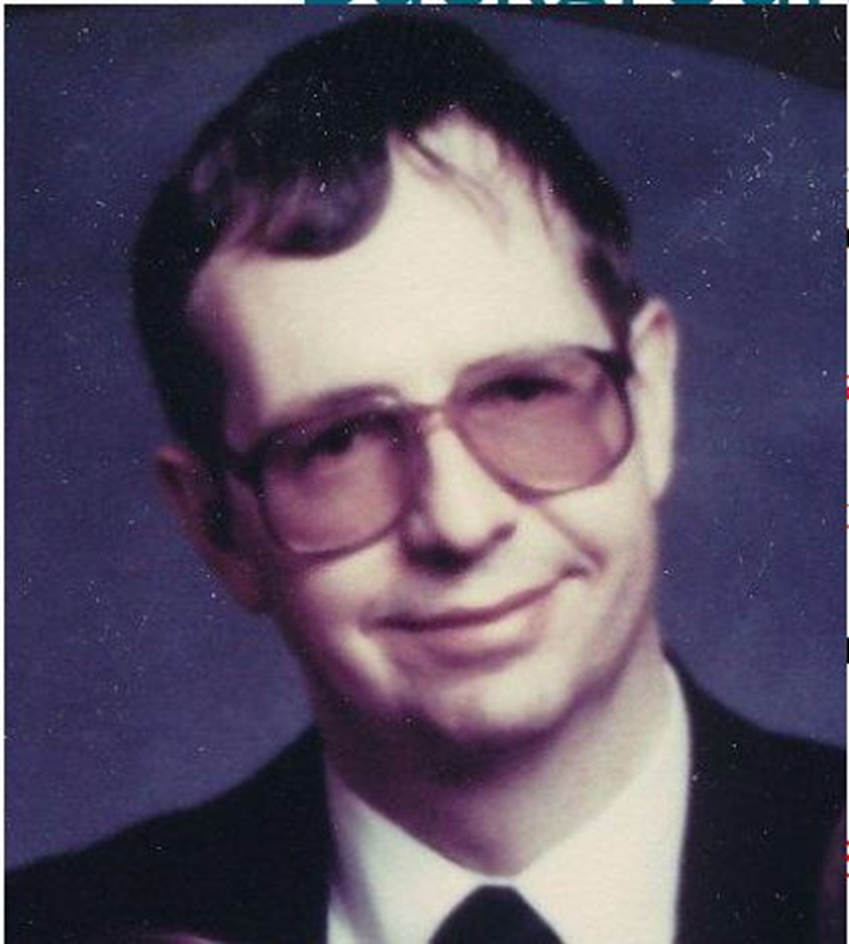

Slide 10
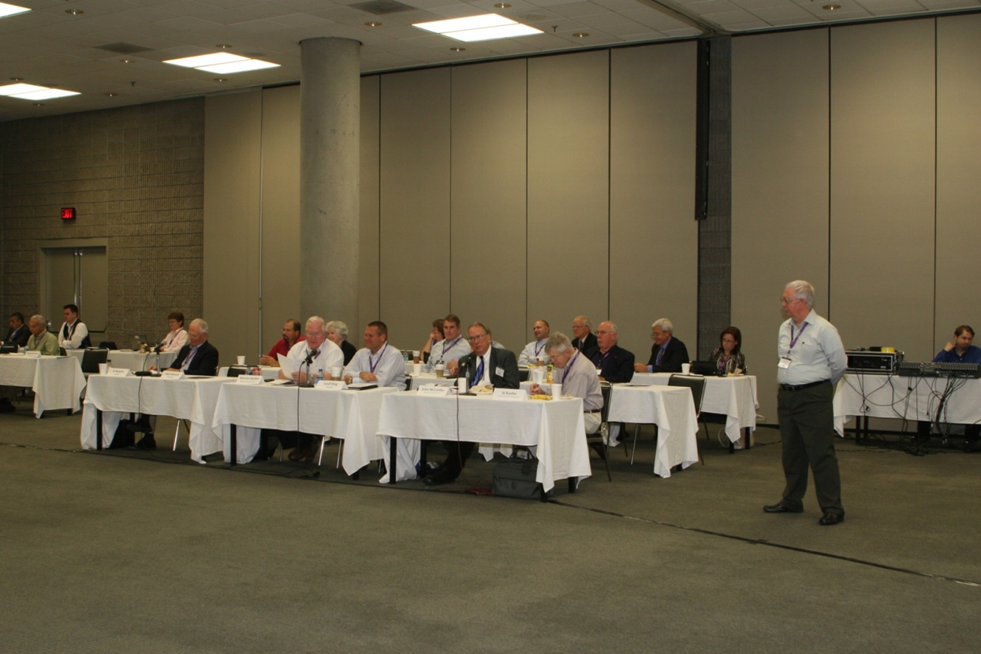

Slide 11
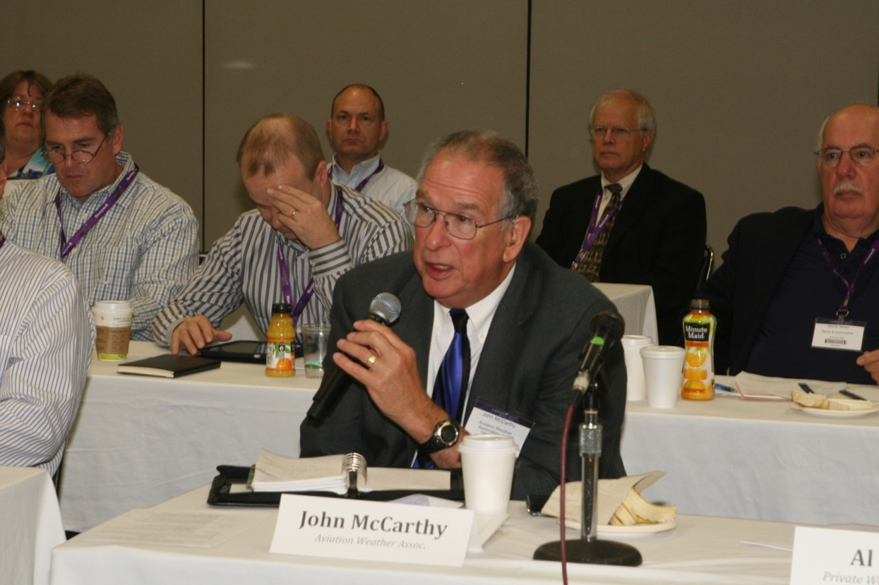

Slide 12
The common thread, instigator, throughout the years from pre-1997 through 2022 has been one person: BRUCE CARMICHAEL
and therefore…
Matt, if you would please…

