Slide 1
Session 1 Revisiting the FAA TFM Thunderstorm Forecast Skill Requirements
Session Hosts
James Pinto (NCAR/RAL)
Scott Minnick (NOAA Aviation Weather Center)
This research and material presented within is in response to requirements and funding by the Federal Aviation Administration (FAA). The views expressed are those of the authors and do not necessarily represent the official policy or position of the FAA.

Slide 2
Session Overview
James Pinto, NSF NCAR Research Applications Lab
Introduction – brief background

Slide 3
Session Overview
Scott Minnick, NOAA Aviation Weather Center
Introduction – brief background

Slide 4
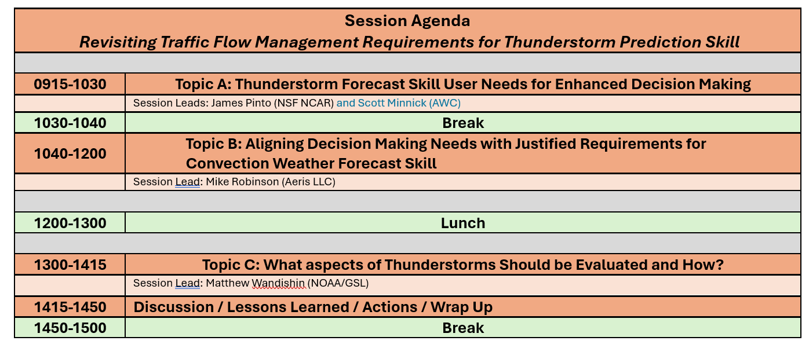
Session Overview
James Pinto, NSF NCAR Research Applications Lab
Scott Minnick, NOAA Aviation Weather Center

Slide 5
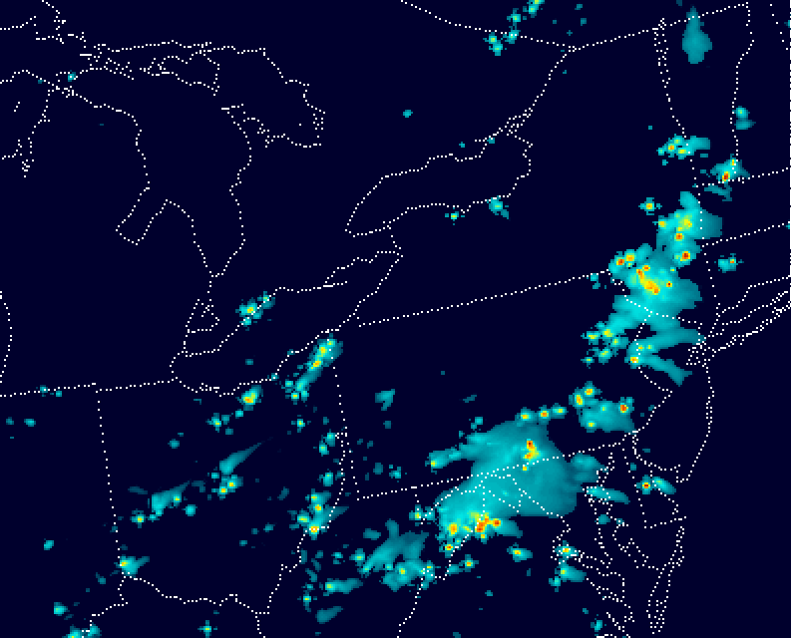
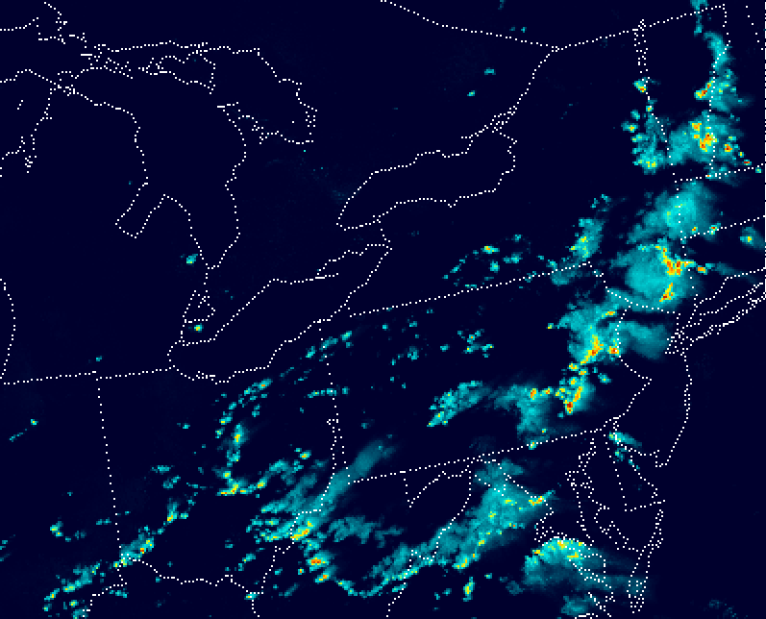
Session Introduction : Storm Forecast Skill Metrics
Model Predicted Reflectivity
Observed Reflectivity
4 hour Forecast Valid at 13 Aug 2025 @ 20:00 UTC (16:00 EDT)
15 25 35 45 dBZ
Is this an actionable forecast?
Can you estimate the POD?
POD = H / (H + M)
Notes:
What aspects of the forecast are useful? What more would you like to know?
August 13, 2025: Mid-Atlantic/Northeast storms led to FAA ground stops at JFK, LGA, EWR, BWI, DCA, and IAD.

Slide 6
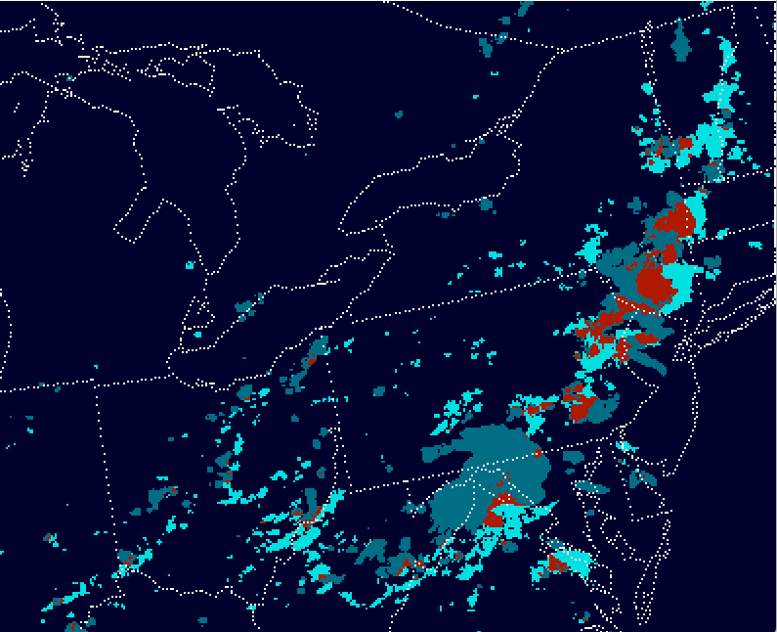
Probability of Detection Example
Pixel-to-pixel Verification Map
25 nautical miles
Hits
False Alarms
Misses
Correct Nulls
False Alarms
POD = 0.22
Pixel-to-pixel comparisons at very high resolution are very challenging.
Current TFM Requirements for a 4 hour forecast are set at 0.75 for predicting the location and timing within 20 NM / 30 min.
CSI/Threat score suffer from the double penalty issue - close is actually penalized twice.

Slide 7
Panelists
Chelsea Kenyon | Aviation Meteorologist, ZKC CWSU
Joshua Garcia | Supervisory Traffic Management Coordinator (STMC) FAA ARTCC - ZKC
Elizabeth Slovak | National Traffic Management Specialist FAA Command Center
Doug Lotter | UAL / Airline Dispatchers Federation
David Dillahunt | Chief Meteorologist, Southwest Airlines

Slide 8
Topic A User Needs hunderstorm User Forecast Skill Needs for Enhanced Decision Making

Slide 9
CWSU Forecaster Perspective

Slide 10
Chelsea Kenyon, National Weather Service KC CWSU
Introduction – brief background
16 years at Kansas City Center Weather Service Unit (ZKC)
forecasting convection, turbulence, icing and other weather hazards for air traffic control
3 years Flight Service (Ft Worth)
pilot weather briefings
flight plan filing, NOTAMs, PIREPs, air traffic messages
4 years weather broadcasting (Gulf Coast)
public forecasting, community preparedness
Education:
Meteorology: University of Northern Colorado
Aerospace: Middle Tennessee State University
Flight Dispatch, CTI Program

Slide 11
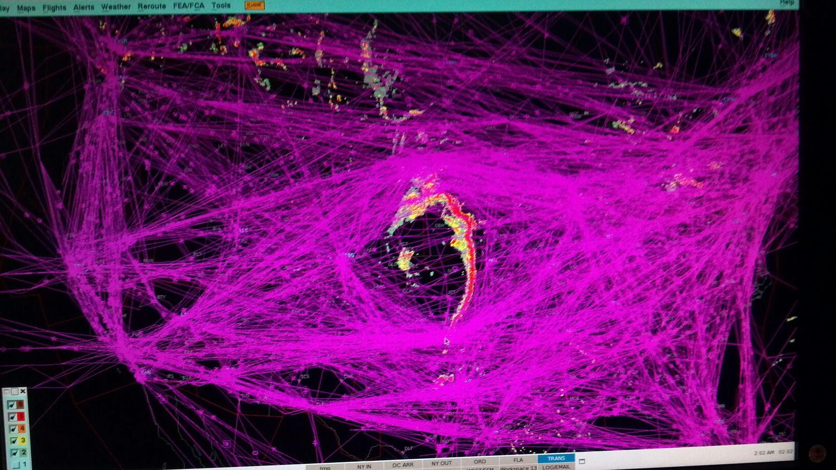
Chelsea Kenyon, National Weather Service KC CWSU
Current issues:
Too much emphasis on “meteorological” TCF verification
Interpretation by users is subjective
SPARSE = planes can still deviate through convection
MEDIUM = ALL planes go around
Forecasters hesitant to draw medium coverage
Too much focus on low confidence areas
users don’t see it
Some locations/times are more impactful than others
one-size-fits-all criteria fails to address IMPACT
Future Improvements:
Need to focus on IMPACT
Some allowances should be made in confidence and/or coverage criteria to effectively convey impact
Break out TCF into regional workflows on high-impact days
Verification needs to address system-wide decision-making and timeliness

Slide 12
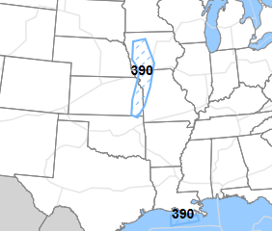
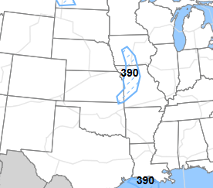
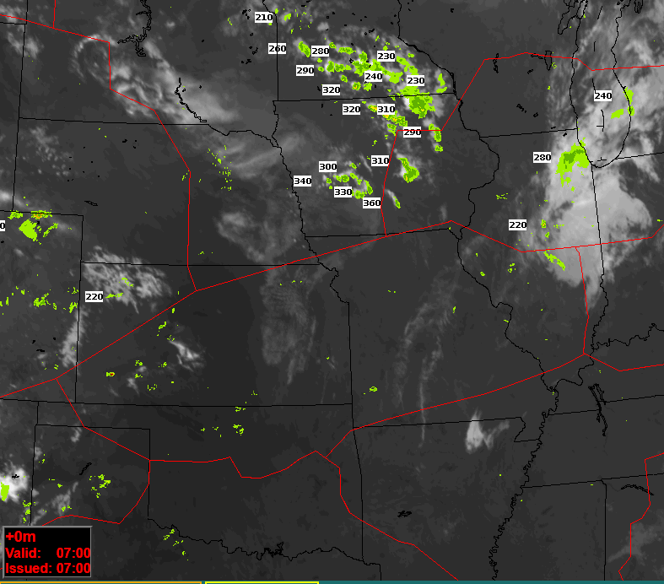
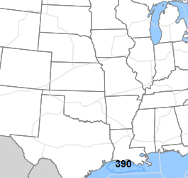
August 7, 2025- 07Z TCF
11Z
13Z
Midshift TCF depicted sparse development
HRRR likely showed development followed by *mid-morning dissipation
CWSU and TMU not yet on shift
*very common with HRRR
15Z
actual weather at 07Z (source: CoSPA archive)

Slide 13
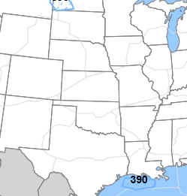
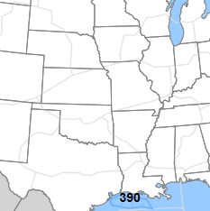
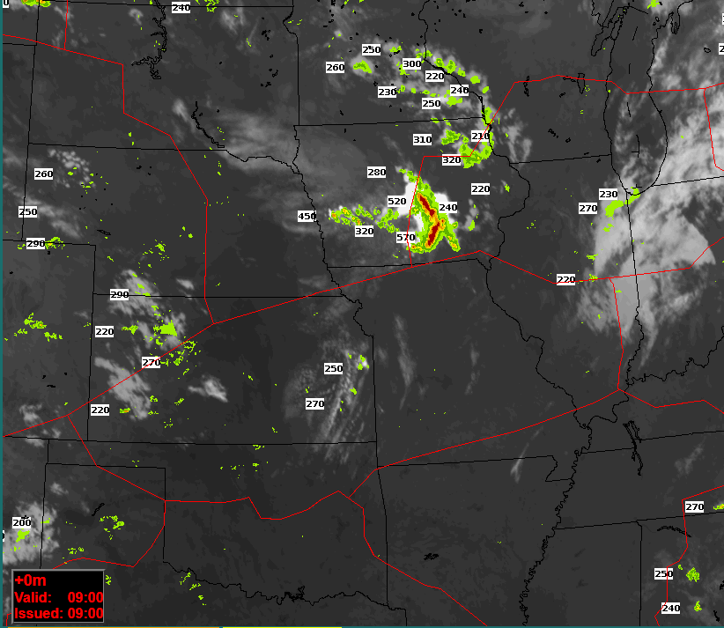
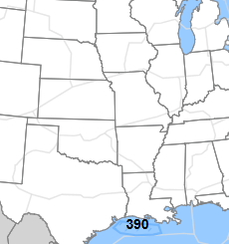
August 7, 2025- 09Z TCF
13Z
15Z
HRRR → TCF removed convective development
Tops now FL500+ over Iowa
CWSU and TMU shift starts at 10z
TCF would remain blank in ZKC for next 3 chat sessions
17Z
actual weather at 09Z (source: CoSPA archive)

Slide 14
Traffic Flow Manager Perspective

Slide 15
Introduction – brief background
Joshua Garcia, TMO, ZKC ARTCC

Slide 16
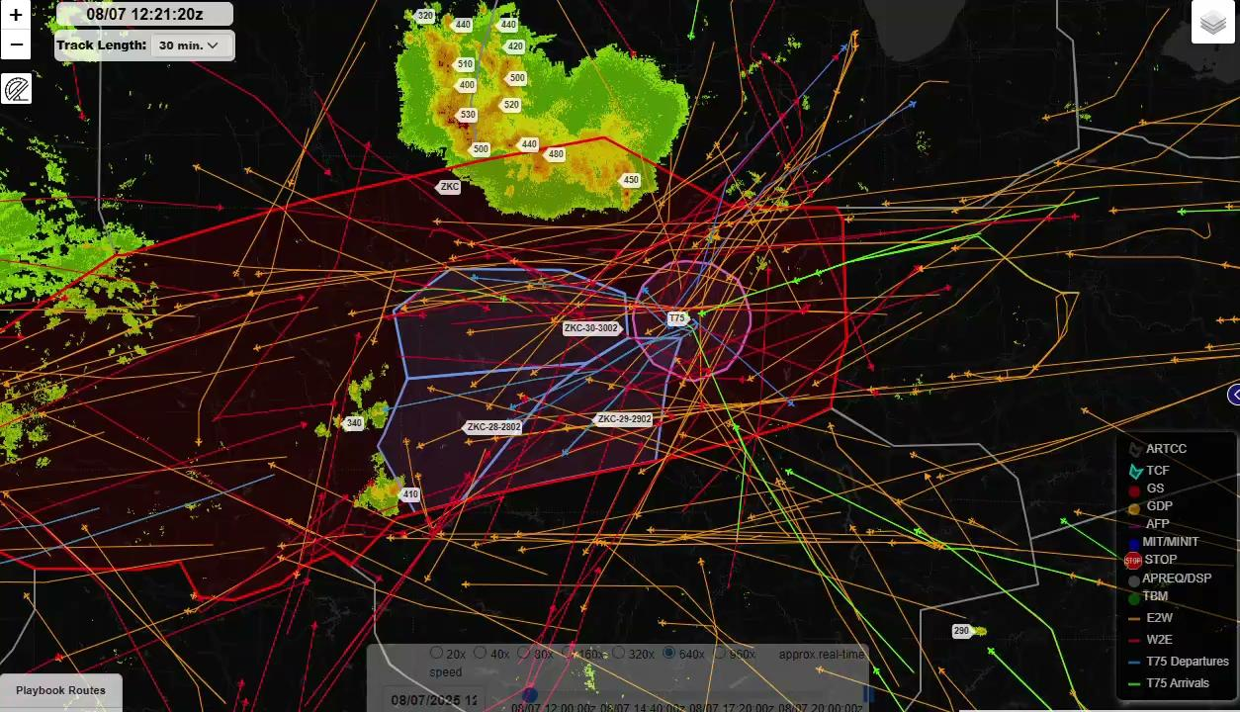
PDARS Replay- ZKC August 7, 2025

Slide 17
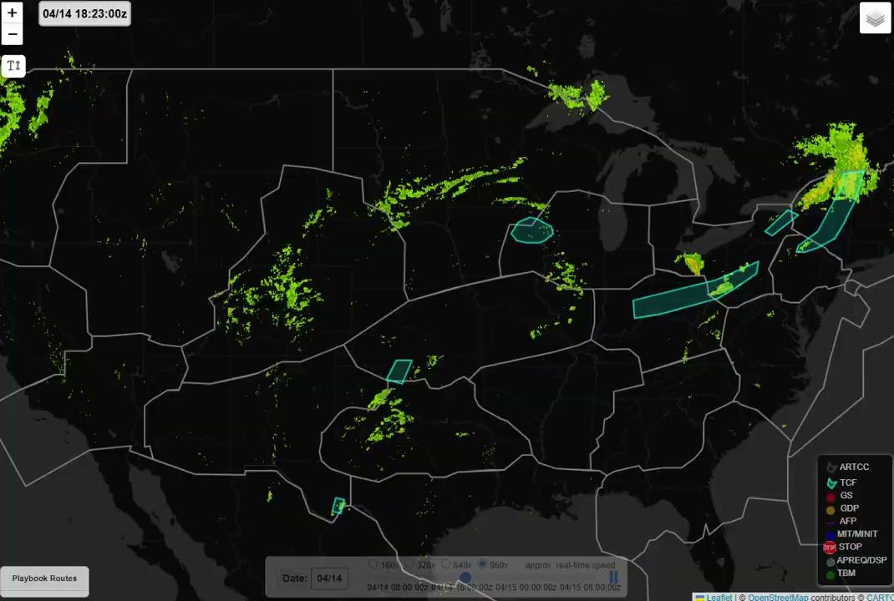
PDARS Replay- ZKC April 14, 2026

Slide 18
Introduction – brief background
Elizabeth Slovak, FAA Command Center

Slide 19
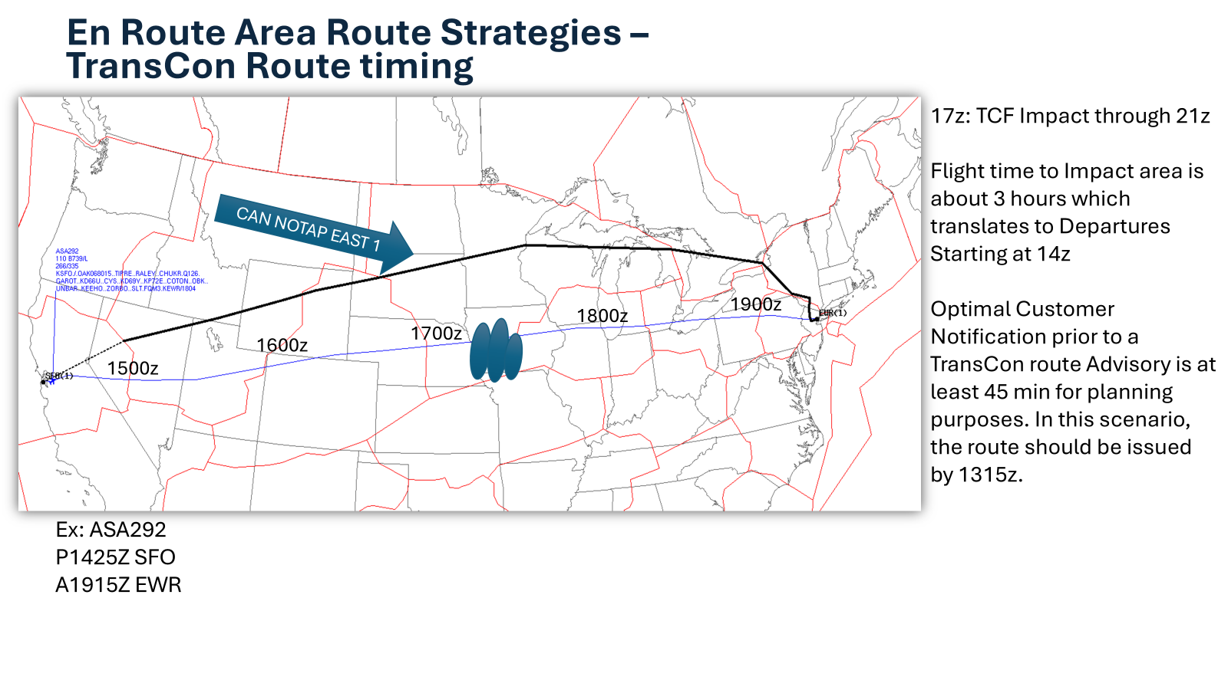
Re-Route Timing

Slide 20
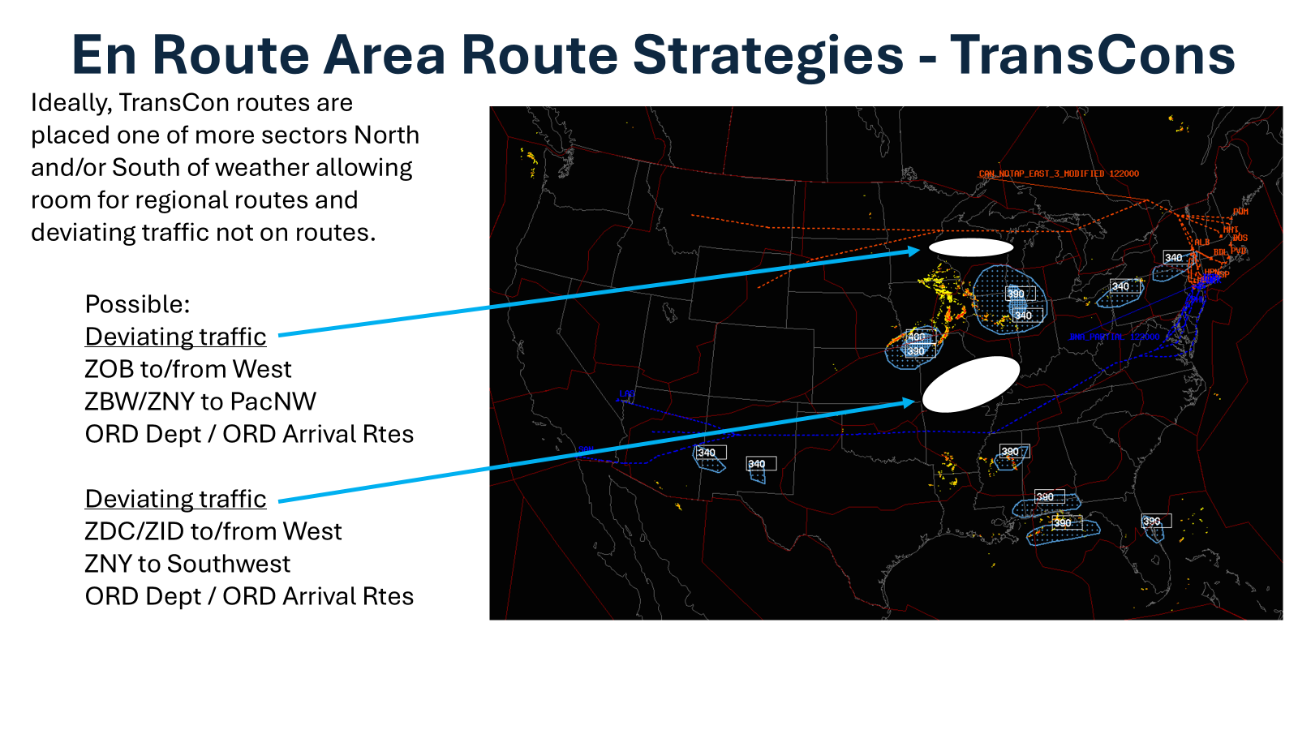
Route Placement

Slide 21
Airline Meteorologist Perspective

Slide 22
Introduction – brief background
Southwest Airlines Meteorology, 2017 - Present
PSA Airlines (AA) Dispatch, 2016 - 2017
ERAU - BS Meteorology (‘16), MS Aeronautics (‘21)
FPAW, A4A, AMS, NWA
David Dillahunt, SWA Chief Meteorologist

Slide 23
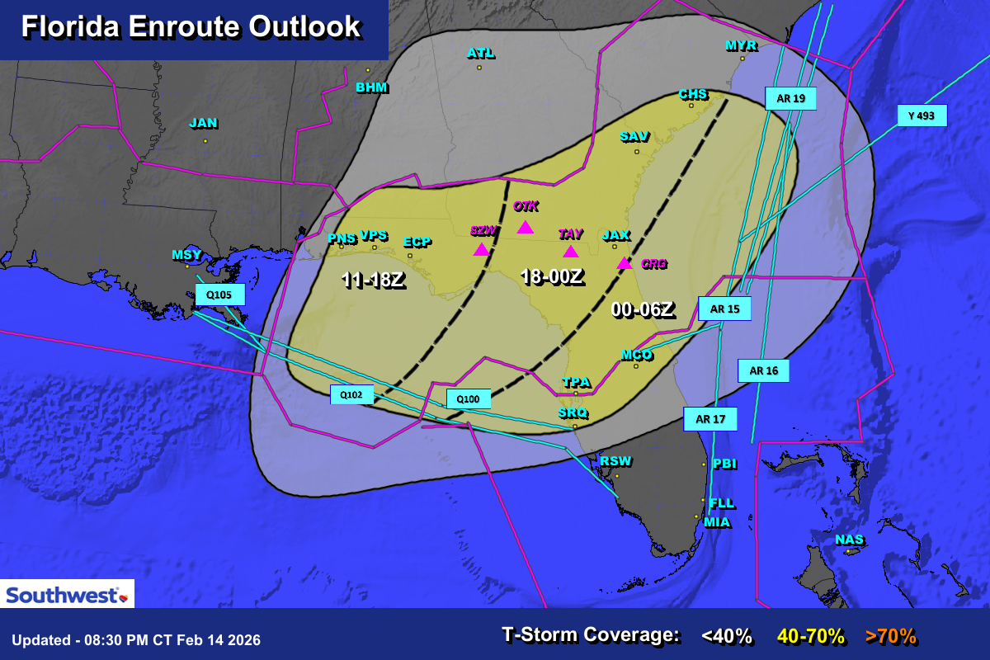
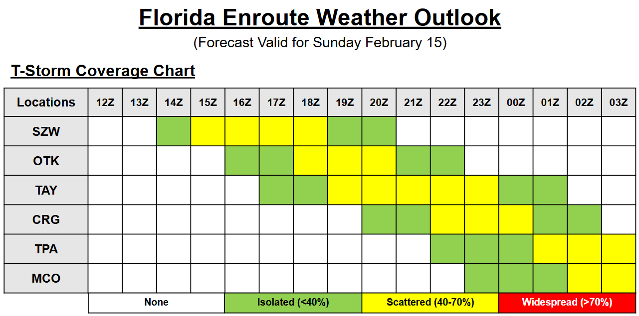
Challenges
Uncertainty too low for typical thunderstorm events
Can lead to big misses
Conveying deterministic vs probabilistic information
Successes
Valuable information when weather + volume bring bigger than usual impacts
Early planning makes decision making process more resilient to evolving forecasts
Allows for risk-based approach
Proactive Approach to Decision Making

Slide 24
Airline Dispatch Perspective

Slide 25
Introduction – brief background
Doug Lotter, UAL / Airline Dispatchers Federation

Slide 26

Doug Lotter, UAL / Airline Dispatchers Federation
Part 121 Flight Dispatch Convective Weather Planning
Dispatcher Needs
Accurate Information
Consistency
Deterministic Information
Probabilistic can certainly be helpful, but in the end, we must make go/no-go decisions

Slide 27
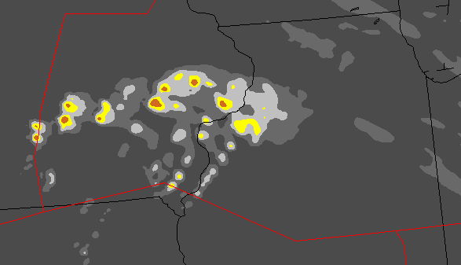
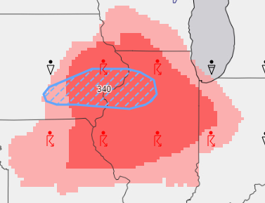
Decisions, Decisions
COSPA:
Higher Resolution.
Animated.
Familiar radar-like display.
Dispatcher Options:
“Good to go” - no concerns. (Nothing showing up)
Route through area with caution and apply mitigations (add extra fuel for potential deviations)
Avoid the area. (Adds time/fuel, leads to airspace saturation)
TCF:
Tells me that I may need to avoid this area, especially at lower altitudes.
Limited time snapshots.
GFA Tool:
Broader area.
Limited gradations make it difficult to determine permeability and tops.
Notes:
Any tool that can help make the “correct” decision is going to be useful.

Slide 28
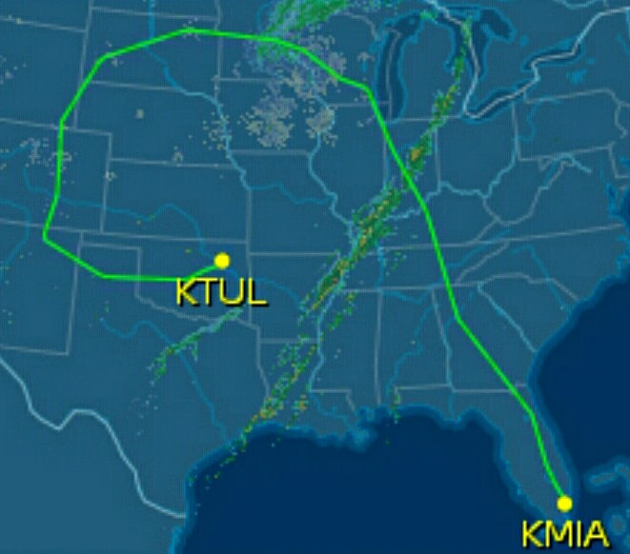
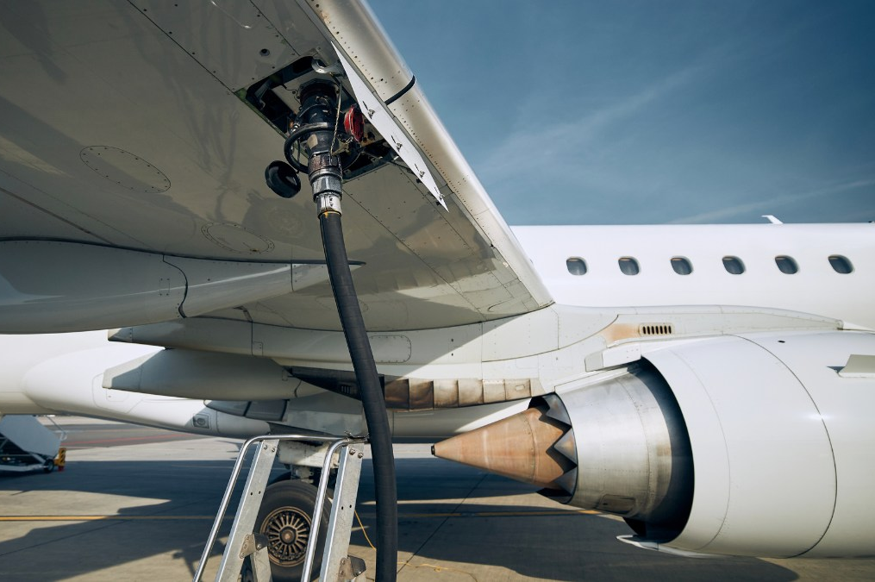
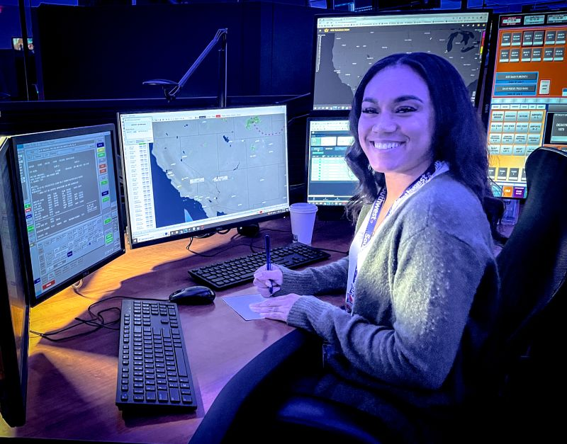
Timeline
Flights are usually planned 2-4 hours before departure time
This means 3-9 hours before the airplane will be in the impacted area
The 4-6 hour timeframe is the most critical for Dispatch evaluation
We make one of these 3 determinations:
Avoid the Area
2. Prepare for Change
3. Not a Problem Today
When is lunch?

Slide 29

Most Critical Aspects of Convective WX Forecasts
Coverage/Permeability
Can I route through this area, or not?
Timing
Will I be in the area at the wrong time?
Tops
Can I get above the wx?
Confidence
Never trust a meteorologist.

Slide 30



Accuracy Requirements
Difficult to place an exact number on a minimum accuracy requirement for a product.
Needs to be accurate enough that the product is trustworthy.
Dispatchers will not use a product if it doesn’t “verify” most of the time.
As mentioned, most important timeframe for accuracy is 4-6 hours before impact.
If I’m forced to provide a number, ~85% accuracy sounds good.
Coverage/permeability is highest priority.

Slide 31



Teamwork
Dispatchers also must consider ATC TFM reactions.
Even if I determine an area is “good” – ATC may issue re-routes and/or other programs.
Or vice-versa; I may route out of an area, but ATC re-routes my flight back into the WX due to traffic concerns.
It is important that everyone has the same “accurate” idea of airspace permeability at a given timeframe.

Slide 32
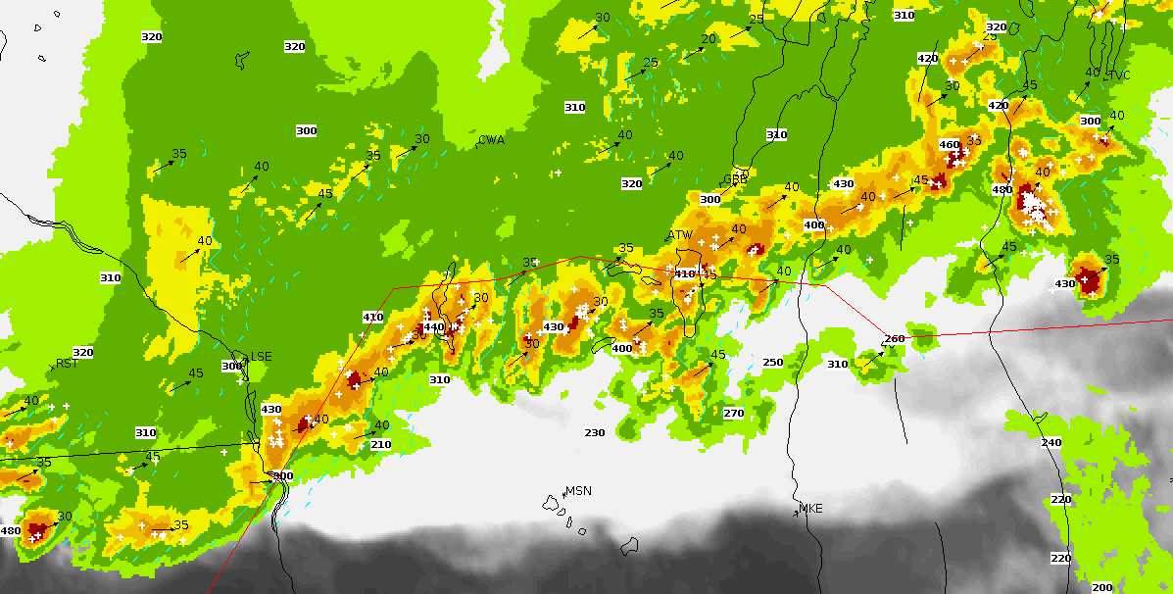
Enroute vs Terminal
Focus mainly on enroute impacts, but similar concerns exist for terminal impacts as well.
Terminal impacts largely focus on timing of when arrivals/departures can no longer safely occur.
Accuracy requirements and timeframe are similar

