Slide 1



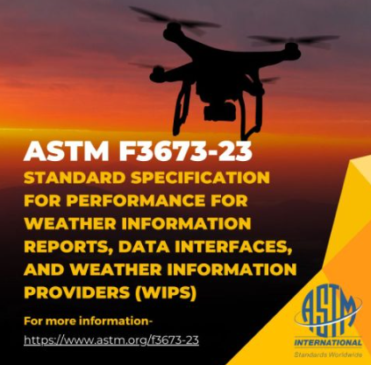
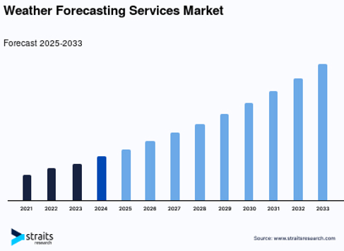
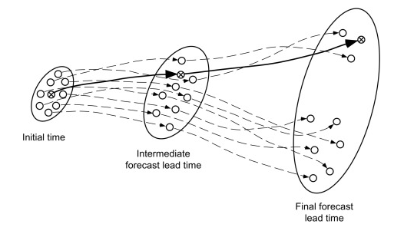

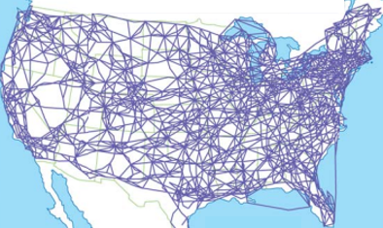


TFM
Source: FAA

Slide 2
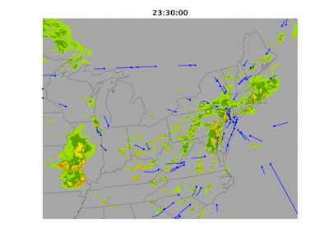
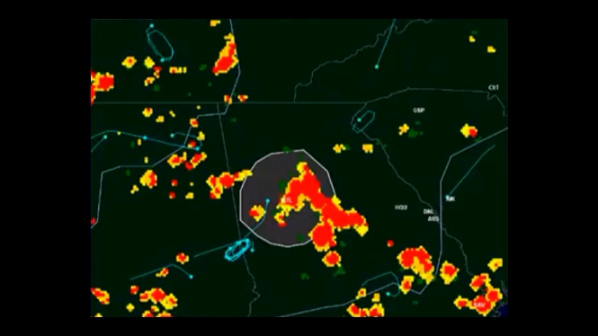
Source: FAA
Source: FAA
The NAS location error for the forecast location of the onset of thunderstorms greater than 20 nautical miles in diameter with a probability greater than 50 percent and with tops over 30,000 feet expected to intersect jet routes that cut across the Flow Constrained Areas with a 4-hour lead time shall be less than or equal to 12 nautical miles.

Slide 3

Source: FAA
Source: FAA
The NAS location error for the forecast location of the onset of thunderstorms greater than 20 nautical miles in diameter with a probability greater than 50 percent and with tops over 30,000 feet expected to intersect jet routes that cut across the Flow Constrained Areas with a 4-hour lead time shall be less than or equal to 12 nautical miles.
2 + 2 =

Slide 4
TFM
Source: FAA

