Slide 1
What aspects of thunderstorms should be evaluated and how?
Stacey Hitchcock – OU School of Meteorology
Jaymes Kenyon – NOAA GSL/CIRES
Joe Grim – NSF NCAR
Mike Baldwin – OU CIWRO
Burkely Gallo – Air Force 16th Weather Squadron

Slide 2
Stacey Hitchcock

Slide 3





Recent Research on Aviation Turbulence Near Thunderstorms
Stacey Hitchcock
Stacey.Hitchcock@ou.edu
With contributions from: Todd Lane², Cole Hartman¹, Christal Xie², Cameron Homeyer¹, and Bob Sharman³, Wiebke Deierling³, Stan Trier³, Greg Maymaris³
¹ The University of Oklahoma,
² The University of Melbourne & ARC Centre of Excellence for Climate Extremes
³ (RAL, NSF-NCAR).
Stacey Hitchcock, Dec 2021

Slide 4
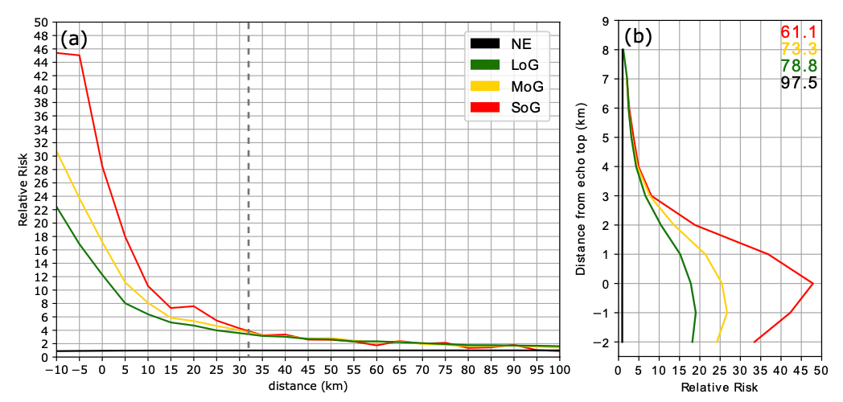

We used nearly 200 million EDR reports from 9 years (2009-2017) to quantify near storm turbulence risk.
A
B
No ETH %
Big caveat: All storms, all seasons, environments, times
Hitchcock, S. M., T. P. Lane, W. Deierling, R. D. Sharman, S. B. Trier, and C. R. Homeyer, 2025: Spatial Patterns of Turbulence near Thunderstorms. Bull. Amer. Meteor. Soc., 106, E1–E22, https://doi.org/10.1175/BAMS-D-23-0142.1.

Slide 5
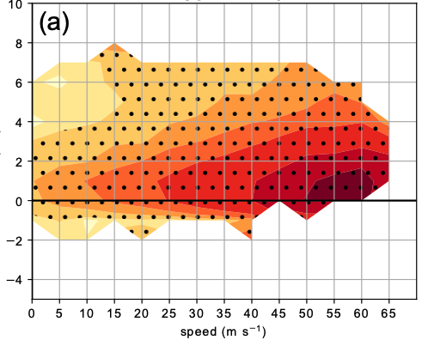
Higher risks extend over a greater distance at larger wind/shear magnitudes
Wind (at aircraft altitude)
(B)
Distance from echo top
Risk
(A)
Stippling = double the background risk
ERA5 hourly reanalysis winds interpolated to 1 km vertical grid.
100 km radius around closest 10 dBZ edge at aircraft altitude
Mean wind at flight level, 8-12 km shear
8-12 km shear qualitatively similar

Slide 6
Extra slides

Slide 7
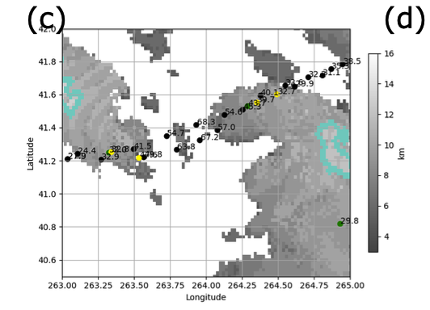
How do we measure distance from a storm?
How do we define a ‘storm’?
What kind of distance measurements are useful?
Radar
Gridrad V3.1 Bowman and Homeyer 2017​
Hourly, .02x.02 degree horizontal, 1 km vertical resolution​
QC: Filtered, Clutter removed
EDR
Legend
Storm edge
1-min peak EDR
downlinked at specified intervals or exceeding threshold (0.18 m^{2/3} s⁻¹)
Cruising altitudes (> 8 km)
+/- 15 minutes of radar
99.5th, 99.9th, 99.99th percentile for
LoG, MoG, SoG
1 per 200 min, 1000 min, 10,000 min
compute location to within ~2.5 km, 6 sec
10 dBZ edge in layer
(here 12 km)
A
Convective region
(via Steiner ’95)
32.7 km
Convective echo top peak
EDR Report
(light, moderate, severe)
Echo top height
Notes:
15 minutes = 225 km
2 minutes = 30 km
Note: I also looked at distance from convective echo top ‘peak’ or maximum within a convective region, but excluded for time sake – check out paper.

Slide 8
Risk extends the greatest distance near the tropopause.
Tropopause
C
C
Risk is greatest for aircraft within 3 km below the tropopause (Right)
Risk increases at greater distances as echo tops approach the tropopause. (Left)

Slide 9
Jaymes Kenyon

Slide 10
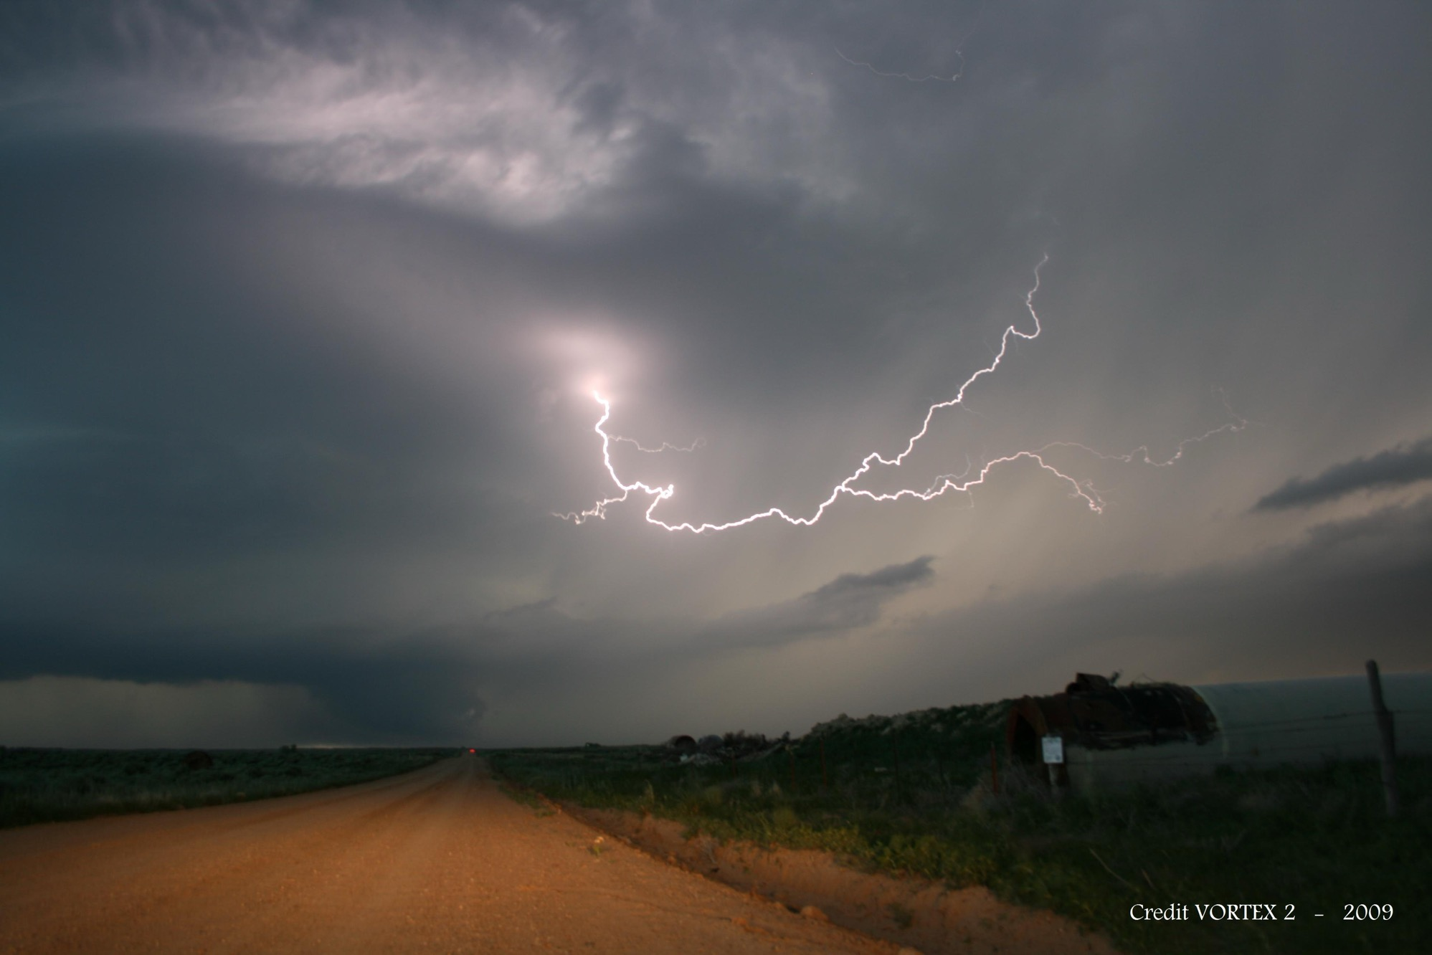


Forecast Verification in the Model-Development Process
Jaymes Kenyon
University of Colorado – CIRES at NOAA Global Systems Laboratory

Slide 11
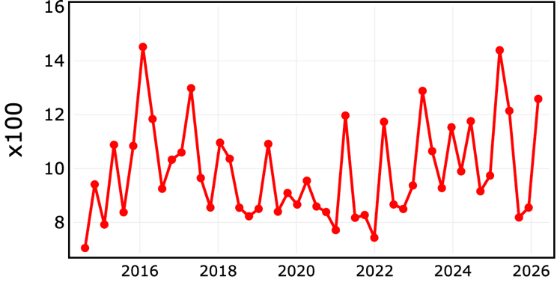
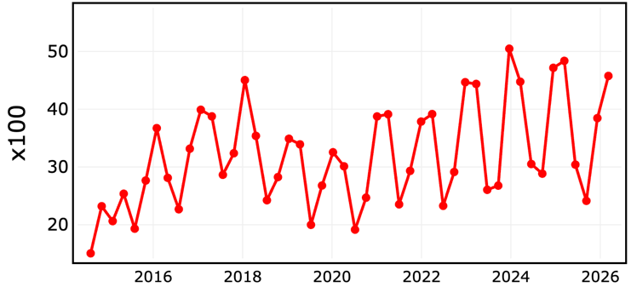

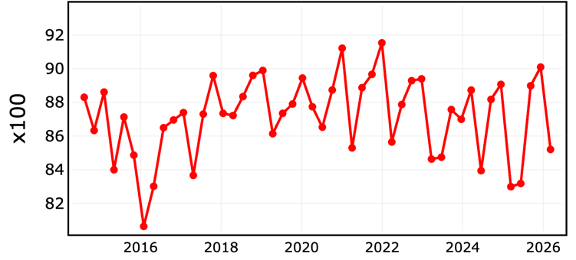
Has HRRR Convective Guidance Improved?
Critical Success Index (CSI) (“Threat Score”)
Selected HRRR Verification Metrics
(2014–present, versions 1–4)
Composite Reflectivity:
6-h Forecasts vs. Observations (MRMS)
Domain: continental U.S.
Threshold: ≥ 35 dBZ
40-km neighborhood radius
90-day running mean
Higher is Better
Probability of Detection
Higher is Better
False Alarm Rate
Lower is Better

Slide 12
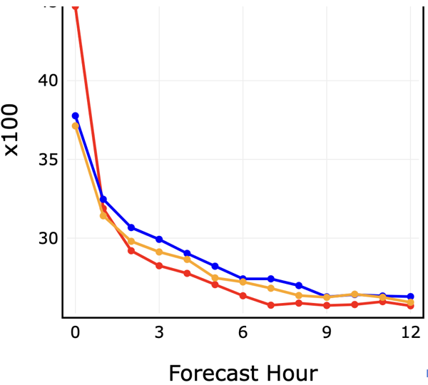
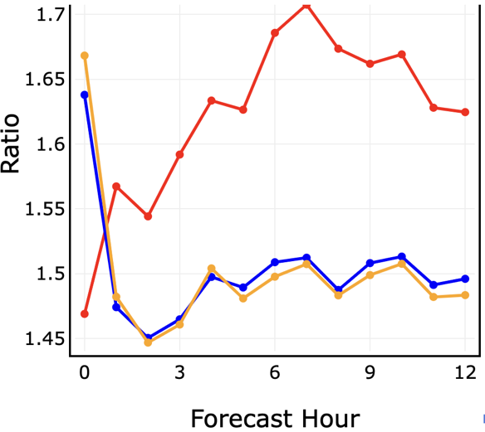
Pursuing Model Upgrades:
…aiming to beat your team’s previous “best”
CSI (20 km)
RRFSv1_beta2
RRFSretv1_beta3
HRRR
RRFSv1 (early) Prototypes vs. HRRRv4
(1–7 Feb 2022 focused evaluation)
Composite Reflectivity:
Forecasts vs. Observations (MRMS)
Domain: continental U.S.
Threshold: ≥ 25 dBZ
→ RRFSv1 prototypes
seemed better than HRRRv4
Bias (3 km)

Slide 13
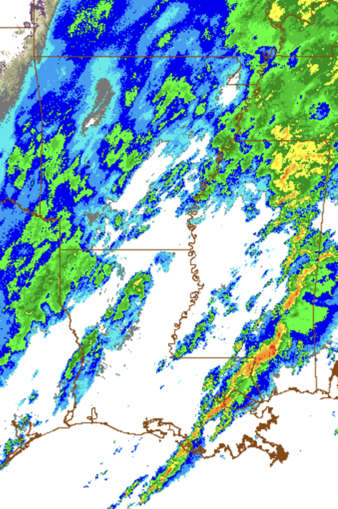
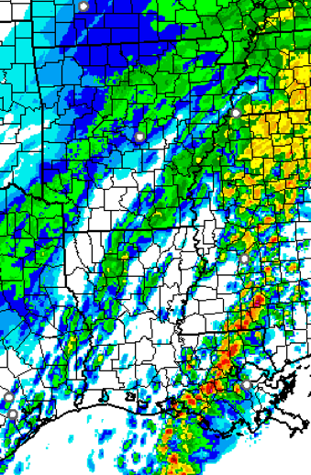
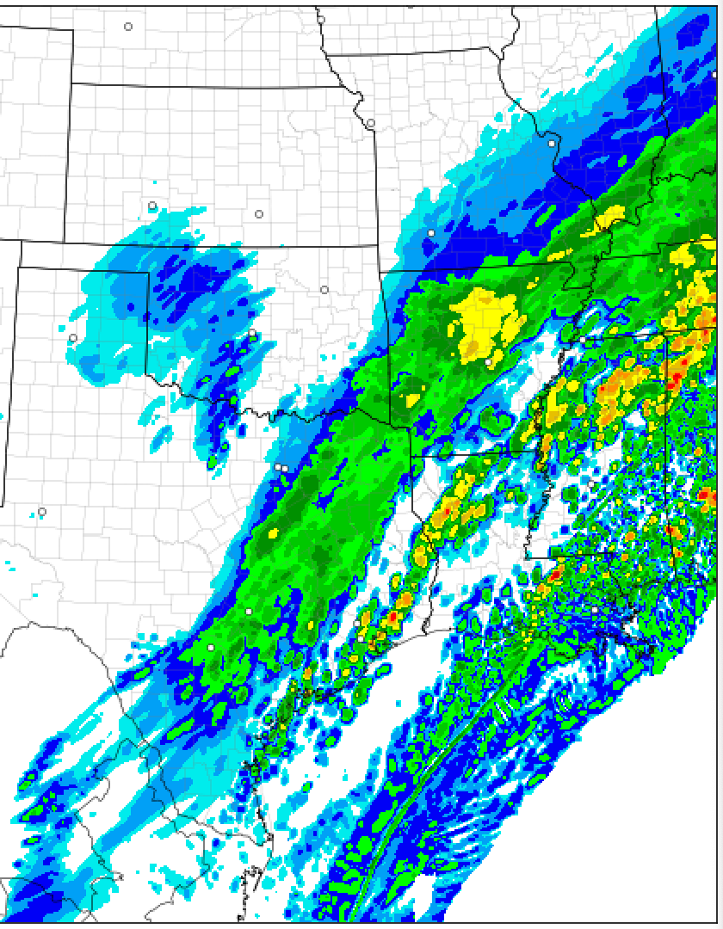
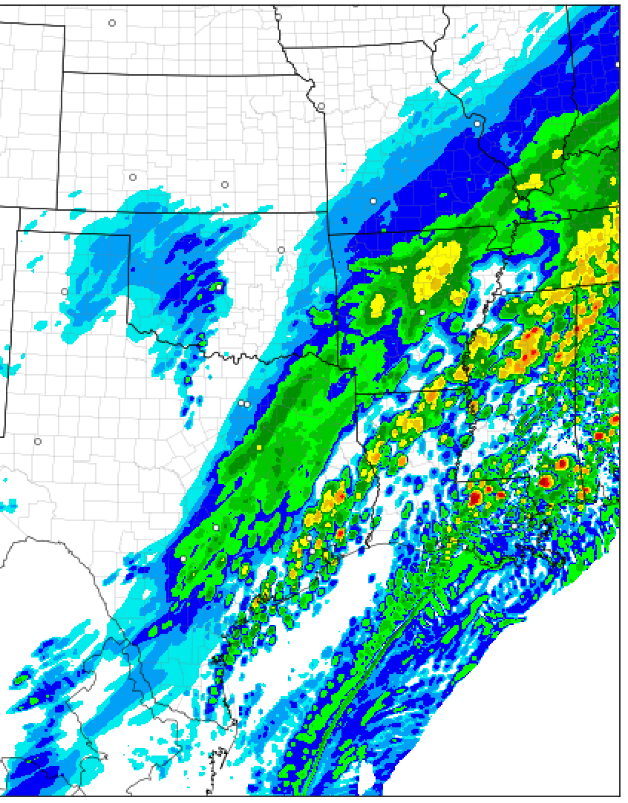
Verification Metrics are Usually Not Enough
…must also examine raw forecast output
Observed (MRMS)
RRFSv1 (early) Prototypes vs. HRRRv4
Case Study: 12-h forecasts valid 1800 UTC 3 Feb 2022
Composite Reflectivity (dBZ)

Slide 14
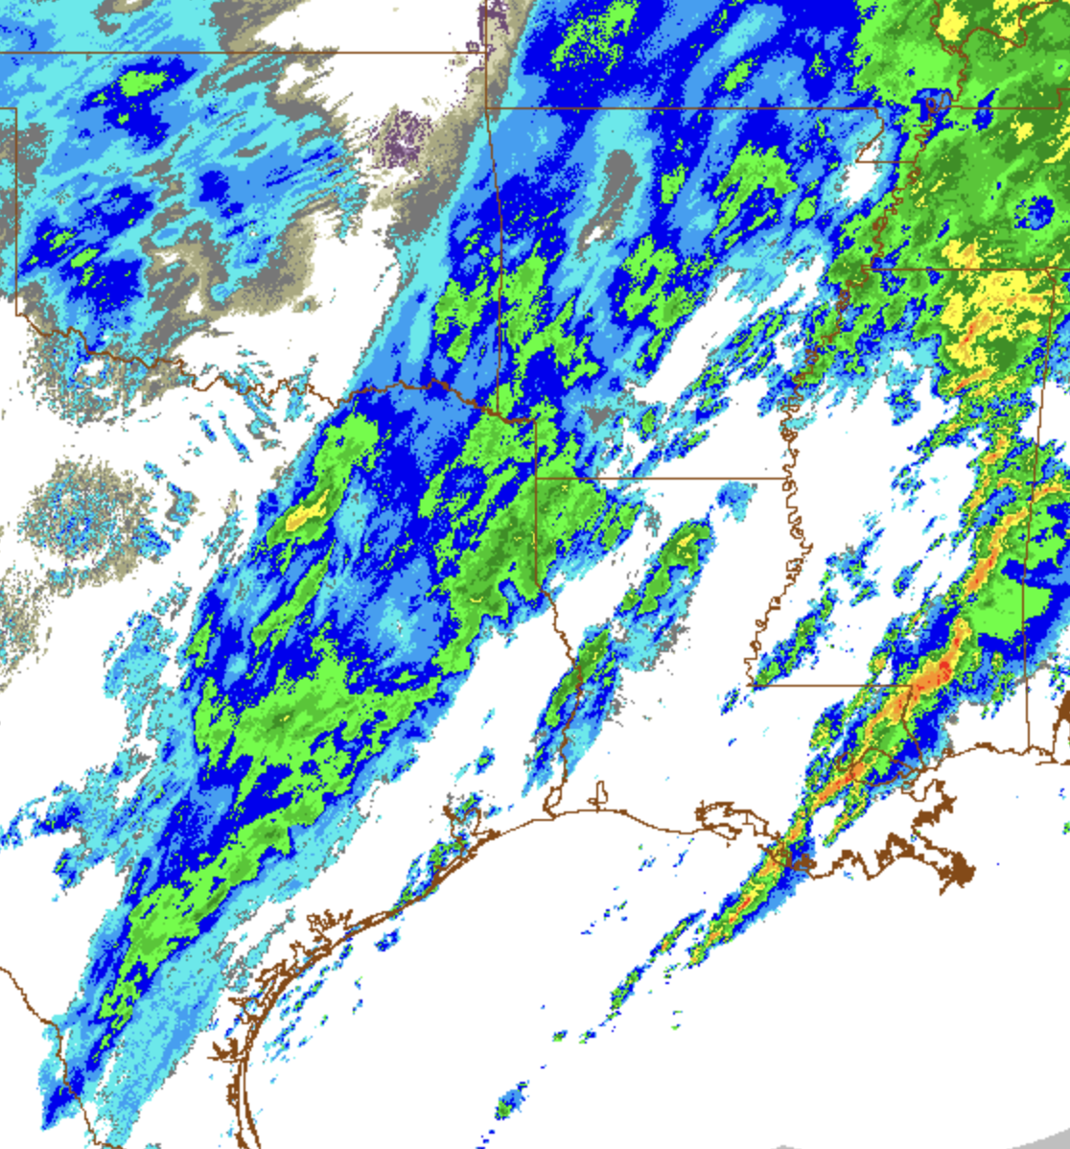
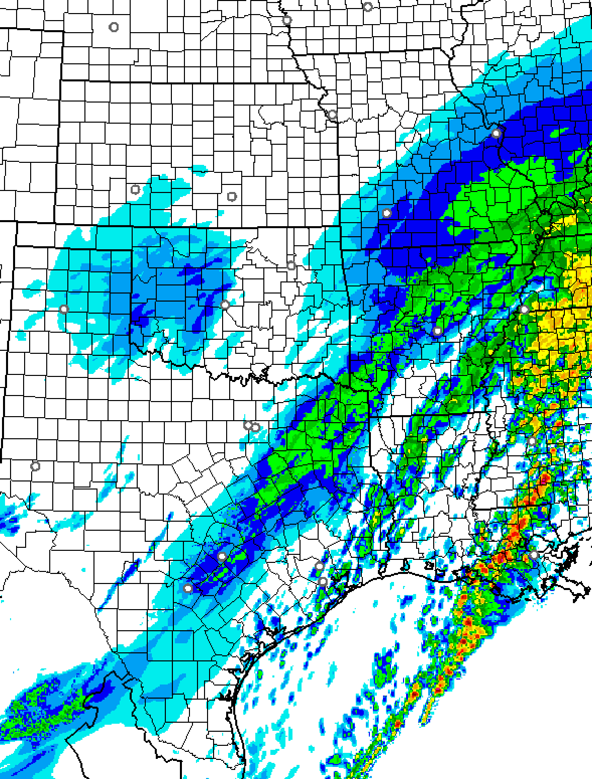
Verification Metrics are Usually Not Enough
…must also examine raw forecast output
Observed (MRMS)
Best forecast?
RRFSv1 (early) Prototypes vs. HRRRv4
Case Study: 12-h forecasts valid 1800 UTC 3 Feb 2022
Composite Reflectivity (dBZ)

Slide 15
Verification Metrics are Usually Not Enough
…must also examine raw forecast output
Observed (MRMS)
HRRR
RRFSv1_beta2
RRFSv1_beta3
RRFSv1 (early) Prototypes vs. HRRRv4
Case Study: 12-h forecasts valid 1800 UTC 3 Feb 2022
Composite Reflectivity (dBZ)

Slide 16
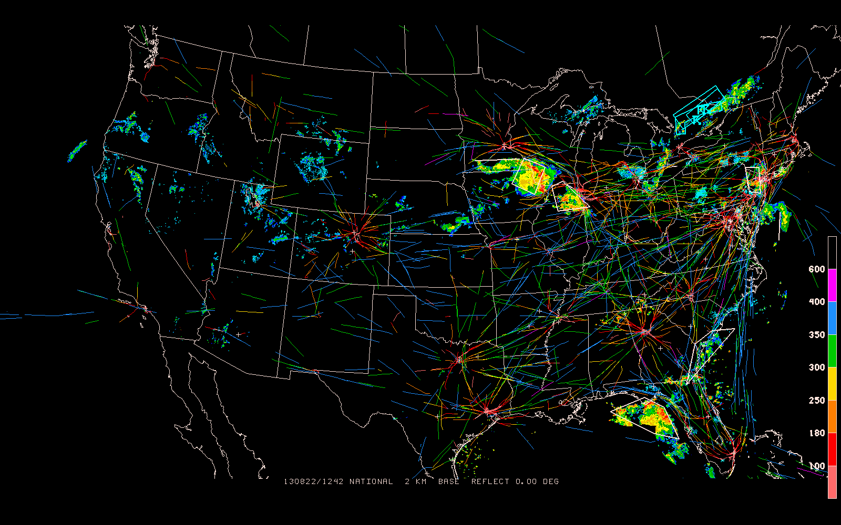

Slide 17
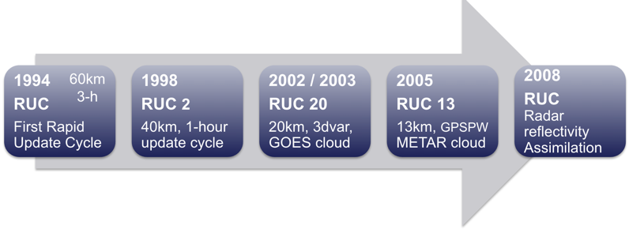
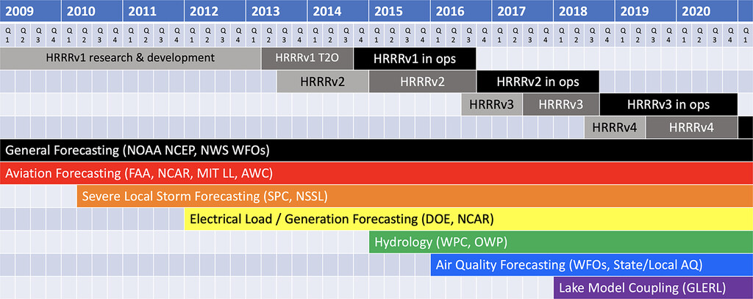
NOAA’s “Rapidly Updating” Models:
Developed at GSL → Implemented at NCEP
RUC era (1994–2012)
RAP / HRRR era (2012–2028?)
RAPv1
RAPv2
RAPv3
RAPv4
RAPv5
RRFSv1 implementation expected in ~July 2026
HRRRv4 and RAPv5 likely to be retired in ~2028
Adapted from Fig. 1 in James et al. (2022) (WAF)

Slide 18
Joe Grim

Slide 19
Joe Grim
NSF NCAR RAL
Various Convective Aviation Meteorology Assessment Techniques
Coauthors: James Pinto, Ken Stone, Tom Blitz, Matthew Wilson
21 April 2026
“This research is in response to requirements and funding by the Federal Aviation Administration (FAA).The views expressed are those of the authors and do not necessarily represent the official policy or position of the FAA.”

Slide 20
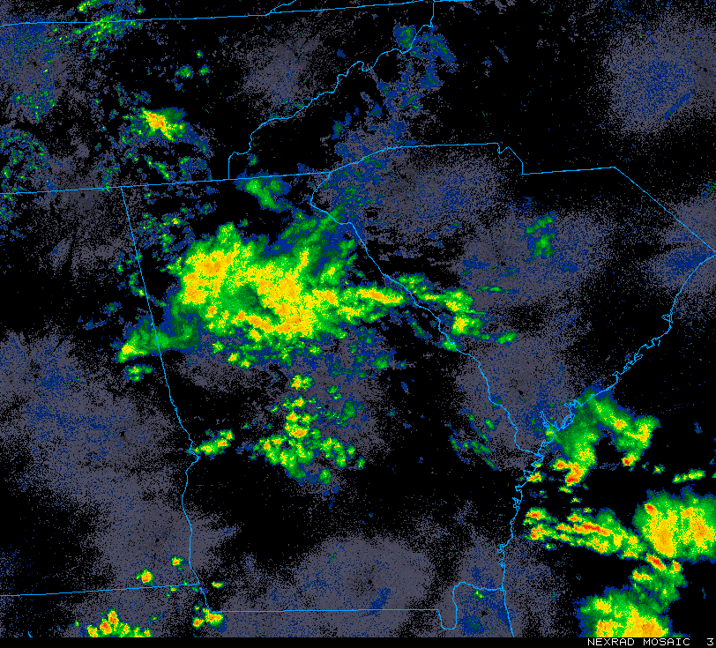
Assessing convective timing near core 30 airports
example image: KATL 03 Aug 1200 UTC yellow = 35dBZ
TRACON
airport
80 km
KATL
17% coverage > 35 dBZ

Slide 21
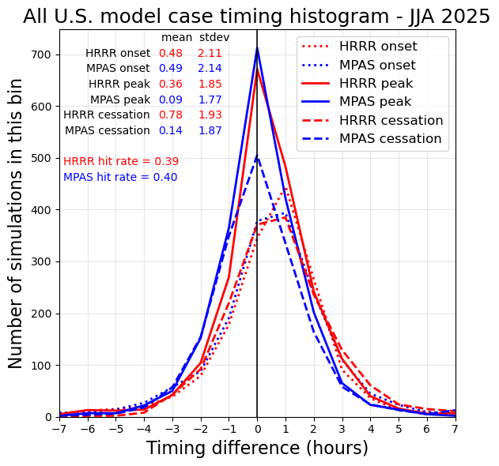
Assessing convective timing near core 30 airports
How did timing vary by model?
• hourly model data
• timing histogram depcits mode
• more precise timing biases indicated by mean values
• higher-temporal resolution would provide more details
HRRR
• ~1/2 hour late for onset
• ~1/3 hour late for peak
• ~3/4 hour late for cessation
MPAS
• ~1/2 hour late for onset
• ~1/10 hour late for peak
• ~1/10 hour late for cessation
see our April 30 final report for more

Slide 22
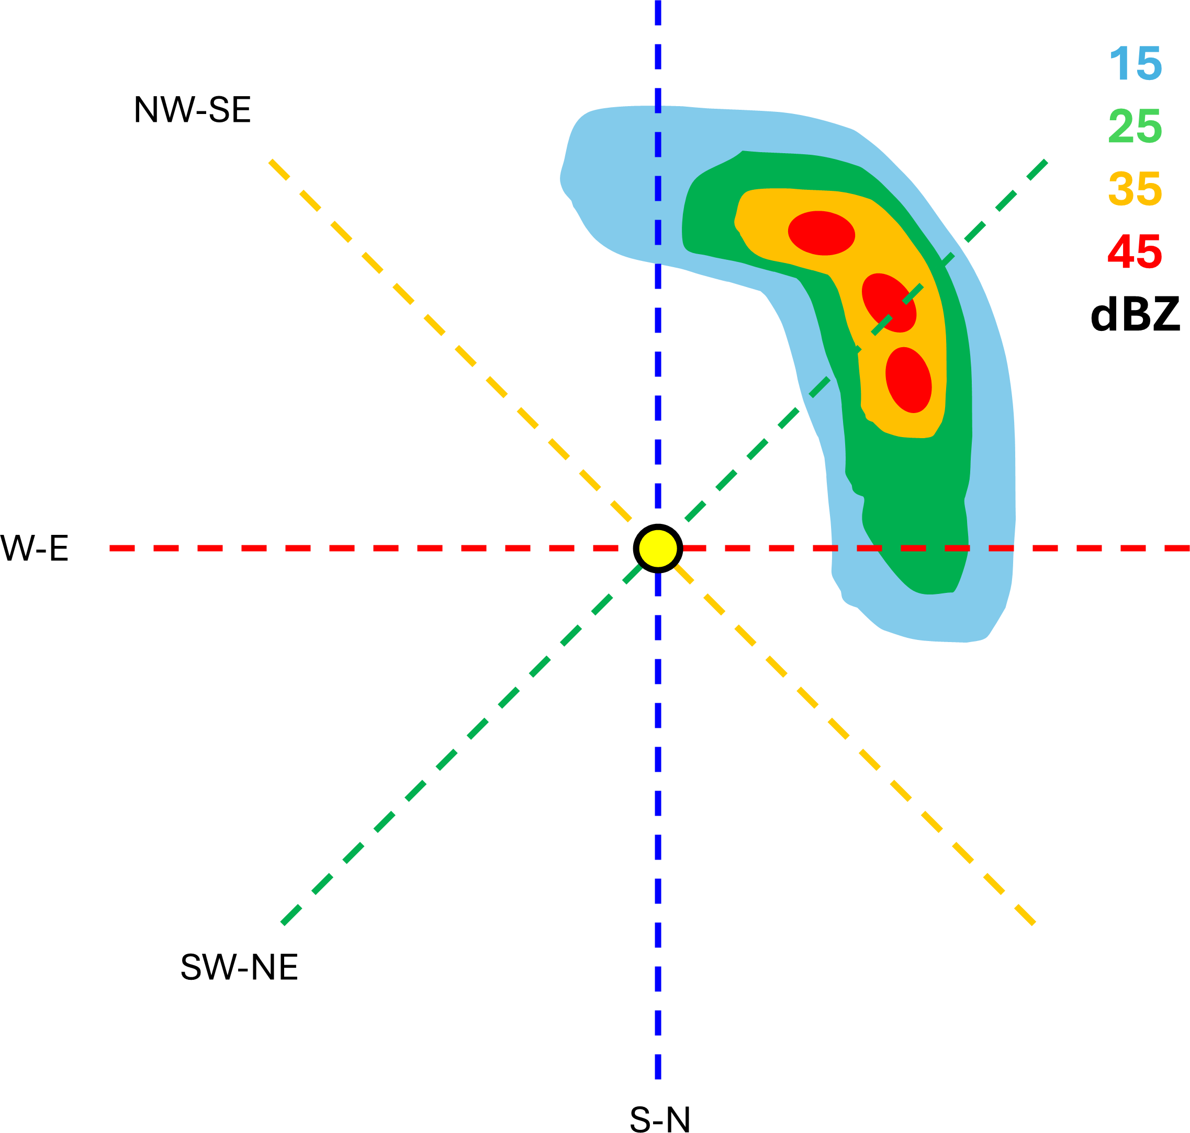
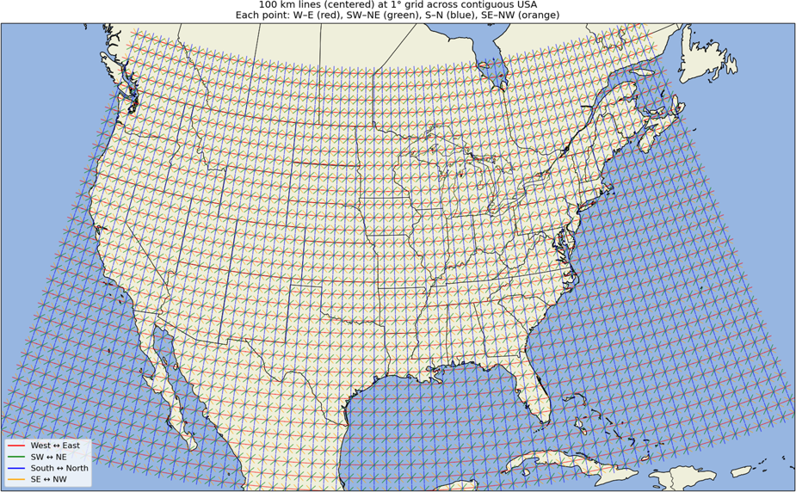
Assessing U.S. flight path permeability by flight direction

Slide 23
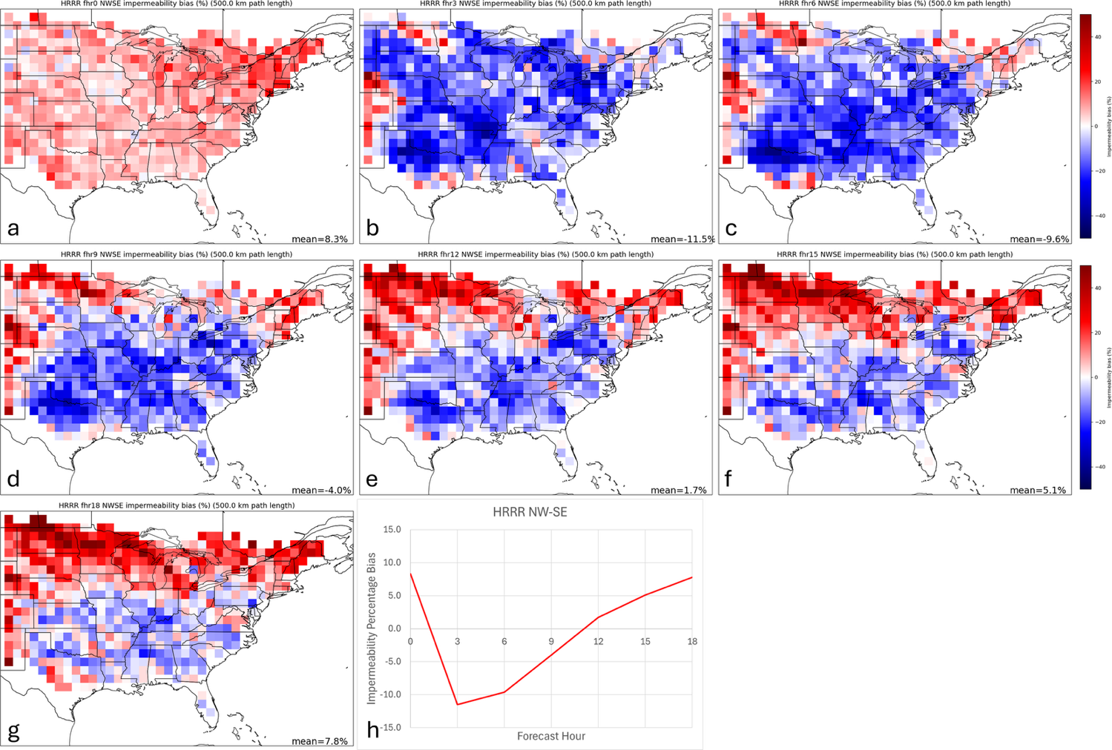
Assessing U.S. flight path permeability by flight direction
fhr00
fhr03
fhr06
fhr15
fhr09
fhr12
example HRRR
NW-SE permeability plot
JJA 2025
fhr18
see our April 30 final report for more

Slide 24
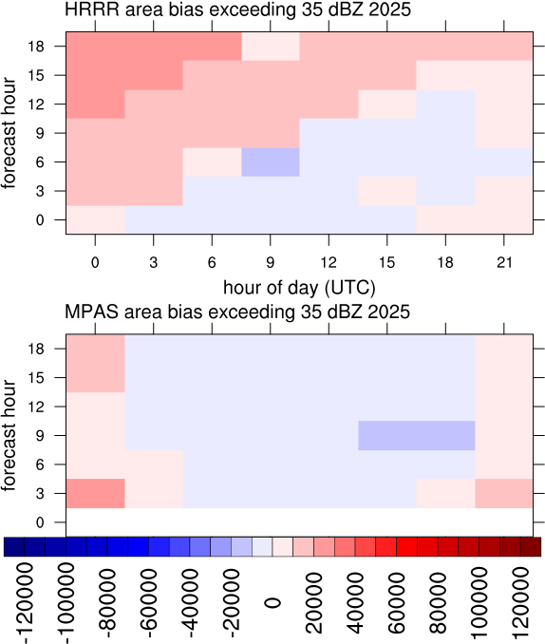
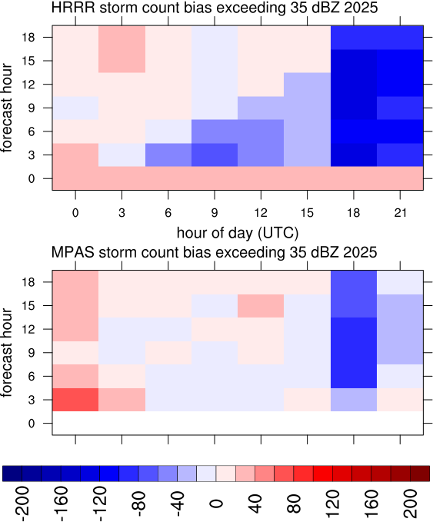
Assessing U.S. model storm area and count biases by time and forecast hour
see our October 31 report for more

Slide 25
Mike Baldwin

Slide 26
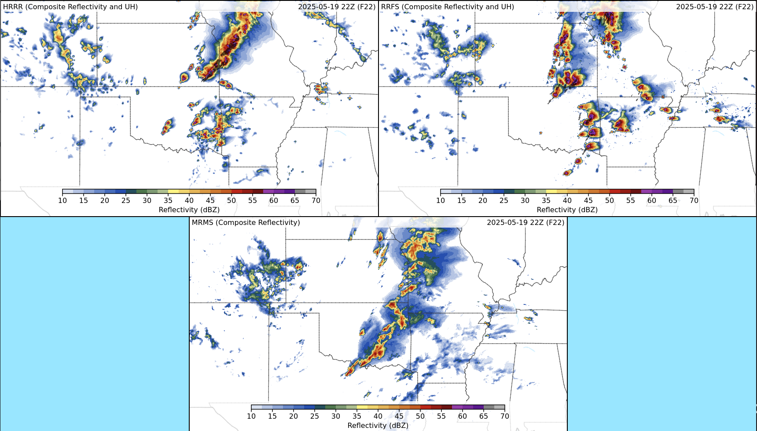


Evaluating the costs of using a forecast system
using a simple “protect/no-protect” decision model
Mike Baldwin
CIWRO/University of Oklahoma
background image created by Tim Supinie (NOAA/SPC)

Slide 27
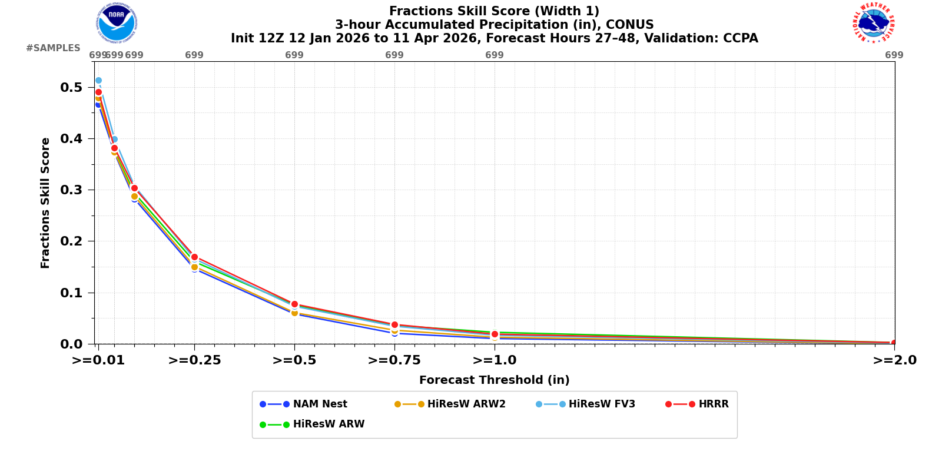
forecasts are evaluated by some performance measure
basis for changes/updates to forecast systems
we don’t fully understand the ramifications of the choice of measures, how those might affect users and decision-making
simple models of decision-making can help determine the range of users that benefit from using the forecasts
https://www.emc.ncep.noaa.gov/users/verification/regional/cam/prod/det/grid2grid/precip/

Slide 28
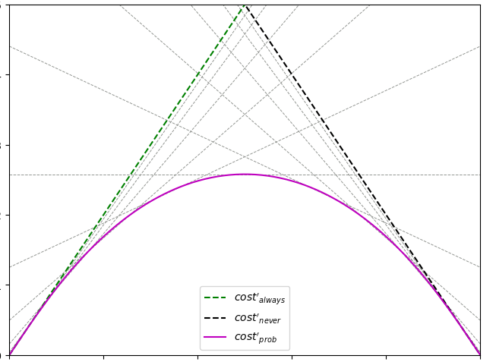
costs to decision-makers of using forecasts
always protect
never protect
forecast system
costs
sensitive to missed events
decision-maker error sensitivity
sensitive to false alarms

Slide 29
costs to decision-makers of using forecasts
always protect
never protect
forecast system
warning high-threshold
costs
higher “warning” decision-threshold leans toward avoiding false alarms
sensitive to missed events
decision-maker error sensitivity
sensitive to false alarms

Slide 30
costs to decision-makers of using forecasts
always protect
never protect
forecast system
warning high-threshold
warning low-threshold
costs
lower “warning” decision-threshold leans toward avoiding missed events
higher “warning” decision-threshold leans toward avoiding false alarms
sensitive to missed events
decision-maker error sensitivity
sensitive to false alarms

Slide 31
Burkely Gallo

Slide 32
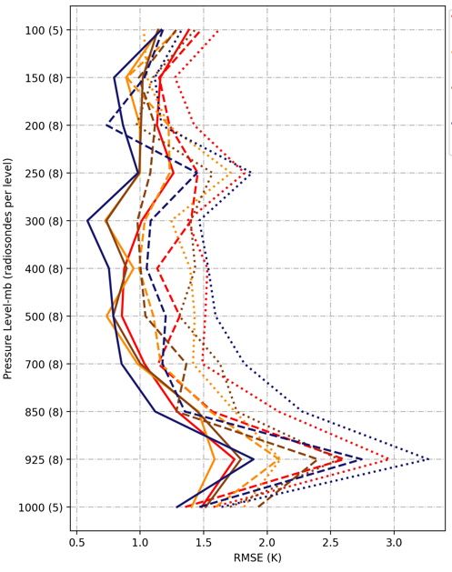
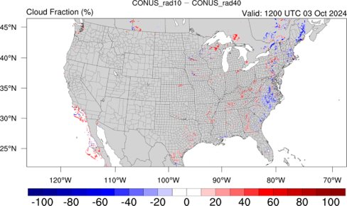
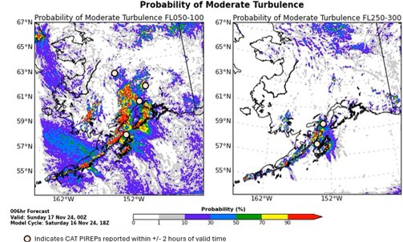
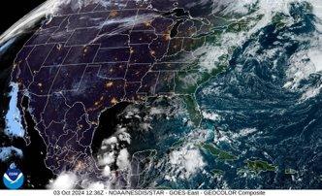
What Makes a Forecast Useful? Takes from Dr. Burkely Gallo, of USAF’s 16 WS
Statistics are meaningless unless they tell a story
Subjective and process-based verification ensure relevance
Metrics should be tailored to the problem set or use case

