Slide 1
ASTM F3673-24
Weather Information Providers Standard Update
Notes:
Introduce myself and Gus with out ASTM Hats

Slide 2
Motivation
Why this matters now
Need for trusted weather beyond traditional airport coverage
ASTM F3673-24 is an attempt to standardize what “usable weather information” means
Operational need
VWOS example
MOC
ASTM
Notes:
Today’s objective: context → structure → motivation → practical setup

Slide 3
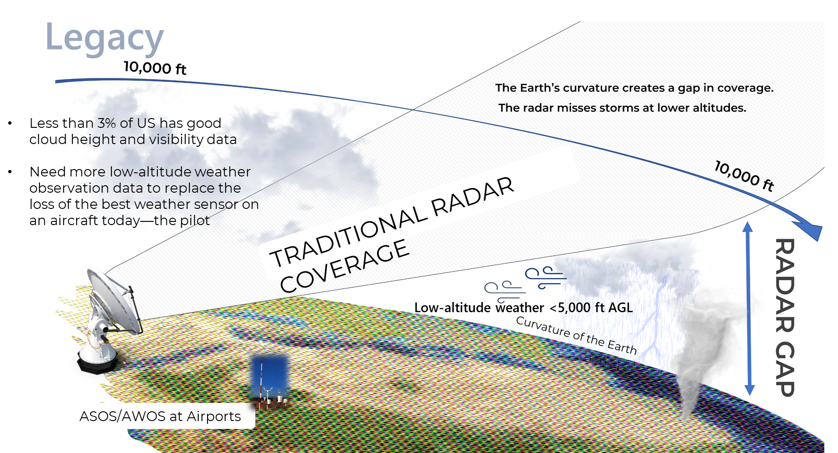
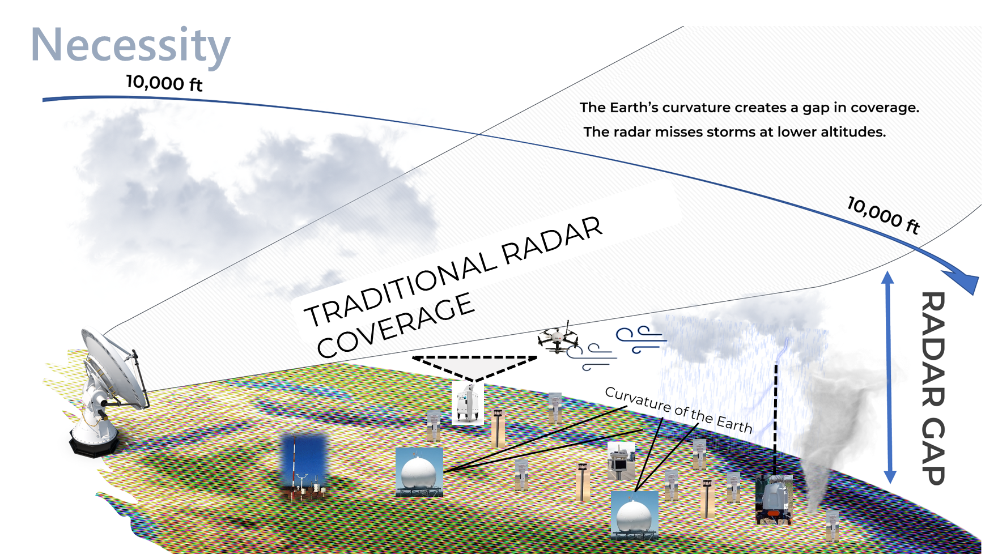
Why the Standard Exists
Low-altitude weather gaps
UAS/AAM operations are moving into areas with major low-altitude weather gaps
Non-traditional weather sources will be needed for safe scaling
The question is no longer “can data be provided?”
The question is “can the data be trusted for operational decision-making?”
Applicability to GA
Notes:
Broader architecture
trusted local weather
standardized interfaces
known uncertainty / quality
Relevance to GA
supplemental weather sources
localized situational awareness
better interoperability with decision-support tools
Especially helicopter operations. They have been mitigating gaps in local weather information with pilot heuristics. With operations pulling the pilot off the aircraft, we are losing that heuristics. But even with a pilot on board, having access to higher density weather information away from airports will only help improve safety and efficiency.

Slide 4

ASTM
What is ASTM?
ASTM is a voluntary consensus standards organization
Founded in 1898 as the American Society for Testing and Materials
Renamed ASTM International in 2001 to reflect global role in standards development
Standards are developed through technical committees, subcommittees, and task groups
Creates common performance language across regulators, operators, suppliers, and researchers
Credit: Alexandra Florin
Notes:
Founded in 1898 in Philadelphia as the American Society for Testing and Materials to address failures in railroad steel rails
Renamed ASTM International in 2001 to reflect global role in standards development
Its mission is: “Helping our world work better by creating a foundation for trust, trade, and transformation through the power of global standardization.”
Why it matters: creates common performance language across regulators, operators, suppliers, and researchers In this case: moves weather from “available” to “defensible and interoperable”
Image link: (26) Post | LinkedIn

Slide 5

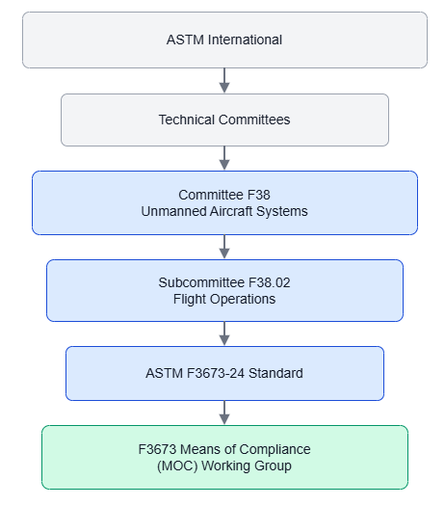

ASTM – Structure and Process
Standard
ASTM Hierarchy
Standards Development Process
Notes:
In this case: moves weather from “available” to “defensible and interoperable”
What I do not have on the plot is what happens after the publication. The standard has to be reviewed, renewed, and sometimes revised. Otherwise it risks becoming irrelevant
Other F38 lanes include airworthiness and personnel/training
Standard Development Process
Identify a gap or operational need
Define scope, objective, deliverables, timeline
Develop draft language, annexes, appendices
Resolve comments and align text
Subcommittee ballot, then committee ballot
Published consensus standard
Test Method Standards
These are standardized methods designed to produce consistent and reliable test outcomes, typically used to identify, measure, or assess specific properties or characteristics.
Practice Method Standard
Practice Method Standards provide procedural guidelines for carrying out specific operations that do not yield measurable test results. They may include tasks such as cleaning, sampling, training, inspection, or material preparation.
Specification Standards
Specification Standards outline the mandatory criteria that a material, product, system, or service must fulfil. They include defined test methods to verify compliance with physical, chemical, mechanical, safety, quality, and performance requirements.
Classification Standards
Classification Standards provide a systematic framework for dividing materials or products into groups that exhibit similar traits in terms of behaviour, composition, or practical use.
Guide Standards
Guide Standards present general information and a range of possible approaches without endorsing any method. They are intended to inform stakeholders about current practices within a specific subject area.
Terminology Standards
These standards provide clear definitions of terms along with explanations of symbols, abbreviations, and acronyms used within a particular field.
What are ASTM Standards? Full Form, Types, and Uses
F38 Committee Scope:
4.1 The Scope of the Committee shall be the development of standards and guidance materials for unmanned aircraft systems. The work of this Committee will be coordinated with other ASTM Committees and organizations having mutual interest. 4.2 The focus of the committee shall be the development of standards and publications including (but not necessarily limited to): 4.2.1 Minimum safety, performance, and flight proficiency requirements. 4.2.2 Quality
assurance – to install manufacturing controls assuring aircraft conform to design criteria. 4.2.3 Production acceptance tests and procedures assuring that the completed aircraft systems meet reported performance as demonstrated in the prototype aircraft system. This performance includes limits such as: empty weight and center of gravity, performance specifications, controllability and maneuverability trim, stability, stall speed and handling characteristics, engine cooling and operating characteristics, propeller limits, systems functions, and folding or removable lifting surfaces. 4.3.3 A baseline plan for continued airworthiness systems, including methods for monitoring and maintaining continued operational safety, and processes for identifying, reporting, and remedying safety-of-flight issues.

Slide 6
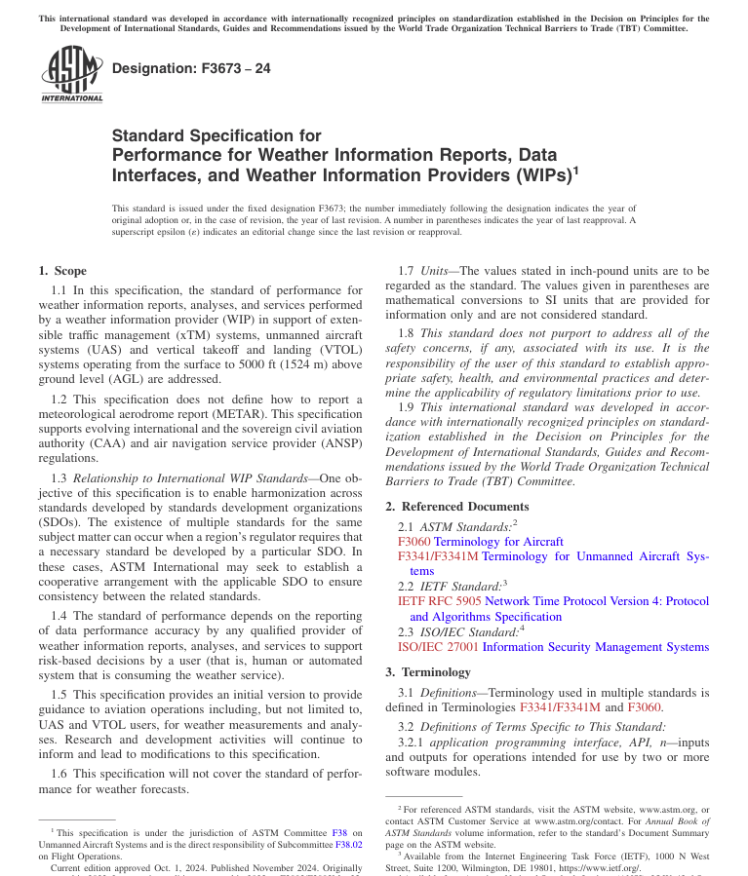
The Weather Standard
ASTM F3673-24
Purpose: Define performance requirements for Weather Information Providers (WIPs).
Scope: UAS, VTOL, and xTM operations from the surface to 5000 ft AGL
Key Principle: Seeks to develop a data-centric, source-agnostic framework for evaluating weather information.
Primary Components
Weather Data Performance and Tiering
Quality Control Measures
Data Reliability, Security, and Management
Metadata
Status: Published and under revision
Notes:
Current edition published November 2024
Next revision likely in 2026
Expected to go to ballot December 2025
Will capture MOC, metadata, and other items that emerged during previous balloting
eXtensible Traffic Management (xTM), a NASA and FAA framework for managing high-altitude (above 60,000 ft) or low-altitude UAS traffic
Purpose: Define performance requirements for Weather Information Providers (WIPs)
Scope: Extensible traffic management systems, uncrewed aircraft systems, and vertical takeoff and landing systems operating from the surface to 5000 ft above ground level.
Approach: Data performance approach that leverages a tier-based weather data quantification framework.
Key Principle: The standard of performance depends on the reporting of data performance accuracy from reliable sources meeting security requirements.

Slide 7
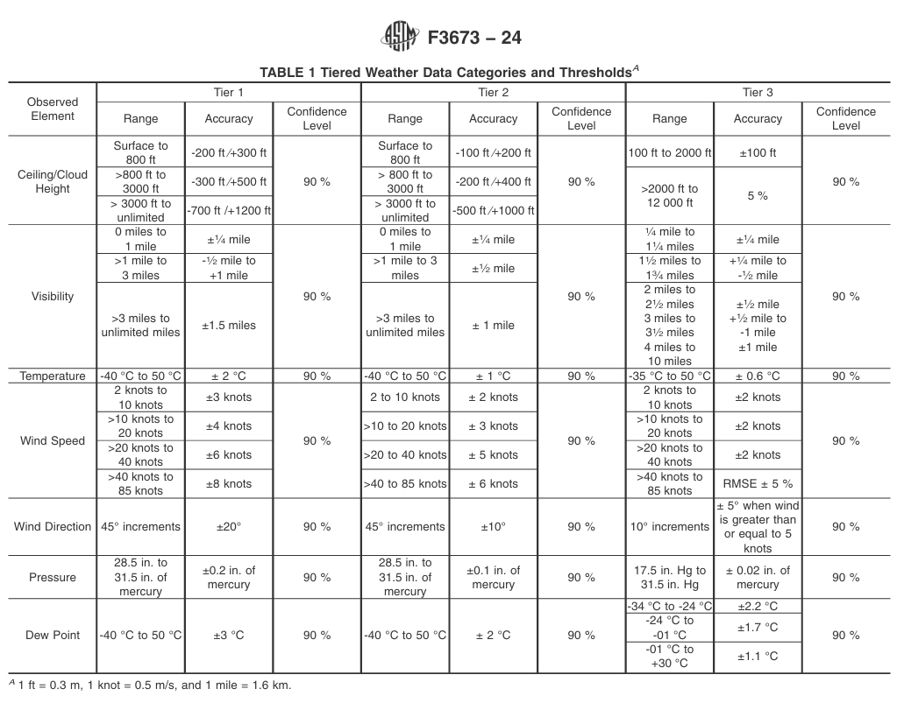
Focusing on the Data
ASTM F3673 is a data-centric standard
Traditional approach: certify the observing system
F3673 approach: evaluate the reported weather element and supporting evidence
Source is treated as an abstraction: in situ, remote, derived, or analyzed
Table 1 organized around parameter performance thresholds
Bottom line: Current version is a hybrid framework allowing for both well-known, long-term data sources and new sources to enter the low-altitude aviation ecosystem.
Notes:
F3673 does not start with “What device is this?” It starts with “What weather element is being reported, how well does it perform, and what supports that claim?”

Slide 8
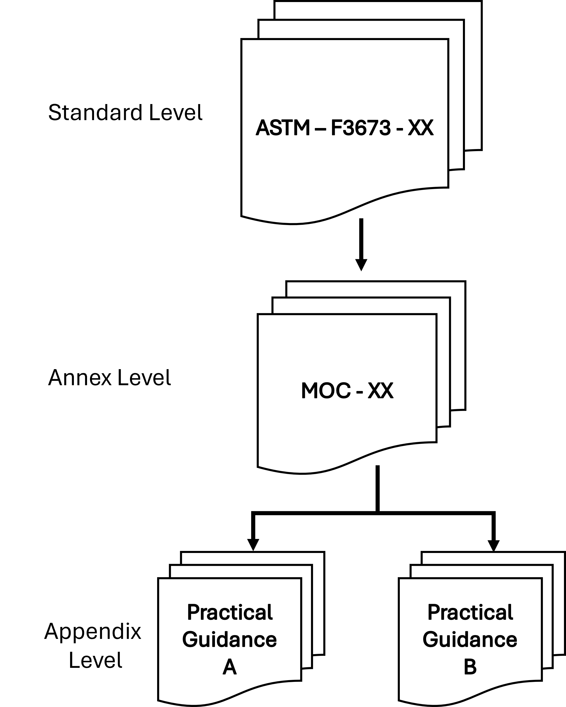
Compliance with ASTM F3673-24
Means of Compliance Work Group
Operationalizing the standard requires documentation of how compliance can be demonstrated
Goal of the group is to develop objective, verifiable, and auditable pathways for F3673 requirements
MOC deliverables:
Recommended revisions to F3673-24
MOC Annex
Compliance matrix
Appendix A: Weather Information Source Assessment
Appendix B: Metadata
Appendix C: Timestamp definitions
Notes:
Early findings from MOC work
Achievable pathway with MOC Annex adoption
Overly burdensome requirements need to be addressed
E.g., Grid-to-point verification for analyzed weather data
Tier approach limits communication of dynamic uncertainty information
Methods defining representativeness need to be demonstrated

Slide 9
Means of Compliance Status
Final internal review before ballot
November 2024
Current edition of F3673-24 published
May 2026
MOC work group revisions head to ballot
Fall 2026
Revision of F3673 expected to be published
Ongoing Development
New working group to review items tabled for alter revision
Need for Nowcast standard work group?
Notes:
Connect with me or Gus if you are interested in joining this “early access” internal review of the proposed MOC annex before it heads to the ASTM subcommittee for balloting.

Slide 10
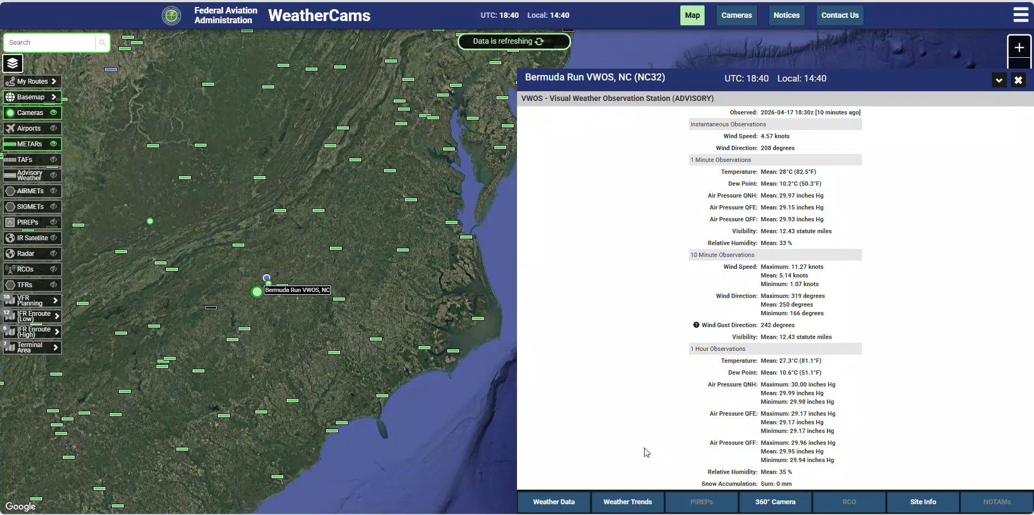
Introduction to FAA’s Visual Weather Observation System
What is VWOS?
Combines advanced 360° imagery with AWOS-grade surface weather observations
Demonstrated first in Alaska; four systems remain operational at Eek, Tatitlek, Healy River, and Palmer
Newest deployment in Bermuda Run, NC
Goal is for VWOS information to be usable by Part 91 and Part 135 operators for flight planning in Alaska
Can F3673 be a path to VWOS NAS integration?
Notes:
What It Provides
360° visual weather imagery
Wind, ceiling, visibility, present weather
Temperature, humidity / dew point, pressure
Automated self-checks and validity monitoring
Most systems are require 3-4 months to acquire/build/ship and only 2-3 days to install.

Slide 11
Practical Entry Point
Weather Information Performance Assessment
Compliance begins with assessing the characteristics of the data source
Core questions:
What is the data source?
How was it deployed?
Was the data validated following F3673 Annex guidance?
What evidence supports tiering / non-tier status?

Slide 12
VWOS Parameters
Leverages AWOS-Grade Technology to Monitor:
Anemometer (Well-established) – Measures Wind Direction/Speed
Heated ultrasonic or traditional cup anemometer
Temperature / Relative Humidity Sensor w/ Radiation Shield (Well-established)
Barometric Pressure Sensor w/ Gill Ports (Well-established)
Triple redundant & calibrated yearly
Visibility & Present Weather Sensor (Well-established)
Ceilometer (Well-established)
Lidar-derived sky condition & vertical visibility reports (Heated/blower)
Select locations
Supplemental Weather Cams (New)
Visual overview of the conditions at and beyond the installation location (ceiling, visibility, and present weather)
Automatic 3-stage self-checking algorithm to ensure sensor performance and data validity

Slide 13
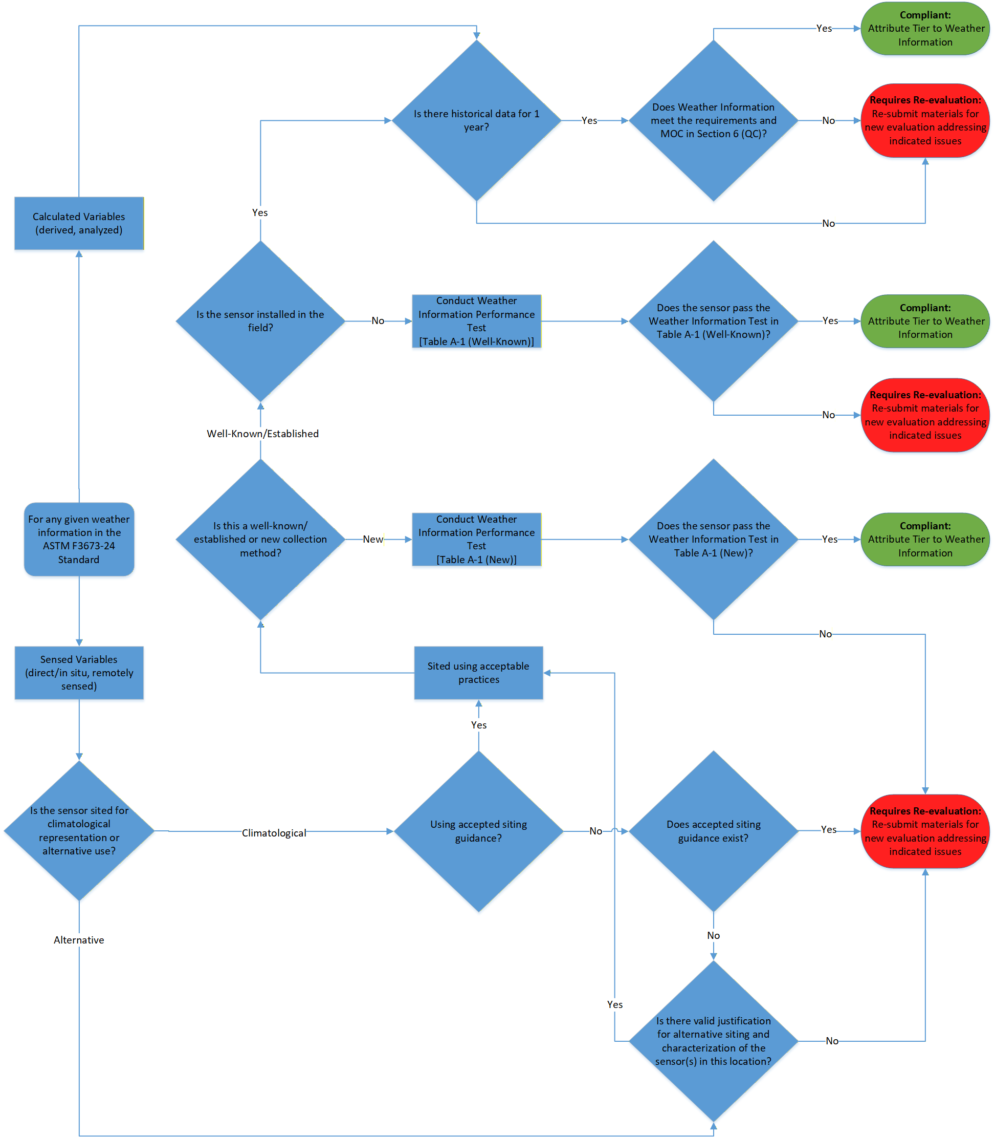

Slide 14
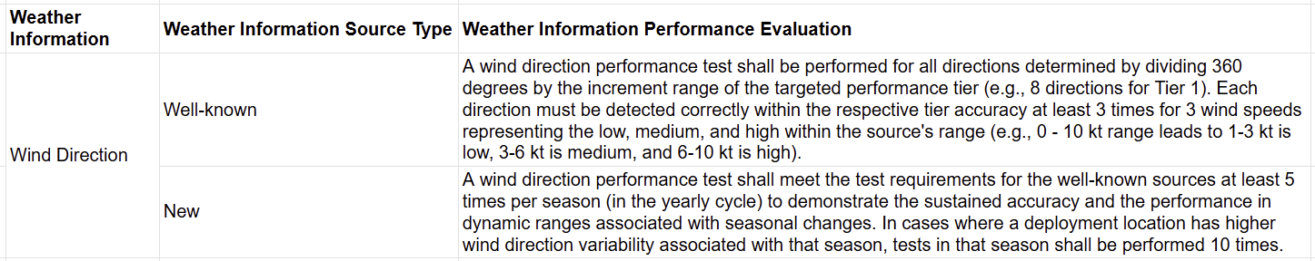
Wind Direction Evaluation

Slide 15
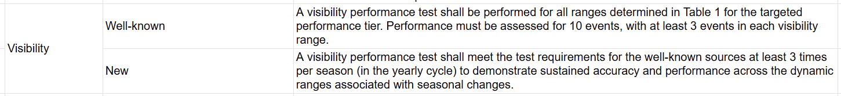
Visibility Evaluation

Slide 16
Thank You
Contact:
Chris Zarzar
Chris.Zarzar@TruWeatherSolutions.com

Slide 17
EXTRA

Slide 19
Weather Standard(s) Next Steps/?s
How do we best support Part 108 and future autonomous operations?
New standard will be required for Nowcasts
Needs of Human-in-Loop vs. Human-out-of-the-loop?
F3673-24 tiering approach is effective to support human operator decision making
Autonomous operations best served with dynamic uncertainty information to continuously calculate and mitigate risk
Prescriptive tiers → uncertainty reporting transition?
Dynamic uncertainty reporting enables risk management at scale
Notes:
And risk mitigation based on platform and payload characteristics
Weather data already has dynamic uncertainty (e.g. radar data impacted by ground clutter, hail spikes, bird migrations)
Today: meteorologists interpret uncertainty for human operators
Tomorrow: machines will need direct uncertainty inputs to assess risk in real time

Slide 20
Potentially Helpful Information
NPRM, NTAP, Part 108, Part 146, and ADSPs
NTAP: Near Term Approval Process
Automated Data Service Providers (ADSPs): Will serve as certificated sources distributing approved performance-based services.
Part 108: Defines operational requirements for BVLOS UAS.
Part 146: Establishes oversight for ADSPs through Service Provider Standard Orders (SPSOs) compliance mechanisms.
NPRM addressing the issue of BVLOS weather risk:
2120-AL82 1652-AA80 BVLOS NPRM (pp. 96-99, Preamble): “Given that part 108 UAS operations would operate primarily outside of this area of approved observation coverage, those operations will need additional sources of weather information to operate safely. FAA anticipates that some of this weather information gap could be filled by third-party weather providers or come from other non-traditional sources, such as locally owned and operated devices.”
Notes:
Briefly explain NTAP and how we are working directly with FAA to understand the current state of the standard, but the challenge of this approach with the knowledge of a forthcoming revisions.
MOP Project will:
Focus on safe integration of 3PWP information into the NAS
Testing campaign designed to evaluate ASTM F3673-24 requirements in practice
Leverage TruWeather testbeds

