Slide 1
FPAW Spring 2026 Adverse Weather in Airline Operations
Captain Christian Amaral
Air Traffic Safety Group

Slide 2

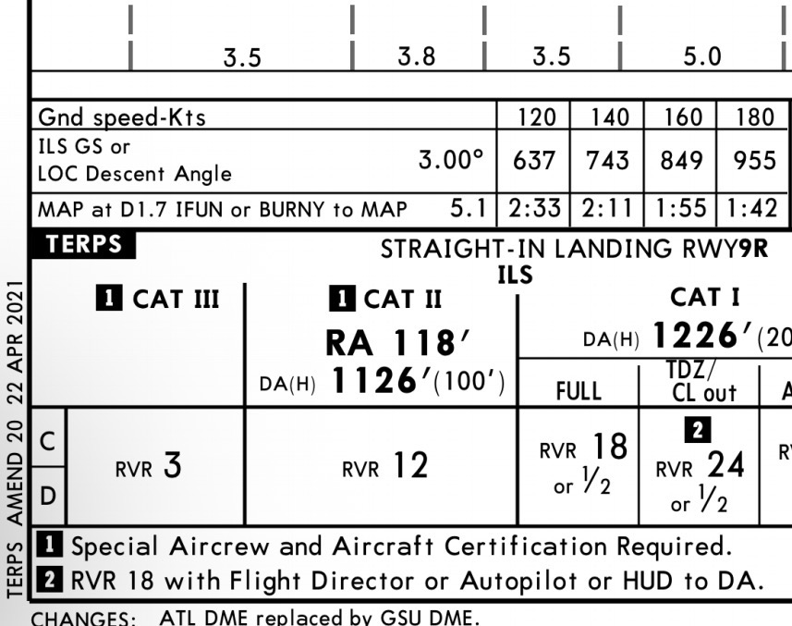
Clouds/Visibility?
What’s a go/no-go decision????
Confirmation Bias may be biggest threat!

Slide 3
Inflight Icing?
Generally, very minor
Jets: Greatest ice buildup on lengthy downwind in damp, cold conditions
Props: Pick up significantly more icing in same conditions
Roselawn, IN – American Eagle ATR-72, 1994
ATR icing limitations poorly understood
Met knowledge/first principles might have helped!
ATS Group

Slide 4
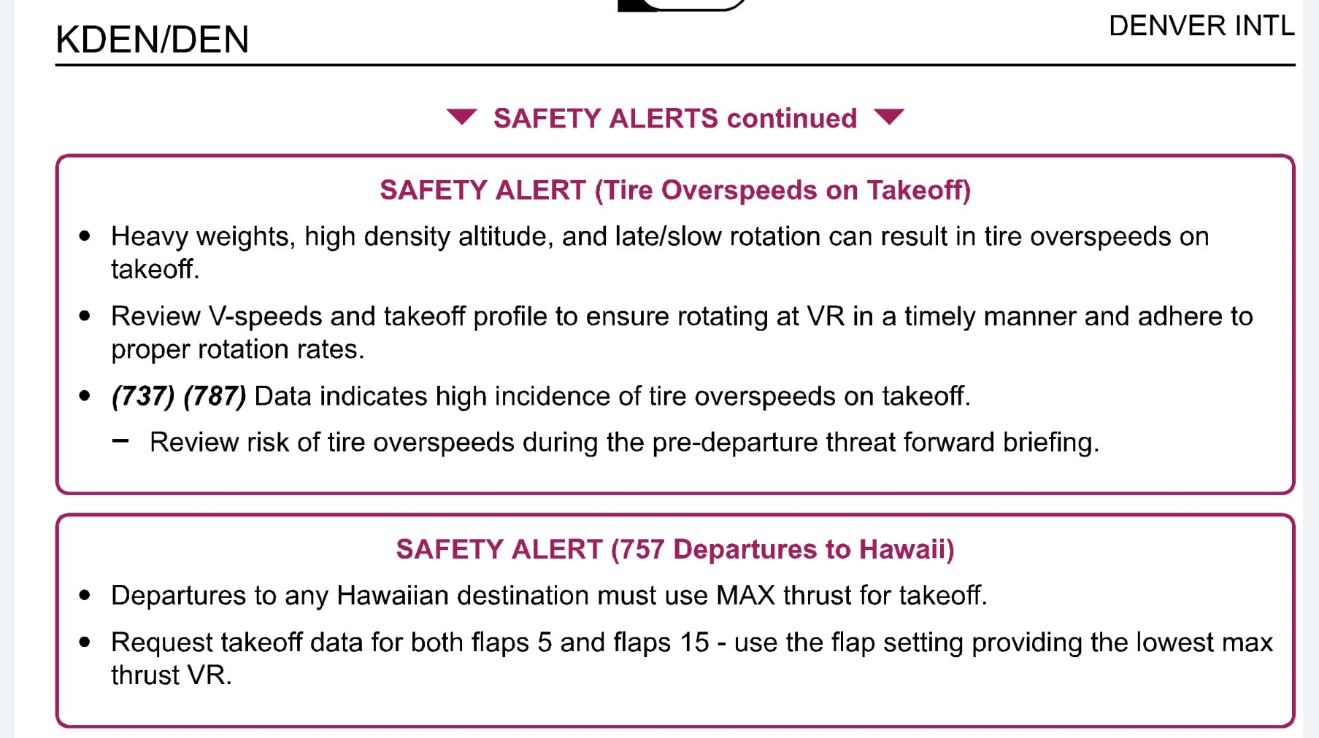
Density Altitude/“Hot and High” Impacts?
Can impact payload
Workarounds
Thrust
Normally “Trick” into Reduced
Tire Speed Limits
“Bleeds Off” Takeoff
ATS Group

Slide 5
When Those Run Out…
DEN, Summer 2023, CRJ700 DEN-SBP
Airport elevation: 5434’
ATIS:
F 1653Z 200/11G15 8SM HZ FEW050 33/7 3010 (Boarding time)
G 1753Z 180/10G17 8SM HZ SKC 35/7 3011
H 1853Z 220/9G17 7SM HZ SKC 38/8 3010
Started with 70 pax (out of 76 seats), ended with 58!
ATS Group

Slide 6
Convective Impacts – Part 1 KBTV-KDEN – August 2025
Arrival Planned for 0000Z
Destination Weather TAF
012330Z 0200/0304 160/8 P6SM FEW 030
FM1500 21015G28 P6SM FEW035 SCT500
FM1800 24022G30 P6SM VCTS SCT035CB
FM1900 VRB25G35 TSRA SCT035CB
TEMPO 0220/0302 1/2SM +TSRA GS SCT040CB
BECMG 0301/0303 NSW SKC
ATS Group

Slide 7
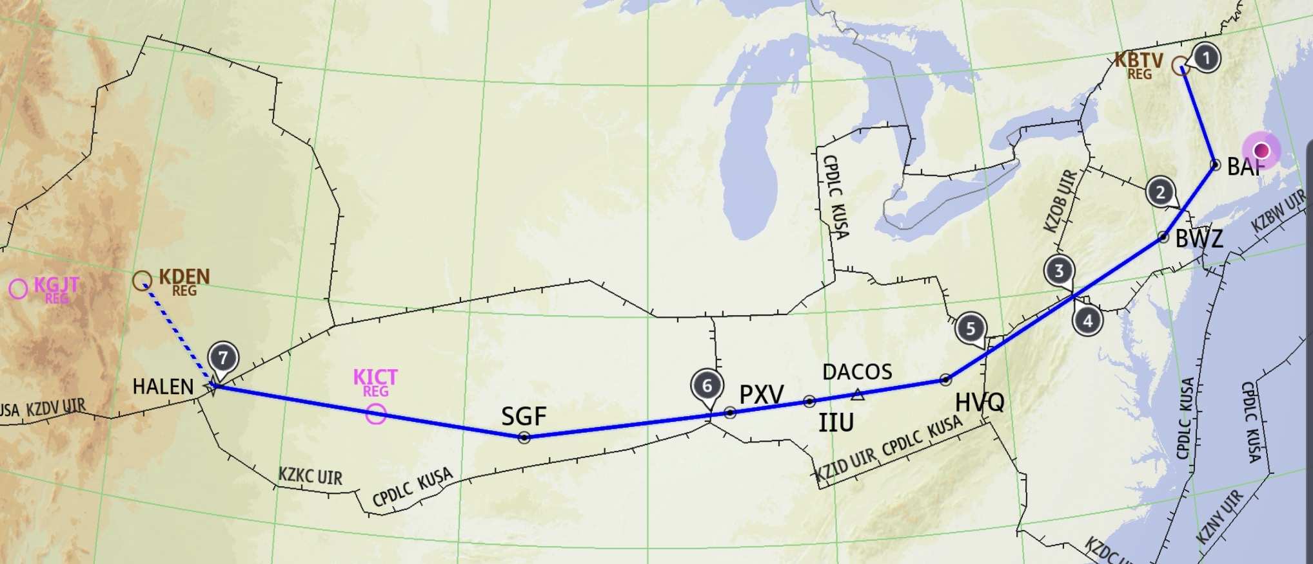

Flight Plan/Initially Cleared Route
TSRA
ATS Group

Slide 8
Fuel Planning
Landing DEN with 12k lbs fuel (~2 hrs 20 minutes) 👍
Alternate 1: KICT – 3.7k lbs fuel
Alternate 2: KGJT – 3.2k lbs fuel
Fuel required: fly to destination, go missed, then proceed to most distant alternate, and land with no less than 45 minutes of fuel
This leaves ~40 minutes of hold fuel
ATS Group

Slide 9
Enroute Considerations/Monitoring
A few shortcuts successful early
Convection blossoming all over Rockies
Still plenty of runway for daytime heating
KGJT viable???
KICT: VFR/NSW
Not many nearby divert options clear of wx
ATS Group

Slide 10
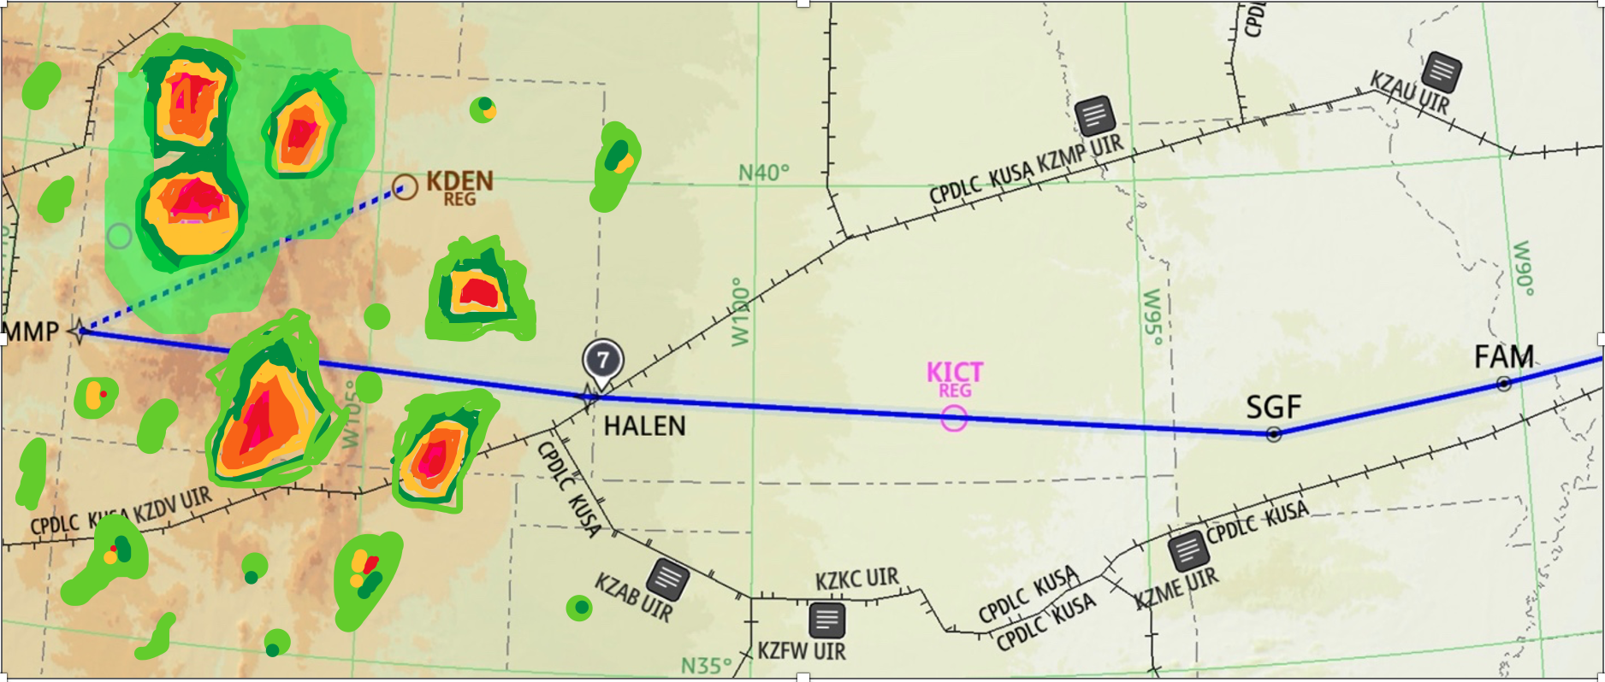
Somewhere west of PXV…
Reroute: After HALEN direct BUMMP.SSKII4 arrival
Adds ~400 miles
More in the path of weather
Narrows diversion options and wipes out hold fuel
Dispatch consulted, alternate changed to COS, but cells nearby and expanding
Overweight for landing in ICT
.
ATS Group

Slide 11
Do not edit How to change the design
What should we do?
The Slido app must be installed on every computer you’re presenting from

Slide 12
What we actually did…
Got dispatcher concurrence to land short in ICT
Required off course vector and early descent to get below MLW
Gassed up, and released 30 minutes later
Might have been nice to hold in between, but in the way at FL340 (ish), and descents narrow options
ATS Group

Slide 13
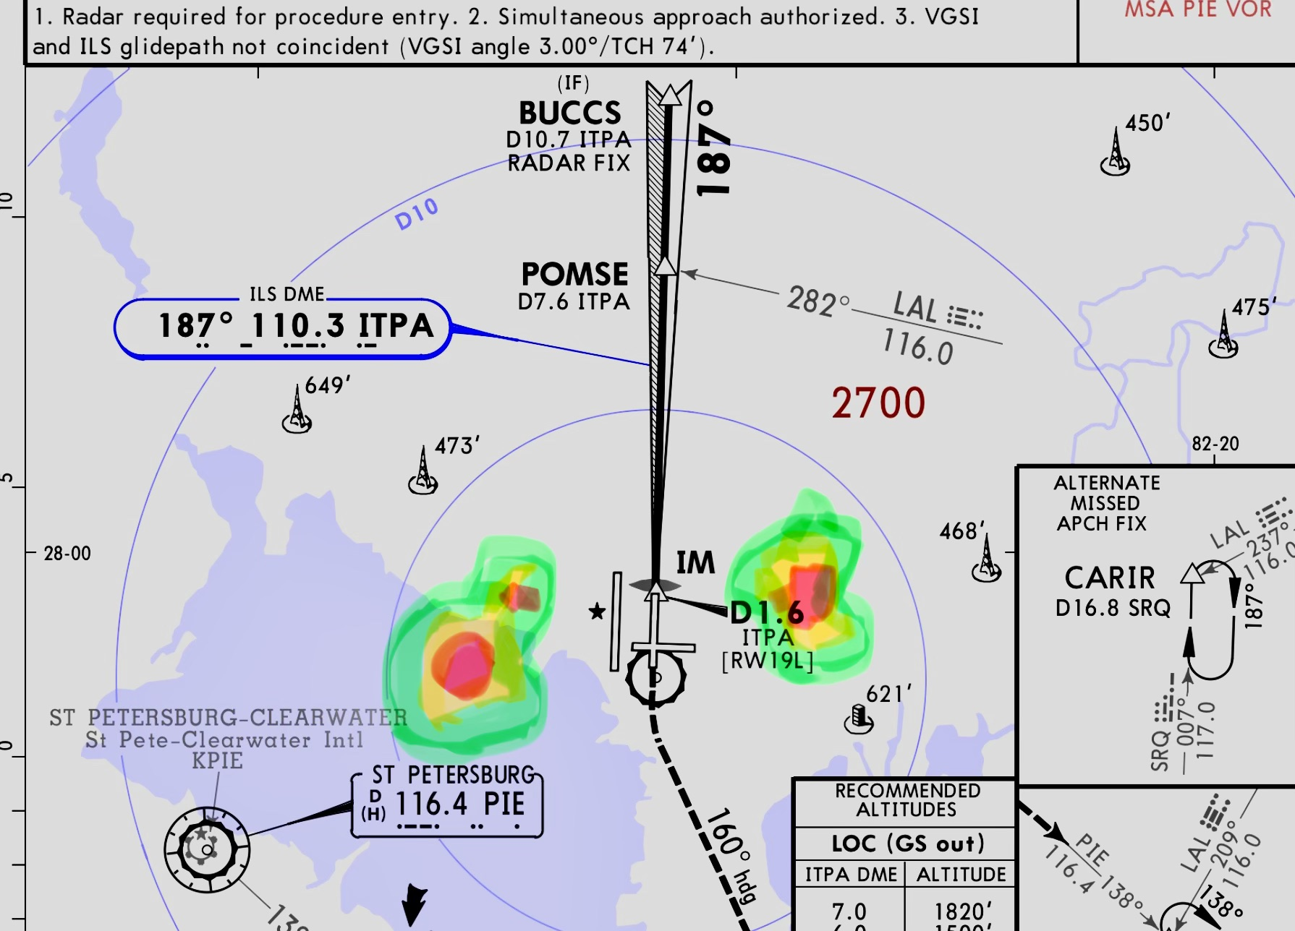
Convective Impacts – Part 2 KEWR-KTPA
Arrival time TAF
FM1600 200/09 P6SM SCT 025
FM1800 PROB30 +TSRA
Enroute prep – TEM
Approaching Final Approach Course…
ATS Group

Slide 14
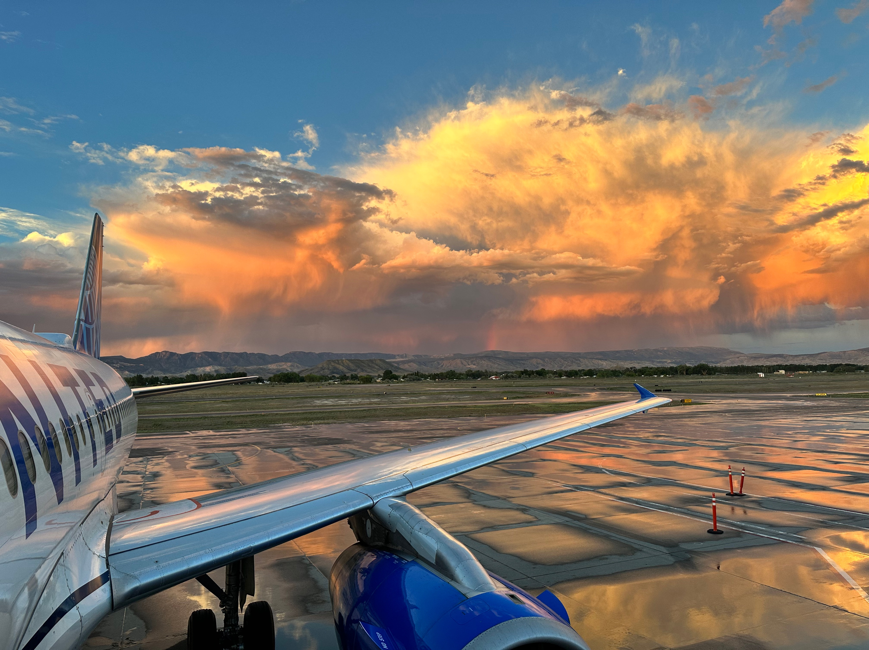
Convective Impacts – Part 3 KDEN-KMTJ
ATS Group

Slide 15
Turbulence?
Significant
Currently leading cause of Part 121 NTSB Classified Accidents
Data hugely important for seatbelt sign/service planning
Still astonishingly dynamic
Operator’s weather knowledge remains crucial!!
ATS Group

Slide 16
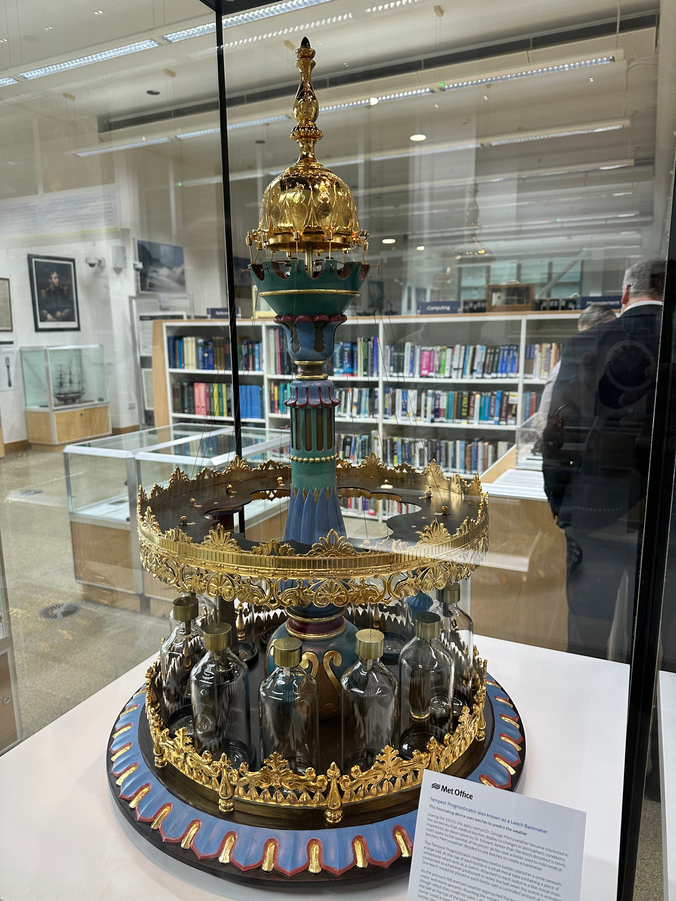
Conventional Turbulence PIREPS?
I give you…the Tempest Prognosticator
Subjective
Sparse
Stale
ATS Group

Slide 17
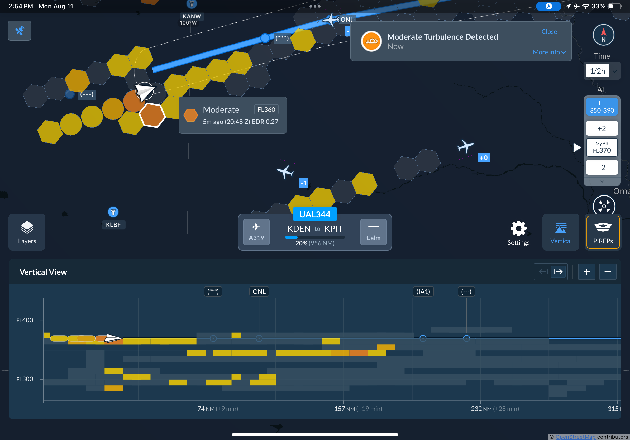
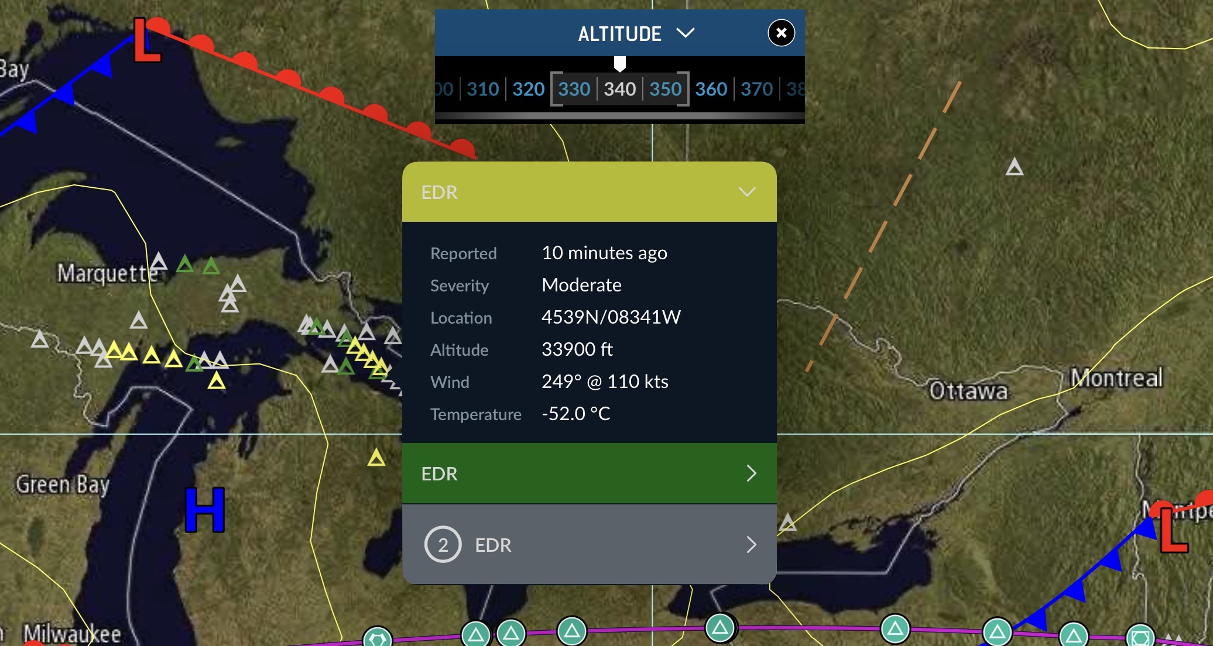
Automatic Turbulence Reporting
Variety of products and methodologies
Aircraft-measured vs. EFB/device based
Outputs differ
Despite differences, vastly superior to PIREPs alone
BUT, frequently proprietary
ATS Group

Slide 18
Wet/Snowy Surfaces?
Runway Condition Codes issued by FICON NOTAM
What about very dynamic conditions?
Heavy rain
Snow/Freezing Precip
ATS Group

Slide 19
Winter Weather – DEN-BOS February 2026
Planned arrival 0350Z – 2 Alternates listed
KBOS TAF
FM 2100 190/10 P6SM OVC015
FM 0300 210/08 2 SM –SN
TEMPO 0305 210/8 ½ SM SN OVC 007
FM 0600 230/15 P6SM BKN 025
ATS Group

Slide 20
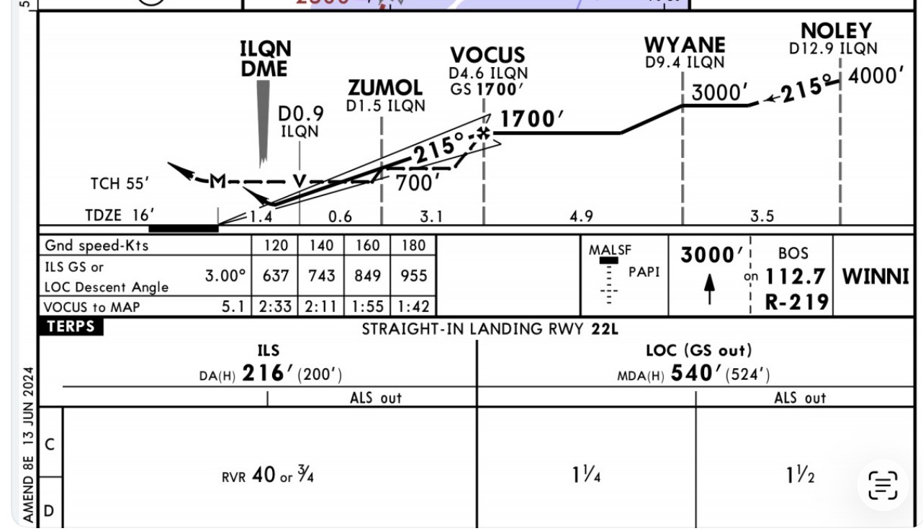
Enroute Considerations
TEM
Conservative Landing Distance Assessments for multiple runways
Approach considerations
Runway Turnoff
ATS Group

Slide 21
How it Went…
BOS ATIS Q SPECI 0325Z 170/8 1SM –SN OVC009 3021
BOS ATIS R SPECI 0333Z 160/7 1/2SM SN OVC007 3020 RVR22L 3500
#3 for landing, pivot to 15R for lower mins
1 aircraft lands, runway taken for snow removal, how about 4R?
BOS ATIS S 0353Z 200/9 3/4SM SN OVC008 3018 RVR22L 5500
Rapid improvement in vis during final
Despite advertised FICON of 5/5/5, actual BA Medium (3/3/3)
”Traffic on a 2-mile final, Can you get K?”
ATS Group

Slide 22
Impostor Syndrome??
Be not Afraid!
Excellent equipment with high levels of redundancy
Top-notch Training and Standardization
OCC/Dispatch Support and resources
Be Patient: savor time spent in the right seat
ATS Group

