Slide 1
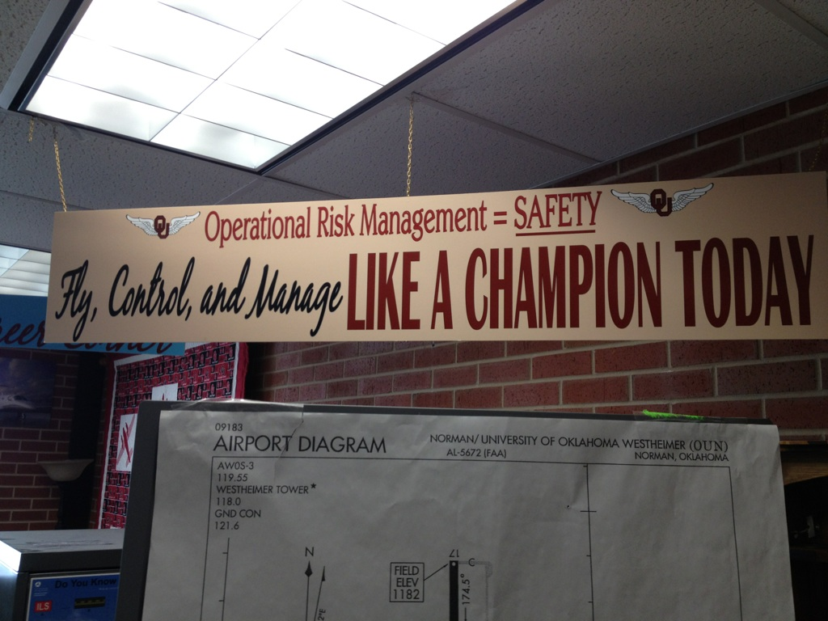
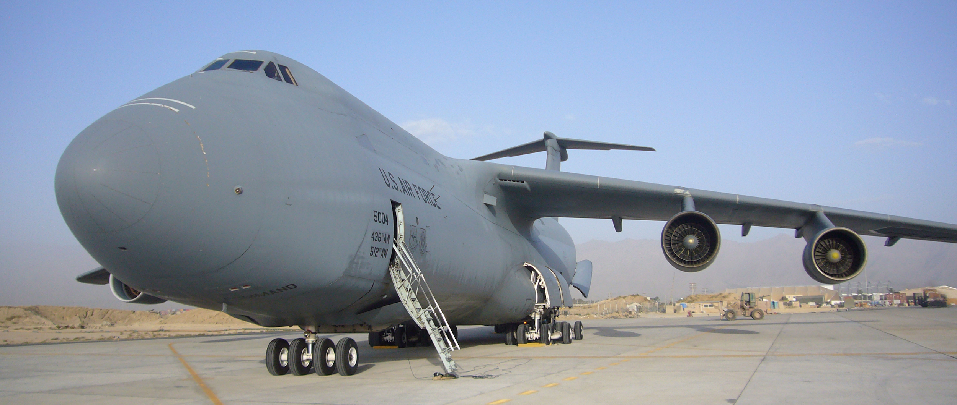
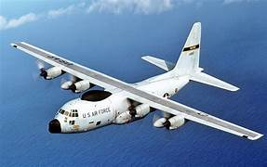
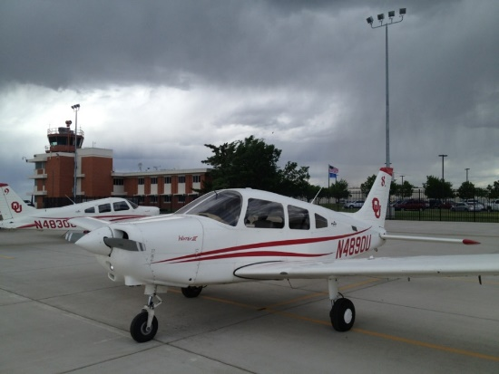
FPAW
Ken Carson
April 21-23 2016
Fly, Control and Manage Like a Champion!

Slide 2
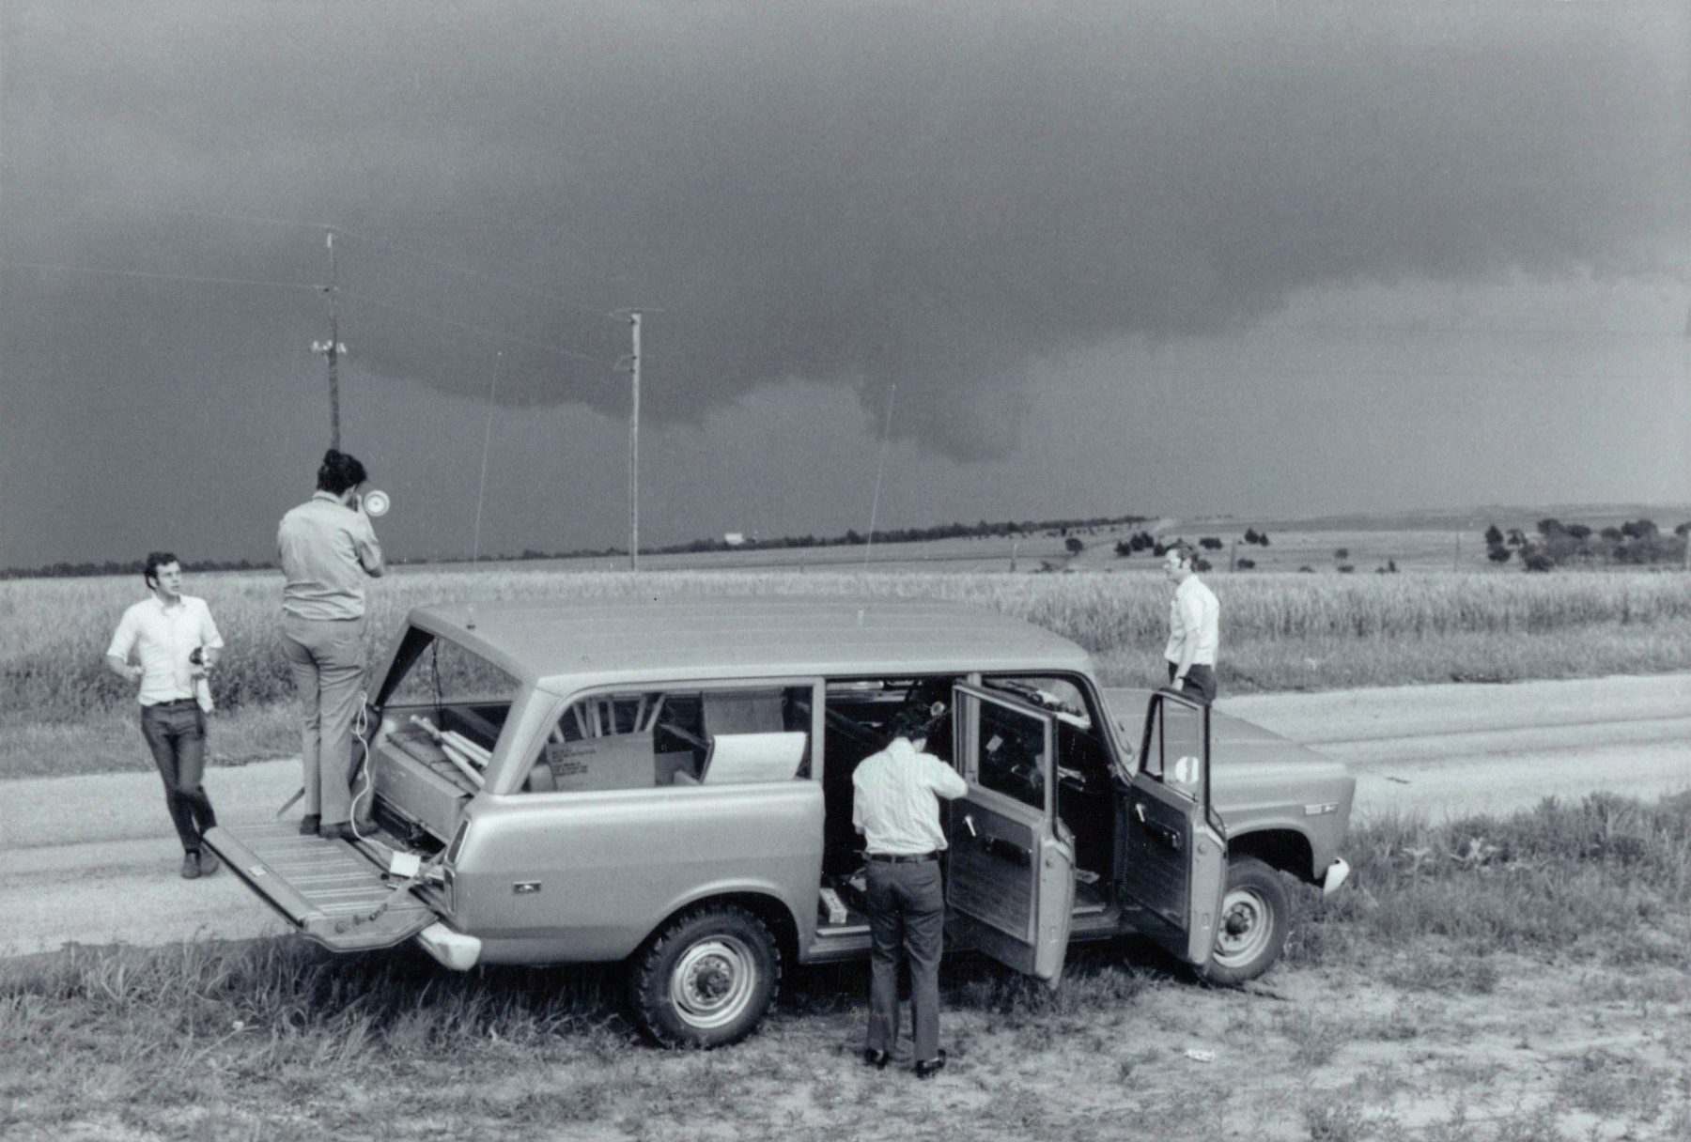
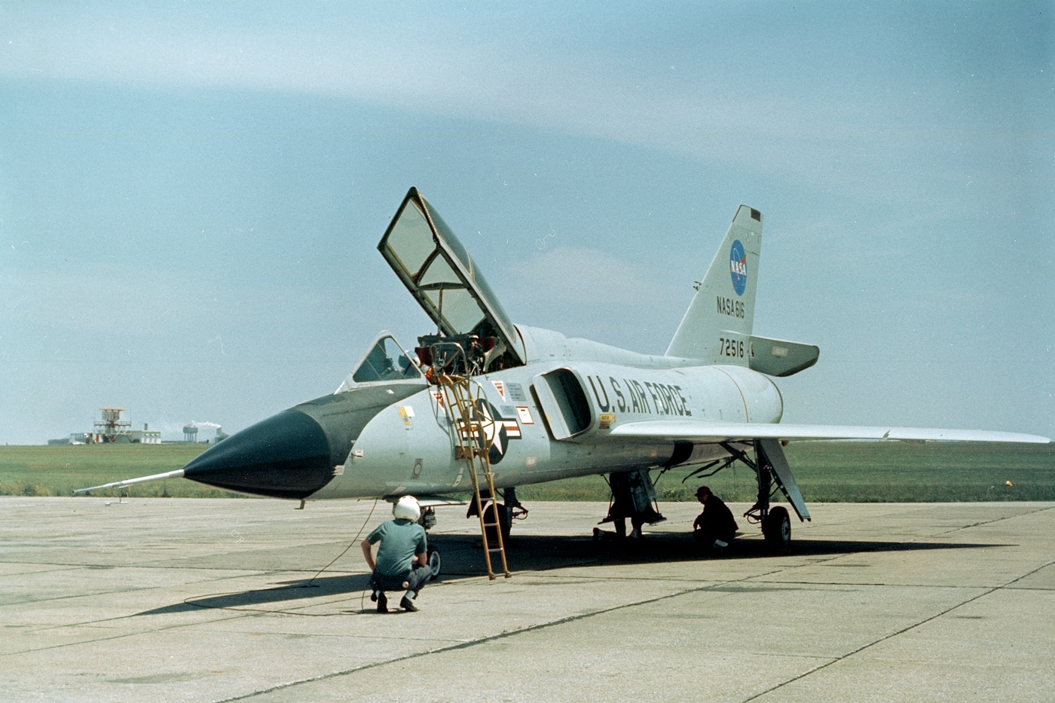

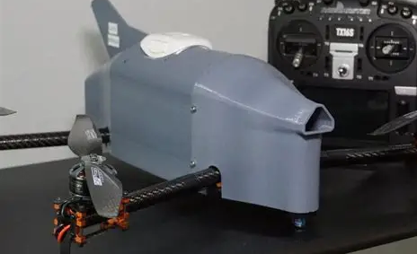
OU
1977 – 1979 NSSL intern – Storm Intercept Doppler Crews
1979 - OU AF ROTC Private Pilot
1980 – NASA NSSL Project Roughrider – NASAF-106 penetrator
USAF
6 years
WC-130 Guam
WC – 130 Keesler
1988 16 years C-5 worldwide
2004 – 2020 OU Director School of Aviation
Enhanced pilot, controller, mgt opsl knowledge of AVIA Weather HZDS
Started working with OU research faculty on 3D mesonet – COA 5,000 AGL
Teach Crew Resource Mgt (CRM) & Avia Safety courses
BETTER AVIATION WEATHER EDUCATED AVIATORS (pilots, controllers, mgt)

Slide 3
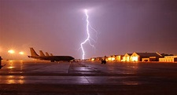
So…… – Viewing Through the Flight Deck “lens”
Educating future aviators!
Weather Hazards: Pilot, Controller, Manager KNOWLDEGE through education, appreciation and real time knowledge of current and forecast WX (using wx info tools) – still key to risk mitigation/safety
Applaud the FPAW for their continuous efforts to improve data / forecasts and disbursement to the end user (ground in in air)
Avia Weather Enterprise – NWS Partners and Ambassadors Program
  Work is critical and important!
  In the end…the history and future of Federal Avia Regs (FARs) 14 CFR 91.3 –
  …..” the Pilot in Command is directly responsible for, and is the final authority as to, the operation of their aircraft.”

Slide 4
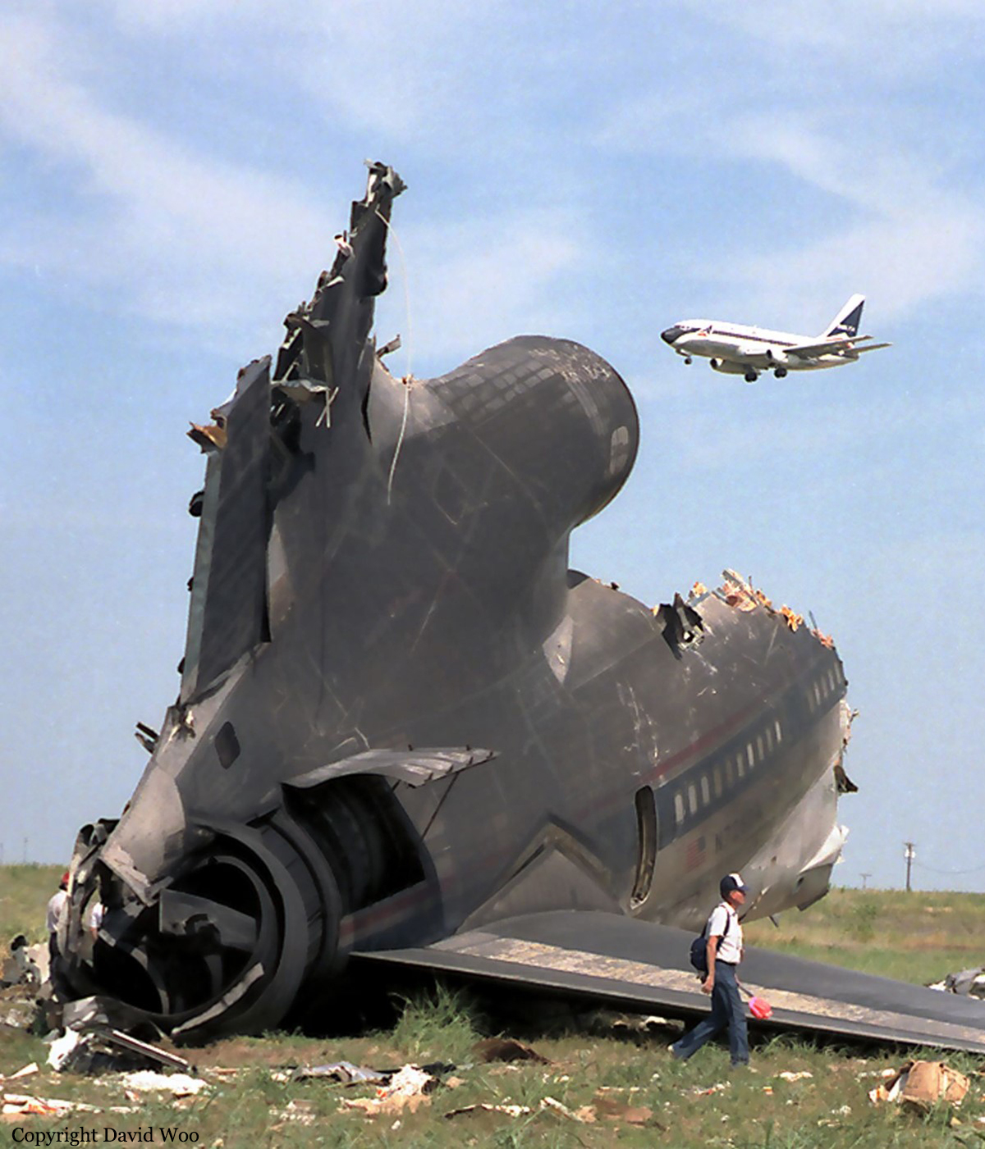
Aug 1985
CFR 91.3 was the last sentence in the NTSB final report on Delta Flt 191
Crash at DFW on final approach (1.63 km) short as they flew into a developing microburst on final approach.
Lockheed L-1011 Tristar

Slide 5
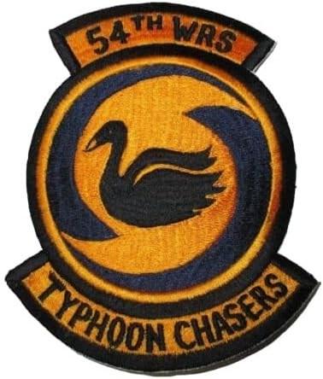
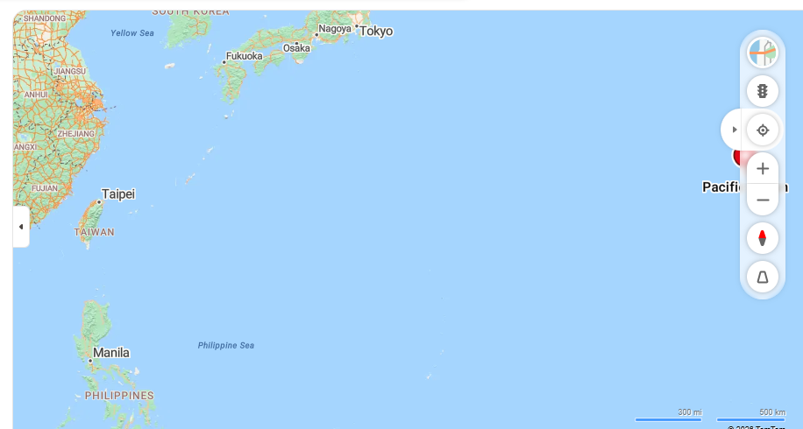
Loss of on board wx radar (lightning strike) inside eye of Cat 4 Typhoon
HF phone patch to Andersen AFB & Clark AFB metro …
Which base would you go to?
Yakota AB
2.5 hours either way
1983
Guam

Slide 6
Top Weather Concerns for Seasoned Airline/Corporate/Military Pilots
Thunderstorm AVOIDANCE –(assoc hzds)
  Avoid at least 20 miles
CAT (Clear Air Turbulence) & Turbulence - Forecast / nowcast…
Wind Shear – Esp approach/landing and takeoff/climbout
Mdt or Svr inflight Icing AVOIDANCE or NO FLY
  Acft flight manuals only allow for flight ”descending or climbing through trace and light icing – Typically a warning for “flight in mdt or severe”
  Caution or Warning for flight in prolonged “light icing” conditions
  NO DE ICE or ANTI ice on entire aircraft surface or wings surface areas!!!!!
  ONLY anti-ice or de-ice on wing / elevator leading edges and windshields
  I always teach new aviators about “think about an Okla ICE STORM” WEIGHT & Airfoil
  Critical pitot/static systems --- Air France disaster transiting a T-storm area at FL 350
Winter Wx Ops
  Runway RCR / Airfoil contamination
Low Vis – Typically no issues with modern flight decks and training
  Once gets less than ½ mile vis – planning issues/ divert issues
Volcanic ASH – Rare – BUT BIG CONCERN for TIMELY ALERTS

Slide 7
Top Weather Concerns for
Private/Commercial GA Pilots
Thunderstorm AVOIDANCE
  AVOID – typically at least 20 miles - DIVERT
Low Vis – Big Issues for VFR and new less exp IFR –
If IFR rated - Inflight Icing NO FLY or some business aircraft limited DE ICE / Anti ICE systems
  Acft flight manuals only allow for flight ”descending or climbing through trace/light icing
  Typically a warning for “flight in mdt or extreme”
  New Aviators -- “think about an Okla ICE STORM” -- WEIGHT
  Critical pitot/static systems --- Air France disaster transiting a T-storm area at FL
Wind Shear or GUSTY SURFACE WINDS –
Winter WX Ops
CAT
Volcanic ASH

Slide 8
Controllers
New FAA Enhanced AT-CTI initiative
Thunderstorms knowledge and awareness
Icing knowledge and awareness
CAT; Turb and LLWS turb knowledge and awareness
Inadvertent flight into IMC
Volcanic Ash knowledge and awareness
Ability for Tower, TRACON and Centers to “help” and provide real time info
Knowledge and Use of AWC products – tools
  Center Shift Change Summaries
Center meteorologists (CWSU) (CWAs and MISs)
Use of Safety Management System

Slide 9
Managers
(Airport / FBO / Maint staff / Line/
Thunderstorms knowledge and awareness
Icing knowledge and awareness
Winterstorm knowledge and awareness
Prepare ramp/airport for T-STORM hazards
Prepare airport with snowplan for winter storms – runway/taxi/ramp snow plans
“Break Bread” with local NWSFO and/or contract forecasting
Knowledge and use of AWC products and tools & SPC info
Lightning awareness / detection – stakeholder decision on shelter (policy/leadership)
Enhance personnel knowledge – Storm Spotter Trg, etc FAA FAST Safety Trg
Kudo’s to NWS Partners / Weather Ready Nation
LEADERSHIP and Making Timely Decisions – KEY in weathering the storms!
Use of Safety Management System -

Slide 10
Experienced VFR Private Pilot
Using AWC Aero Decision Making (ADM) Skillsets
Ceilings: Will the ceilings stay comfortably above me my whole flight?
Vis: Is or is it possible for visibility (inflight and surface) to get worse?
  Are either trending worse?
WHAT “weather” is moving toward me? (Use forecast, radar, sat, AWC; mesonet)
  CRM – “use ALL available resources – including “what you SEE!”
Winds / Turb : Are surface winds within my personal limits
Storms: Any convective activity near or forecast near my route?
Icing: Know the freezing level
  Any current icing along or near my route / any forecast?

Slide 11
NTSB Safety Alerts for “WEATHER”
The “seam areas”
Weather
SA-011 - Thunderstorm Encounters
SA-017 - In-Cockpit NEXRAD Mosaic Imagery – Caution… can be up to 20 min delayed
SA-014 - Aircraft Inflight Icing
SA-006 – Ground Icing - Aircraft PreFlight and taxi build up
SA-020 - Reduced Visual References -- Requires Vigilance
SA-020 Safety Alert Video
SA-082 - Flight in Snow: Assess the risk of flight in wet snow conditions, especially at low altitudes
SA-064 – Importance of - Pilot Weather Reports (PIREPs): Pay It Forward
- Esp for all hazds but esp for TURB, Low Vis and Icing

Slide 12
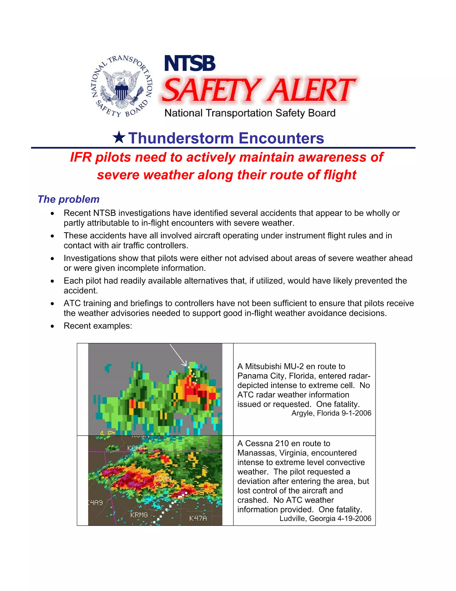
NTSB Safety alert – timeliness of radar presentations

Slide 13
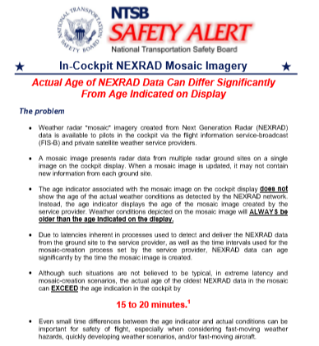
On board
Sat and NEXRAD
“Devil in the DETAILS”

Slide 14
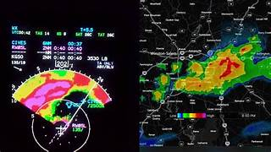
Pilots must know “how to use acft Wx Radar
Nexrad updates (caution timeliness)
Augment with satellite data / stormscope

Slide 15
STORMSCOPES
Assist
But all pilots should have good training on their on board weather radar on how to “tilt” beam as you approach weather – back up with storm scope options

Slide 16
PIC Responsible for final operation….
Cooperate and Graduate with ATC – and other traffic
“EARLY” requests for deviations for “storms” – get out of icing
How to request – IMPORTANT Techniques
Request “at least XX miles (direction) of course for storms”
Request “at least XX miles either side of course for storms”
  Knowledge of storm movement and speed
  Knowledge of storm cell “footprint” – current – future (knowledgeable pilot)
  Hail/Lightning/Turb
  If unable – may have to declare an “EMERGENCY” – not taken lightly but may have to…. (divert or declare emergency for AVOIDANCE)

Slide 17
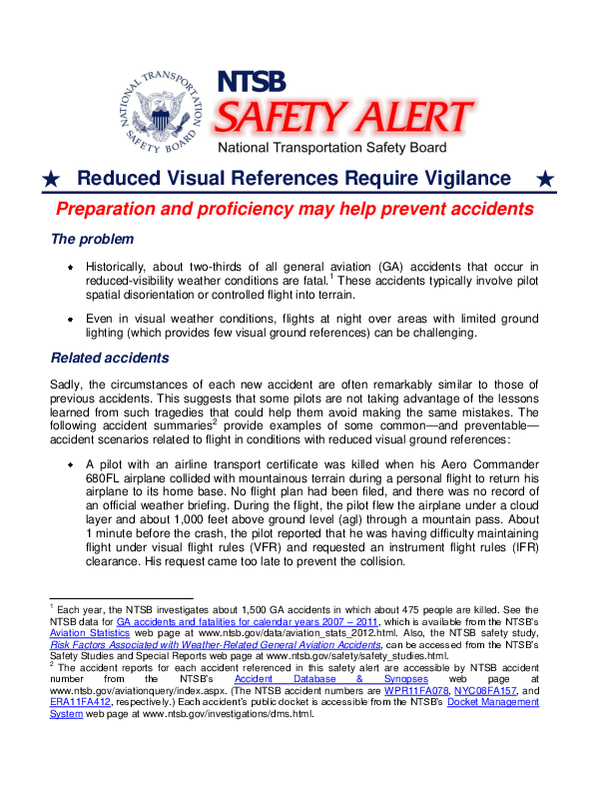

Slide 18
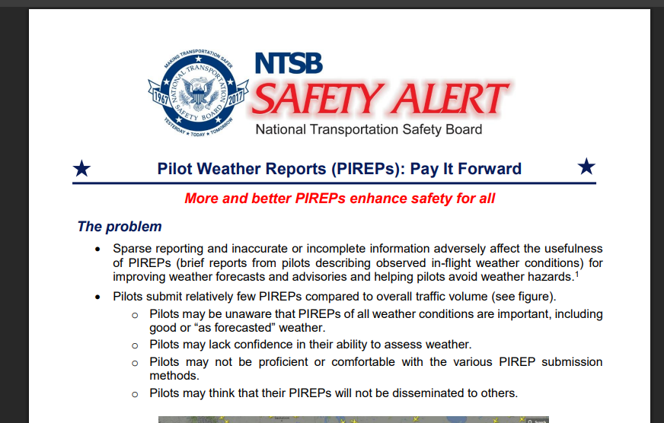

Slide 19
Over the 20 years, the NTSB has determined the probable cause for numerous turbulence-related accidents and has issued safety recommendations for improving weather forecasting, dissemination of weather reports, and air traffic management practices to reduce the likelihood of aircraft encounters with turbulence. More recently, in 2017, the NTSB issued several recommendations addressing safety issues related to turbulence as part of its special investigation report Improving Pilot Weather Report Submission and Dissemination to Benefit Safety in the National Airspace System, SIR-17/02​

Slide 20
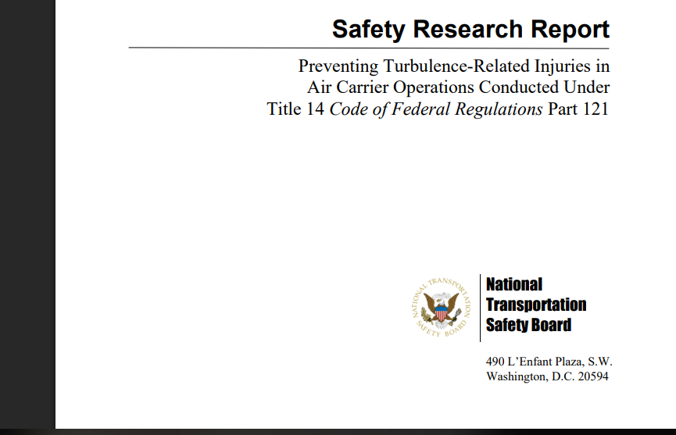

Slide 21
0ver 20 Recs to FAA
Revise Advisory Circular 120-88A, “Preventing Injuries Caused by Turbulence,” to reflect current best practices and the findings of this research report, such as new turbulence forecasting and warning technologies; training methods; in-flight communications between pilots and flight attendants, procedures, and available information for predicting turbulence; and altitudes at which flight attendants should be secured in their seats. (A-21-42)

Slide 22
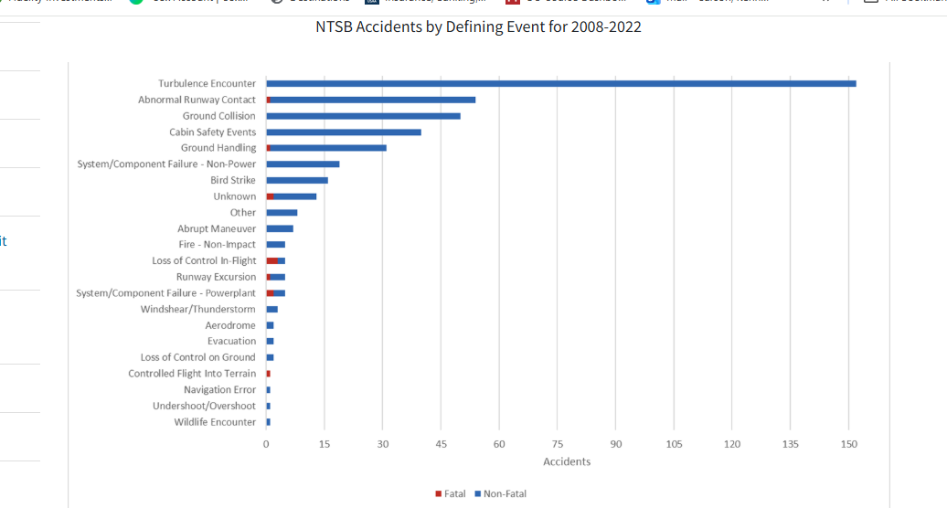
FAA Turbulence web page
FAA NEXTGEN Wx Programs - Turb

Slide 23
Pilot Knowledge of Inadvertent STORM penetration or CAT
IMMEDIATELY: Get all occupants mandatory strapped in
Slow to “best penetration airspeed” (Va) (ol Typhoon/Hurricane Hunter)
Typically this is 250 to 280 kts or higher FL 0.70 to 0.75 mach
  Typical cruise 0.78 (540 KIAS) to 0.95 mach
Set throttles – not chase altitude
Turn ON flight deck “Thunderstorm Flood Lights”
WC-130 Va - typically 180 KIAS (cruise 410 mph or 360 KIAS)
For Icing – INFORM ATC!!!!
Inform ATC you want lower if better/able

Slide 24
To the Federal Aviation Administration:
Encourage industry safety efforts, such as the Commercial Aviation Safety Team and the General Aviation Joint Steering Committee, to identify, develop, and implement incentives for 14 Code of Federal Regulations Part 121, 135, and 91K operators and the general aviation community to freely share pilot weather reports (PIREPs), including braking action or runway condition reports filed as PIREPs, to the National Airspace System to enhance flight safety. (A-17-25)

Slide 25
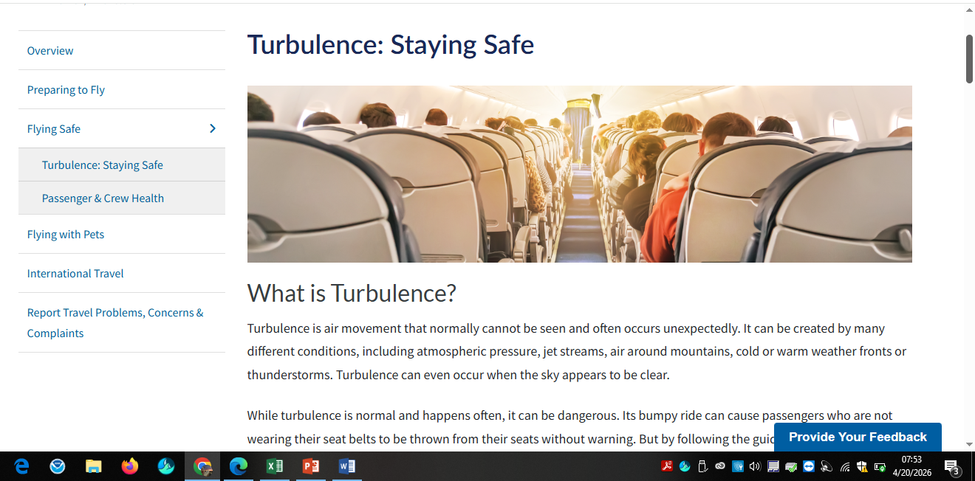
NCAR
Turb Staying Safe Page
15 min updates

Slide 26
