Slide 1
Weather Radar and Aviation
Where we are now and the wild blue yonder of tomorrow

Slide 2
Weather Radar and Aviation
Where we are now and the wild blue yonder of tomorrow
The current state of affairs - We use radar mostly to gauge storm intensity and depth.

Slide 3
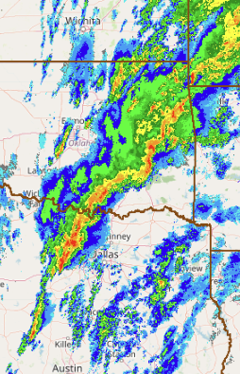
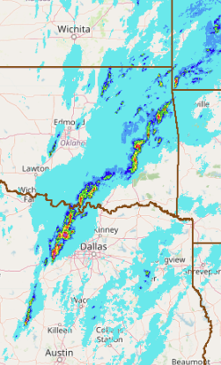
Weather Radar and Aviation
Where we are now and the wild blue yonder of tomorrow
The current state of affairs - We use radar mostly to gauge storm intensity and depth.
Storm Intensity
Composite Reflectivity – The maximum reflectivity in a column
Precip – The vertically integrated water in a column

Slide 4
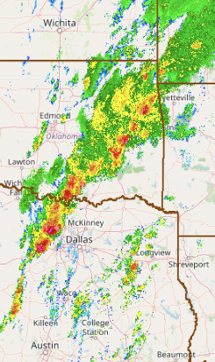
Weather Radar and Aviation
Where we are now and the wild blue yonder of tomorrow
The current state of affairs - We use radar mostly to gauge storm intensity and depth.
Storm Intensity
Storm Depth
Composite Reflectivity – The maximum reflectivity in a column
Precip – The vertically integrated water in a column
Echo Top – The altitude of the 18.5 dBZ threshold
Why 18.5 dBZ?
The WSR-57s had too low a SNR to declare as echo for returns less than 18.5 dBZ.
Why doesn’t Heather like Echo Top?
It is vulnerable to the beam width. As this increases, the error in the ETP18 increases.
We have no way of knowing what ETP18 is in the Cone-of-Silence.

Slide 5
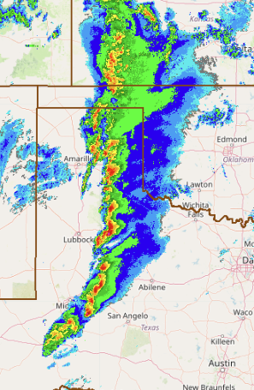
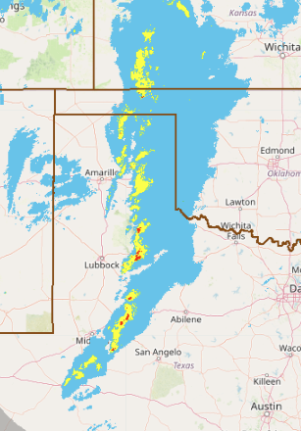
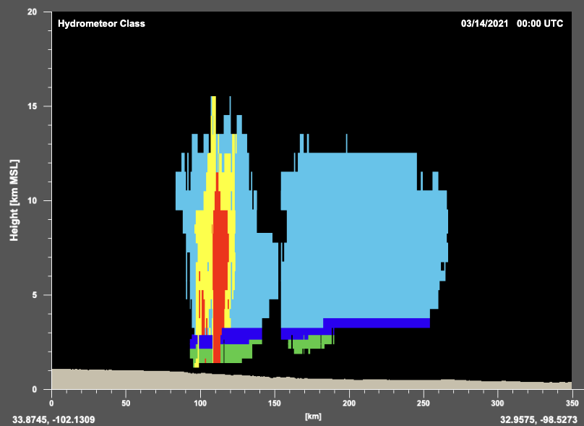
The wild blue yonder of tomorrow - Dual polarization
Dual polarization allows us to diagnose the hydrometeor phase so that we can identify hail of all sizes (not just severe) and graupel (which implies SLW)
Snow
Graupel
Hail

Slide 6
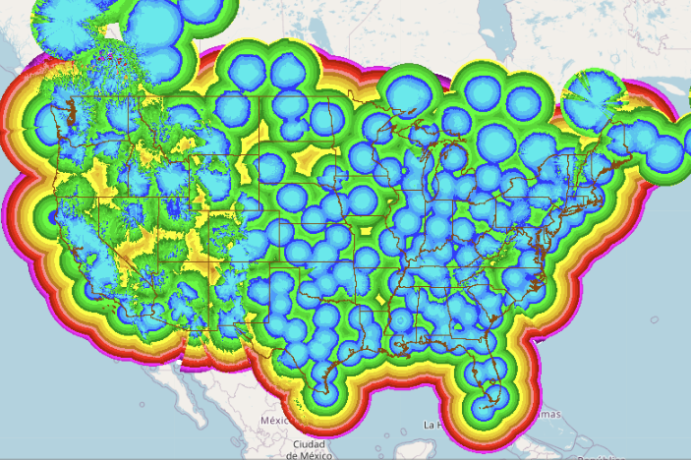

The wild blue yonder of tomorrow - Supplemental Radars
Large swaths of the lowest 5000 ft of the NAS do not have radar coverage
This is a limiter for low-altitude flight
The emergent network of supplemental radars from agencies like Climavision can help fill these gaps to provide improved decision support.

Slide 7
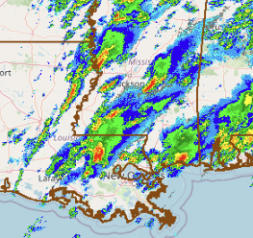
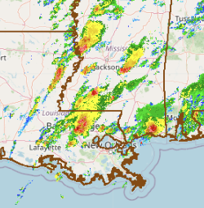
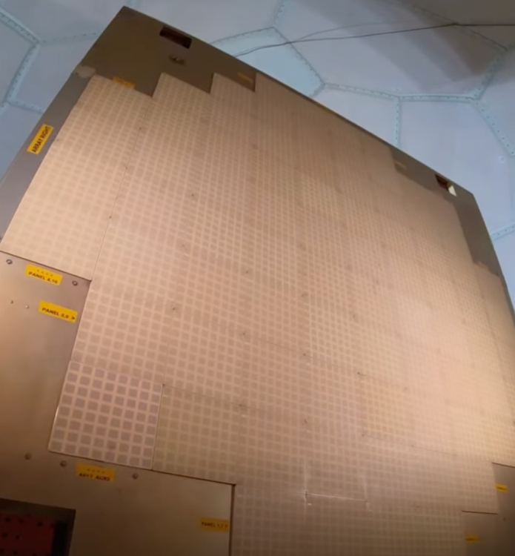
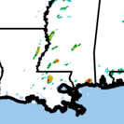
The wild blue yonder of tomorrow - Phased Array Radars
Conventional radars can take between 5 and 10 minutes to complete a full volume scan.
Phased Array Radars have hundreds of antennae and can scan a complete volume in ~30 s
This leads to offsets in locations of CREF and ETP maxima, which can impact decision support, such as TCF verification.

Slide 8
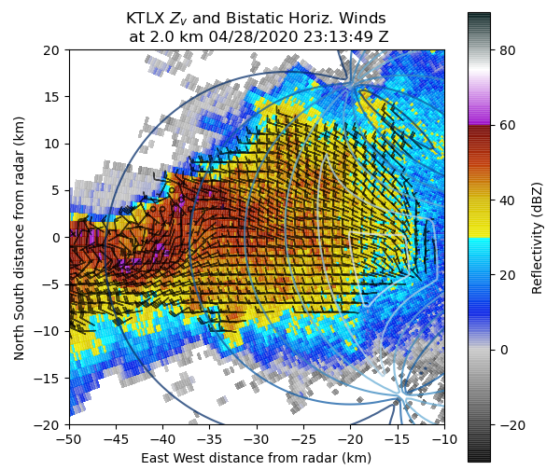
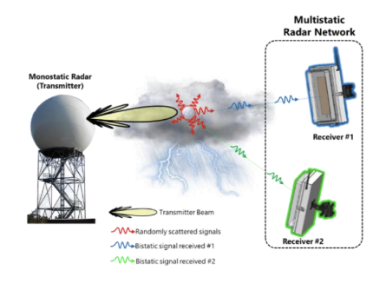
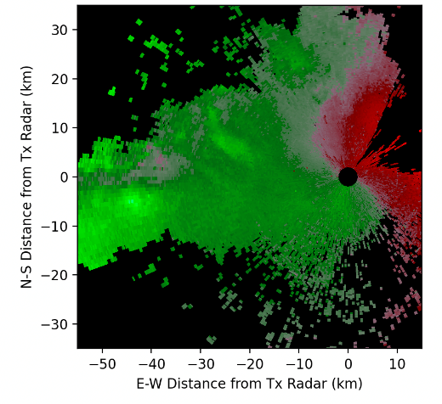
The wild blue yonder of tomorrow - Passive Receivers
We are currently limited to radial velocities, which can be challenging for the nonmeteorologist to effectively use
Actual horizontal winds
Images courtesy of D. Schvartzman

