Slide 1
The Multi-Radar Multi-Sensor (MRMS) System: Current Status and Future Plans
Race Clark
NOAA/OAR/National Severe Storms Laboratory
with contributions from Jian Zhang, J.J. Gourley, Steve Martinaitis, Stephen Cocks, Heather Reeves, Karen Cooper, Carrie Langston, Lin Tang, Mike Taylor, Robert Toomey, Timothy Miller, Travis Smith, Gabriela Fisher, Brent Kraninger, Andrew Osborne, Jackson Anthony, John Cintineo, Dean Meyer, Andrew Osborne, Daniel Tripp, and Brandon Smith

Slide 2
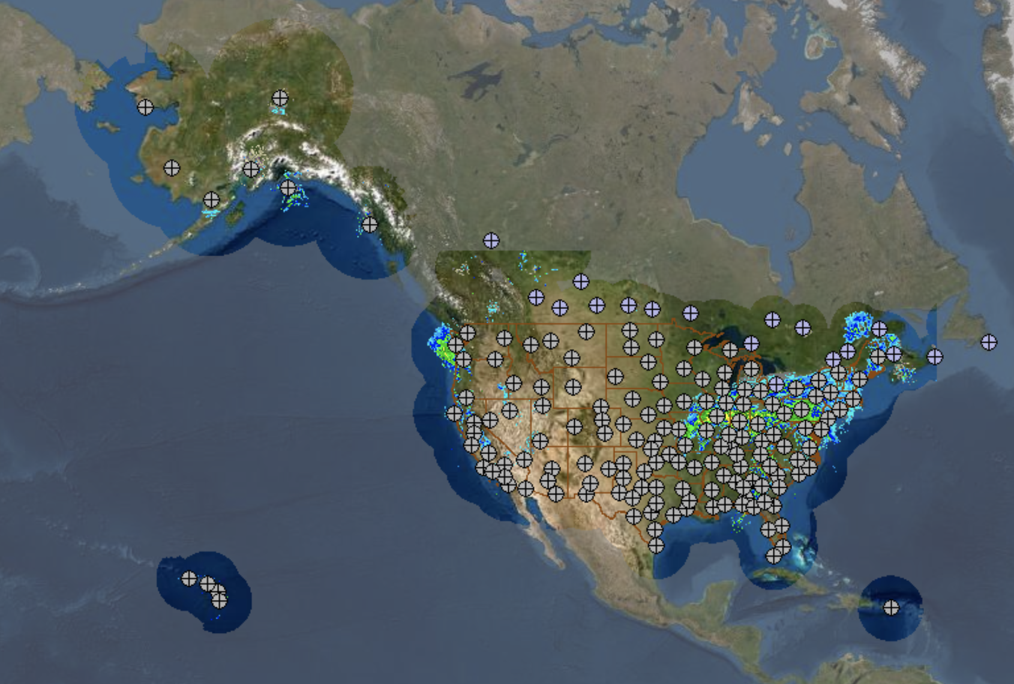
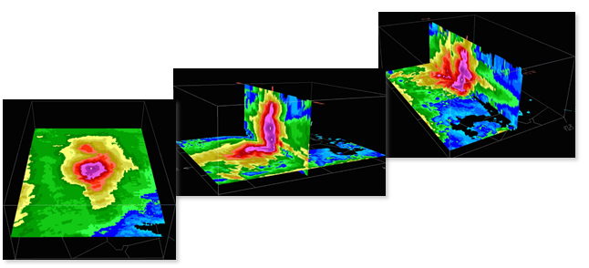
MRMS has been operational at NCO since 2014.
MRMS provides weather intelligence across the weather enterprise:
Integrating Federal, state, and commercial data
Providing 3D insights into the atmosphere
Unleashing capabilities of the radar network
Assimilating radar data for models
Decision support for severe weather, hydrology, aviation, and ground transportation
MRMS Coverage and Radar Locations
Continental US and Southern Canada
Alaska
Hawaii
Guam
Caribbean
~180 Radars continuously streaming data
~20,000 Rain Gauges hourly

Slide 3
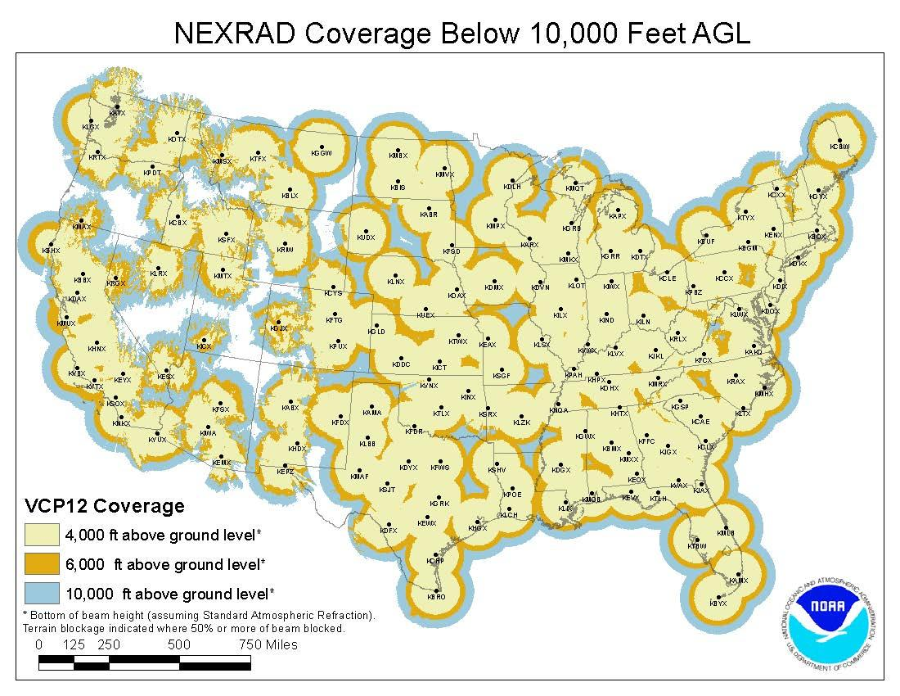
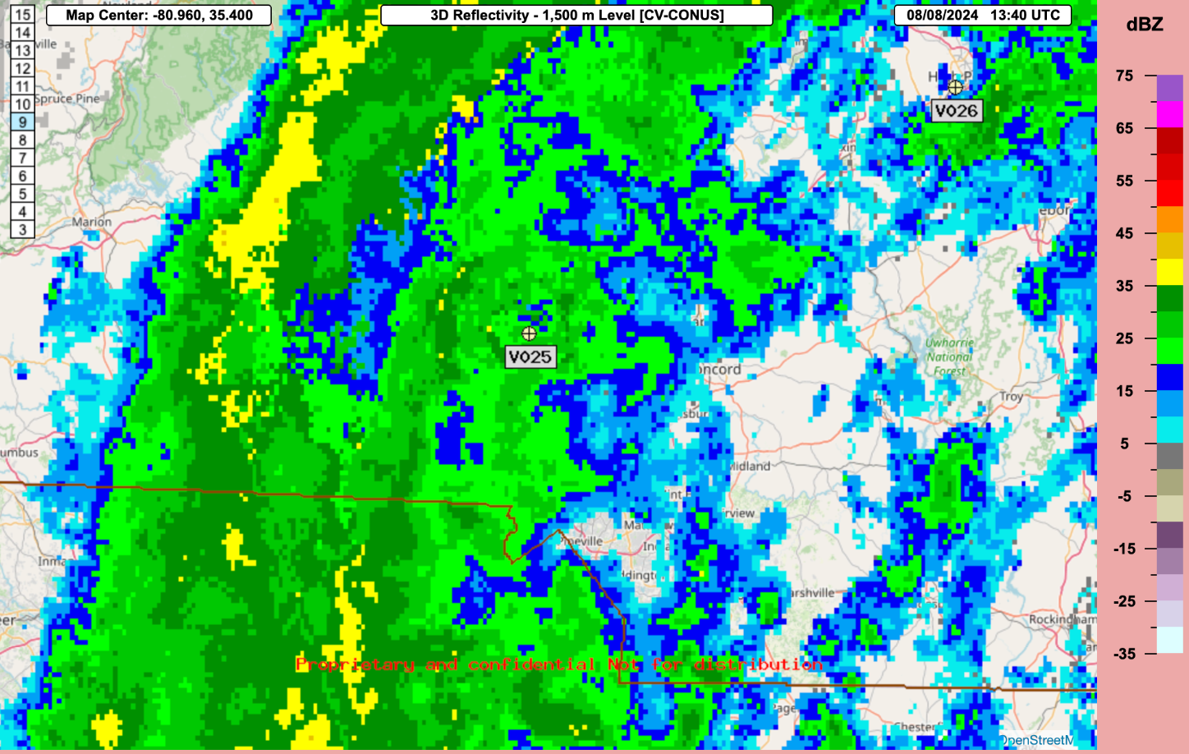
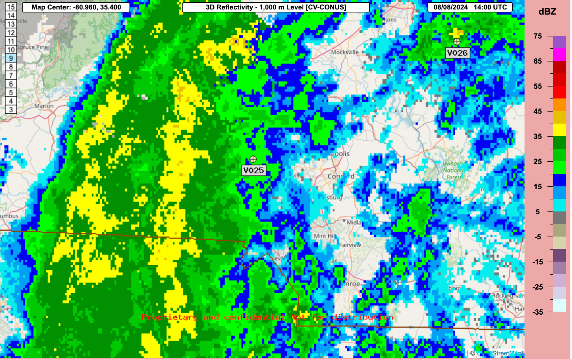
The next generation of radar data mosaicking: VCP Independence
-0.2
+0.2
-0.2
+0.3
+0.2
0.0
+0.3
0.0
-0.2
+0.4
0.0
+0.2
+0.2
-0.2
+0.3
+0.3
+0.2
Making MRMS more agile and flexible
VCPs have gotten more complicated
New types of radars coming online
Enables more rapid incorporation of new supplemental radars
Enables new products
Active testing/development at NSSL and CIWRO
+0.3
25%
1%

Slide 4
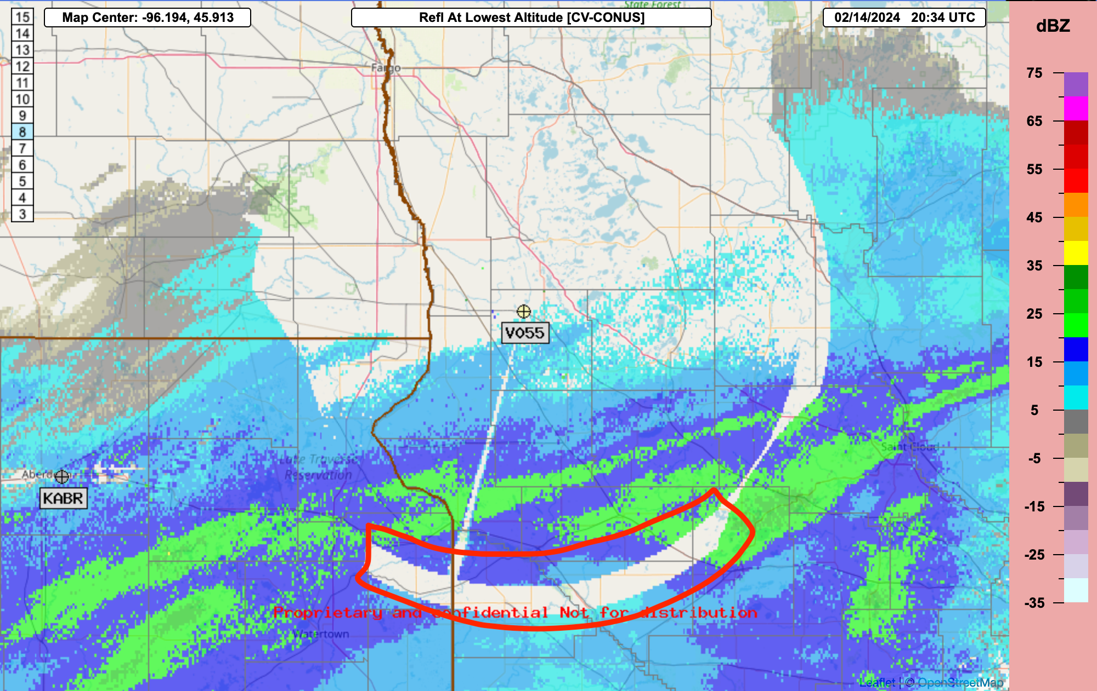
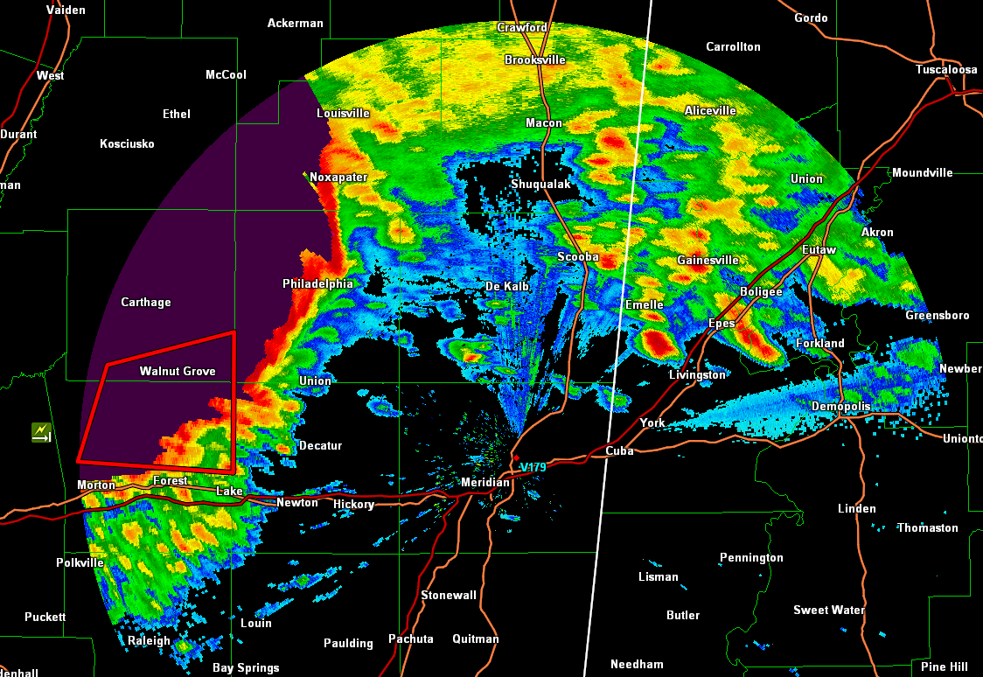
Expanding Capabilities: Supplemental Radars
CRADA with Climavision
Publicly-owned supplemental radars
  Alamosa, Durango, etc.
Related R&D topics
  S-, C-, and X-band mosaics
  Effects of mosaic weighting
  Spatial resolution
  Attenuation correction
  Radar (network)-specific QC
  Establishing supplemental radar data standards/workflows

Slide 5
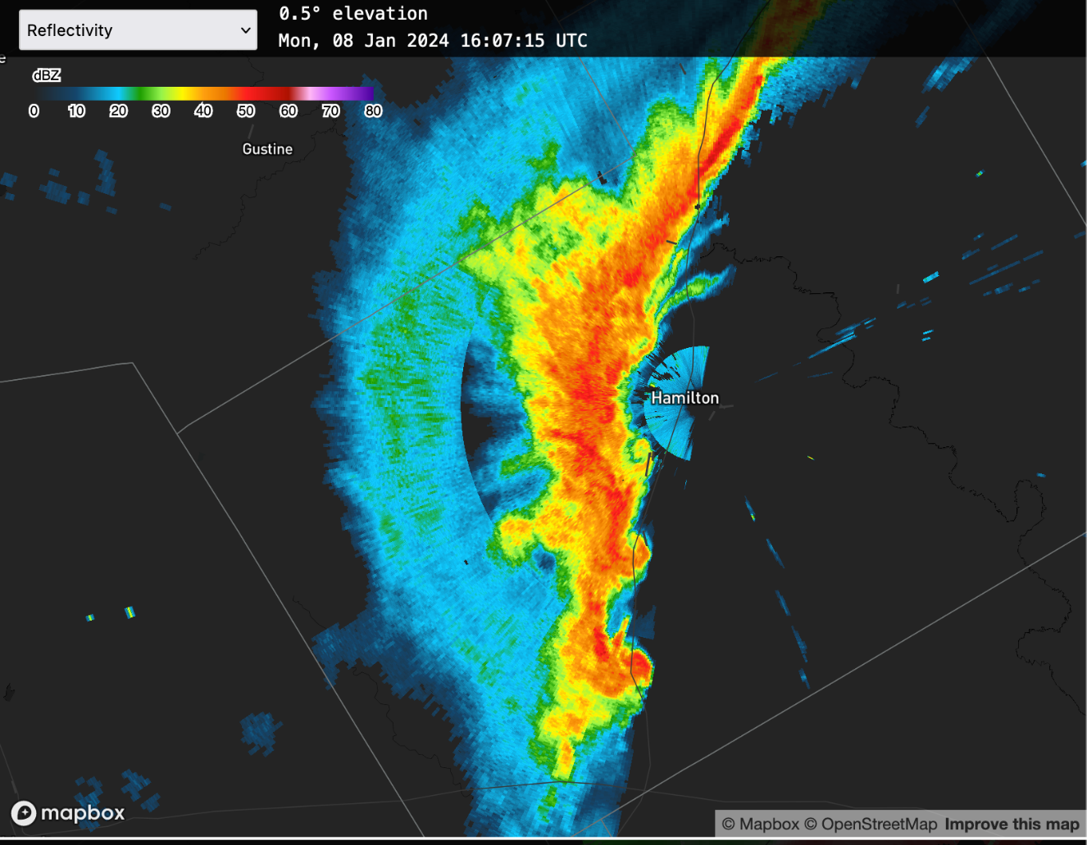
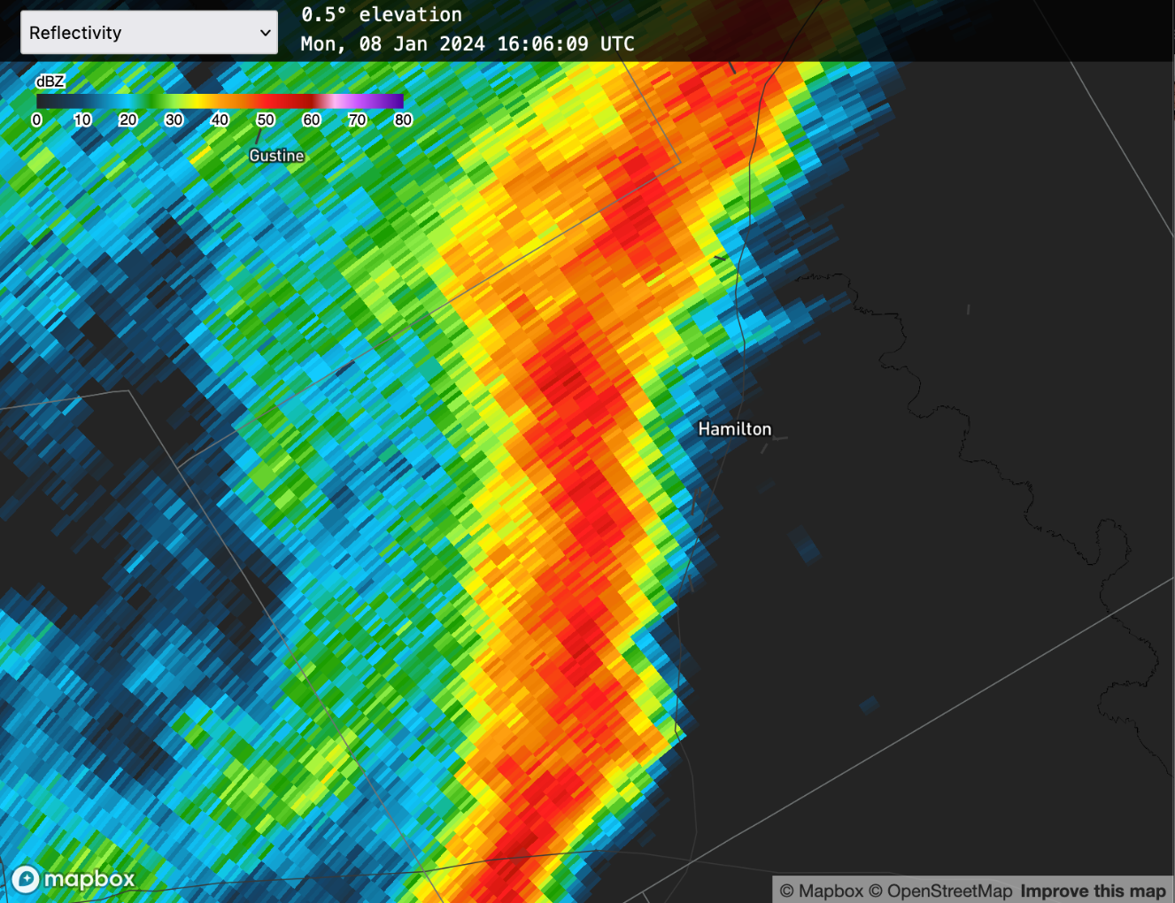
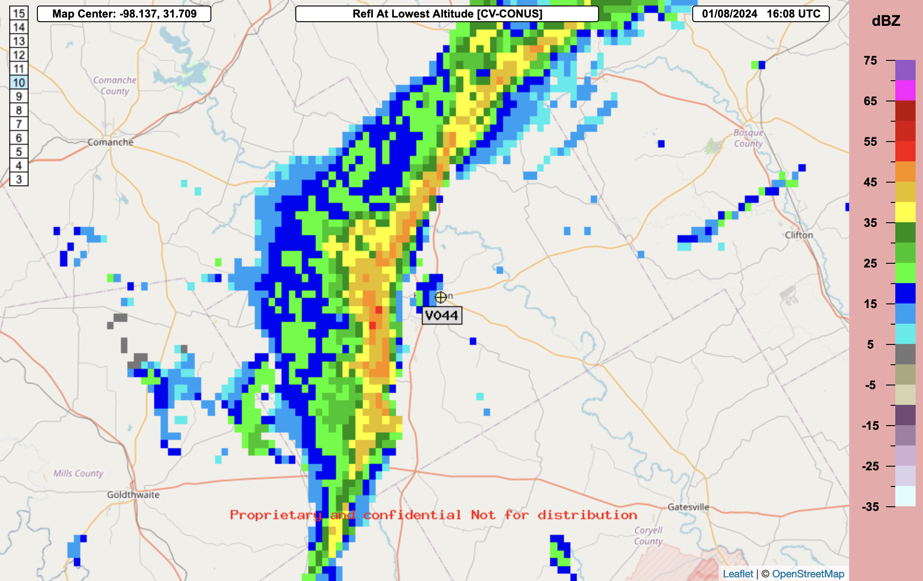
Spatial Resolution
Inclusion of C- and X-band radars with finer range resolution
Case from Hamilton, TX in Jan 2024 →
  Climavision gate resolution 31.25 m
  WSR-88D gate resolution 250 m
  MRMS resolution 1,000 m
Finer resolutions enable new products
  3D KDP mosaics
Climavision
WSR-88D
0.01-deg MRMS

Slide 6
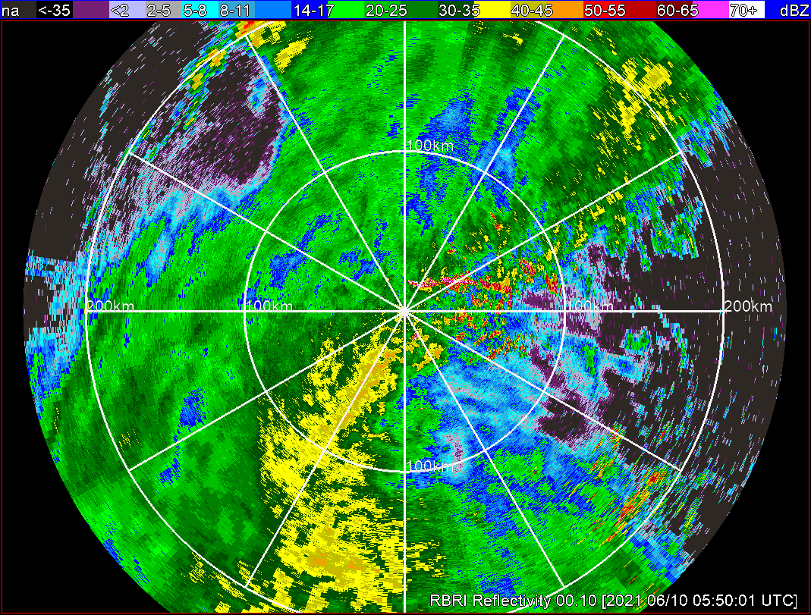
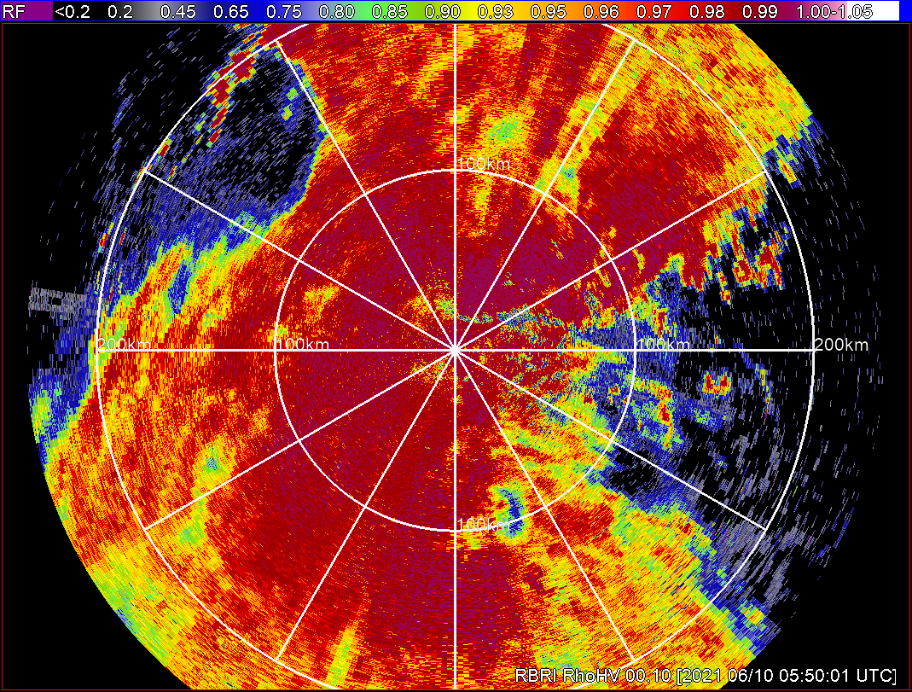
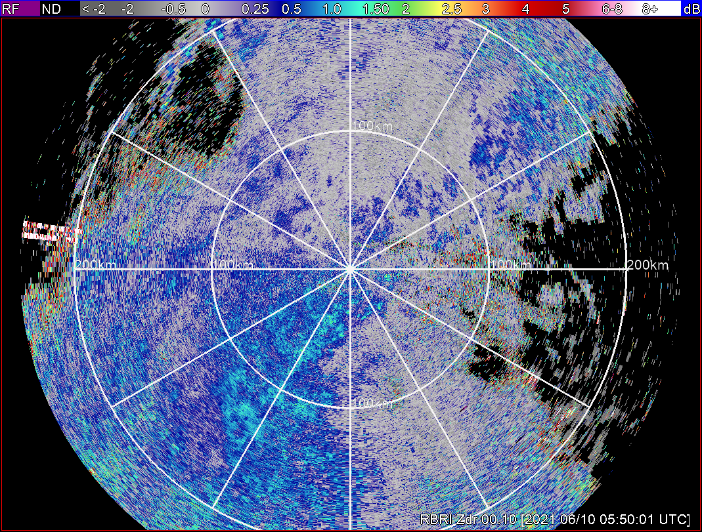
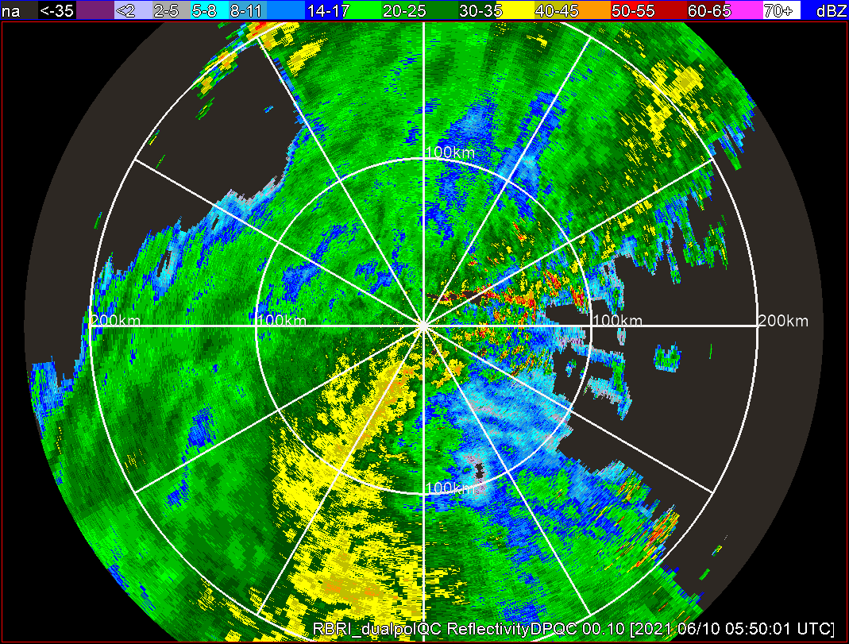
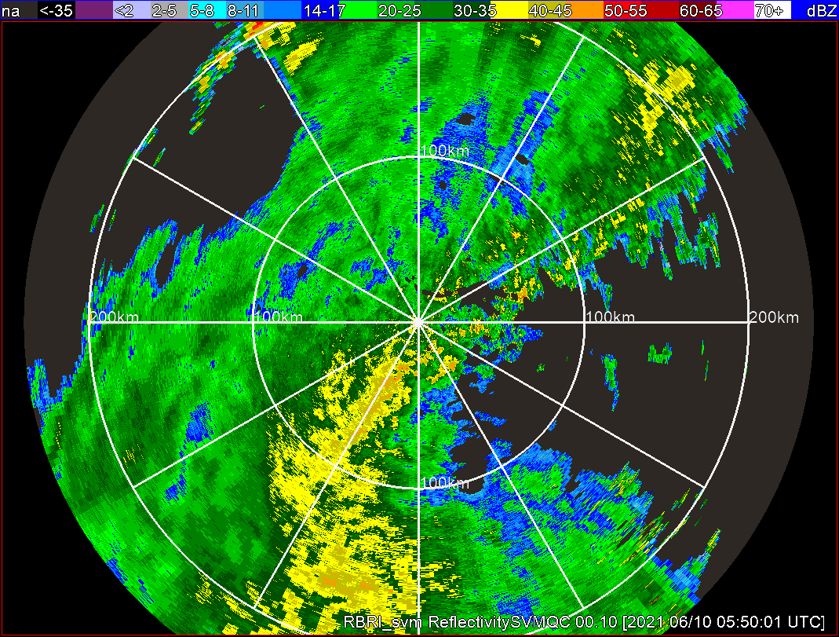
AI-Based Radar QC - Preliminary Testing in South Korea
Raw Z
RhoHV
Zdr
SVM results show improvement in removing sea clutter (rectangles) and retaining the far-range echoes, but too aggressive in the circled region near the radar site.
dualpolQC
SVM

Slide 7
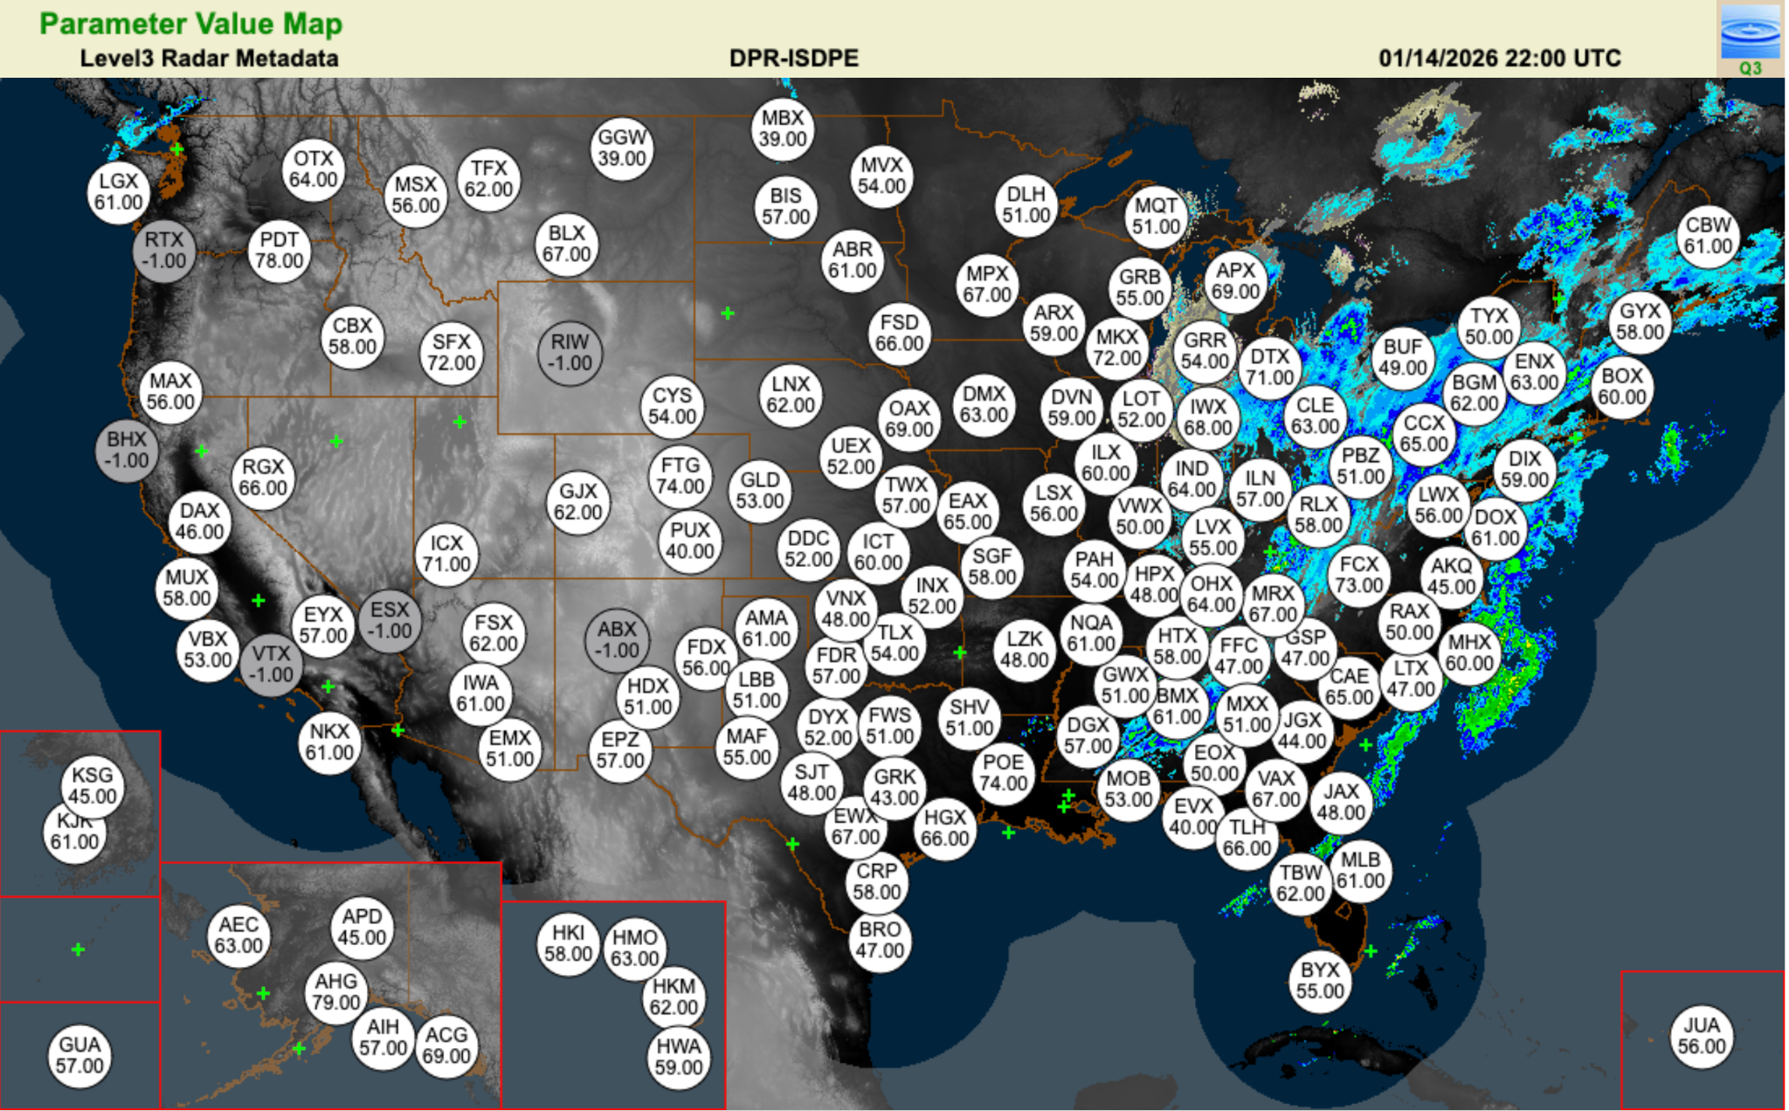
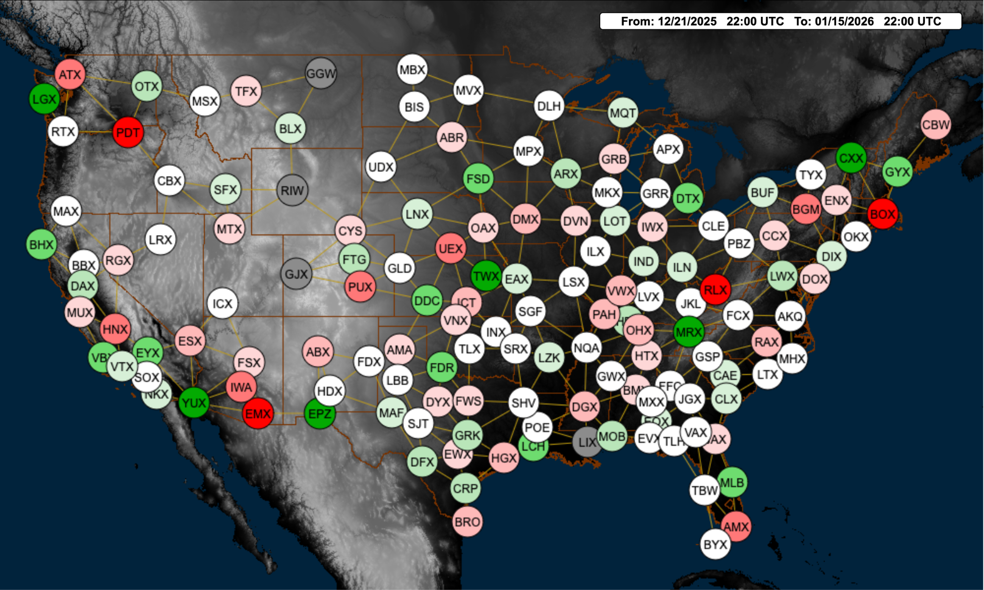
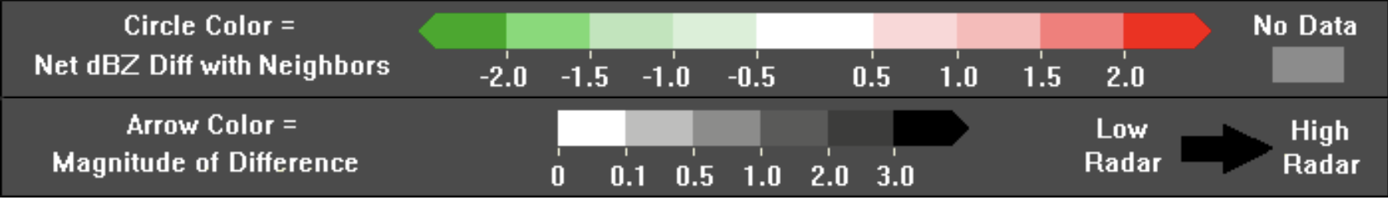
Single Radar Products
Plan to expand to supplemental radars, mimicking ORPG functions
Radar calibration and correction
Growing our monitoring, assessment, and network management capabilities →

Slide 8
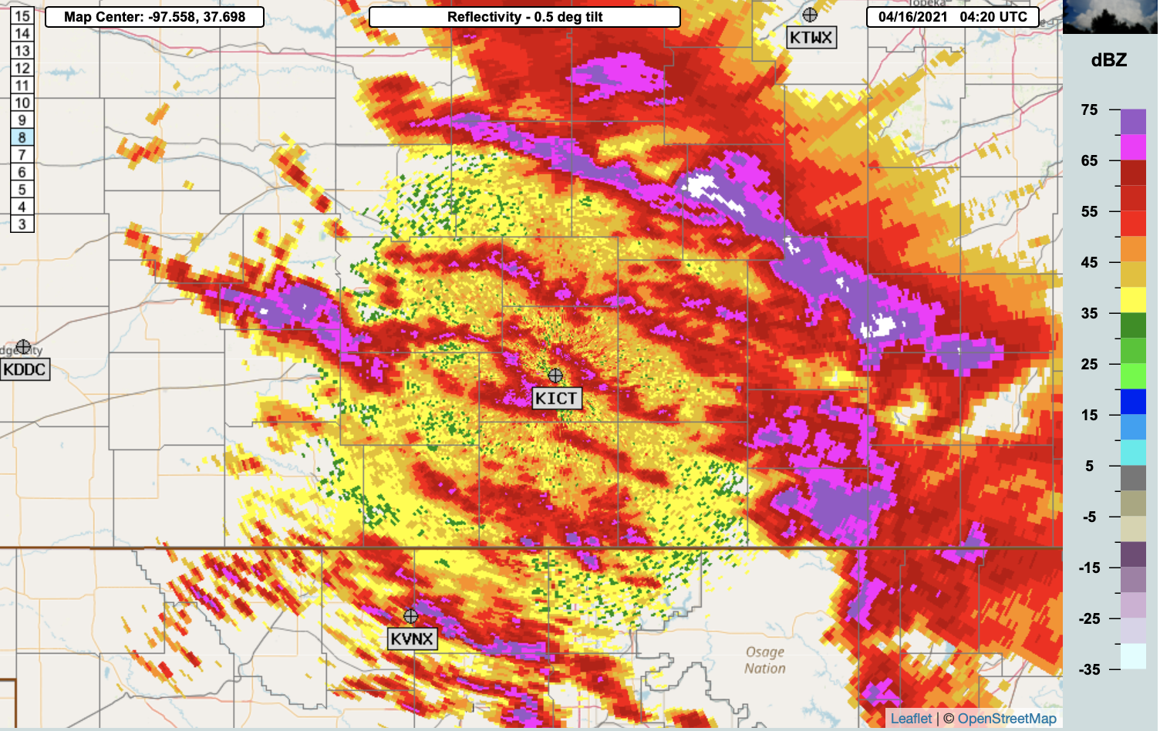
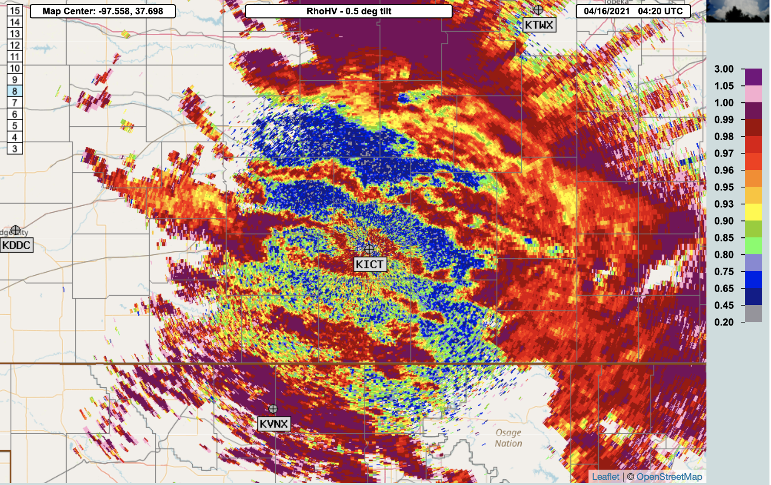
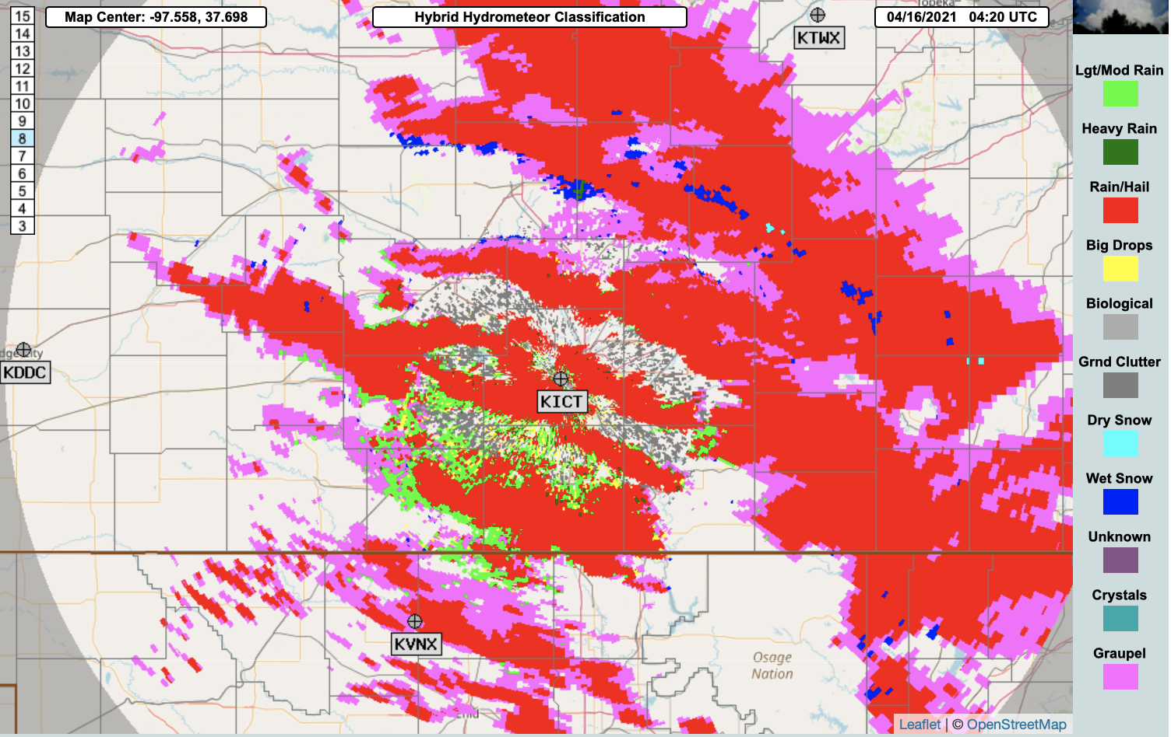
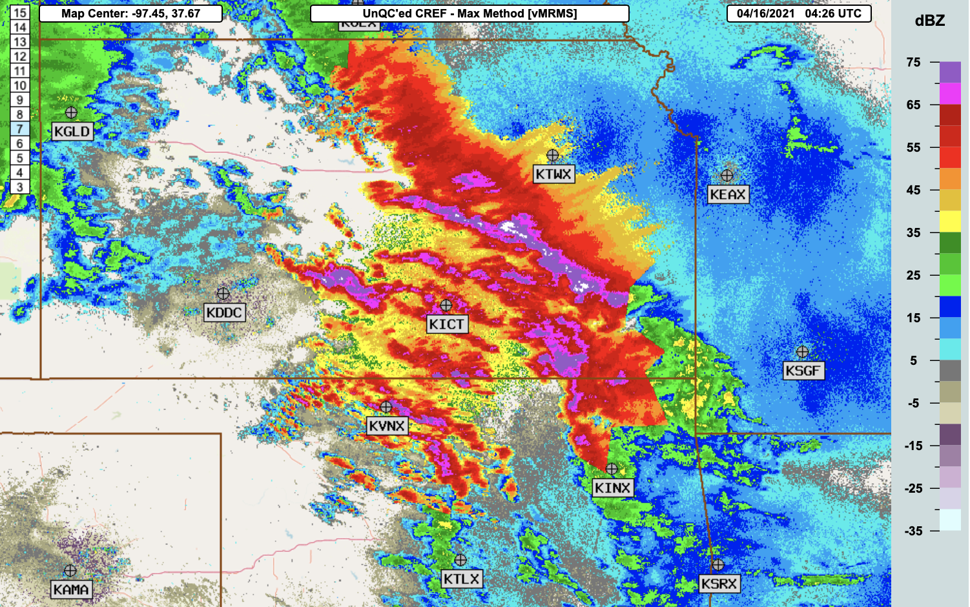
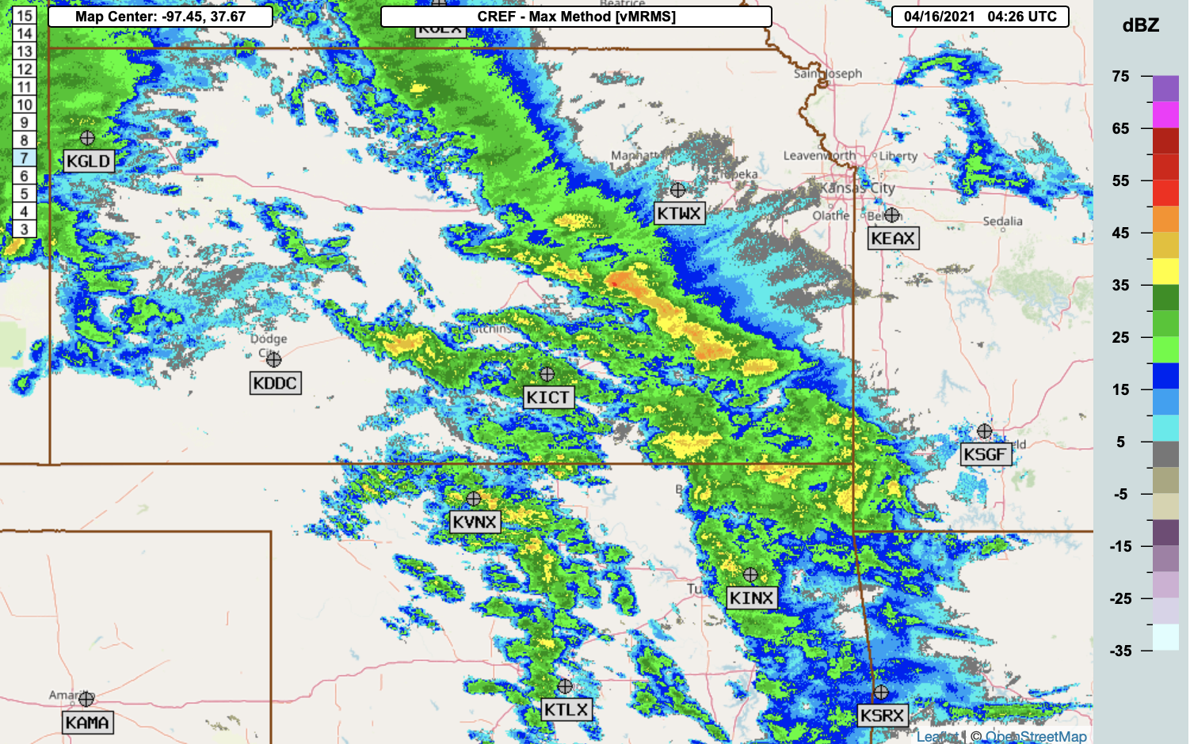
Mitigation of Hardware Issues
Example corrupt data: KICT 04:20Z 4/16/2021
Corrupt radar data due to hardware issues does not follow theory and can cause the physically-based hydrometeor classification to fail
Specific techniques were developed to address these issues, e.g., application of global properties to identify corrupt data (figures to the right)
Hardware related data quality issues are relatively rare, but each new issue may require a new specific QC technique (an R2O challenge)
Raw Reflectivity
Raw Corr. Coef.
Hydrometer Classification
pixel-based QC
Composite Reflectivity before QC
Composite Reflectivity after QC
global QC based on intensity and areal coverage

