Slide 1
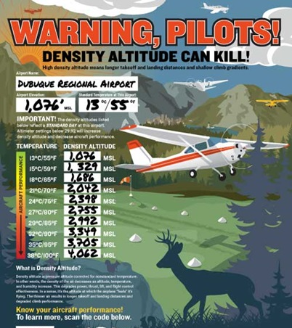

Density Altitude and Mountain Flying
Prof. Michael Splitt
Florida Tech College of Aeronautics
Spring 2026 FPAW
msplitt@fit.edu

Slide 2
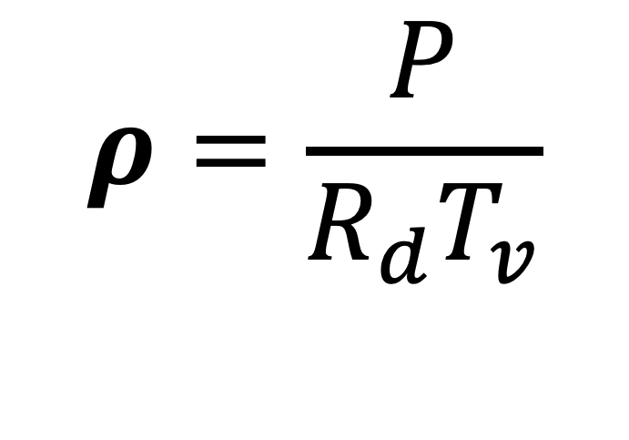
Density altitude, it’s a gas!
Density altitude: “the actual altitude at which the plane “feels” it’s flying “.(Plane+Pilot)
Hot Temperatures
High Altitude (lower pressure)
High Humidity (higher T_{v})
$$ρ=\frac{P}{R_{d}T_{v}}$$
Virtual temperature (Tv):
The temperature needed to get the correct density given the humidity

Slide 3
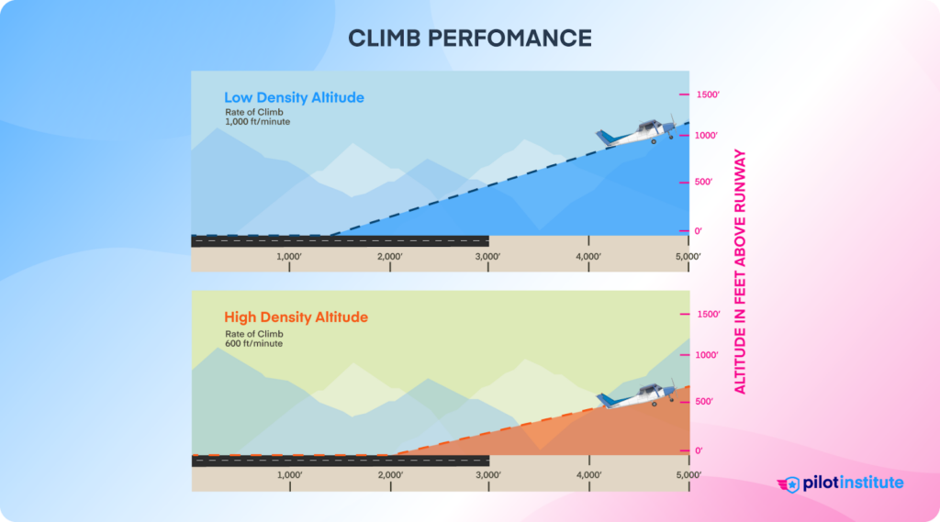
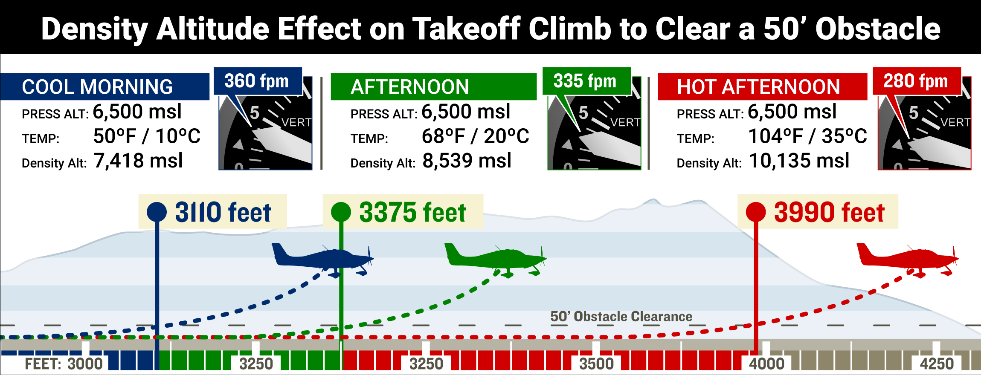
Density altitude, it’s a gas!
Density altitude: “the actual altitude at which the plane “feels” it’s flying “.(Plane+Pilot)
Hot Temperatures
High Altitude (lower pressure)
High Humidity (higher T_{v})

Slide 4

KSWO DA (HOT vs. HOT AND HUMID)
Let’s guess the difference in DA considering calculations with and without humidity:
HOT AND DRY
  43.0 C (109.4 F)
  Altimeter 30.33”
  No moisture
HOT AND HUMID
  43.0 C (109.4 F)
  Altimeter 30.33”
  Dew Point 25.0 C (77 F)

Slide 5
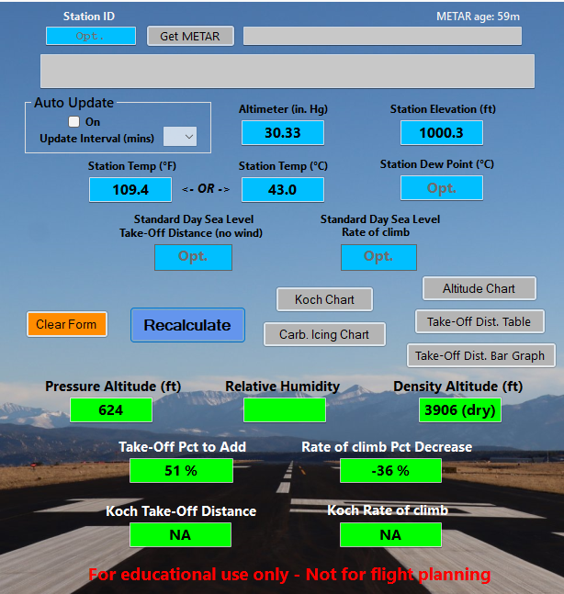
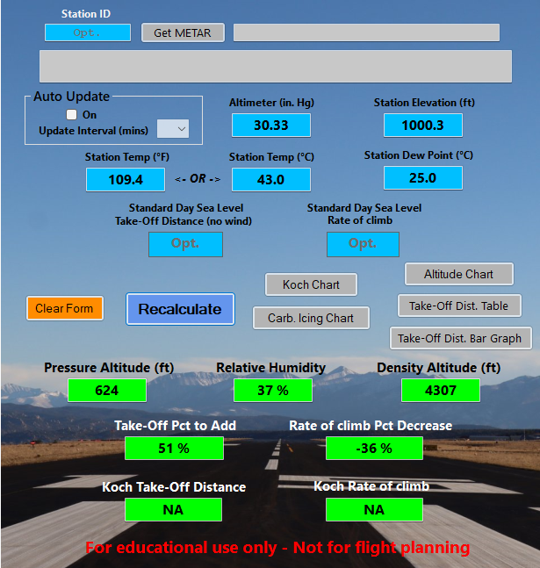
KSWO (HOT vs. HOT AND HUMID)
Performance doesn’t update for humidity
Figures created with KochChart V4.0.6

Slide 6
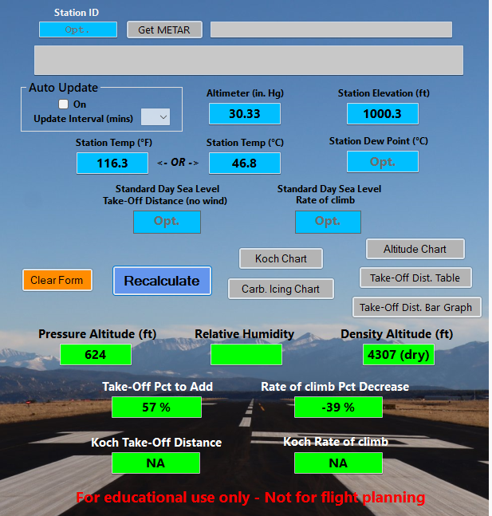
KSWO (HOT vs. HOT AND HUMID)
“Corrected” for equivalent dry atmos.
Figures created with KochChart V4.0.6

Slide 7
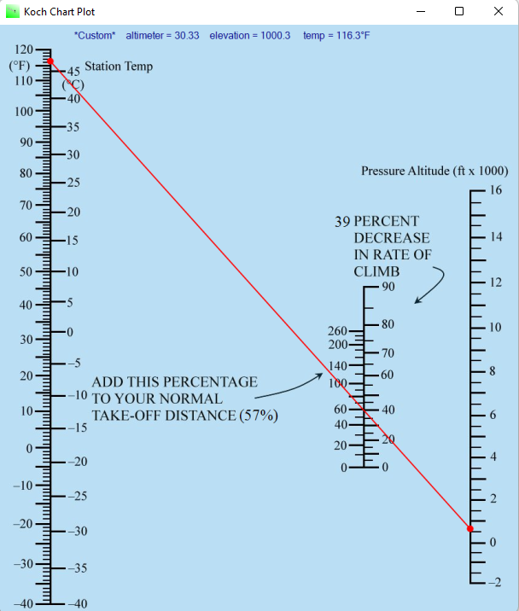
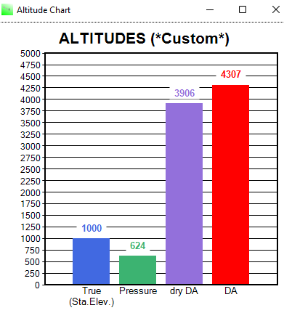
KSWO (HOT vs. HOT AND HUMID)
Figures created with KochChart V4.0.6

Slide 8
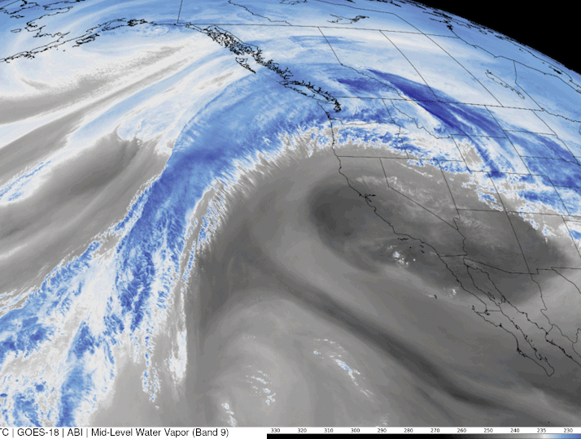
March Madness 2026!
“As record heat bakes the western U.S. this week, NOAA’s GOES West satellite tracked the atmospheric setup for this extreme heatwave. In this water vapor imagery from March 18, you can see how the satellite captures the deep moisture (shades of blue) surging northward as a large area of high pressure settles into the Southwest. “
https://www.nesdis.noaa.gov/news/noaas-goes-west-watches-record-heat-wave

Slide 9
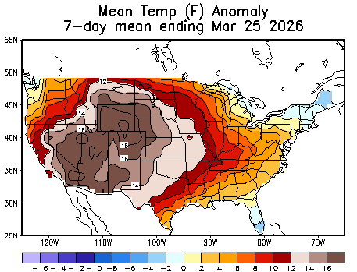
March Madness 2026!
THERMAL, Calif. (AP) — A desert community in southwestern Arizona reached 110 degrees (43.3 C) on Thursday, breaking a record for the highest March temperature recorded in the United States. The record-setting temperature was recorded just outside Martinez Lake, Arizona, in the Yuma Desert, as a winter heat wave scorched the Southwest, according to the National Weather Service.

Slide 10
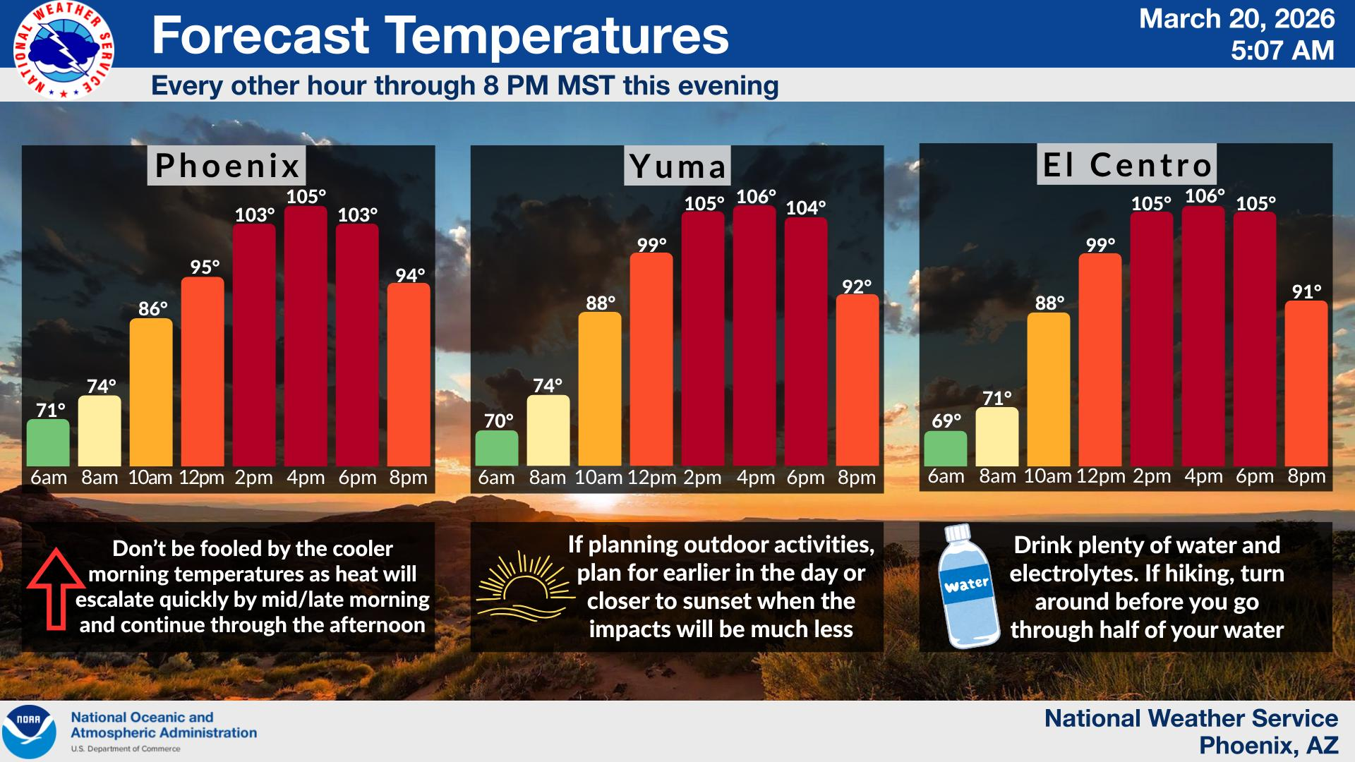

Slide 11
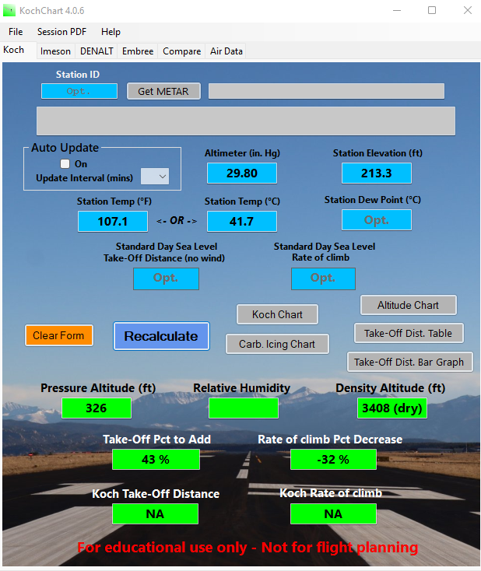
Density Altitude Deviation (KNYL) March Madness
Yuma Marine Corps Air Station/Yuma International Airport
METAR KNYL 202257Z 00000KT 10SM CLR 42/M04 A2980 RMK AO2 SLP089 T04171039
What is the deviation between the Density Altitude and the Field Elevation?
With a density altitude of 3408 feet (dry) and an elevation of 213 feet this would be a density altitude deviation of +3195 feet from the field elevation.

Slide 12
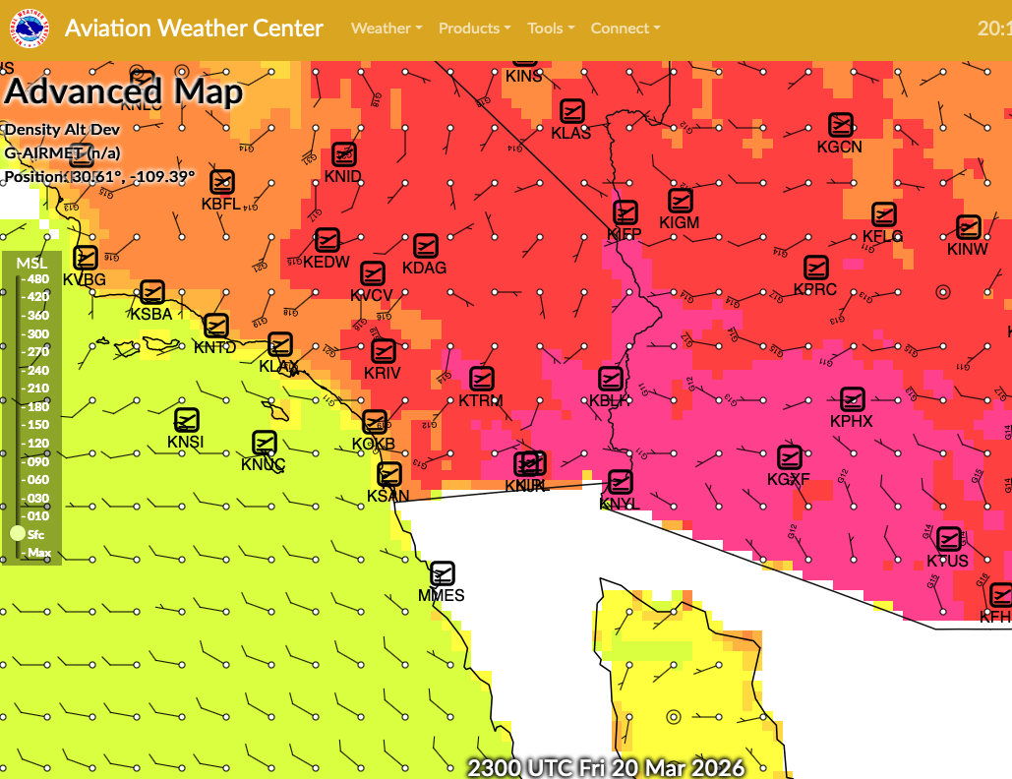

AWC Density Altitude Deviation
MARCH MADNESS!

Slide 13
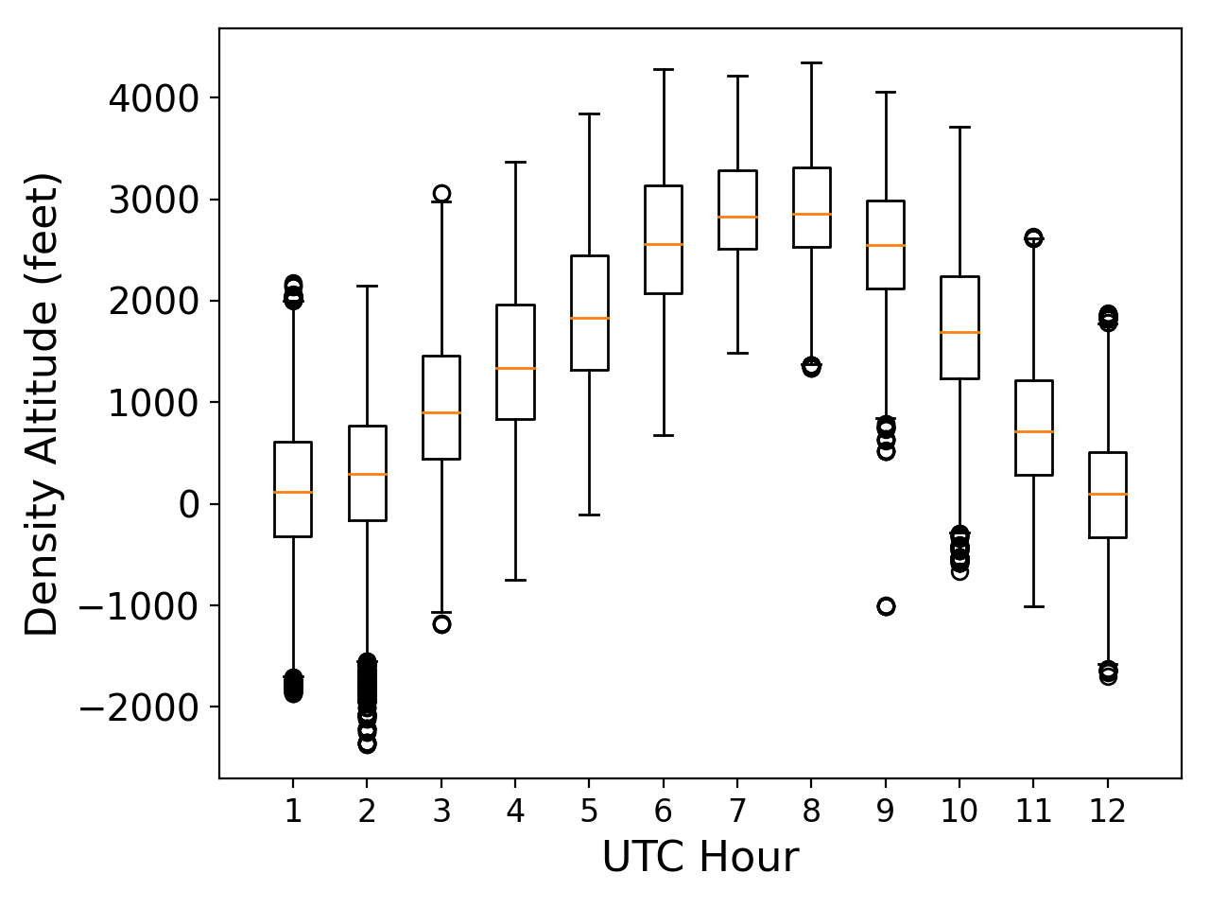
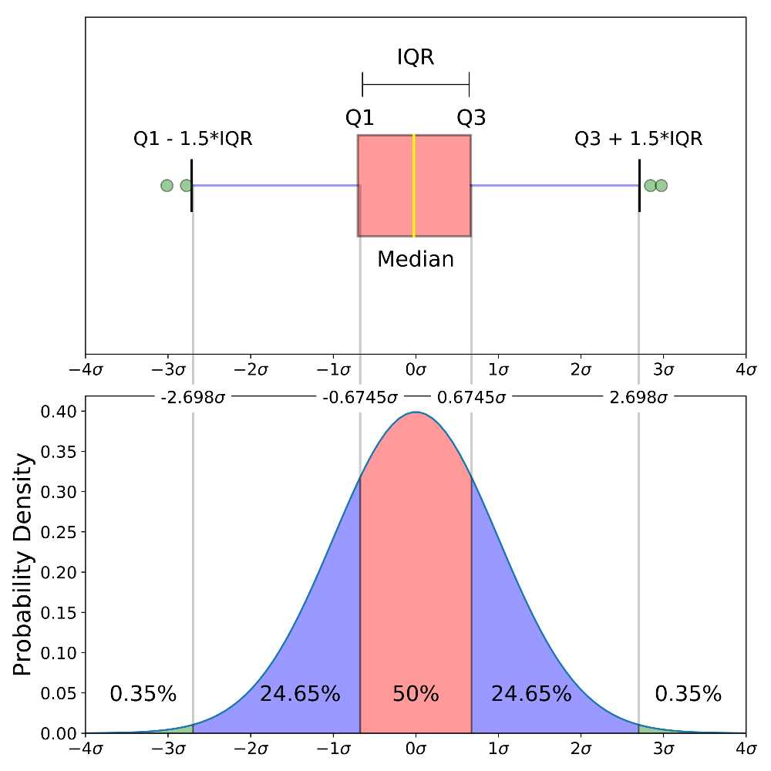
Density Altitude (KNYL) March Madness
Monthly DA Stats at KNYL
Box and Whiskers Plot
Approximately 1–2% of data points are considered outliers in a box-and-whiskers plot.
KNYL: DA 3408 feet

Slide 14
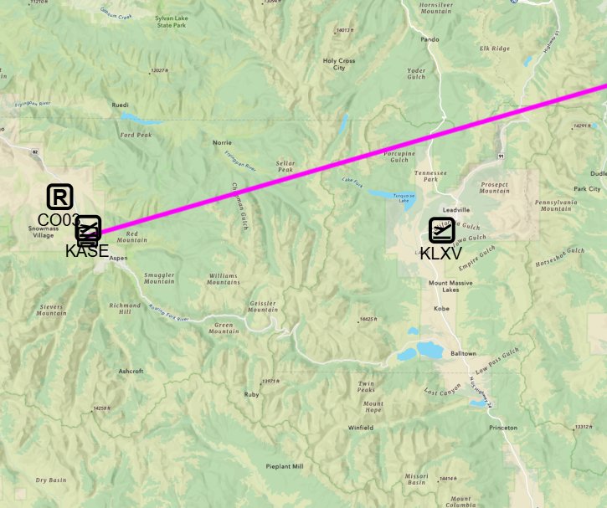
Density Altitude
Case 1
July Flight Aspen (KASE) to Des Moines (KDSM)
  KASE at 7838 feet
    DA 10380 feet
  KLXV at 9934 feet
    DA 12182 feet
  Early afternoon flight
  Beechcraft G36 Bonanza
    Service Ceiling ~18,000 feet
Service Ceiling:
the altitude where the aircraft's climb rate falls to about 100 feet per minute under standard atmospheric conditions

Slide 15
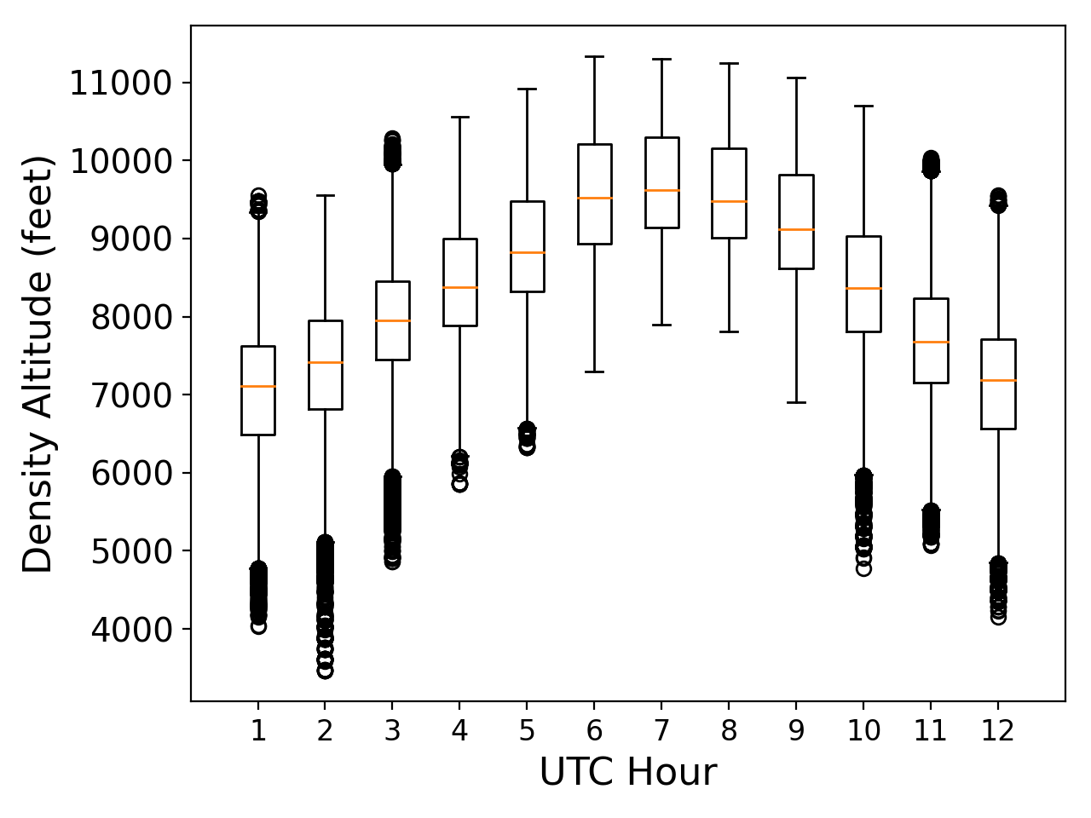
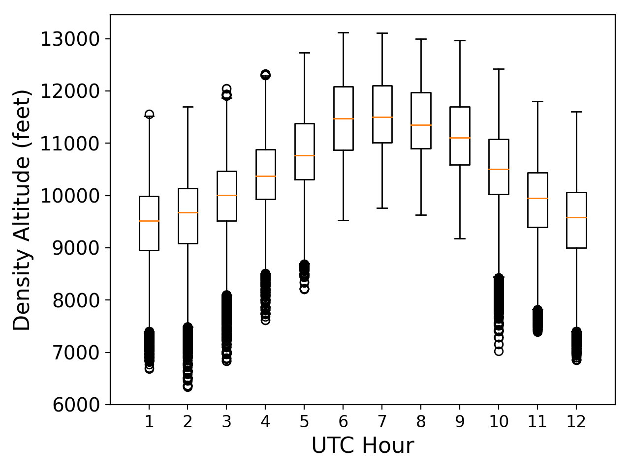
Density Altitude at KASE and KLXV
KASE: DA 10380 feet
KASE: DA 10380 feet

Slide 16
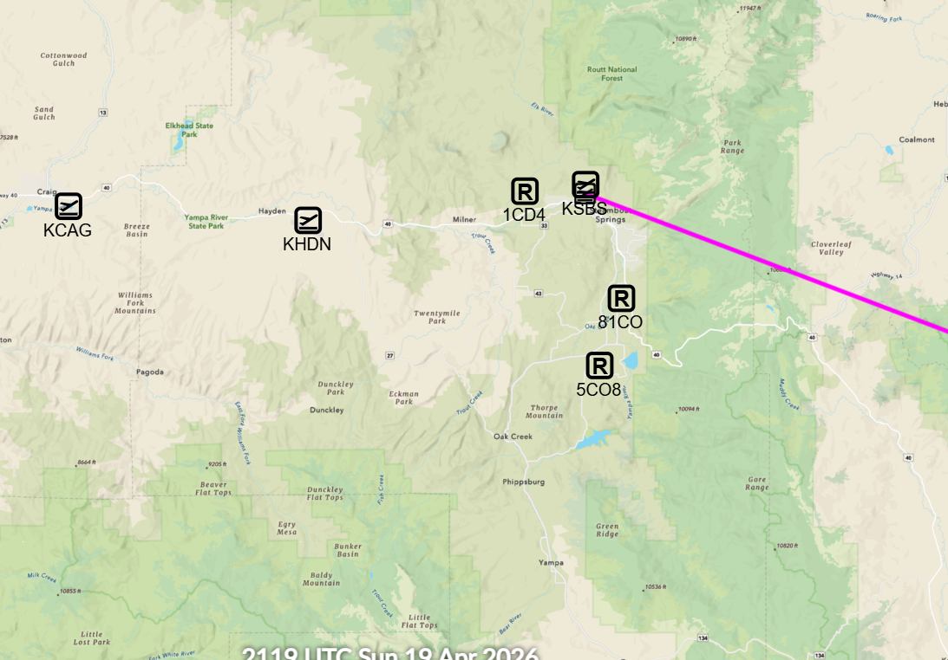
Density Altitude
Case 2
August Flight Steamboat Springs (KSBS) to Boulder (KBDU)
  KSBS at 6882 feet
    DA 8605 feet
  KCAG at 6198 feet
    DA 8254 feet
  Morning flight
  Piper PA 28R-201
    Service Ceiling ~15,000 feet
Service Ceiling:
the altitude where the aircraft's climb rate falls to about 100 feet per minute under standard atmospheric conditions

Slide 17
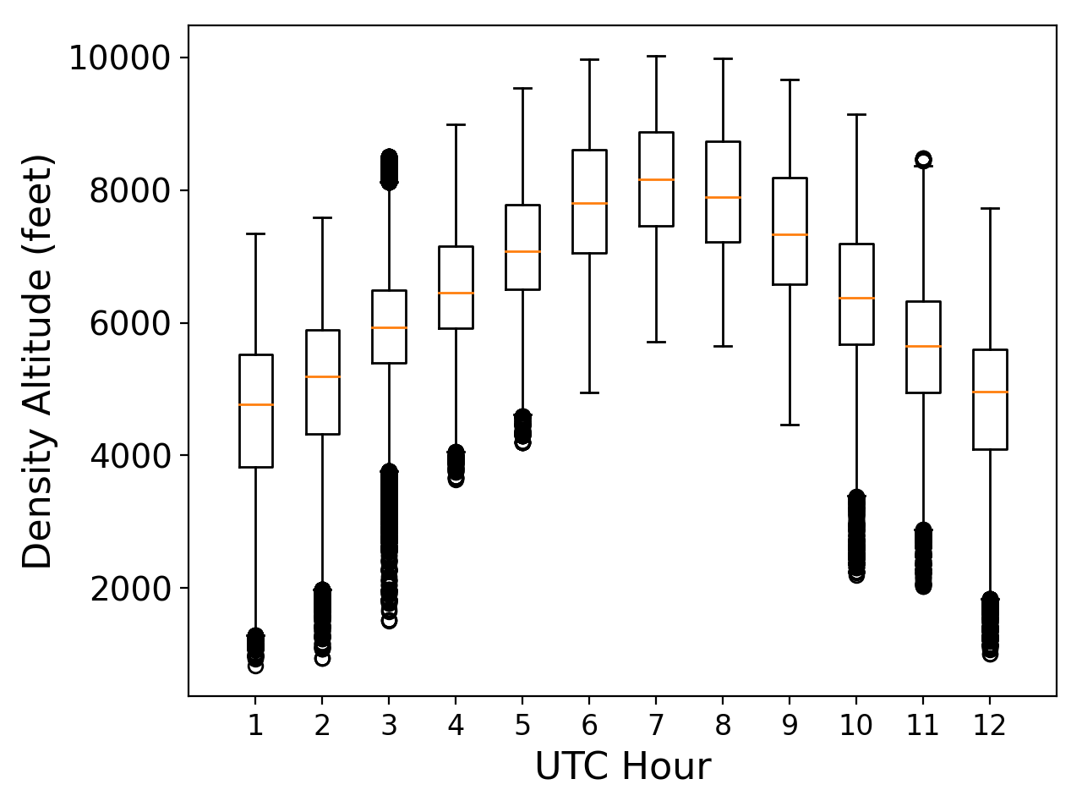
Density Altitude at KCAG
KCAG: DA 6198 feet

Slide 18
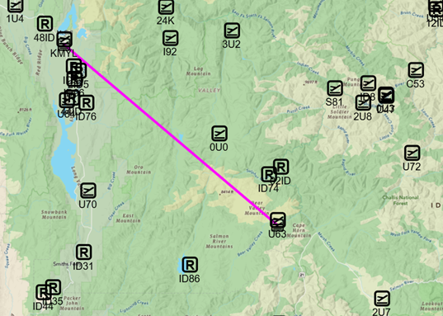
Density Altitude
Case 3
June Flight Stanley (U63) to McCall (KMYL)
  U63 at 6370 feet
  KMYL at 5024 feet
    DA 7403 feet
  Afternoon flight
  Stinson
    Service Ceiling ~14,000 feet
Service Ceiling:
the altitude where the aircraft's climb rate falls to about 100 feet per minute under standard atmospheric conditions

Slide 19
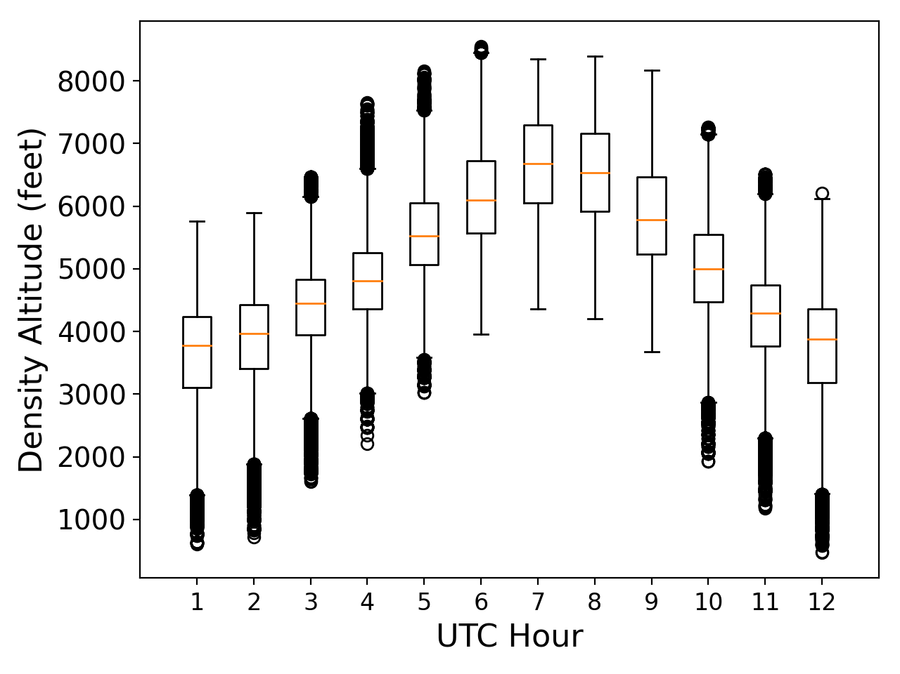
CASE 3 Density Altitude at KMYL
KMYL: DA 7403 feet

Slide 20

Select which incident you think is the true density altitude related incident!

Slide 21
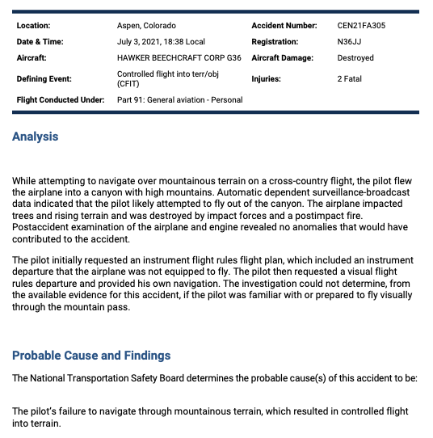
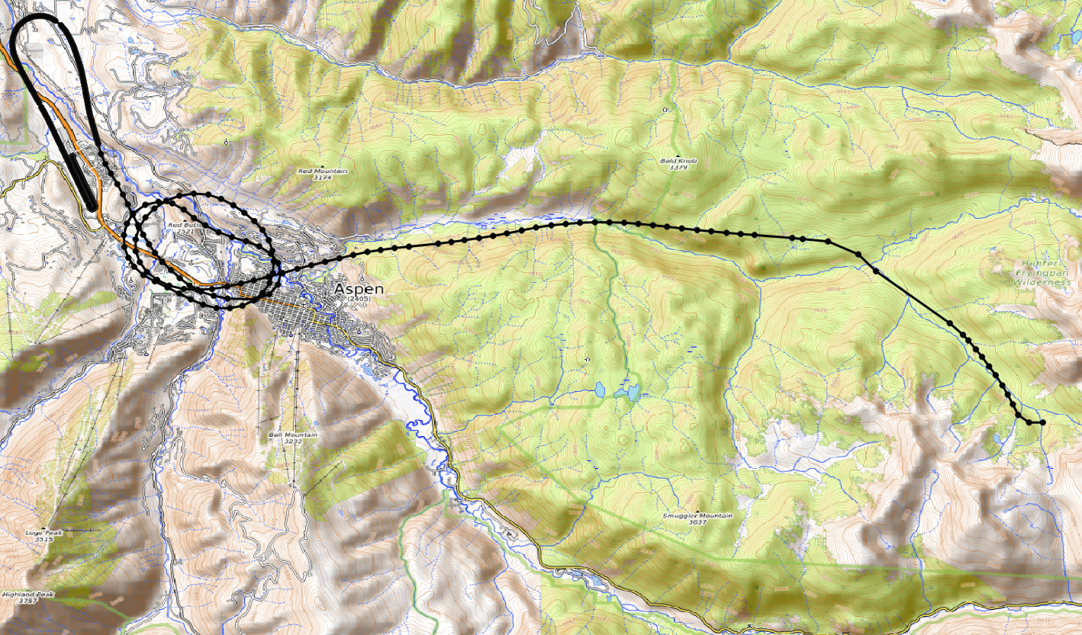
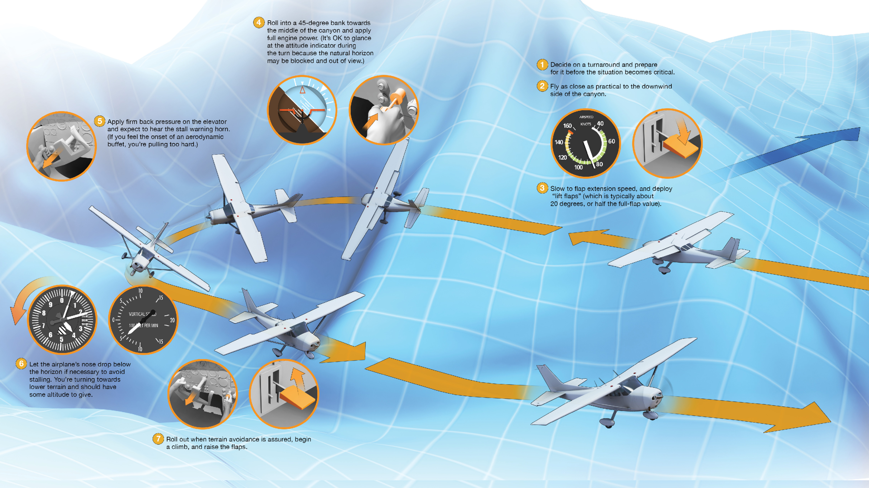
CASE 1
Turn into the Basin
The airplane continued towards Independence Pass staying a few hundred feet above the terrain. At 1838:11, the airplane climbed through 11,300 ft and began a turn into a basin walled by mountains with peaks up to 13,000 ft. The flight path turned left, likely in a maneuver to reverse course and exit the area. The last recorded point had the airplane’s groundspeed at 95 kts. Exact winds in the canyon are unknown but based on the ADS-B plotted turn radius and the
location of the accident site, the airplane turned with a 28° to 39° bank angle. In addition, the airplane was likely above stall speed for the duration of the turn.
Findings
1. (F) WEATHER CONDITION - HIGH DENSITY ALTITUDE
2. (C) IN-FLIGHT PLANNING/DECISION - INADEQUATE - PILOT IN COMMAND

Slide 22
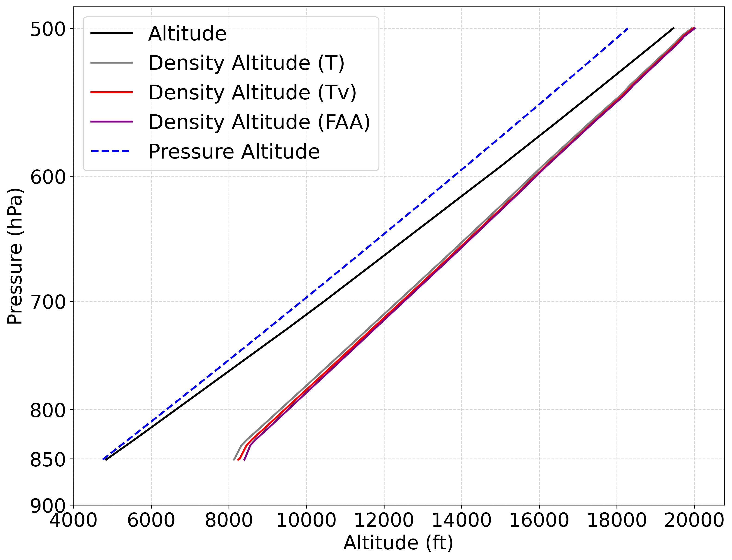

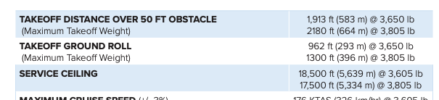
CASE 1
The airplane’s route of flight was consistent with an attempt to cross at Independence Pass. Entries in www.flycolorado.org list Independence Pass at 12,095 ft, it is located along the Continental Divide and surrounded in all directions by 14,000 ft peaks, and “to be approached with extreme diligence”.
Colorado Pilot’s Association’s website www.coloradopilots.org lists Independence Pass as one of the highest passes in Colorado and should be avoided by pilots of
light aircraft.
Proximity radiosonde data (Grand Junction)

Slide 23
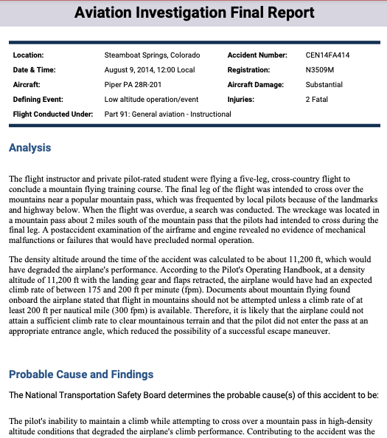
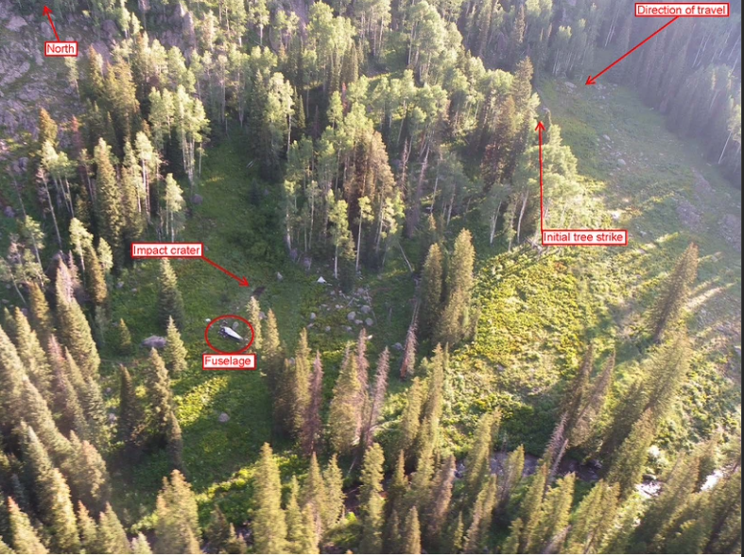
CASE 2
The density altitude around the time of the accident was calculated to be about 11,200 ft, which would have degraded the airplane's performance. According to the Pilot's Operating Handbook, at a density altitude of 11,200 ft with the landing gear and flaps retracted, the airplane would have had an expected climb rate of between 175 and 200 ft per minute (fpm).
Documents about mountain flying found onboard the airplane stated that flight in mountains should not be attempted unless a climb rate of at least 200 ft per nautical mile (300 fpm) is available. Therefore, it is likely that the airplane could not attain a sufficient climb rate to clear mountainous terrain and that the pilot did not enter the pass at an appropriate entrance angle, which reduced the possibility of a successful escape maneuver.

Slide 24
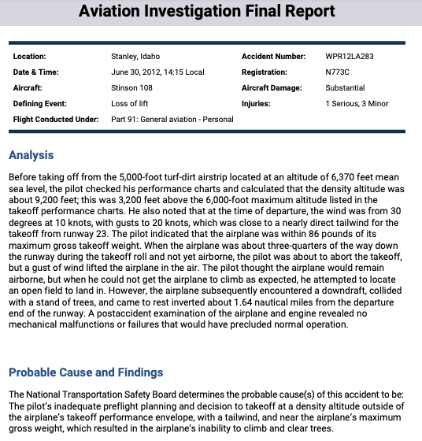
CASE 3
The National Transportation Safety Board determines the probable cause(s) of this accident to be: The pilot’s inadequate preflight planning and decision to takeoff at a density altitude outside of the airplane’s takeoff performance envelope, with a tailwind, and near the airplane’s maximum
gross weight, which resulted in the airplane’s inability to climb and clear trees.
Mr. XXXXX stated that prior to departing the Bruce Meadows airstrip (U63) he reviewed the airplane’s performance charts and determined the density altitude to be about 9,700 feet. He further stated about three-quarters of the way down the runway and still not airborne, he was about to abort the takeoff, when a gust of wind put the airplane in the air. He reported that at this time he thought he was fine, but then he realized that the airplane wasn’t climbing like he thought it should be, and with the elevation of the terrain increasing in front of him, he began to look for a road to land on, but the airplane impacted a stand of trees before he could get it down.

Slide 25
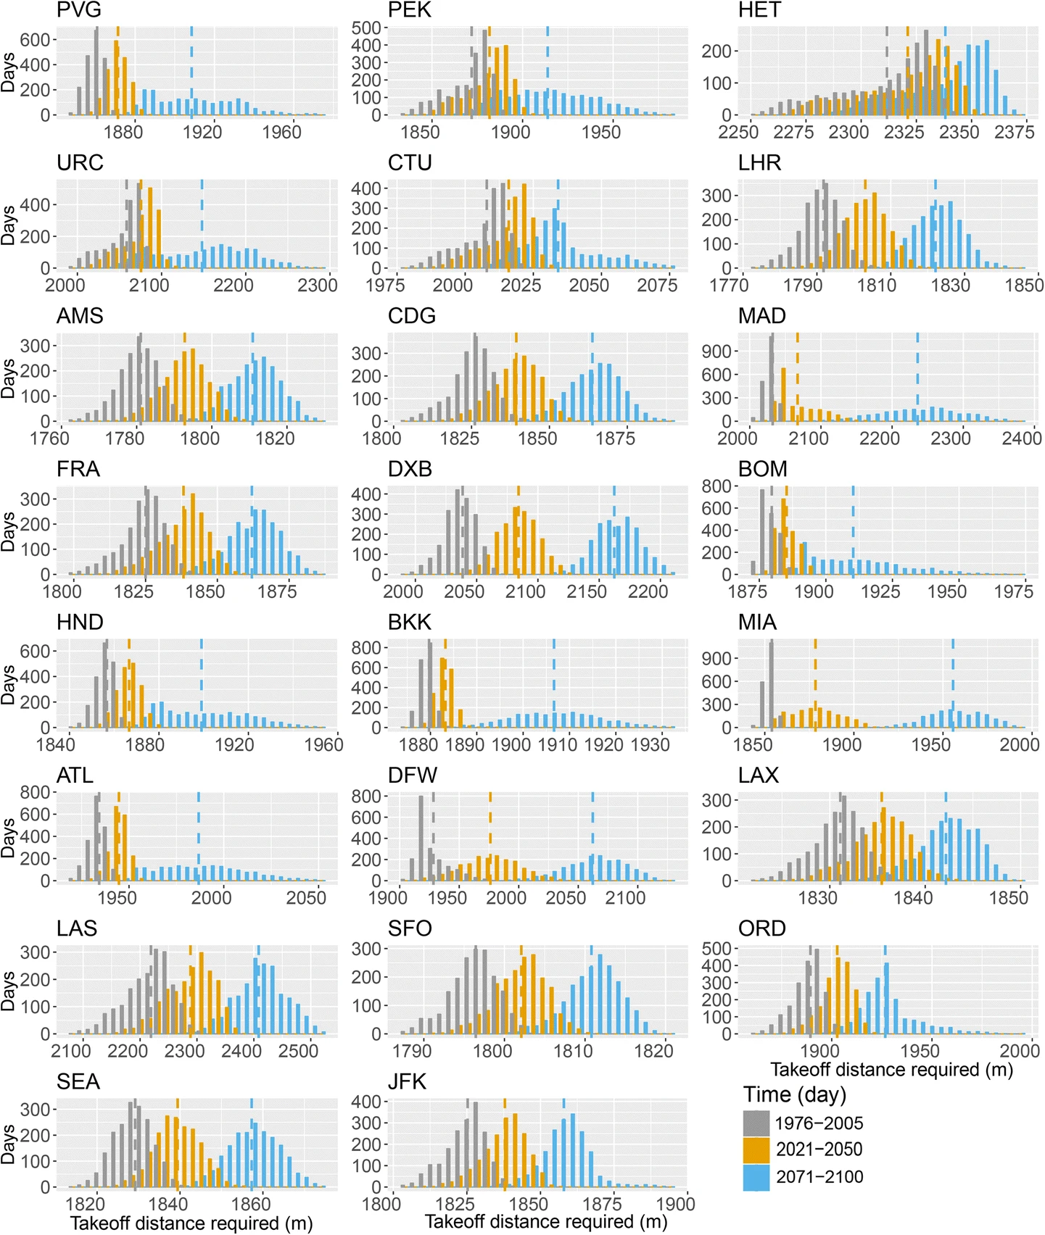
One last thought…
Density Altitude and Climate Change
Probability distributions of required takeoff distance of Boeing 737-800 aircraft in 1976–2005 (gray), 2021–2025 (yellow), and 2071–2100 (blue) at the 30 airports around the world. Dash lines represent mean values. The takeoff distances all shift toward higher values from the history to the future
Zhou, Y., Zhang, N., Li, C., Liu, Y., & Huang, P. (2018). Decreased takeoff performance of aircraft due to climate change. Climatic change, 151(3), 463-472.

