Slide 1
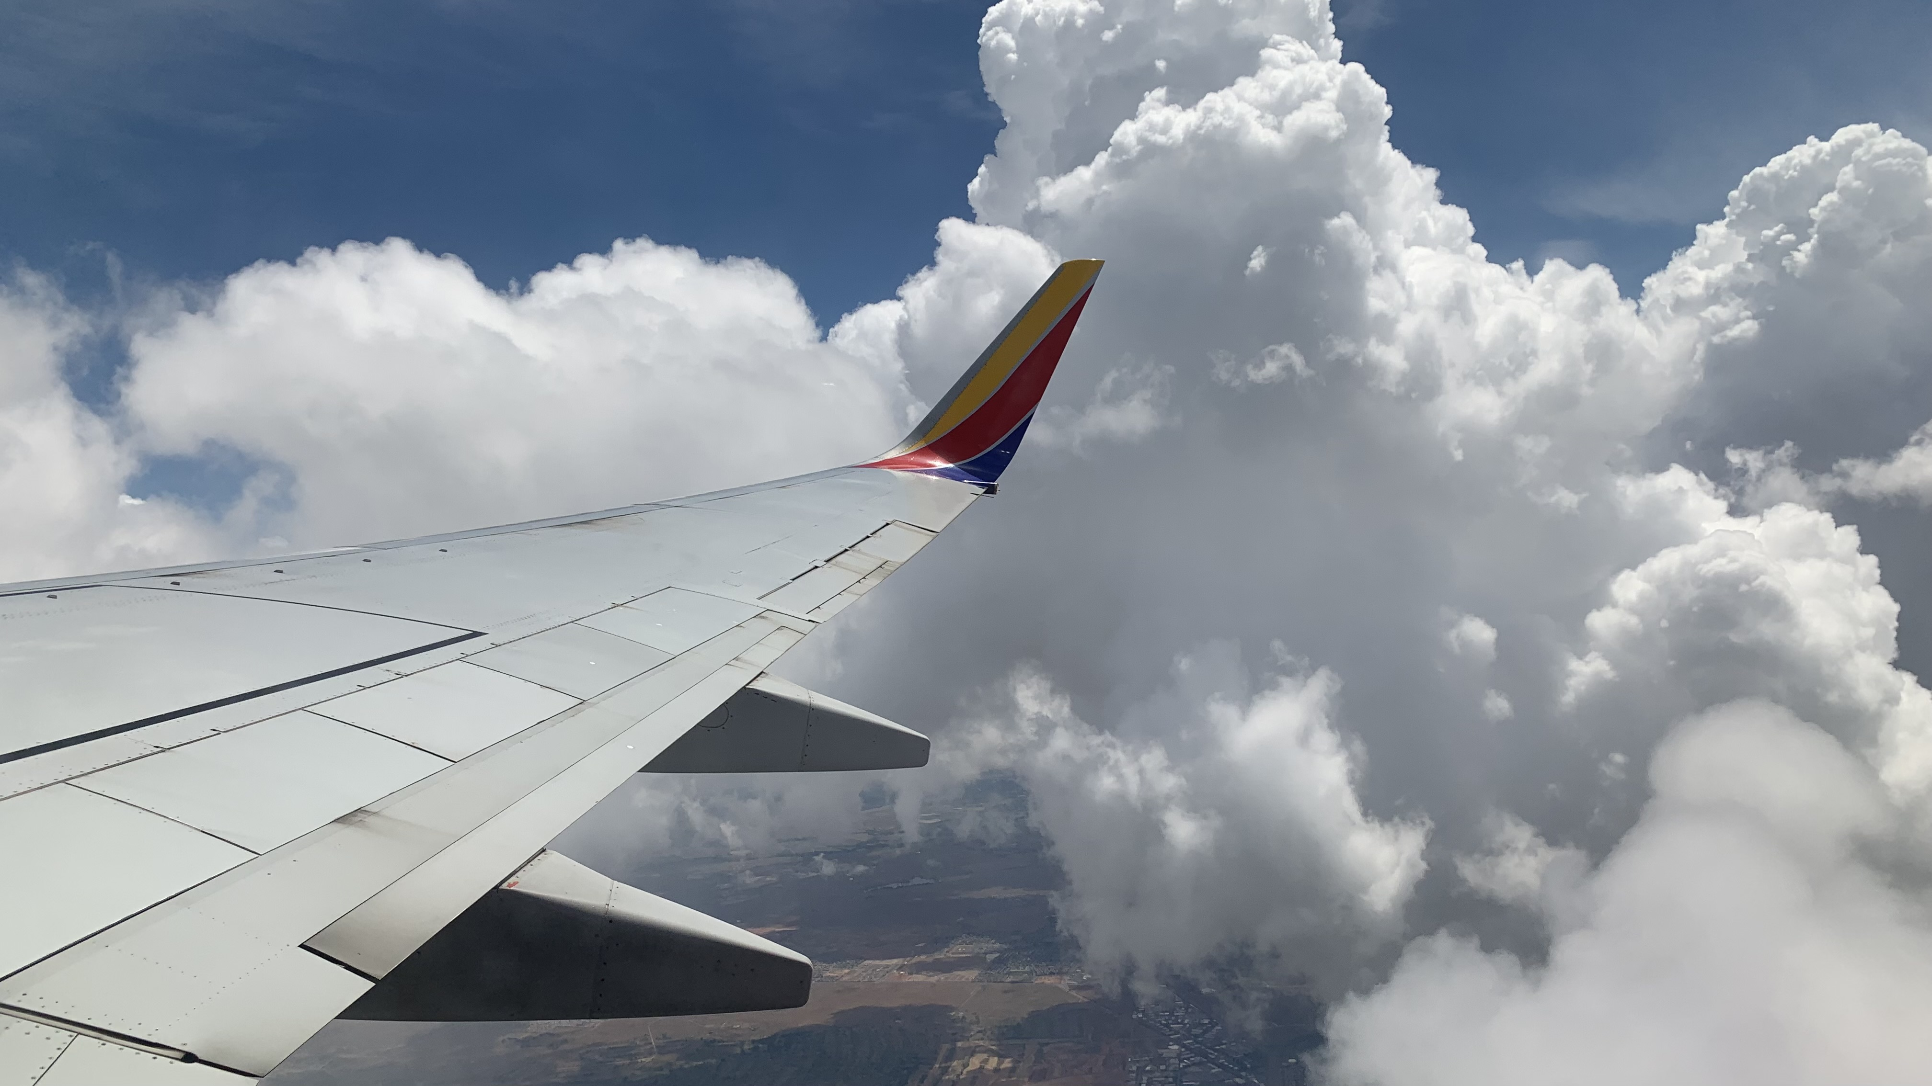
Teaching winter weather from the Sunshine State: Is building awareness & simulating experience sufficient?
The ERAU Aviation Weather Teaching Team: Rob Eicher, Tom Guinn, Dan Halperin, Brad Muller, Debbie Schaum, Zoe Searcy, & Sarah Strazzo
Dan Halperin | Embry-Riddle Aeronautical University | halpea17@erau.edu
Notes:
Background: https://www.geonet.org.nz/about/volcano/whiteisland Whakaari Island, NZ

Slide 2

What types of weather conditions are familiar to student pilots training in Daytona Beach, FL?
Notes:
internalize

Slide 3
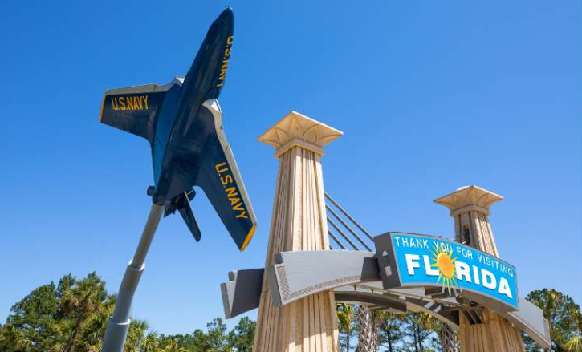
Notes:
First image: NY Times Second Image: Visit Florida

Slide 4
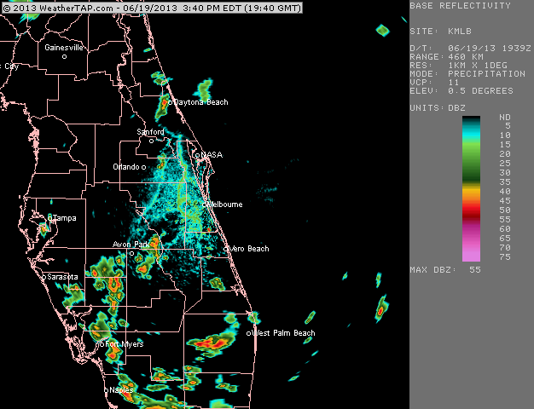

Slide 5
What types of weather conditions are unfamiliar to student pilots training in Daytona Beach, FL?
Notes:
internalize

Slide 6
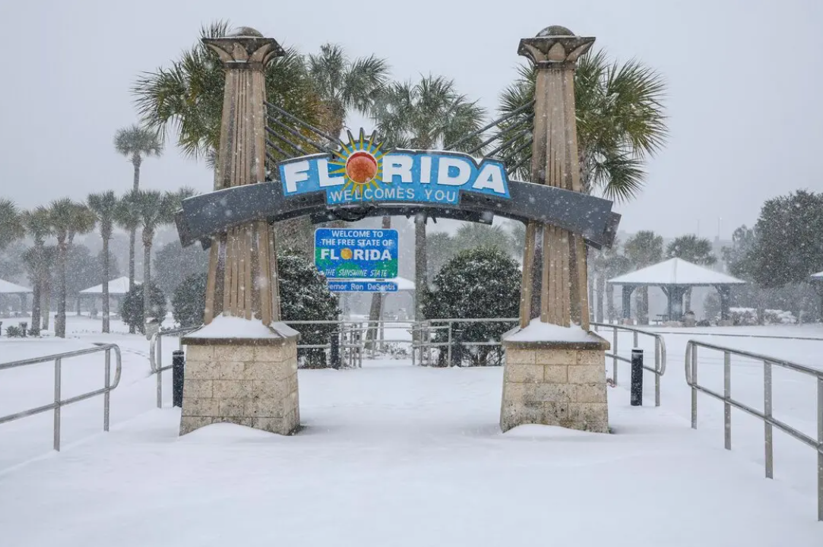
Notes:
First image: NY Times Second Image: Visit Florida

Slide 7
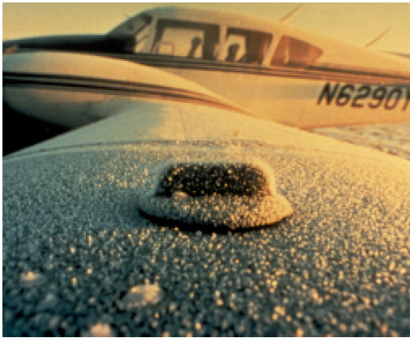
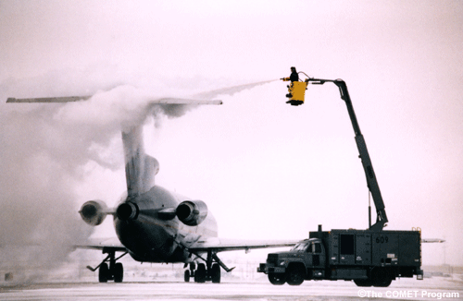

Slide 8
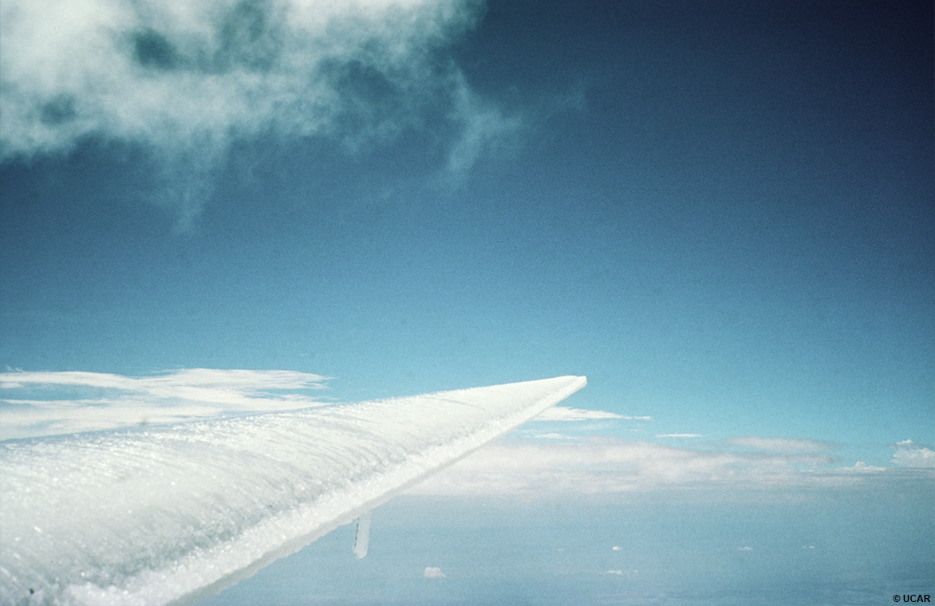
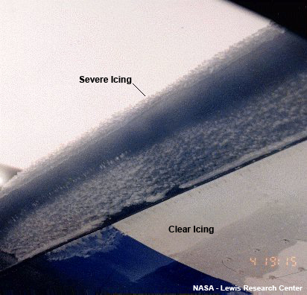
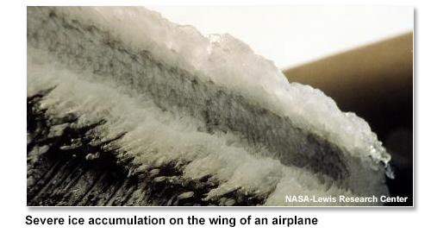

Slide 9
How can we teach pilots to fully appreciate the aviation impacts of weather phenomena they don’t experience in situ during training?
Notes:
internalize

Slide 10
Approaches at ERAU-Daytona Beach
Building awareness
Developing basic knowledge
Case studies
Simulating experience
Flight planning scenarios to apply basic knowledge
XR/VR and other tech (aspirational)

Slide 11
Weather requirements for ERAU flight students
WEAX 201: Intro to Meteorology
All the meteorology you can throw at them in one semester
Classic survey course with lots of breadth and very little depth
All pilots take this course, often before they have completed any flight training
WEAX 301: Aviation Weather
More applied, with emphasis on altimetry and specific aviation weather hazards (convection, IMC, icing, turbulence)
All pilots take this course, typically after they have already begun some of their flight training

Slide 12
Approach 1: Building Awareness

Slide 13
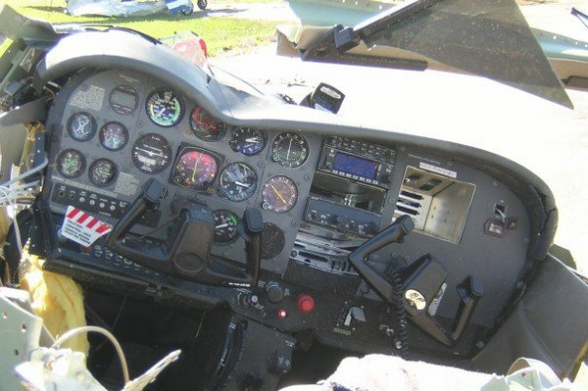
Developing Basic Knowledge
METARs, TAFs, PiREPs
ASOS/AWOS, station plots
Altimetry
Wind, mid-latitude cyclones, fronts
Stability and convection
Convective products and weather radar
IMC, satellite interpretation
Winter weather and icing
Wind shear and turbulence
Flight planning
Emphasis on problem solving rather than memorization!
Lots of “scenario-based” approaches, playing different roles (pilot vs. AWC met)

Slide 14
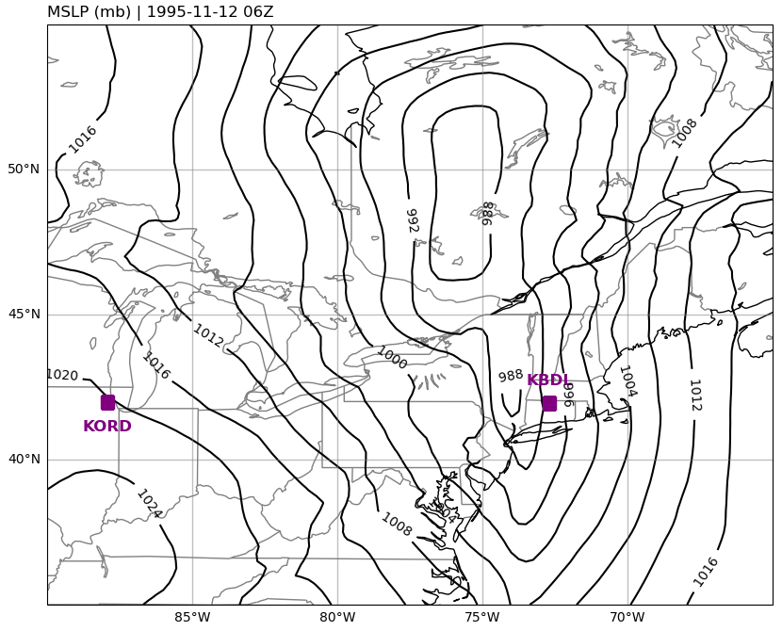
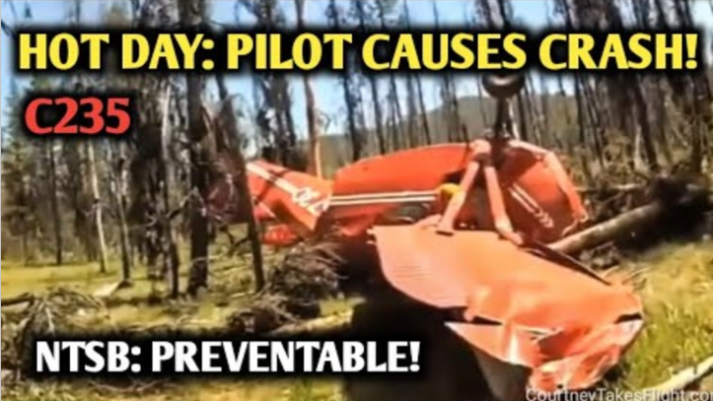
Case studies (scare tactics?)
Altimetry Example:
American 1572 (1995)
“Hot and High” Density Altitude Example:
Notes:
American 1572, Nov 1995

Slide 15
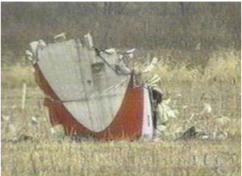
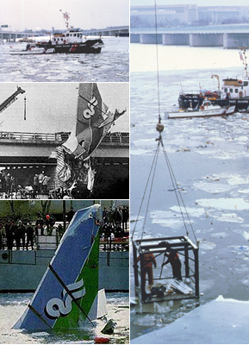
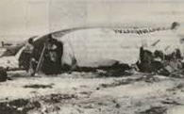
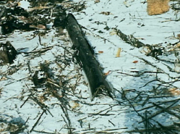
Case studies (scare tactics?)
Icing Examples:
American Eagle 4184 (1994)
Comair 3272 (1997)
Holdover Time Examples:
Air Florida 90 (1982)
Continental 1713 (1987)
Notes:
American 1572, Nov 1995

Slide 16
Approach 2: Simulating Experience

Slide 17
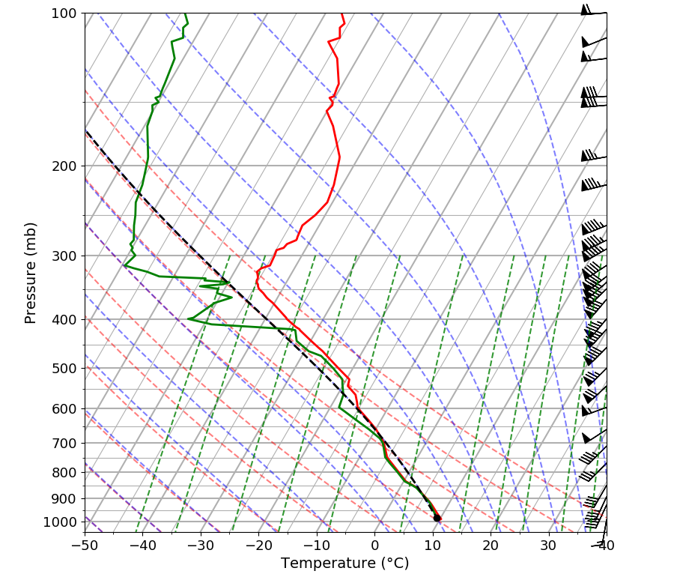
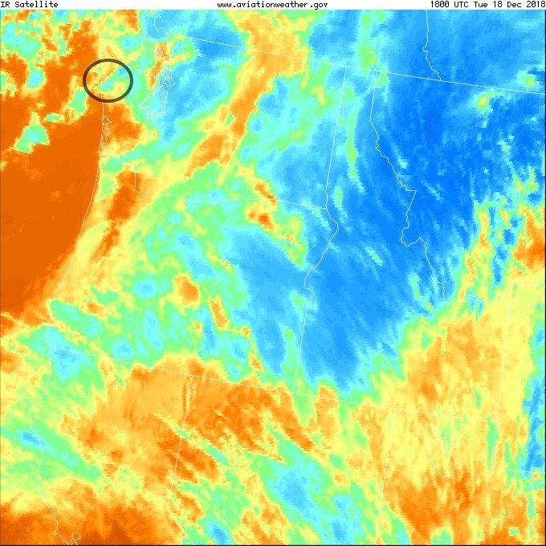
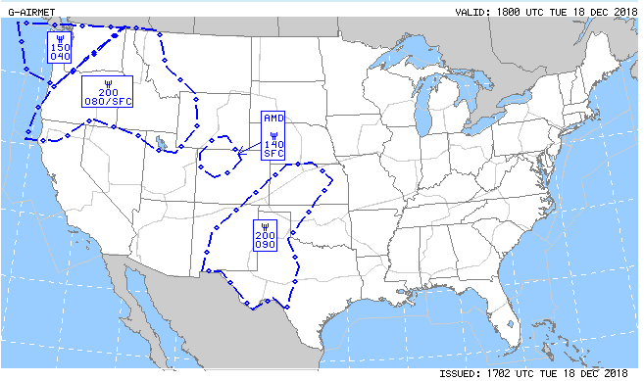
Create your own AIRMET
Students are given sounding data (tabular and skew-T) and satellite imagery.
They are tasked with determining whether an AIRMET for icing is warranted, and if so, for which altitude layer?
Students’ AIRMETs are compared with the actual AIRMET valid at the time of the example case.
Icing threat based on sounding data: 050-170
Actual AIRMET layer: 040-150

Slide 18
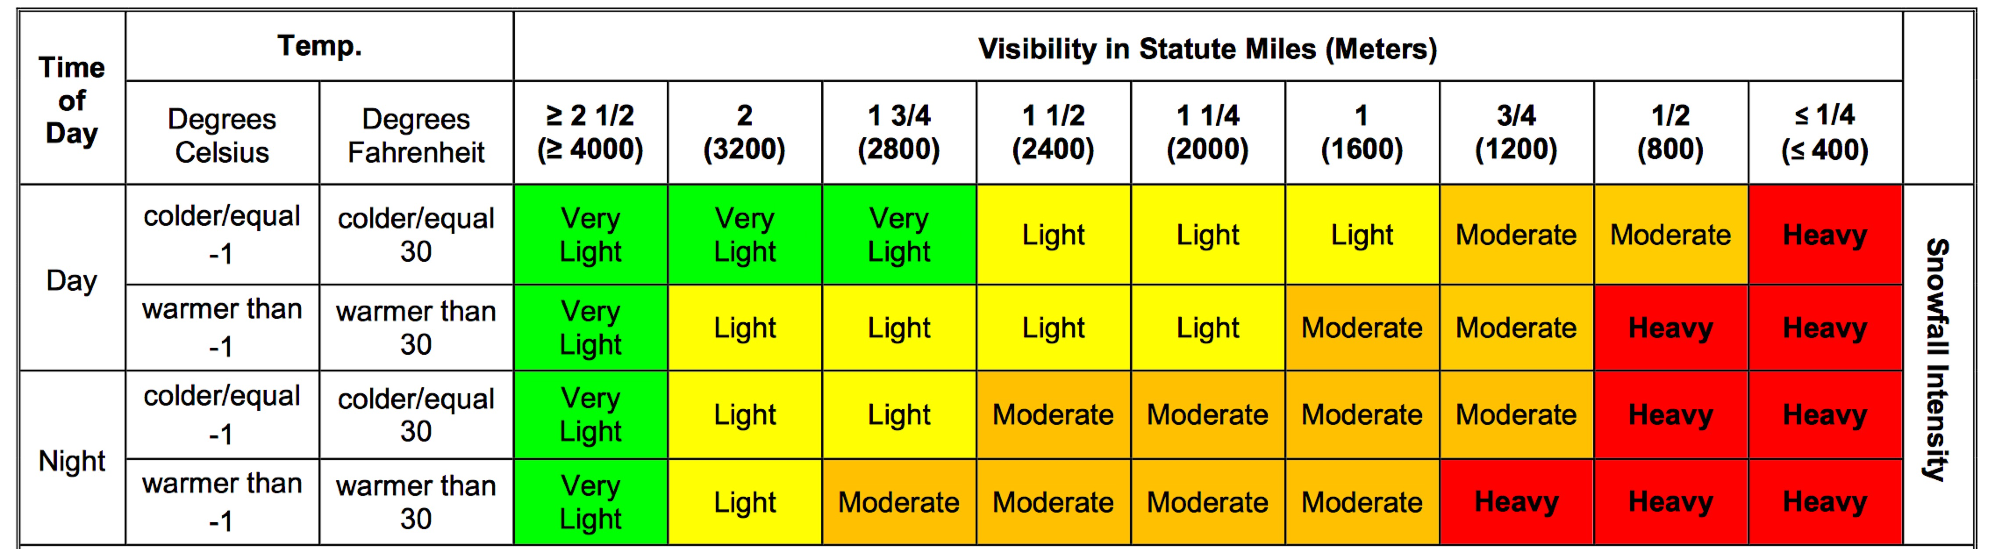
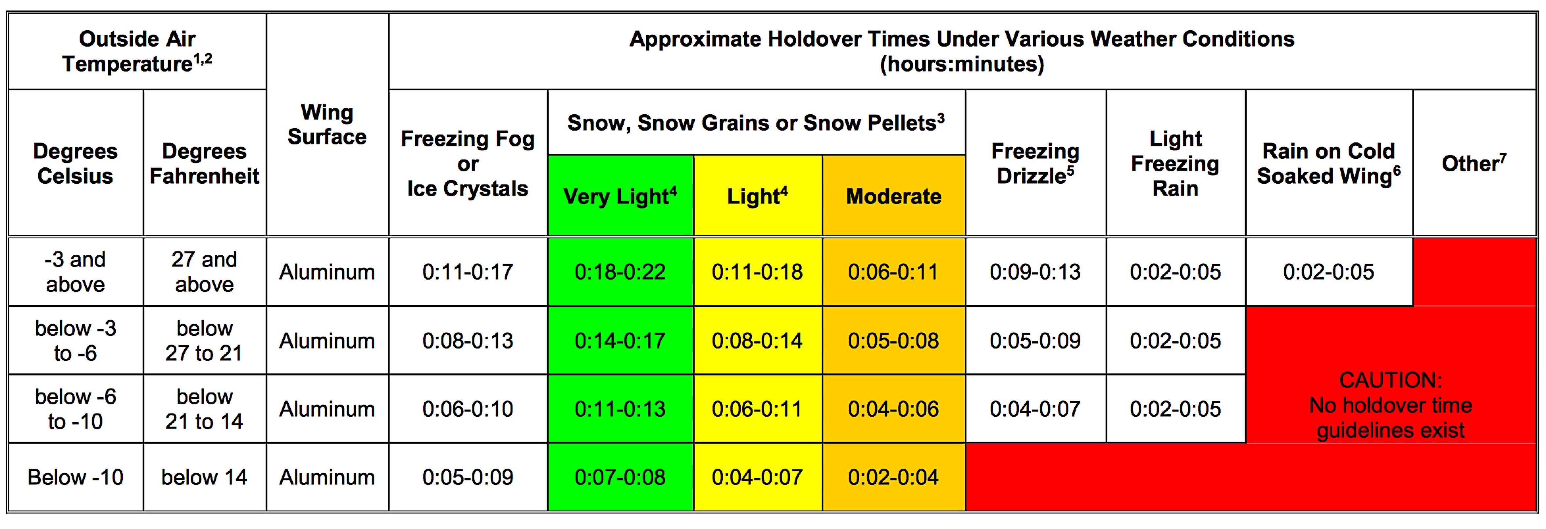
Calculate your estimated holdover time
KDTW 291905Z 31017G24KT 1SM -SN BKN015 OVC030 02/M01 A3013 RMK AO2 TWR VIS 2 T00221006 PNO

Slide 19
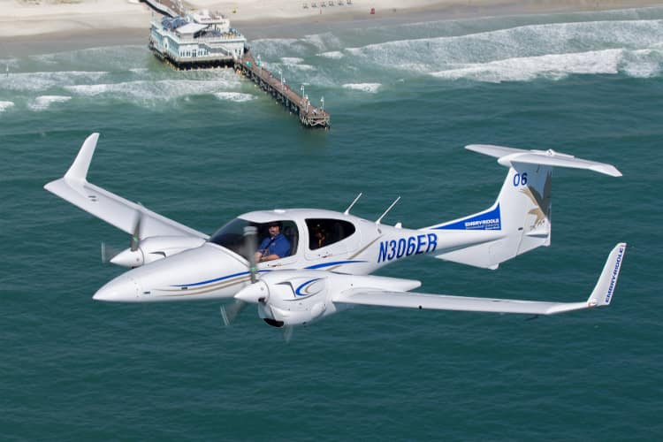
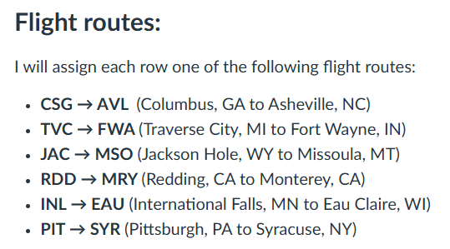
Go or no-go?
Routes vary each class based on real-time weather conditions.
Students are tasked with identifying all weather-related hazards for their flight route, with an ETD two hours after the beginning of class.
Students must make go/no-go decision based on weather conditions.
Focus is on marginal weather conditions.

Slide 20
XR/VR and other Simulation
XR/VR lab at ERAU can provide new opportunities to simulate weather conditions that students would not experience during flight training in Central Florida.
First use case currently in development: The difference between executing an approach with a definite ceiling (OVC005) vs an indefinite ceiling (VV005).
Implementation challenge: With a limited supply of headsets and lab space, how can we provide this opportunity to all 300+ students who enroll in the Aviation Weather course each semester?
Notes:
Definite vs. indefinite ceiling…..got below 500 ft could see runway vs. got belo

Slide 21
Questions/Discussion?
The ERAU Aviation Weather Teaching Team: Rob Eicher, Tom Guinn, Dan Halperin, Brad Muller, Debbie Schaum, Zoe Searcy, & Sarah Strazzo
Dan Halperin | Embry-Riddle Aeronautical University | halpea17@erau.edu
Notes:
Background: https://www.geonet.org.nz/about/volcano/whiteisland Whakaari Island, NZ

