Slide 1

Oklahoma Aviation Weather: A Student’s Perspective
Sammy Rodriguez

Slide 2
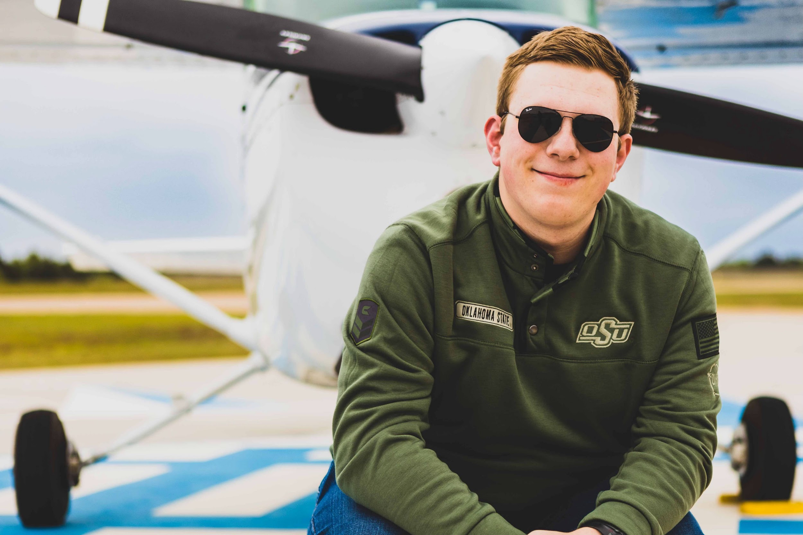
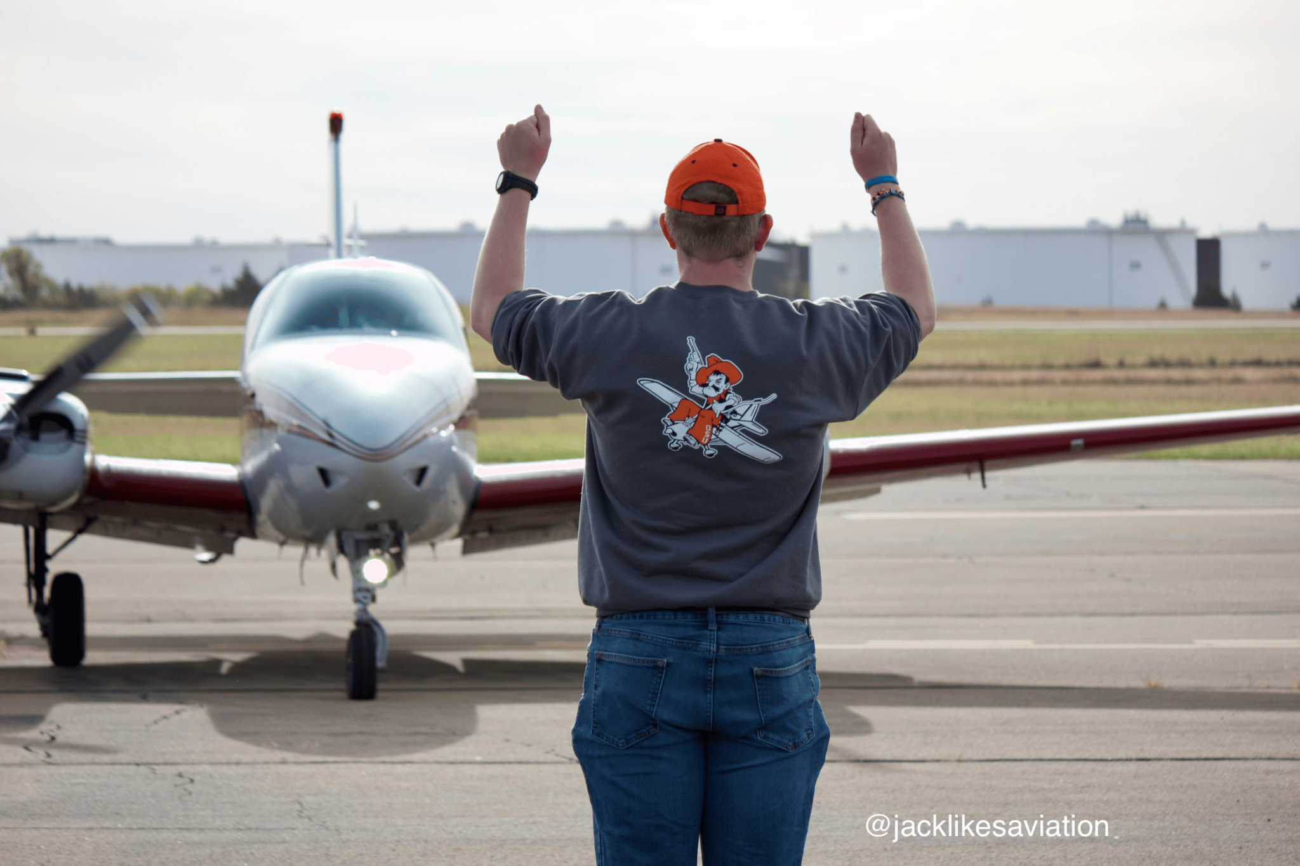
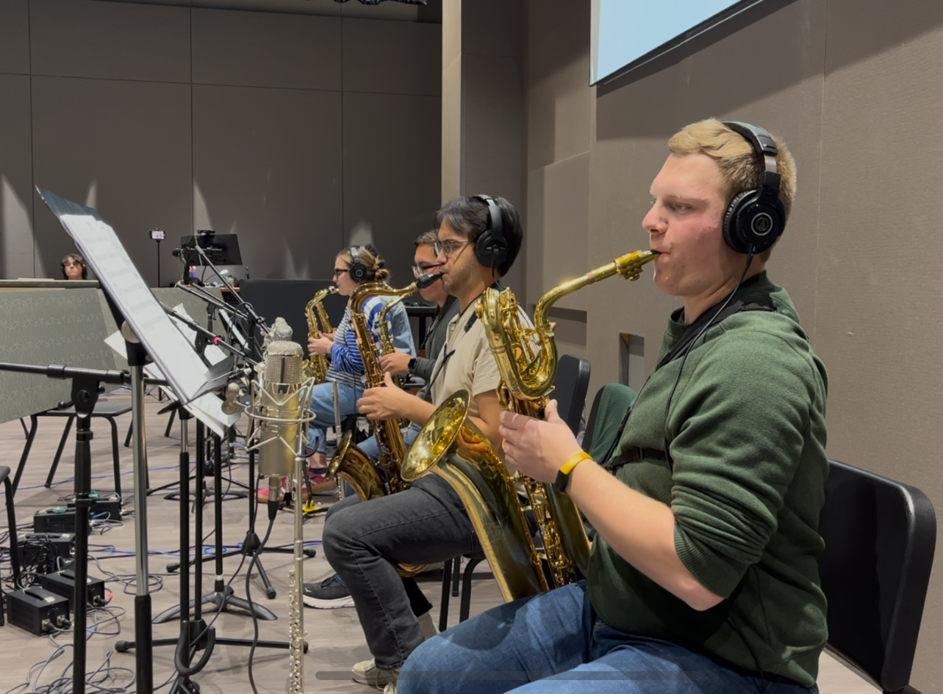
About Me
Professional Pilot Senior at OSU
Commercial Rated Pilot
Working on my CFI
Flying Aggies VP 25-26

Slide 3
Objectives
Introduce OSU Aviation
Introduce OSU Flying Aggies
Discuss flying in Oklahoma
What we don’t experience
Food for thought / ideas for mitigation

Slide 4
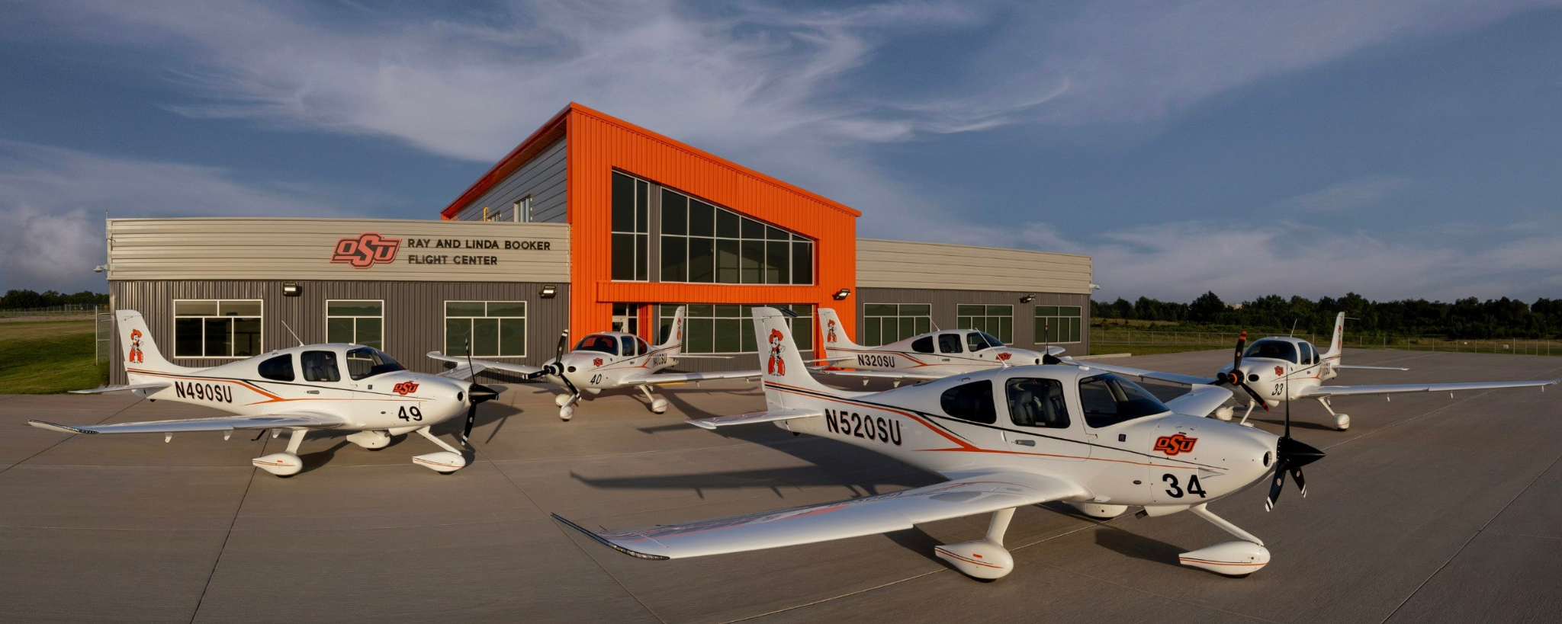
141 Flight Program
About OSU
Aviation
Private - CFI
45 Aircraft (and growing)
Fleet:
Cirrus SR20
Cessna 152
Cessna 172
Piper Seminole

Slide 5
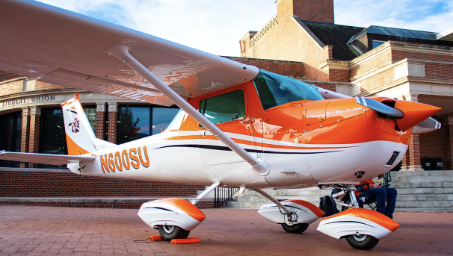
OSU Flying Aggies
Second oldest student organization at OSU
Goal is to share aviation and education
Not only pilots, members with other OSU aviation degrees
Open to any student at the university
Club Cessna 150

Slide 6
What is it like flying in Oklahoma?

Slide 7
Wind!
Strong wind is common throughout the year
Can cancel flights or inhibit younger students from flying on the worst days

Slide 8
Thunderstorm Development
Especially in the spring, commonly experience multi-day weather events with severe thunderstorms and their hazards. Not the best flying weather!

Slide 9
Seasonal Temperature Changes
Warm / hot summers
Cold winters
Students experience flying in different conditions

Slide 10
Wildfire Risk
Becoming more common
Pockets of fire visible while flying
*Hasn’t inhibited flights
Two air tractors and PC 12 on field for mitigation

Slide 11
What aren’t we used to?

Slide 12
Lots of Winter Weather
State as a whole shuts down during winter weather events
Students don’t experience flying in the worst conditions
SOPs and aircraft limitations prevent training in icing conditions

Slide 13
Desert Flying
Although Oklahoma has seasonal temperature changes with warm summers, we don’t experience the conditions that are common in the Southwest

Slide 14
Mountain Flying
Oklahoma isn’t known for its mountainous terrain
Students and private pilots don’t get experience or instruction on mountain / canyon flying

Slide 15
How Can We Mitigate These Risks?

Slide 16
Open Dialogue Between Students
“Low density altitudes are great, fast climbs!”
“I just flew in IMC, it was really cool!”
“I just de-iced for the fourth time this week :( ”

Slide 17
Keeping Private Pilots in the Loop
Organizations like FPAW and AOPA as well as the FAA Wings program are expanding weather education in the industry
The industry to needs to focus on those who are not seeking out additional training. How can we encourage preparation for unfamiliar conditions?

Slide 18
Passionate Education of the Weather
Great teaching can equal great retention!

Slide 19
Oklahoma is a great Teacher!
Strong wind and other adverse flying conditions builds strong pilots
Oklahoma demonstrates a good blend of the climates common in the U.S.

Slide 20
Thank You!

