Slide 1


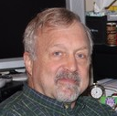
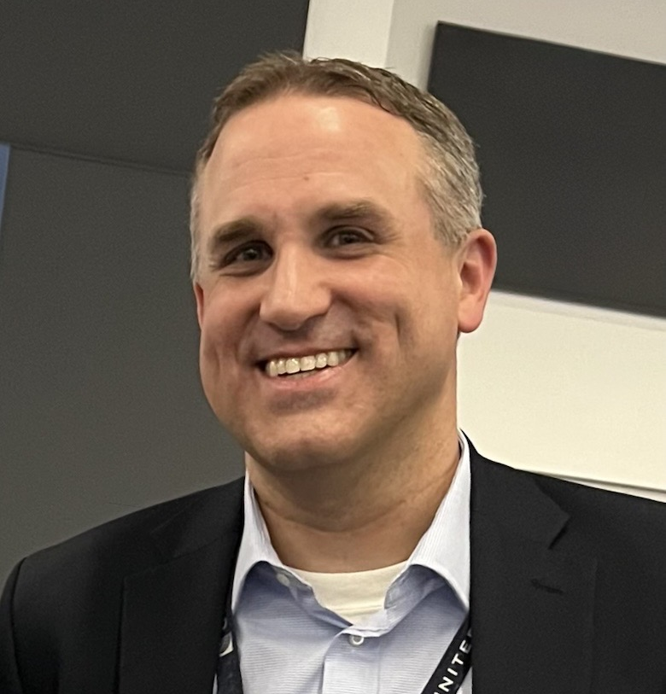
FPAW Organizational & Future Meeting Updates
Nathan Polderman
United Airlines, Inc.
nathan.polderman@united.com
Matt Fronzak
The MITRE Corporation
mfronzak@mitre.org
Contact FPAW: https://fpaw.aero/contact

Slide 2
FPAW Frequently Asked Questions
What is the Friends and Partners in Aviation Weather (FPAW)?
FPAW is an all-volunteer aviation weather organization (established in 1997) comprised of members from one or more of four related constituencies:
Users of Aviation Weather
Providers of Aviation Weather
Aviation Weather REDs and Academicians
Developers of Aviation Weather Regulations and Standards
What is the FPAW mission?
Increase understanding of the impact of weather on current and emerging aviation operations, identify, discuss and provide support to problem areas that need further development of accurate and timely weather guidance, and facilitate the integration of weather into the operational decision-making process.
How many FPAW members are there?
~700 registered members
How does one become a member of FPAW?
Sign up here (it’s free!): https://fpaw.aero/form/become-a-member

Slide 3
FPAW Steering Committee
Overview
The FPAW SteerCo is comprised of 13 elected members plus the FPAW Co-Chairs. Elected members serve 3-year terms, with no term limits.
Four (4) elected members from the Users community
Four (4) elected members from the RED/Academia community
Three (3) elected members from the Producers community
Two (2) elected members from the Regulators community
Two (2) FPAW Co-Chairs
Upcoming Elections
Four (4) FPAW SteerCo positions will be open effective October 1, 2026
Two Users rep slots, one Producers rep slot and one RED/Academia rep slot
Interested? Reach out to us via https://fpaw.aero/contact, or directly by email
Current activities
Establishing new relationship with FAAST to secure WINGS credit for all future meetings
Working to establish annual Spring meeting location on a college/university campus
Will be soliciting candidates for a new student member on the SteerCo
Considering new position papers

Slide 4
FPAW Steering Committee Members
Name | Affiliation | Constituency | Term
Eric Avila | NATCA | Users | 10/23 – 9/26
Christian Amaral | ALPA | Users | 10/25 – 9/26
Beth Welliver | Joby Aviation | Users | 10/25 – 9/27
David Dillahunt | Southwest Airlines | Users | 10/25 – 9/28
Jennifer Stroozas | NWS AWC | Providers | 10/23 – 9/26
Jeff Weinrich | IMSG | Providers | 10/24 – 9/27
Elizabeth Wilson | Synoptic Data | Providers | 10/25 – 9/28
Rick Curtis | Collins Aerospace | RED / Academia | 10/23 – 9/26
Ian Johnson | FAA | RED / Academia | 10/24 – 9/27
Michael Splitt | FL Institute of Technology | RED / Academia | 10/24 – 9/27
Scott Landolt | NCAR | RED / Academia | 10/25 – 9/28
Gus de Azevedo | Oklahoma State University | Regulators | 10/25 – 9/27
Gordy Rother | FAA | Regulators | 10/25 – 9/28
Matt Fronzak | MITRE | FPAW Co-Chair | N/A
Nathan Polderman | United Airlines | FPAW Co-Chair | N/A

Slide 5
FPAW Steering Committee - Student Representative
Overview
Unique opportunity to step into a visible role within the aviation weather community, working alongside professionals from government, academia, and industry to shape the future of aviation safety and operations. As the Student Representative, you will have a direct voice in Steering Committee discussions, contribute to conversations that influence real-world decision-making, and help ensure student perspectives are meaningfully integrated into FPAW activities. This role offers valuable exposure, networking opportunities, and a platform to represent the next generation of aviation weather professionals.
Terms & Eligibility
1-year commitment with possibility to extend
Undergraduate or graduate student interested in aviation weather with a background in aviation and/or meteorology
Responsibilities
Participate in monthly Steering Committee meetings
Represent student perspectives on aviation weather topics
Communicate student interests and concerns to the committee
Serve as a student ambassador to the university community to improve student engagement with the FPAW community
Application
CV or resume
A brief paragraph describing your interest in the position and relevant experience
A letter of support from a faculty member

Slide 6
Fall 2026 FPAW Meeting
Location
DC Area – MITRE
Dates
Tuesday-Thursday, October 27-29, 2026
Themes / Draft Agenda
Primary theme: Weather impacts and information in the lower atmosphere
Framing weather challenges unique to lowest 5,000 ft; case studies from 121, 135 and UAS/AAM
Weather hazards to low-flying aircraft – icing, turbulence, wind shear, visibility/ceiling
Weather observing, sensing and modeling in the low altitude environment; WMO UAS Demo Campaign
Weather tools and resources for pilots; human factors
Other possible discussion topics
FAA Weather COI updates
FAA Surface Weather Status Dashboard
Aircraft-based observations (ABO)
Snowfall – LWE vs prevailing visibility
FAA NWP/CSS-Wx and the Aviation Weather Display
Possible tours / events
NOAA Weather Prediction Center
Udvar-Hazy Museum
MITRE

Slide 7
Future FPAW Meetings
Locations
Endeavor to hold Spring FPAW meetings on a college/university campus
Spring 2027 – Florida Tech (FIT), Melbourne, FL (tentative)
Topics
Turbulence – automated observing systems, EDR standards, GTG/modeling, data sharing
Space weather
Weather observing infrastructure, standards and regulations (PBWS, ASOS/AWOS, mesonets, urban, ABO, etc.)
Weather for low altitude and off-airport operations (helicopter/air medical, oil platforms)
Aviation forecast verification and validation
Weather and automation/autonomy
Volcanic ash – quantitative volcanic ash products
Weather needs for stratospheric operations (supersonic flight, balloons, UAS, etc.)
Alaska PIREP Smart Solicitation project
Top weather concerns from professional organizations (i.e. AOPA, A4A, NATCA, etc.)
Submit a topic: https://fpaw.aero/form/submit-topic

