Slide 1
Icing hazards due to supercooled large droplets (SLD)
Presented by: Wayne R. Sand
Big Sky Weather Consulting
Essex, Montana

Slide 2
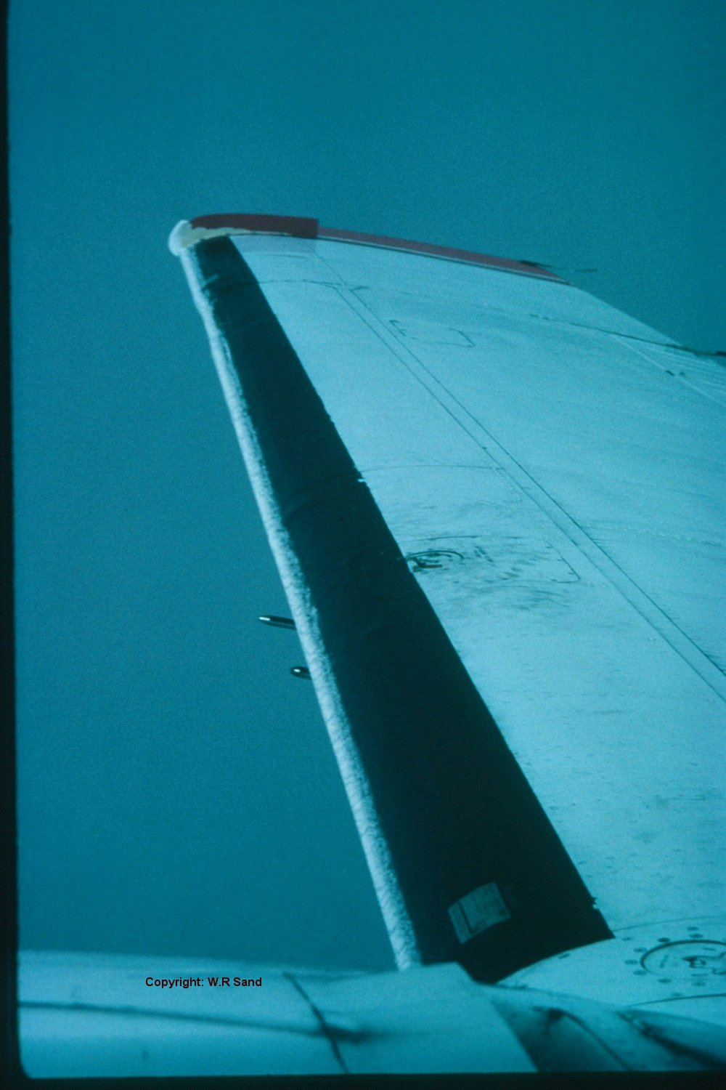
Common Icing: FAR 25 Appendix C
Historically, icing has been described in the Federal Air Regulations and typically appears as shown in the photo on the right.
These FAR 25, Appendix C icing conditions were specified to certify and test airplanes in icing conditions.
Supercooled large droplets were previously known as freezing drizzle and freezing rain.
Pilots were instructed to avoid these conditions. Flight was not authorized in ZR or ZL.

Slide 3
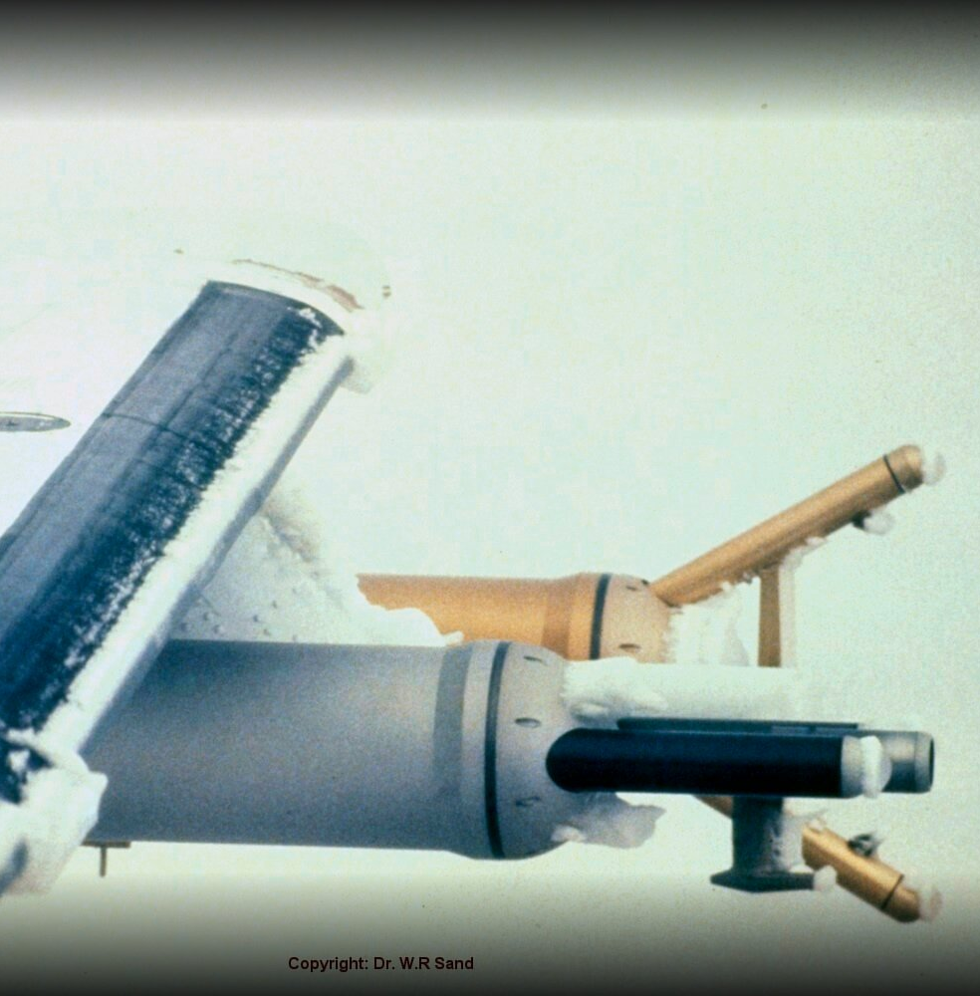
Common Icing: FAR 25 Appendix C
FAR MORE ICING IN THIS PHOTO – MODERATE ICE
PROTECTIVE EQUIPMENT WILL REMOVE THIS ICE
ALL ICE IS ON THE PROTECTED AREA OF THE DEICING BOOT

Slide 4
Icing was HISTORICALLY grouped into two categories for certification 1. Maximum continuous icing: Stratiform clouds 2. maximum intermittent icing: Cumuliform clouds

Slide 5
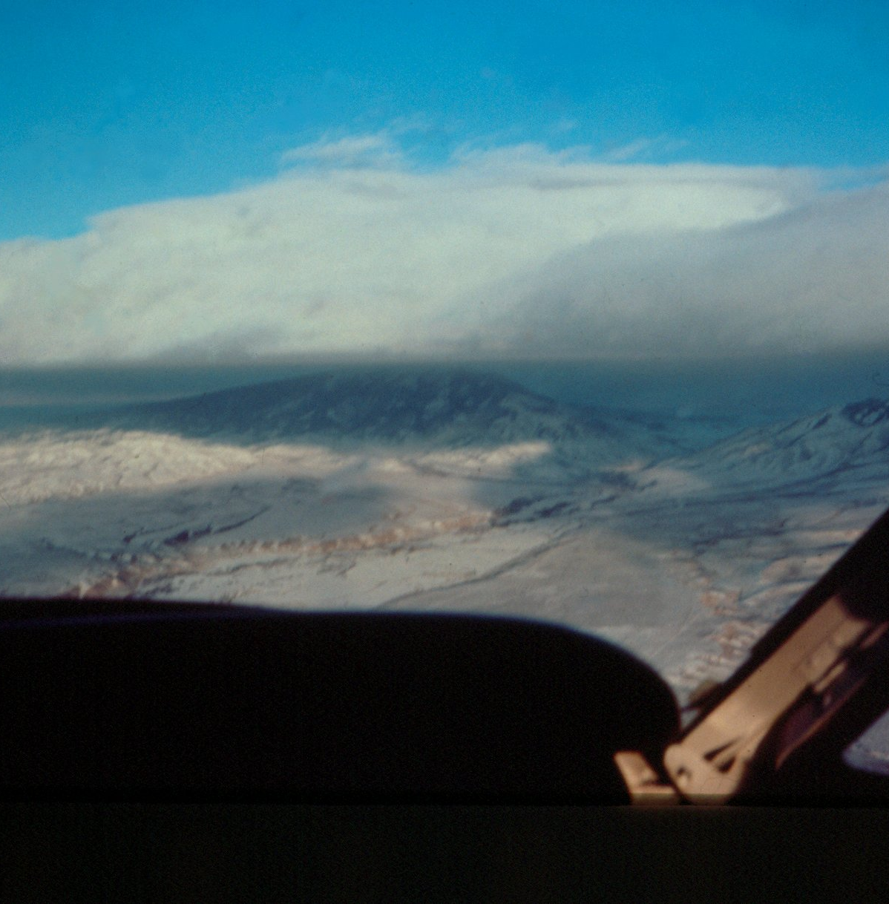
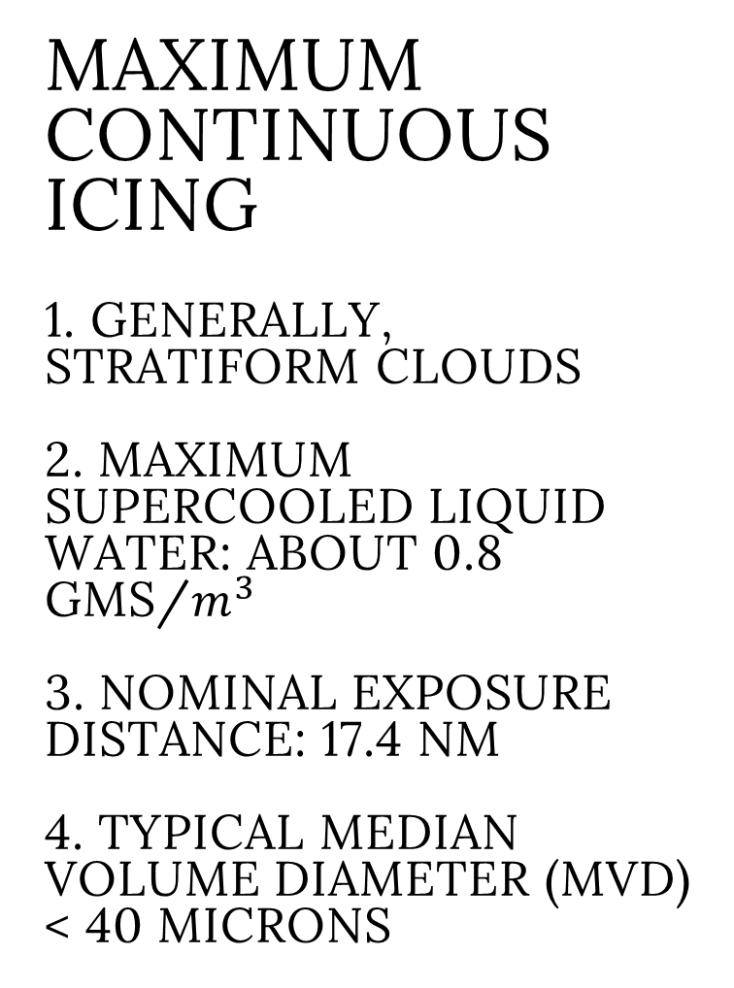
Maximum continuous icing 1. Generally, stratiform clouds 2. Maximum supercooled liquid water: about 0.8 gms/$m^{3}$ 3. Nominal exposure distance: 17.4 nm 4. Typical Median Volume Diameter (MVD) < 40 microns

Slide 6
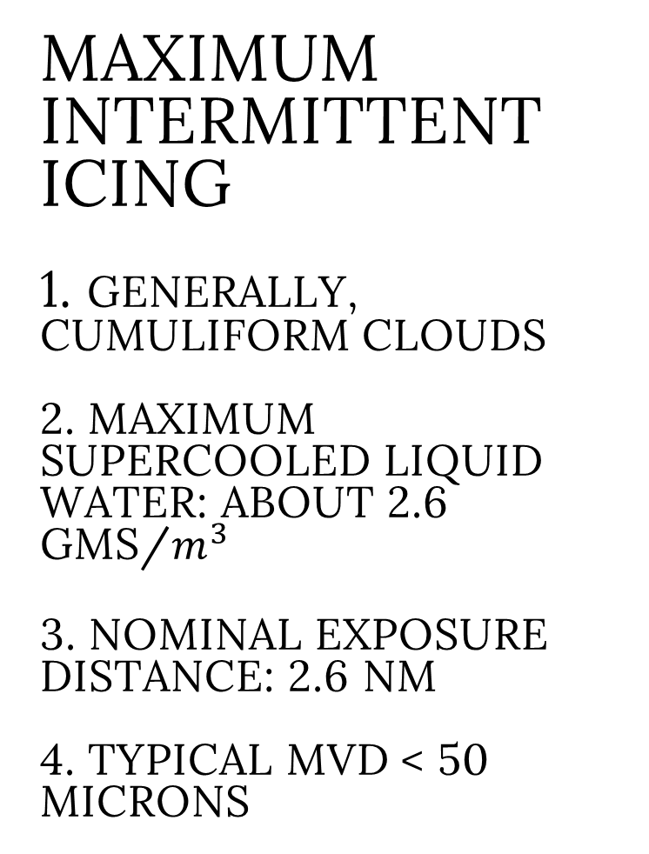

Maximum intermittent icing 1. Generally, cumuliform clouds 2. Maximum supercooled liquid water: about 2.6 gms/$m^{3}$ 3. Nominal exposure distance: 2.6 nm 4. typical MVD < 50 microns

Slide 7
Supercooled Large Droplets (SLD) 1. Formerly known as freezing drizzle or freezing rain 2. Two fatal twin-engine, turboprop, commuter airliners crashed in the early 1990’s due to Sld icing encounters. These fatal accidents brought this phenomenon to the attention of the FAA and NTSB 3. SLD ICE IS SEVERE ICING BY DEFINITION. SLD ICE WILL ACCUMULATE OUTSIDE THE PROTECTED AREA

Slide 8
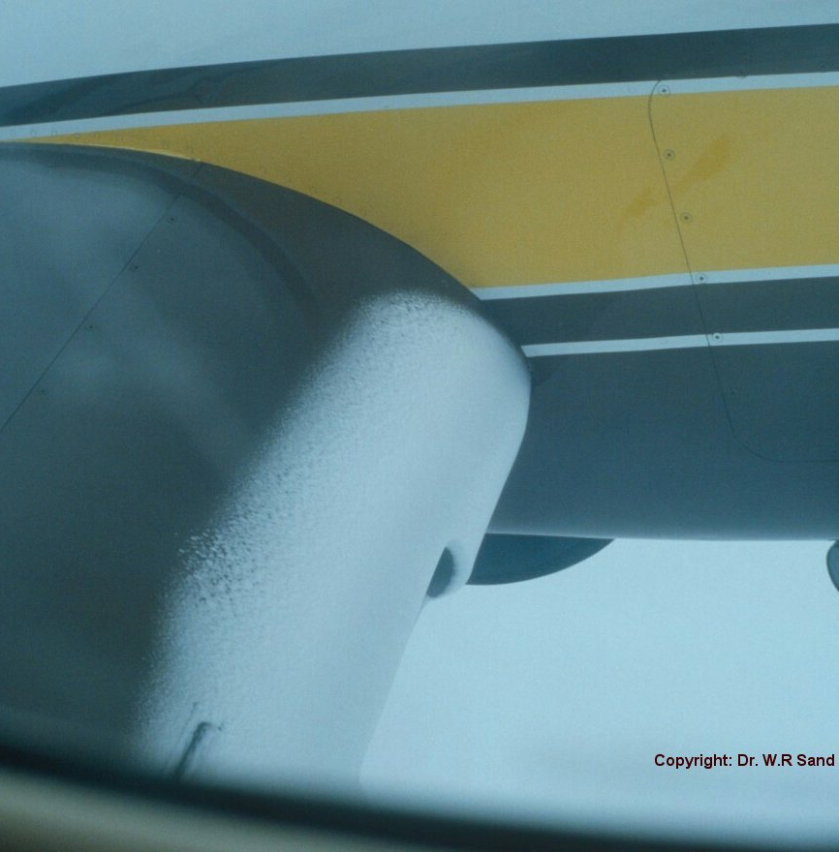
Sld icing 1. Can occur in either stratiform or convective clouds 2. supercooled liquid water: Generally low values 3. Unknown exposure distance 4. KEY: MVD > 50 microns 5. High LARGE DROPLET collection efficiency in unprotected areas

Slide 9
ASSUMED SUPERCOOLED CLOUD DROPLET DISTRIBUTION
MOST APPENDEX C CLOUD DROPLETS 10 TO 20 MICRONS MVD, CONTRIBUTE LITTLE TO IMPINGING MASS
MOST OF THE COLLECTED MASS OF ICE ON THE WING FROM THIS SPECTRUM IS BY 40 MICRON DROPLETS
TAIL OF THE SPECTRA (LARGE DROPS) DRIVES IMPINGING AND COLLECTION CONTRIBUTION
WITH AN MVD > 50 MICRONS, MOST OF THE SLD DROPLETS WILL IMPINGE AND COLLECT
ASSUMED
CLOUD
DROPLET
DISTRIBUTION
IMPINGING
MASS

Slide 10
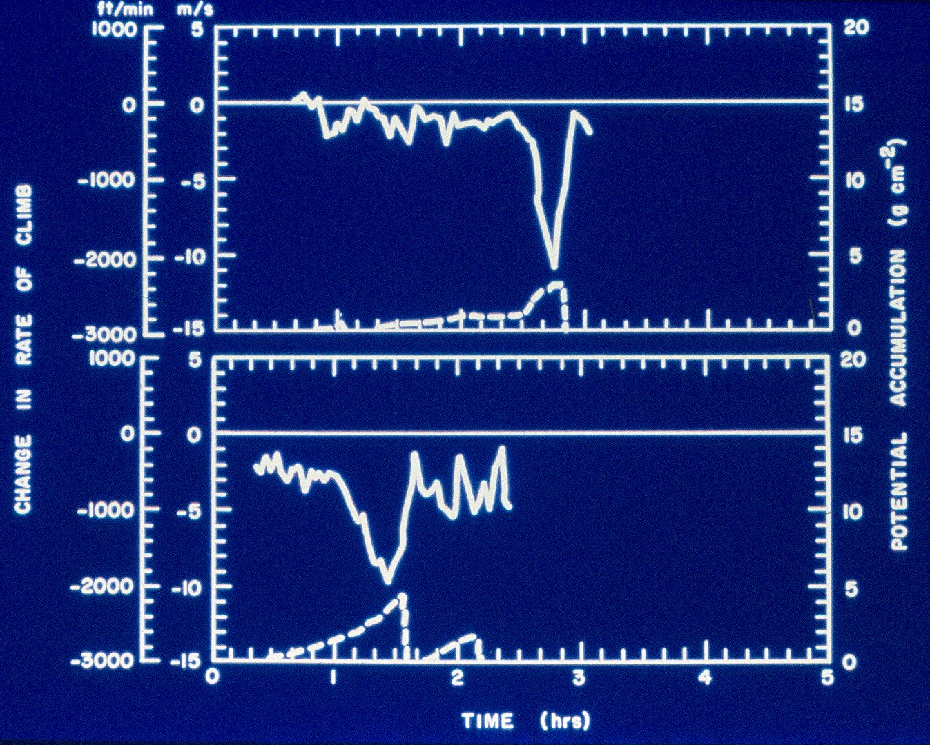
Quote
SLD ICING IMPACT ON the University of Wyoming King air research aircraft
About 2000 fpm climb capability lost in 15 min
Full speed ahead and stall buffet occurred at 140 kias with full power

Slide 11
SLD ICING
LARGE DROPLETS
IMPACTING AND
FREEZING
WELL AFT OF
PROTECTED
AREA
DRASTICALLY
AFFECTS LIFT AND STALL CHARACTERISTICS
COPYRIGHT W. R. SAND

Slide 12
COPYRIGHT W. R. SAND
SLD ICE
ICE RIDGES
POSSIBLE TURBULENCE CAUSING ICE AFT
STILL OUTSIDE PROTECTED AREA
SEVERE ICING

Slide 14
SUMMARY
SLD ICING IS A LOW PROBABILITY EVENT
SLD ICING IS SEVERE ICING
SLD ICE ACCUMULATES BEYOND THE AREA WHERE AIRCRAFT ARE PROTECTED FROM FAR 25 Appendix C ICING
SLD ICING IS SUBTLY DIFFERENT FROM FAR 25 APPENDIX C ICING
SLD ICING CONDITIONS MUST BE EXITED IMMEDIATELY BY ALL AIRCRAFT
ALL MANUFACTURERS MUST PROVIDE PILOTS WITH CUES TO IDENTIFY SLD ICE

Slide 15

Questions

